Slide 1
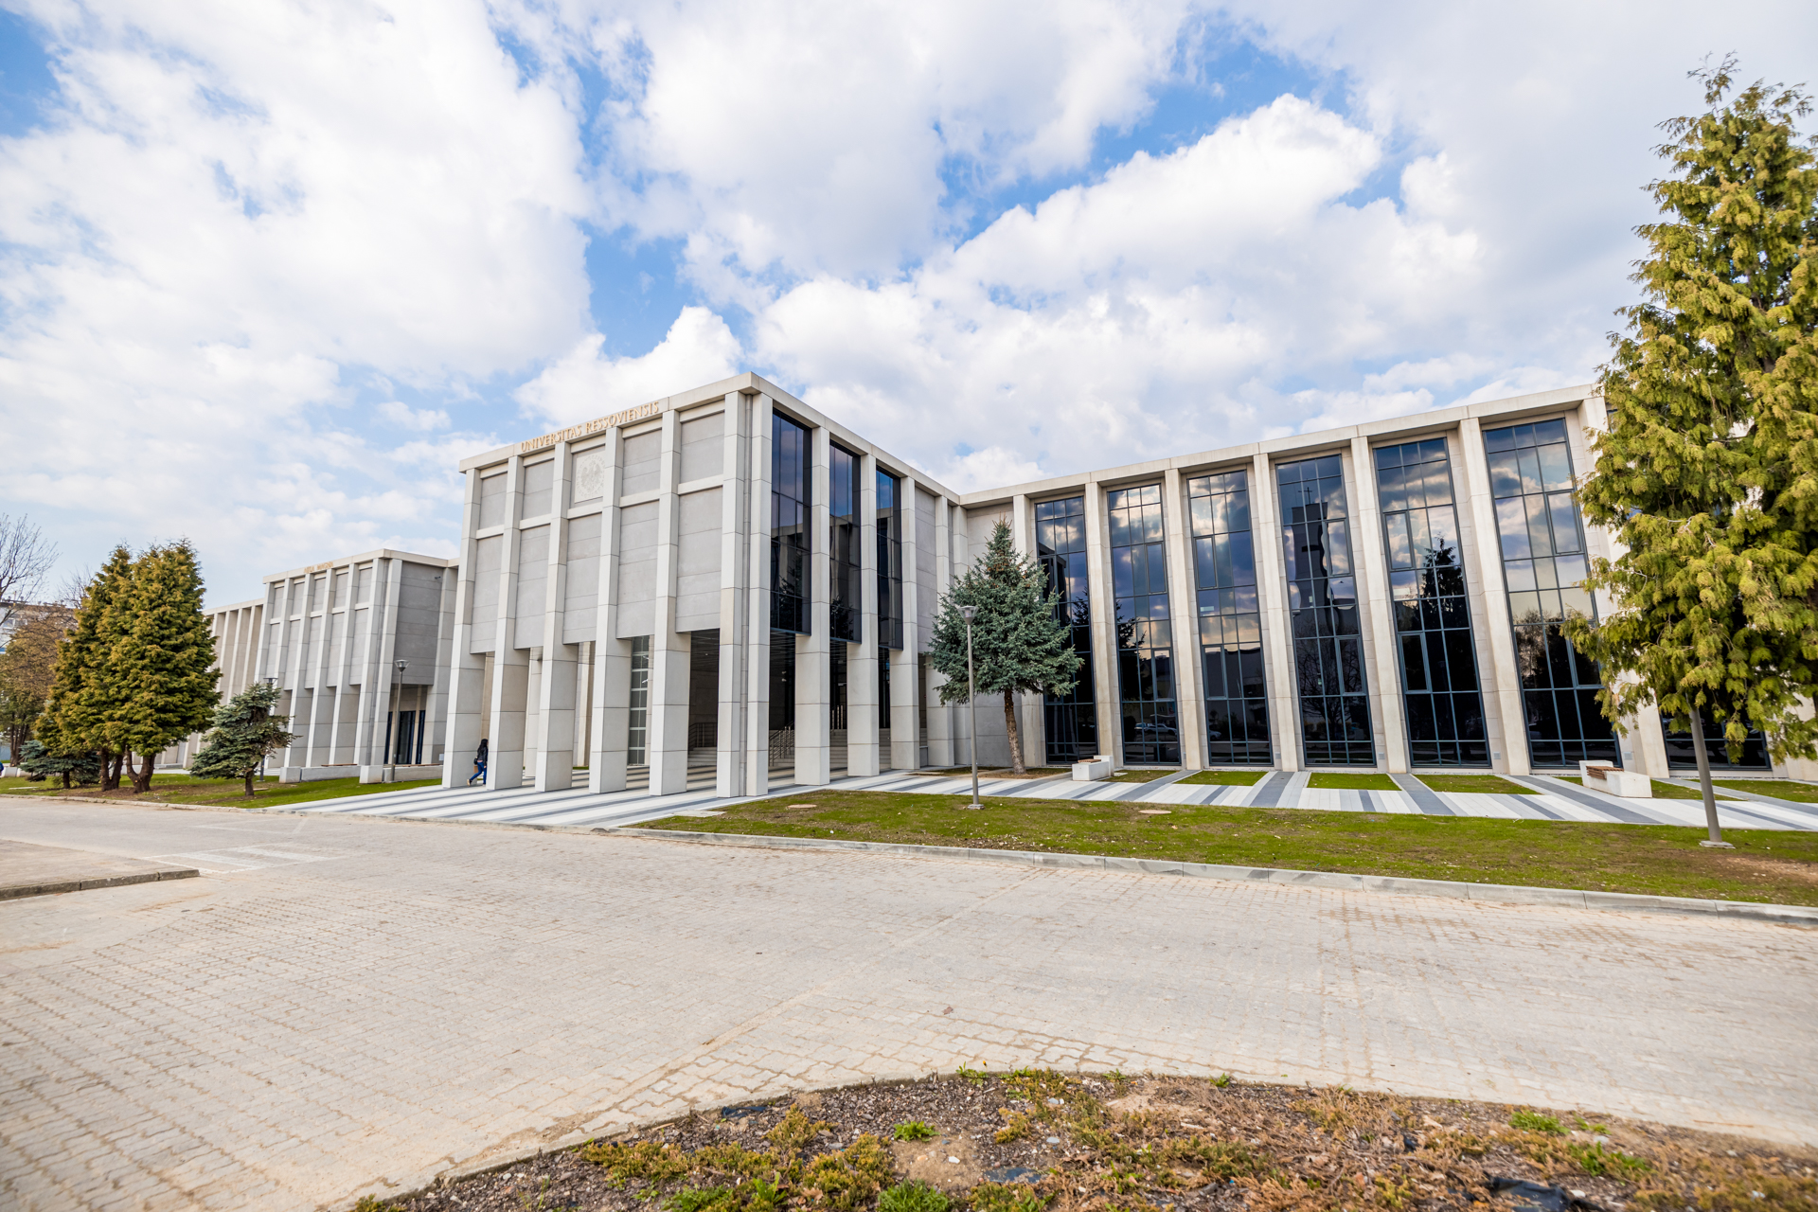
since 2001 r.

Slide 2
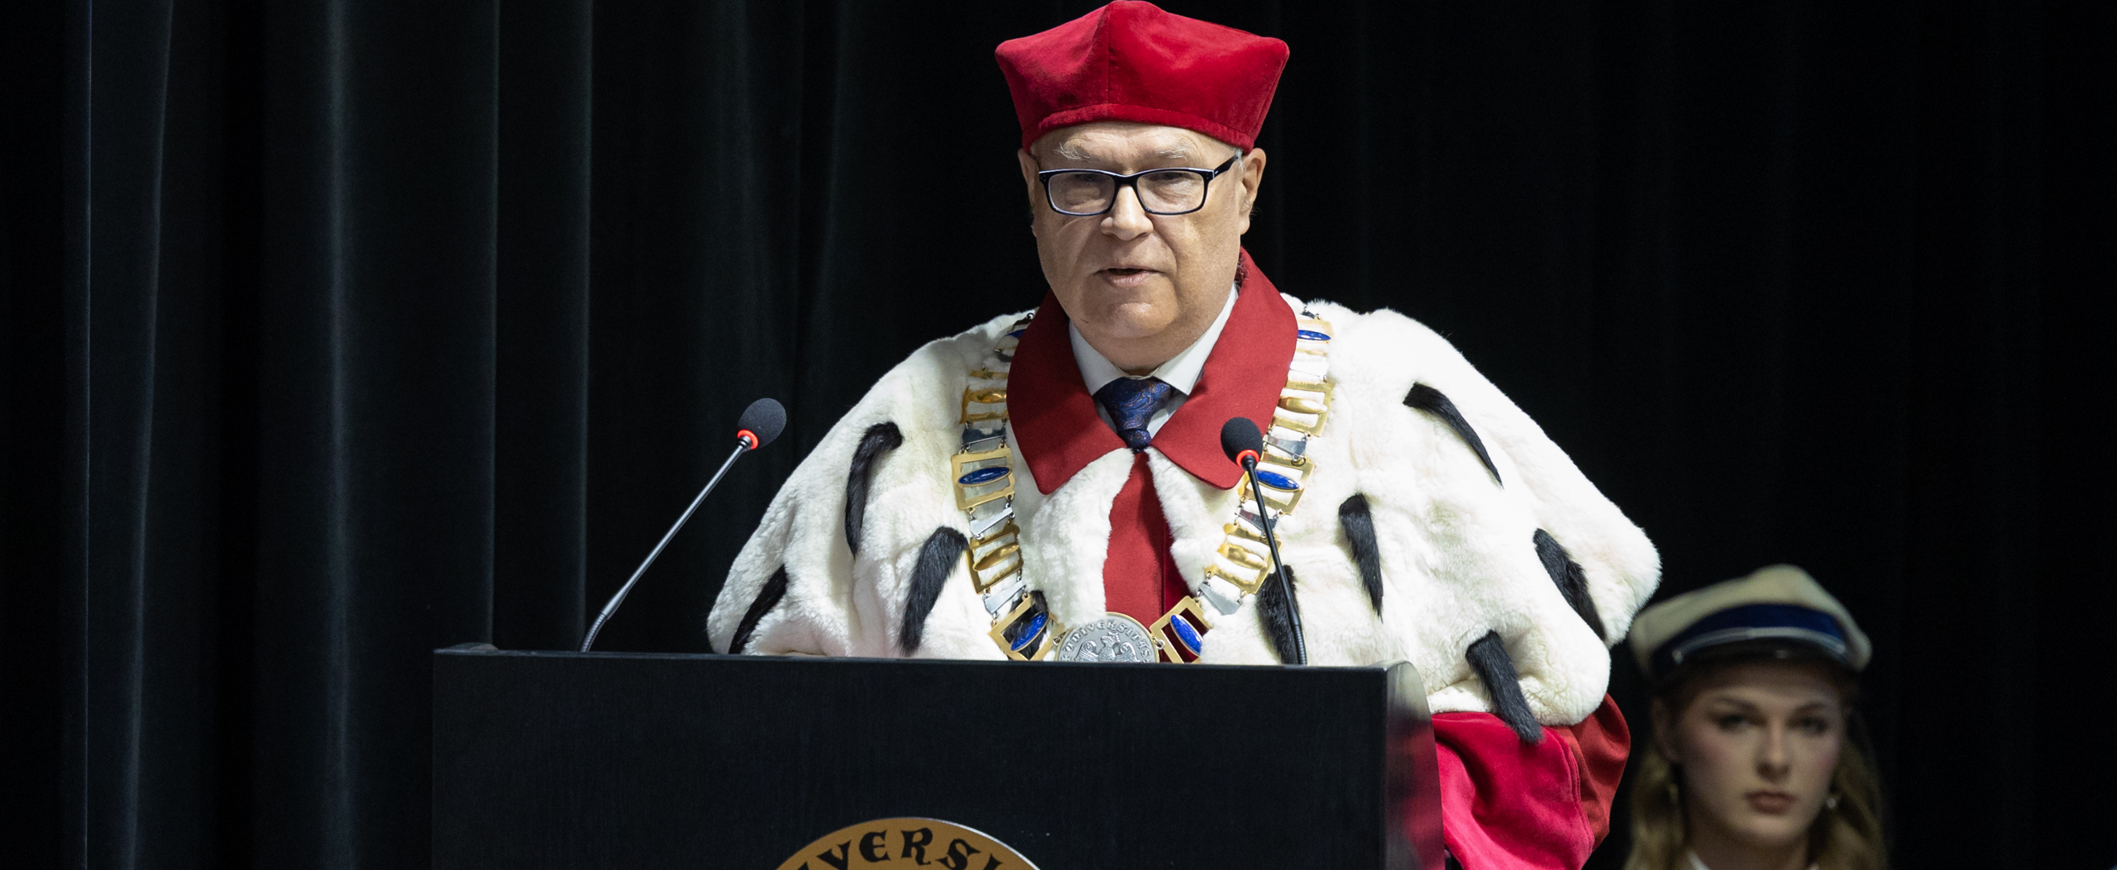
UNIVERSITY AUTHORITIES prof. dr hab. Sylwester Czopek - Rector

Slide 3
HISTORY
The University of Rzeszów was legally constituted on 1 September 2001.
lt was created out of three independent academic entities, namely:
University of Pedagogy in Rzeszów,
Maria Curie-Skłodowska University in Lublin-Rzeszów Campus
as well as the Faculty of Economics-Rzeszów of the Hugo Kołłątaj Academy of Agriculture in Kraków.

Slide 4
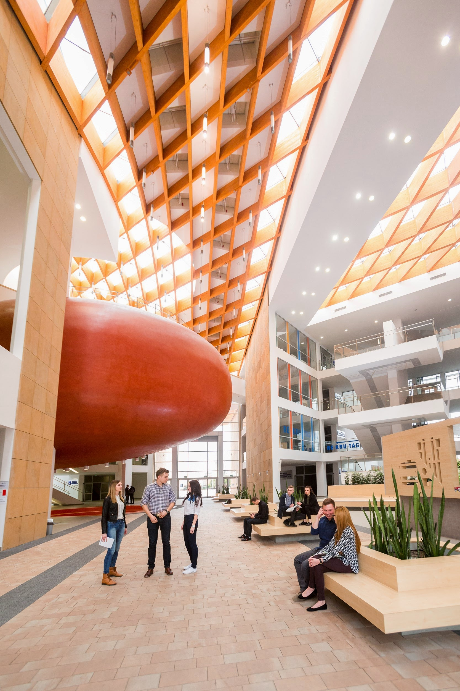
The University of Rzeszów had, prior to 1 October 2019 been organized into 12 faculties, headed by respective Deans. Under the new arrangement, however, the University is organized in the following manner:
The overall functioning of the University is managed by the Rector, who appoints 4 Vice-Rectors responsible for the newly established colleges, namely:
the College of Humanities,
the College of Medical Sciences,
the College of Natural Sciences
and the College of Social Sciences.

Slide 5
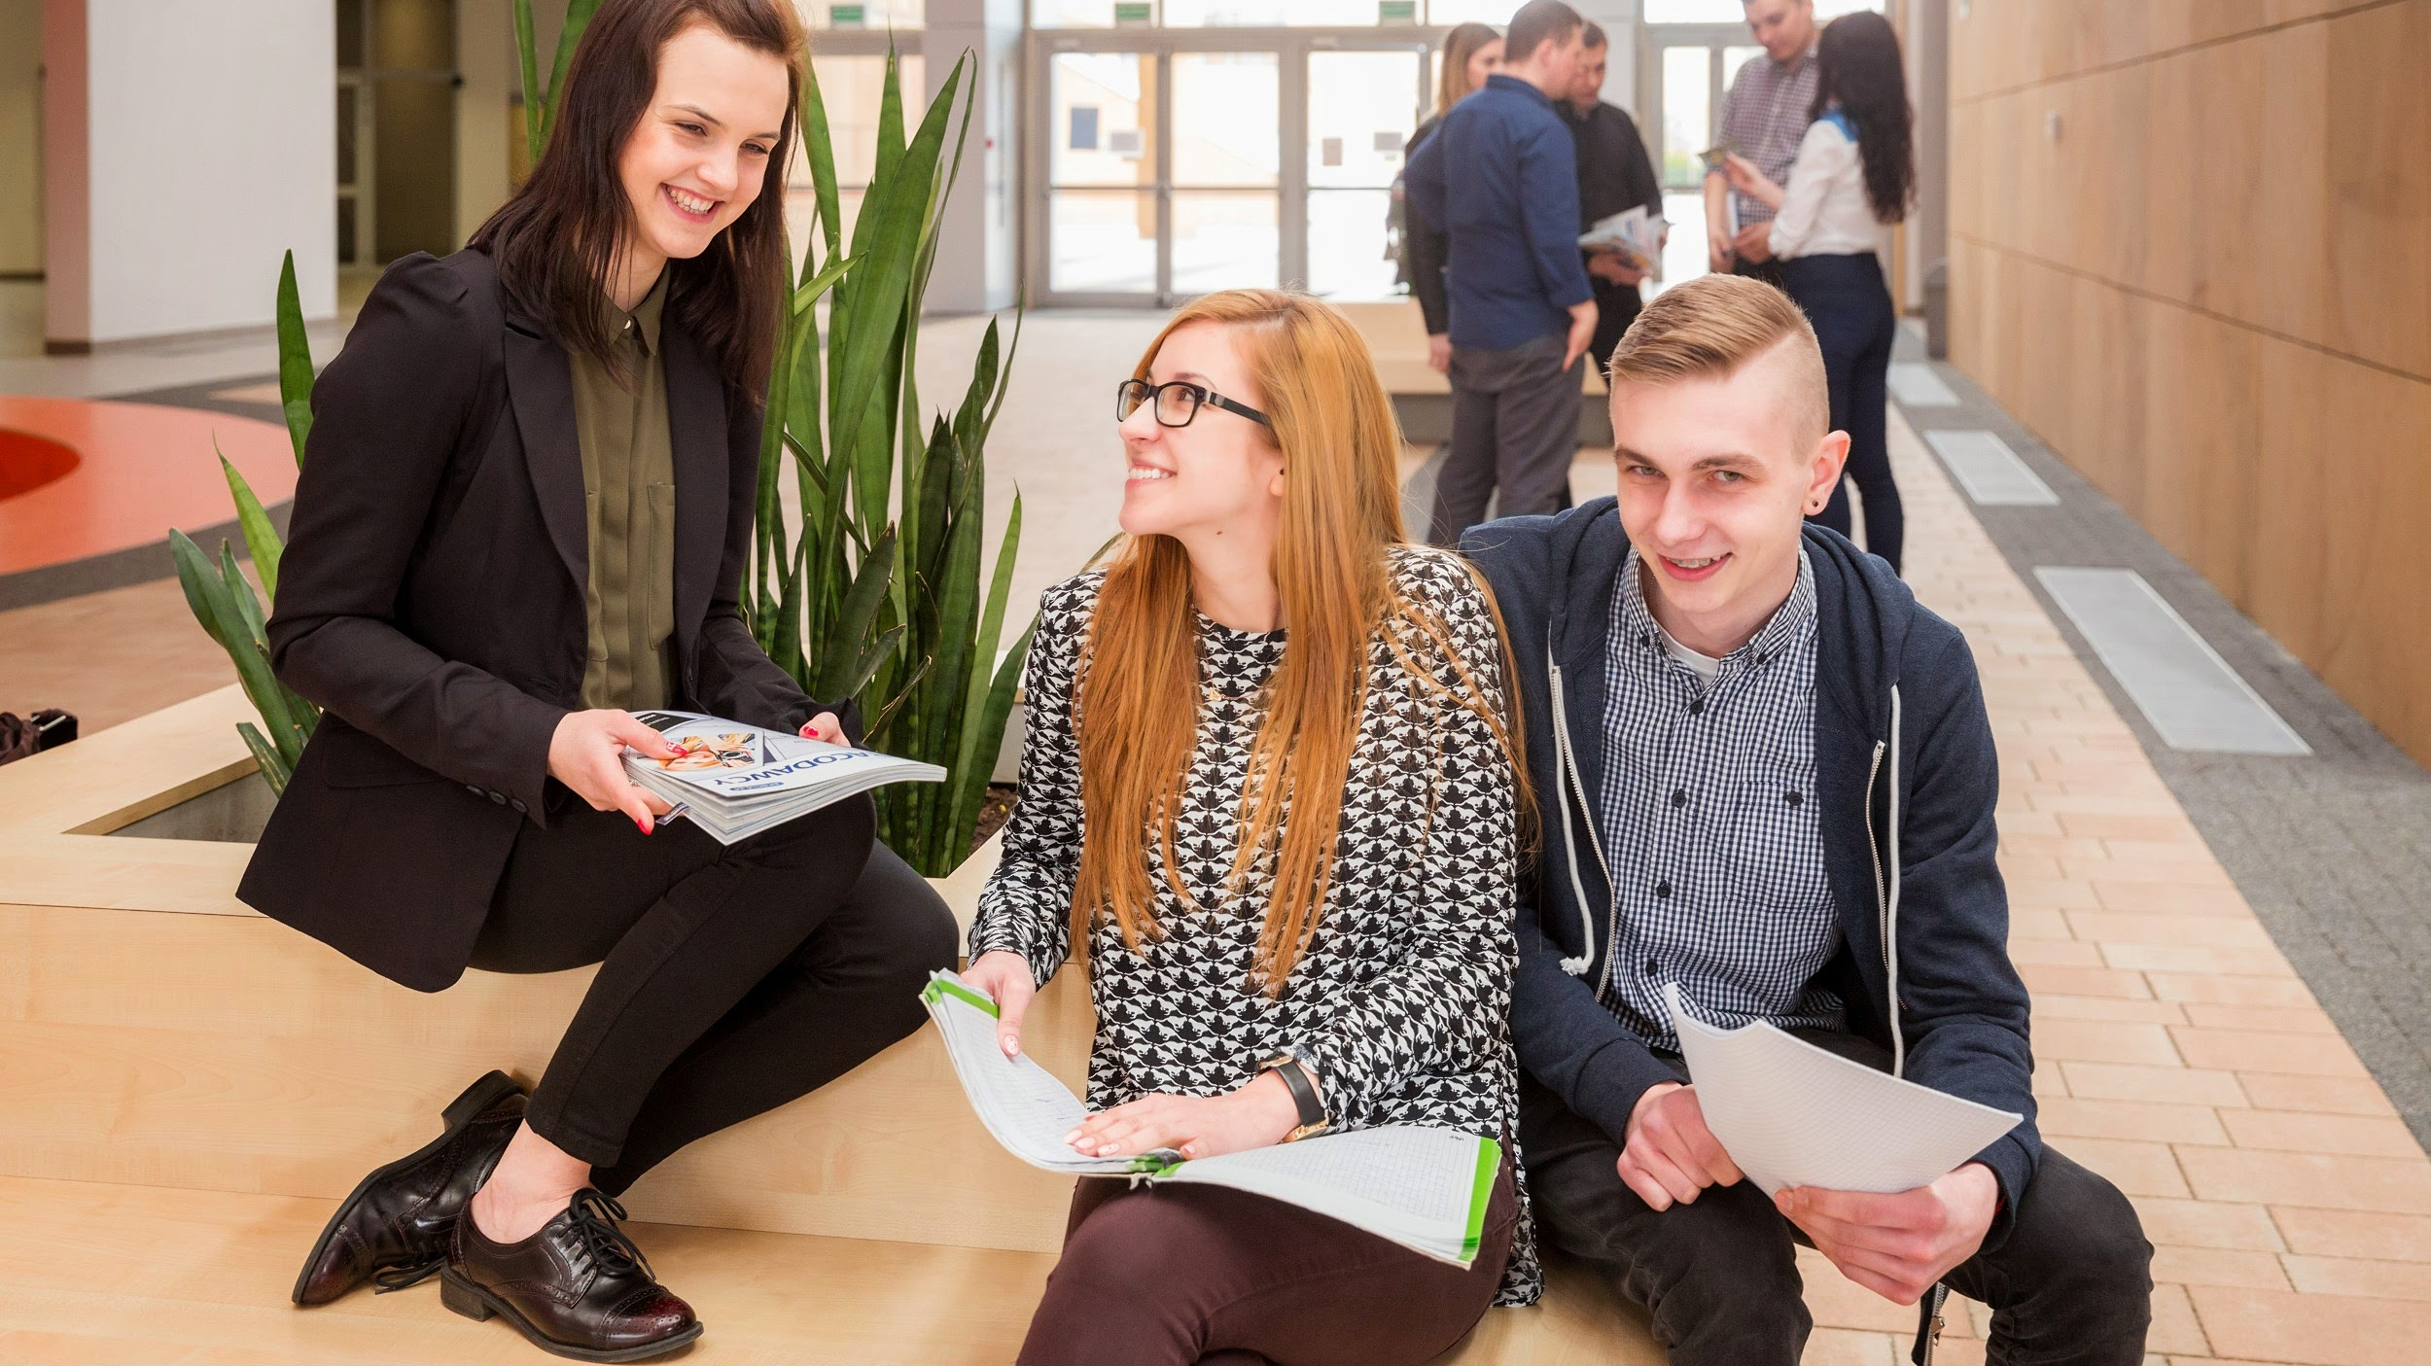
University in numbers:
more than 60 courses of study
16 500 students
1300 academic teachers
4 colleges
5 student houses
cooperation with nearly 300 partner universities

Slide 6
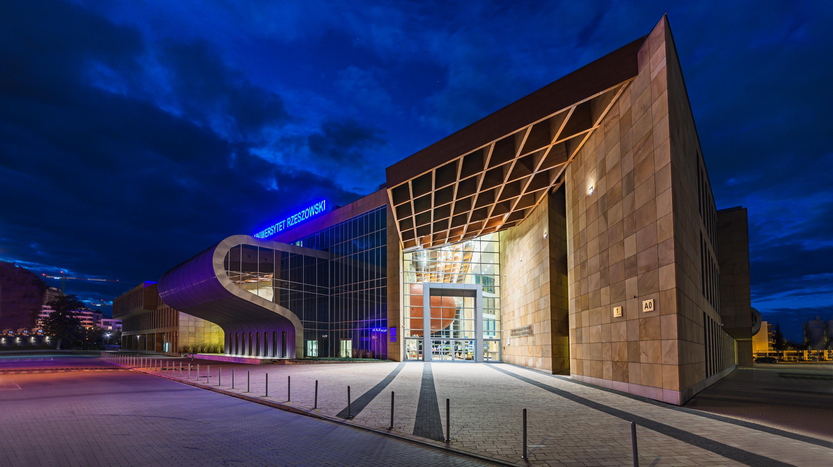

Slide 7
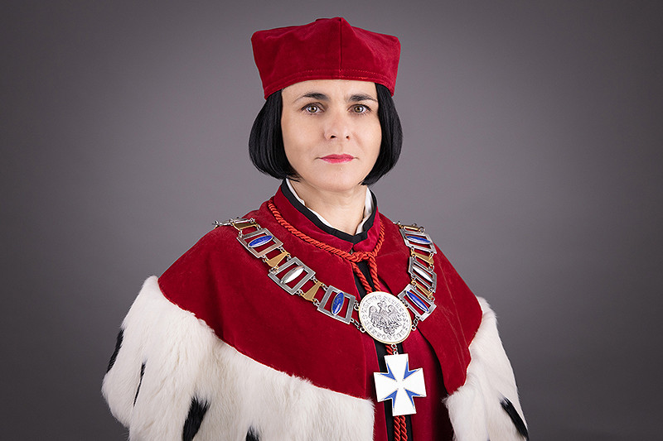
COLLEGE AUTHORITIES
Vice-Rector for the College of Natural Sciences
Idalia Kasprzyk, PhD, DSc, ProfTit

Slide 8
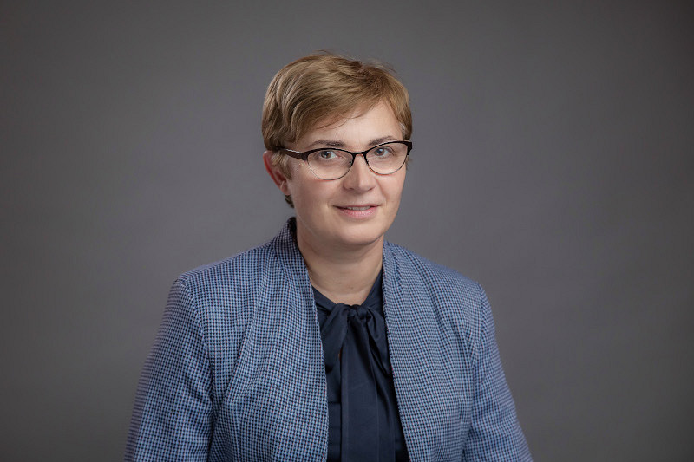
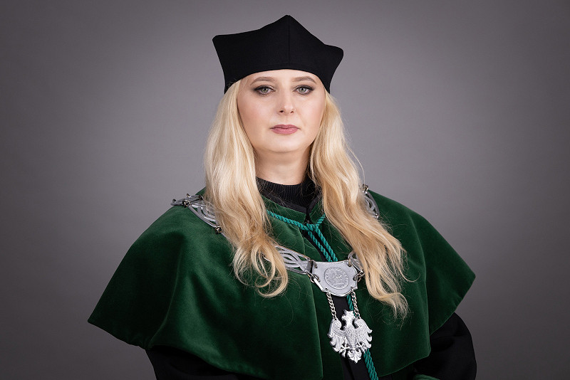
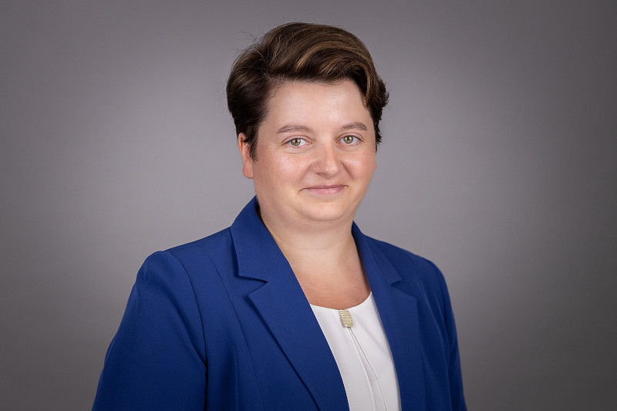
COLLEGE AUTHORITIES
Vice-dean
Anna Szpila, PhD
Vice-dean
Karolina Pycia, BEng, PhD
Dean
Marta Łuszczak, PhD, DSc

Slide 9
ABOUT THE COLLEGE
The College of Natural Sciences was created from the merger of
the Faculty of Biotechnology, the Faculty of Biology and Agriculture and the Faculty of Mathematics and Natural Sciences
There are 8 institutes in the college
Institute of Biology
Institute of Computer Sciences
Institute of Mathematics
Institute of Physics
Institute of Agricultural Sciences, Land Management and Environmental Protection
Institute of Food Technology and Human Nutrition
Institute of Materials Engineering
College of Natural Sciences
Institute of Biotechnology

Slide 10
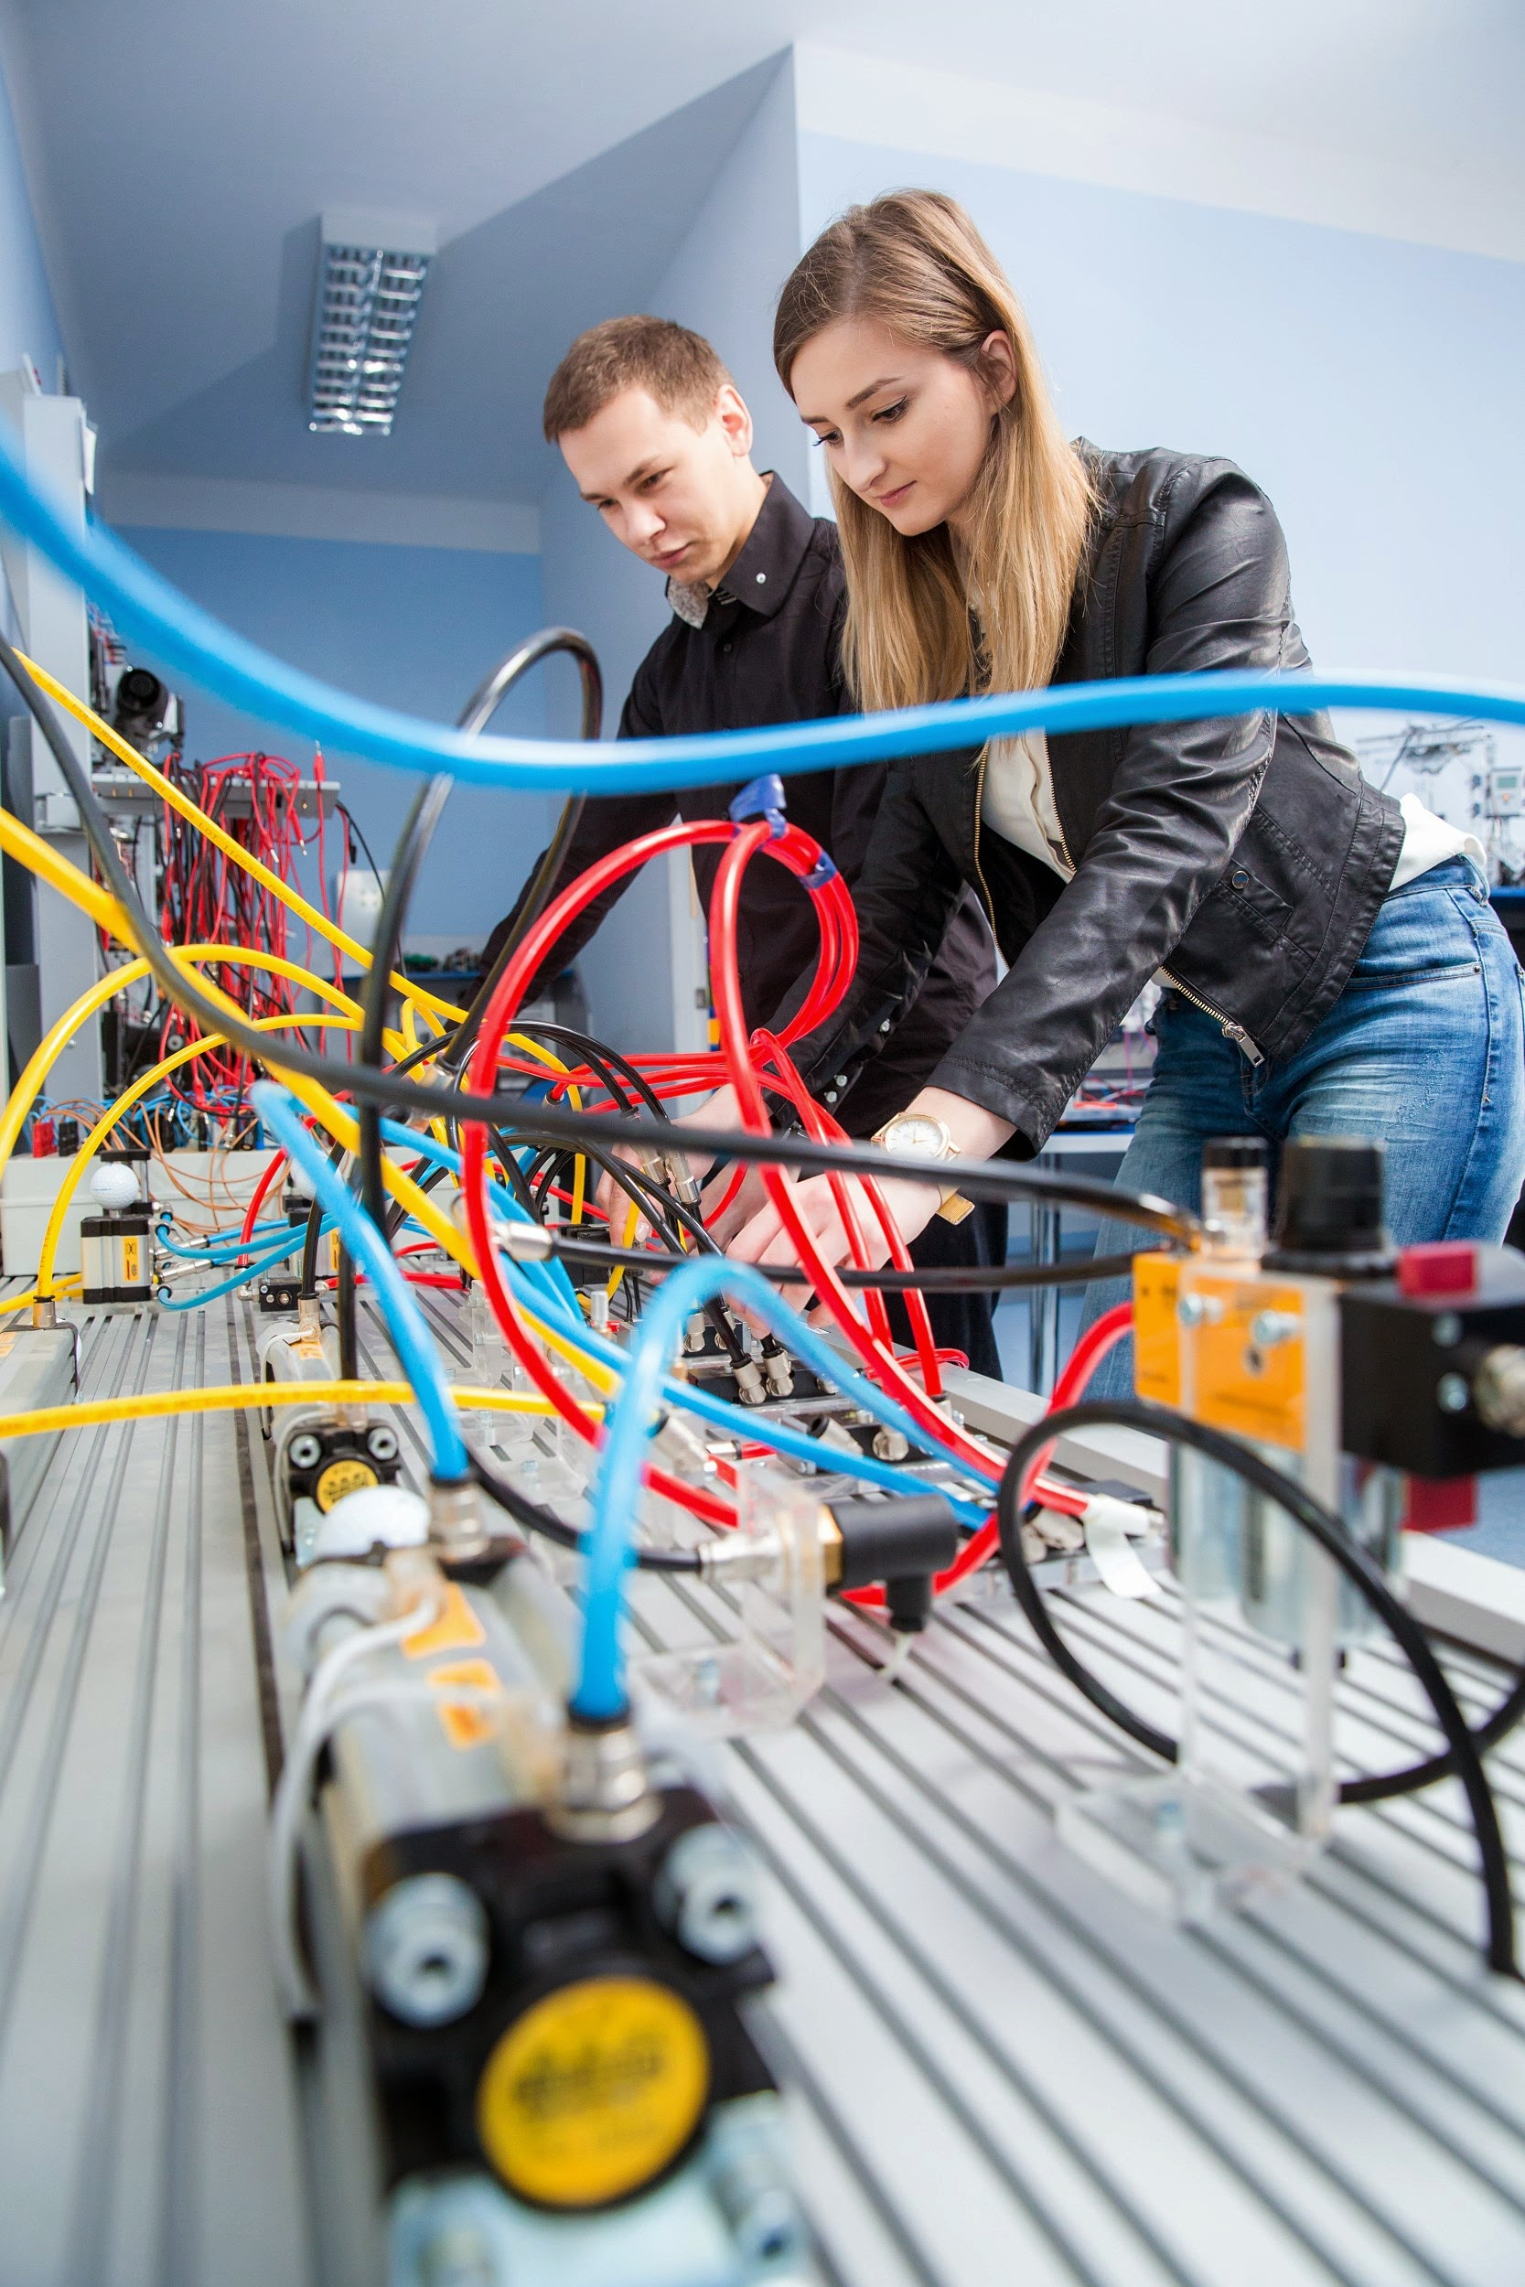
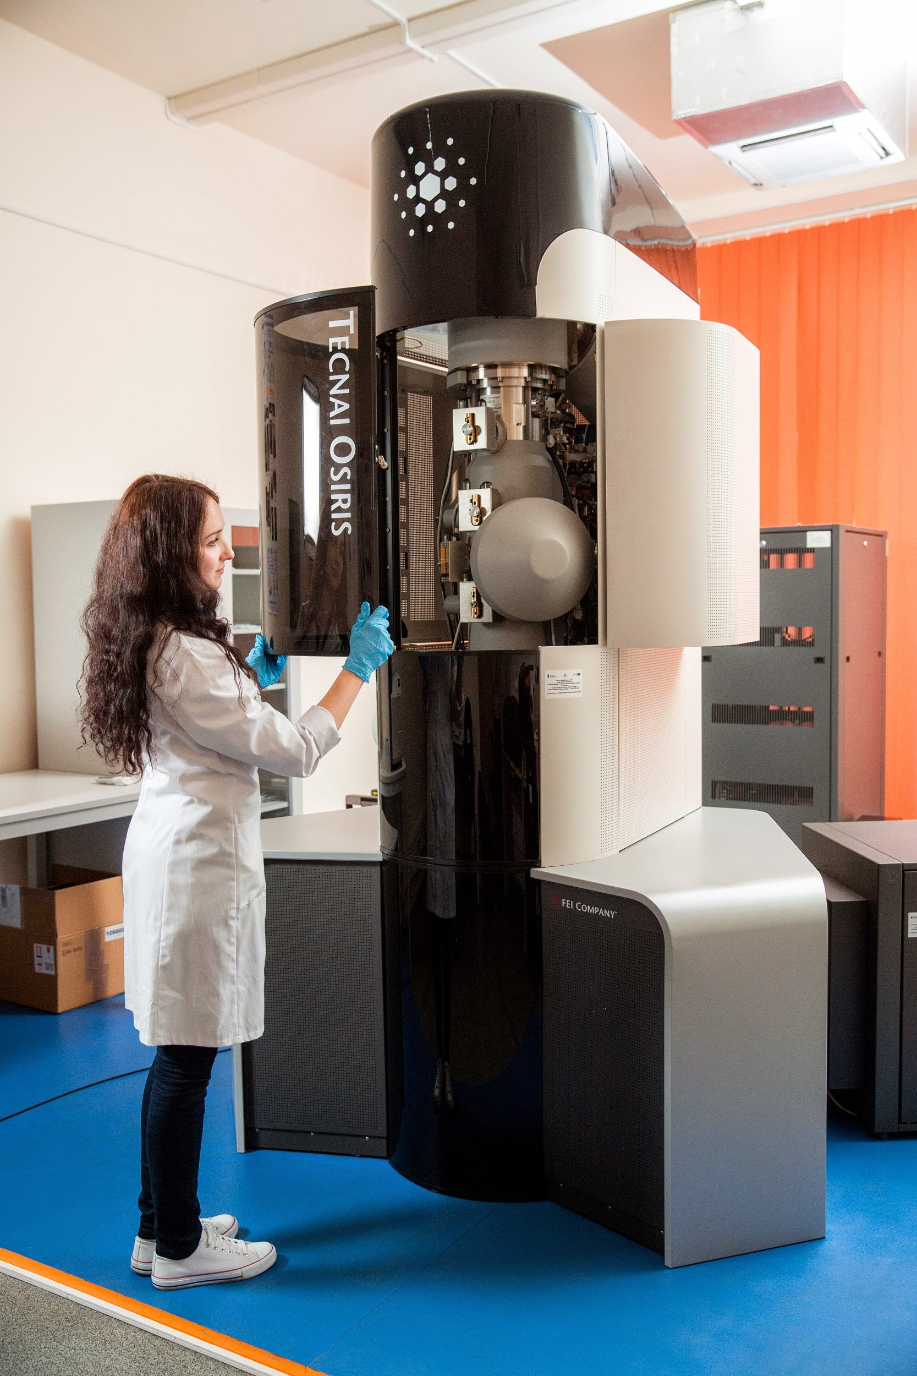
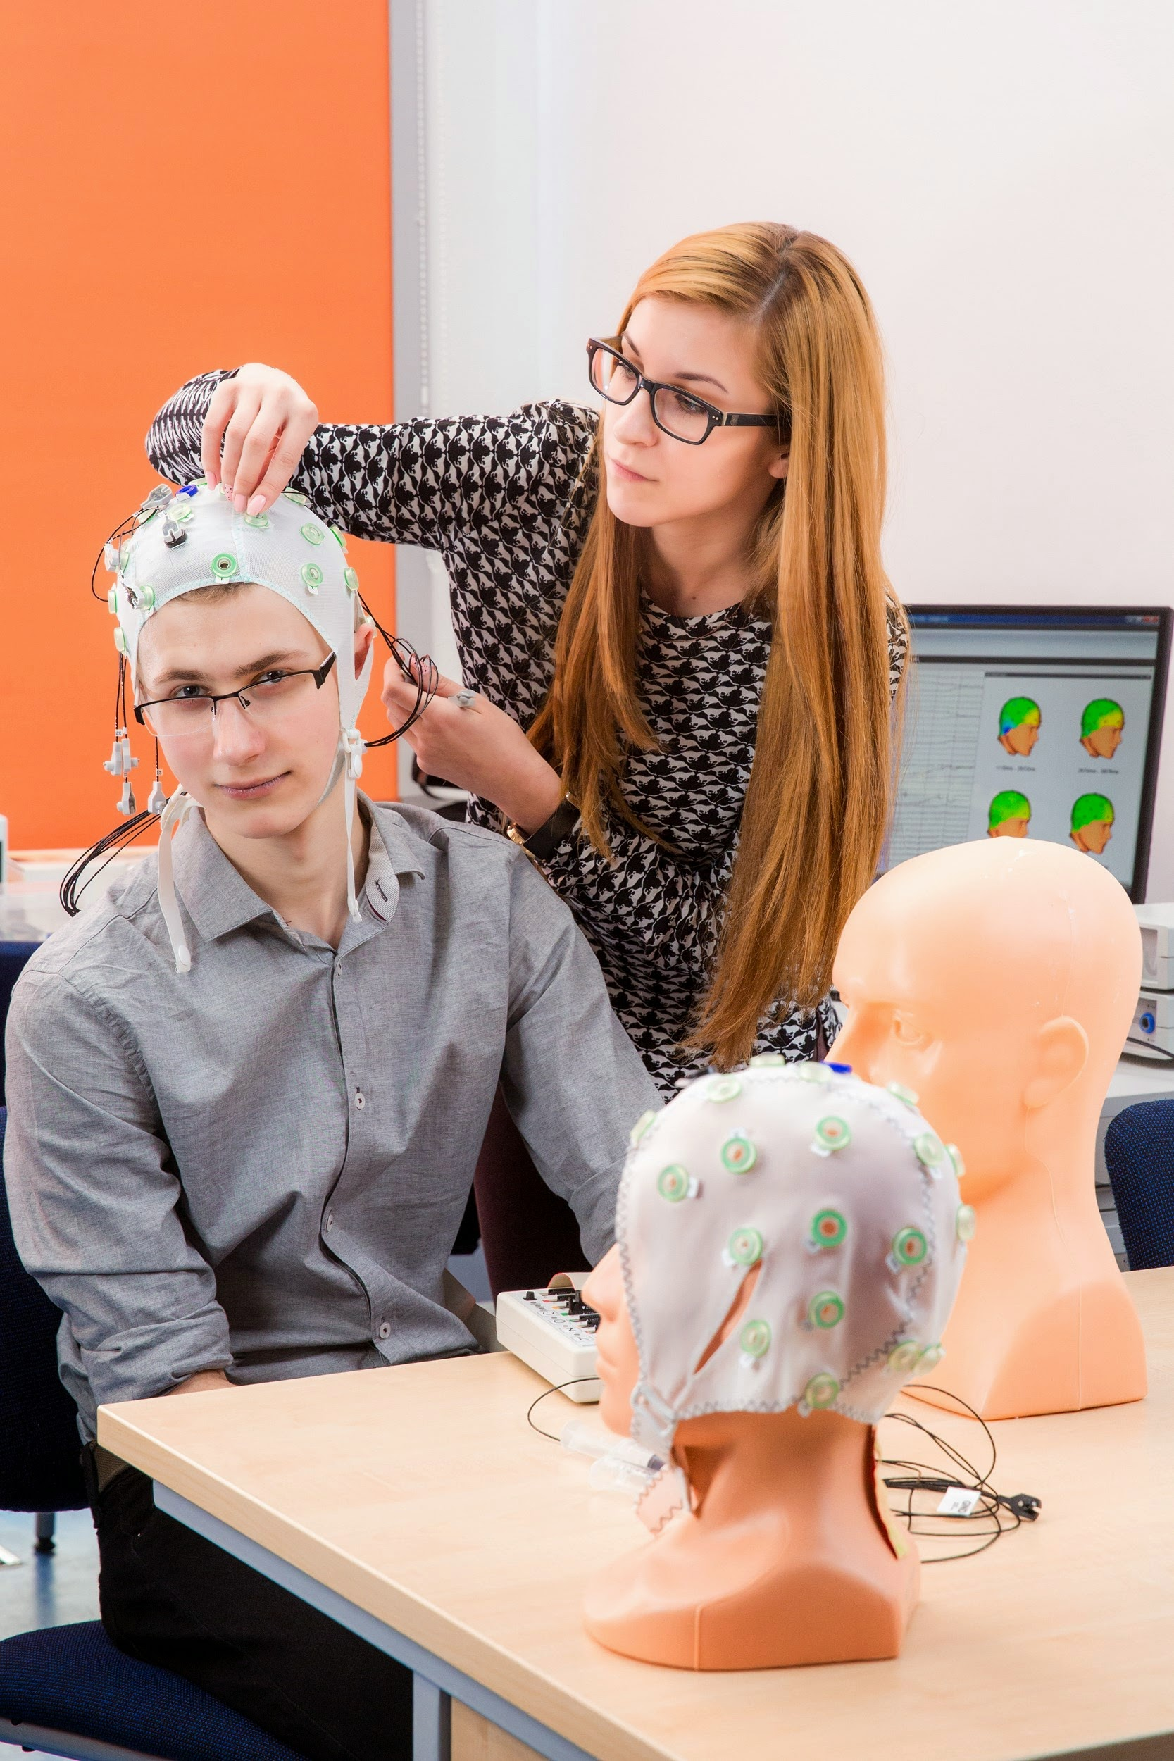
FIELDS OF STUDY
CAMPUS ZALESIE
agroforestry
landscape architecture
biology
logistics in the agri-food sector
environmental protection
renewable energy sources and waste management
agriculture
food technology and human nutrition
CAMPUS REJTANA
biotechnology
physics
information technology
information and econometrics
materials engineering
mathematics
mechatronics
diagnostic systems in medicine

Slide 11
Agriculture and horticulture
Matematyka
Mathematics
Biological sciences
Materials engineering
IT
and Telecommunication
SCOPE OF OUR RESEARCH
Biotechnology
Physical sciences
Food and Nutrition
Technology

Slide 12
| Not only about learning
Night of Biologists - an action popularizing science, addressed to all enthusiasts of biology
Science Exploration Picnic - for bioscience and natural science lovers
„KultURalia” (student festival), „Night of board games”, biegUR (road race), concerts, events in Klub Pod Palma.
Physical education classes within the sports and recreational sections (including volleyball, basketball, football, swimming, cycling, table tennis, rugby, climbing, sports bridge, chess), participation in the Polish Academic Championships, recreational activities, including: canoeing, tennis, table tennis, climbing, horse riding, survival, physical preparation for uniformed services
Modern sports facilities (hall at Zalesie Campus)
Cultural and Educational Study enabling the acquisition and improvement of dance skills, vocal skills, or improvement of instrumental and musical skills (including preparation for playing in a band)
For students with disabilities, the university offers extensive support through the Office for People with disabilities (BON)
Erasmus+ - the possibility of going for a semester as part of international academic exchange to one of about 80 universities in the world, participation in an international summer school under the CEEPUS program

Slide 13
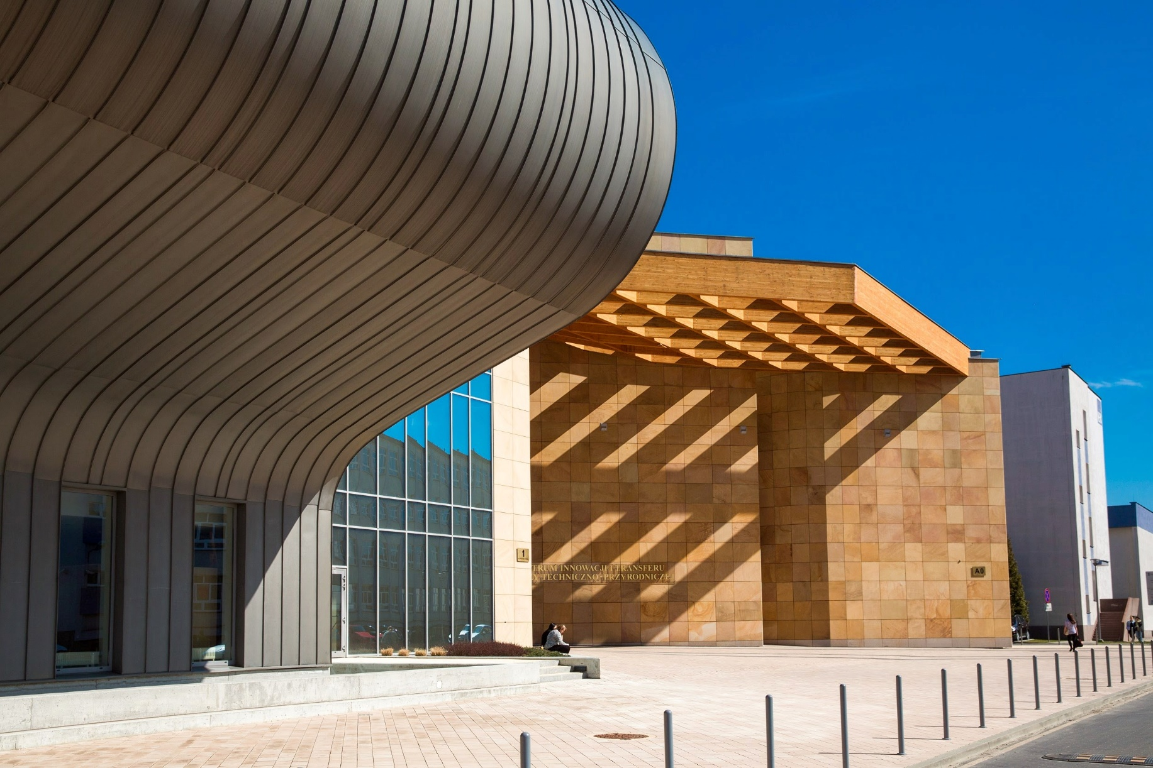
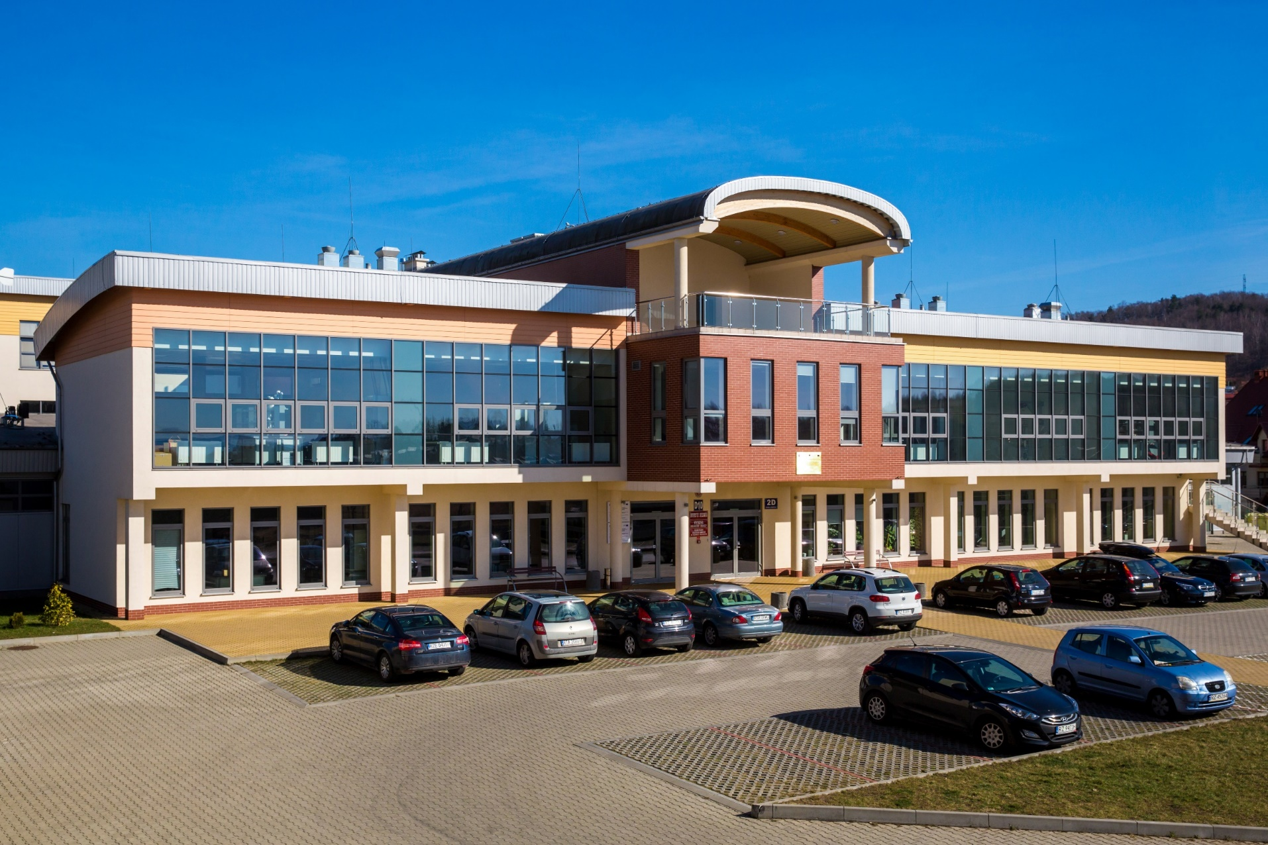
SEAT
Campus Rejtana
Campus Zalesie

Slide 14
| Thank you for your attention!

