Slide 1
Polish inheritance law
in compliance with the provisions of the Civil Code (1964) and even more with the Legal English textbook by H. Sierocka, Warszawa 2014

Slide 2
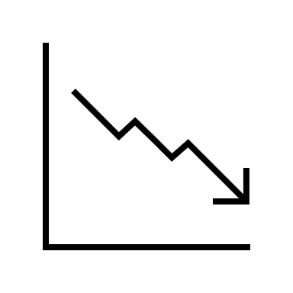
Introduction
statutory succession
division of inheritance
inheritance proceedings
inheritance debts
Inheritance law is concerned with a set of legal provisions regulating devolvement of rights and duties pertaining to the estate of the deceased, to one or several persons.

Slide 3
Inheritance
elementary terms

Slide 4
devisor
a natural person
inheritance
heir
a natural person
a legal person
Only a natural person may leave an inheritance.
A person entitled to accept the inheritance is an heir – they can either be a natural person or a legal person.

Slide 5
STATUTORY SUCCESSION
the children and the spouse of the deceased
the deceased’s siblings (in absence of aforementioned)
the deceased’s parents (in absence of aforementioned)
the deceased’s grandparents (in absence of aforementioned).
Statutory succession takes place when the deceased did not draft a will or none of the persons mentioned in the will is entitled to inheritance or wishes to inherit.

Slide 6
TESTAMENT SUCCESSION
counscious and free decision
required form
full capacity for acts in law
accordance with legal regulations and principles of community life
Testament succession takes place when the testator has drafted a valid will before his death. Testament succession takes precedence over statutory succession. A testament is a unilateral declaration of the testator’s will to be executed in the case of their death.

Slide 7
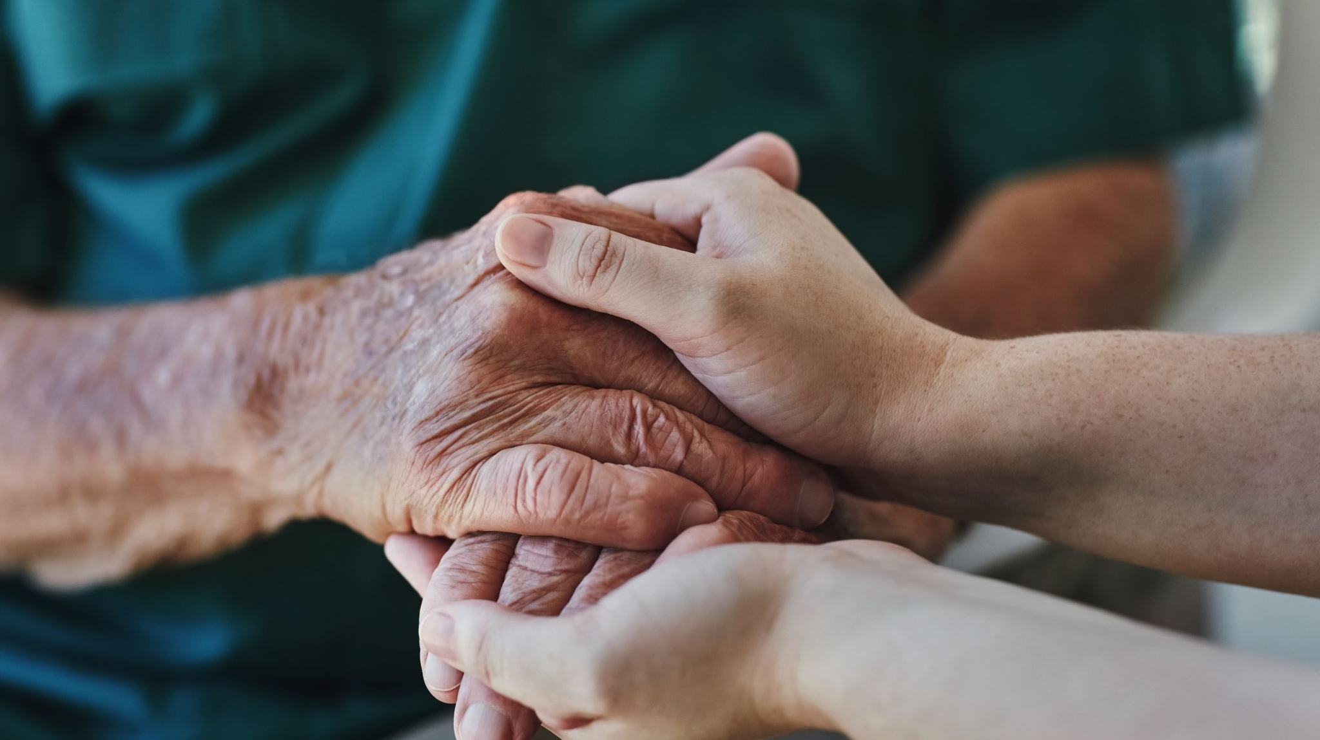
AN APPOINTED HEIR MAY:
accept the inheritance without limitation of the liability for debts (simple acceptance);
accept the inheritance with limited liability (with the benefit of inventory);
reject the inheritance.

Slide 8
LEGITIM
The legitim is an institution which protects the interests of the deceased’s family members. It is the right of statutory heirs who were not mentioned in the will to a defined share of the inheritance. The spouse, the parents and the descendants of the deceased are entitled to the legitim (a stricture to this rule can be found inter alia under art. 935 [1] of the Civil Code).

Slide 9
DIVISION OF THE INHERITANCE
In order to cancel the co-ownership of the estate which may come with an inheritance, it is necessary to divide the inherited estate. This may be conducted in two ways:
contract agreed upon by all the heirs
decision of the court

Slide 10
DICTIONARY
Devolvement of rights and duties = przekazanie praw i obowiązków
Statutory succession = dziedziczenie ustawowe
Division of inheritance = dział spadku
Inheritance debts = długi spadkowe
Inheritance proceedings = postępowanie spadkowe
Devisor = spadkodawca
Inheritance = spadek
Heir = spodkobierca
Natural person = osoba fizyczna
Legal person = osoba prawna
Deceased = zmarły
Will = testament
Entitled = uprawniony

Slide 11
Testament succession = dziedziczenie testamentowe
Take precedence over sth = mieć pierwszeństwo względem czegoś
Unilateral declaration of the will = jednostronne oświadczenie woli
Full capacity for acts in law = pełnazdolność do czynności prawnych
Principles of community life = zasady współżycia społecznego
Appointed = wyznaczony, powołany
Legitim = zachowek
Stricture = ograniczenie
Co-ownership = współwłasność
Representative = przedstawiciel
Drawn up = sporządzony
Revoked = odwołany

Slide 12
Thank you for listening
Jagoda Szal

Slide 13
BIBLIOGRAPHY
Sierocka H., Legal English, C.H.Beck, Warszawa 2014

