Slide 1
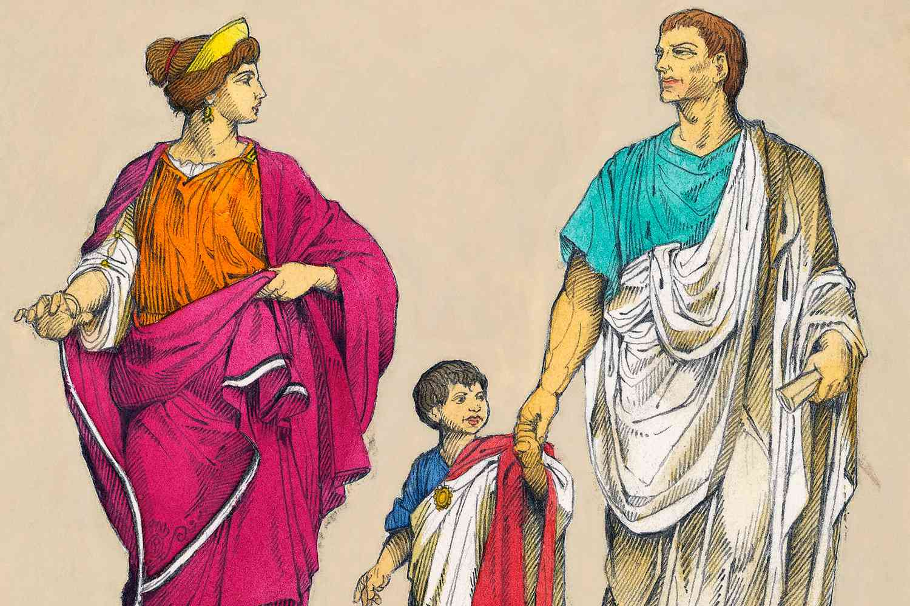
FAMILY LAW
Natalia Szabat
Jakub Szczęch
Szymon Szurlej

Slide 2
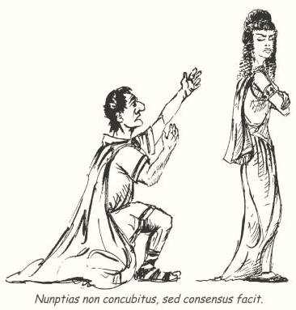
marriage
nuptiae; matrimonium

Slide 3
Nuptiae
Concepts and premises
Marriage in the Roman sense
GENERAL DEFINITION:
A recognized, lasting community of life between a man and a woman, which should ensure the possession of legal offspring.
Modesto (D. 23, 2, 1)
Uptiae sunt coniunctio maris et feminae et consortium omnis vitae, divini et humanis iuris communicatio
Justinian Institutions (Inst. 1, 9, 1)
Nuptiae autem sive matrimonium est viri et mulieris coniunctio, individuam consuetudinem vitae continens

Slide 4
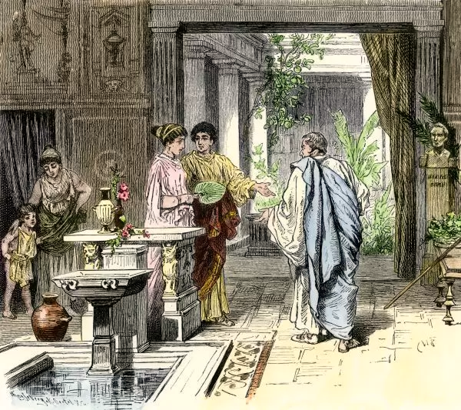
Nuptiae
Consensus et affectio maritalis

Slide 5
Nuptiae
Marriage requirements
iustum matrimonium
physical maturity
ius conubii
consensus
Nuptias non concubitus, sed consensus facit

Slide 6
Nuptiae
Obstacles and prohibitions of marriage
marriage between patricians and plebeians
marriages of Roman officials in the provinces with female inhabitants of those provinces
consanguinity resulting from adoption and affinity
marriages between freeborns and freedmen
marriages of soldiers during military service
under the emperor Diocletian, bigamy and polygamy became a crime
marriage between relatives, in the direct line always, in the collateral line initially to the sixth and finally to the third degree

Slide 7
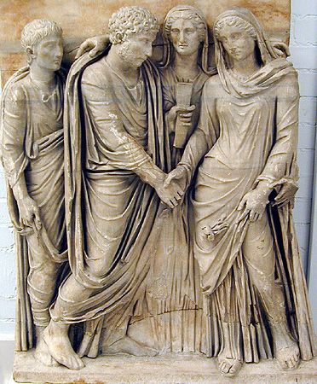
Nuptiae
sponsalia
Detail of a sarcophagus depicting a marriage ceremony, 3rd century AD, British Museum, London

Slide 8
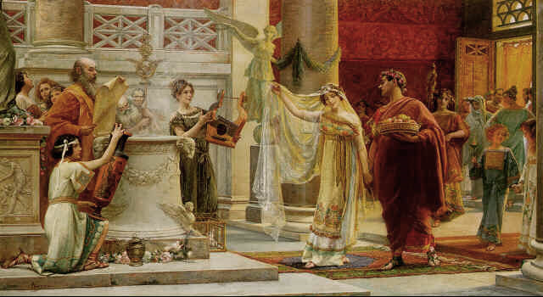
Nuptiae
marriage contract
„Libera matrimonia esse antiquitus placuit”
(constitution of Alexander Severus– C. 8, 32, 8)
„Nuptias non concubitus, sed consensus facit” (Ulpianus, D. 50, 17, 30)

Slide 9
Nuptiae
marriage dissolution
death
loss of conubium
Divortium
Repudium

Slide 10
Nuptiae
Legal Consequences of Marriage
Personal effects: | Financial consequences:
1. Honor matrimonii | Wife in manu:
2. The rise of affinity | 1. Lack of property - if she was sui iuris before the wedding, all her property passed to her husband's family
3. Children came under the authority of the father (status of married children)
 | II. Wife sine manu:
4. Name mater familias | Parapherna
 | 2. Separation of property masses

Slide 11
Nuptiae
Dowry and donations between spouses
Dos / rex uxoria
Dos profecticia
Dos adventicia
Donationes
donationes inter virum et uxorem
donatio ante nuptias
„Ibi dos esse debet, ubi onera matrimonii sunt.”
(D. 23, 3, 56, 1)

Slide 12
Nuptiae
Marriage-like and extra-marital relationships
concubinatus
contubernium
matrimonium iuris gentium
incestum
adulterium
stuprum
Relationships forbidden and prosecuted

Slide 13
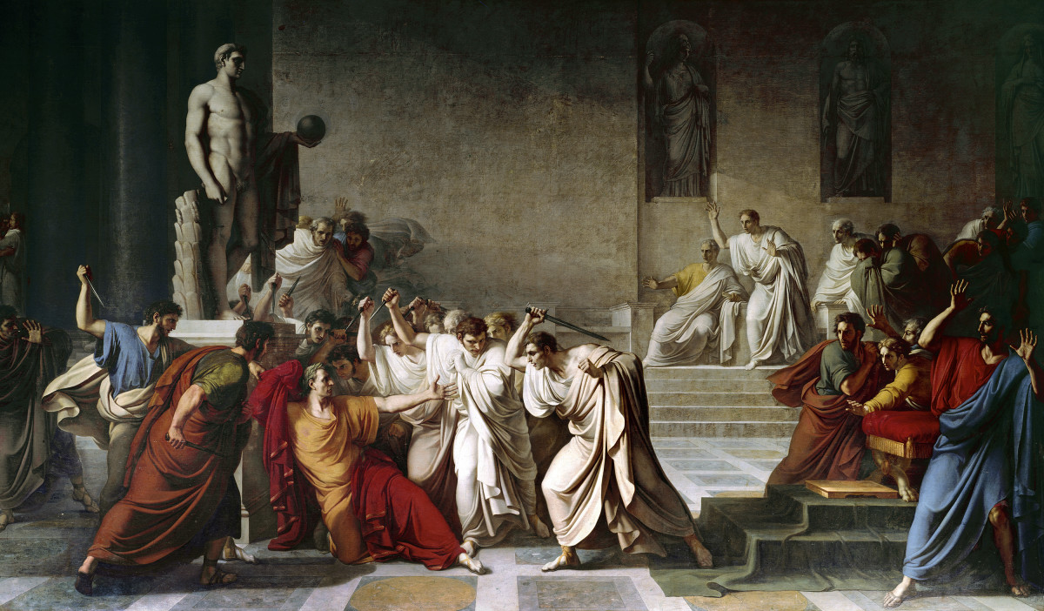

Slide 14
1. Marriages could not contract with each other: | 2. A man having a concubine until the time of Constantine the Great:
a. Slaves | a. could get married
b. a slave with a free person | b. he could take another concubine
c. a Roman citizen with a member of the Latini veteres community | c. he had to abandon his concubine, as concubinage was prohibited by law
3. The dowry was intended to:
a. help the husband bear the burdens of marriage
b. protect a woman in the future in the event of a divorce
c. to scare her husband away from a wrongful divorce
Notes:
a,b
a,b
a,b,c

Slide 15
DICTIONARY
adulterous relationships – związek cudzołożny, pozamałżeński
affiliation – przynależność, afiliacja
be bound to – być związanym, złącznym z
bear the costs – ponosić koszty
born in wedlock - urodzony z zamężnych rodziców
bride and groom – pani i pan młody
cohabitation – tu: wspólne pożycie, współbytowanie
collateral line – linia boczna pokrewieństwa
concubinage – konkubinat
dowry – posag
engagement – tu: zaręczyny
entrust – powierzać
extra-dowry property - majątek pozaposagowy

Slide 16
DICTIONARY
fiancé – narzeczony
freeborn – wolny z urodzenia
freedwoman – wyzwolenica (wyzwolona niewolnica)
incestuous relationships – związek kazirodczy
kinship – pokrewieństwo
obstacles and marriage prohibitions - przeszkody i zakazy małżeńskie
offspring – potomstwo
paternal authority – władza ojcowska (zwierzchnika rodziny)
revoke donation – odwołać darowiznę
straight line – linia prosta pokrewieństwa
unanimously – jednomyślnie, zgodnie

Slide 17
BIBLIOGRAPHY
M. Kuryłowicz, A. Wiliński, Rzymskie Prawo Prywatne zarys wykładu, Warszawa 2021
A. Dębiński, Rzymskie Prawo Prywatne kompendium, Warszawa 2021
J. Misztal-Konecka, M. Wójcik, Rzymskie Prawo Prywatne kazusy i ćwiczenia, Warszawa 2012

