Slide 1
University of Rzeszów
College of Social Sciences
The Council of Europe
Prepared by:
Justyna Nehrebecka
1st year of Administration,
2nd Cycle Studies,
Part time studies
2022/2023

Slide 2
The Council of Europe is an international governmental organization bringing together almost all the countries of Europe and several countries outside the continent.
The main objective:
„To achieve greater unity among its members in order to protect and implement the ideals and principles which constitute their common heritage and to facilitate their economic and social progres.”
Article 1a of the Statute of the Council of Europe

Slide 3
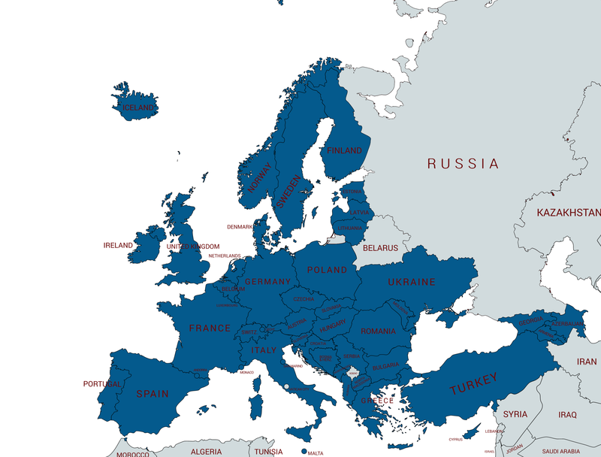
Belgium
Denmark
France
The Nederlands
Ireland
Luxembourg
Norway
Sweden
United Kingdom
Italy
Albania
Andorra
Armenia
Austria
Azerbaijan
Bosnia & Herzegovina
Bulgaria
Croatia
Cyprus
Montenegro
Czech Republic
Estonia
Finland
Greece
Members of The Council of Europe
Georgia
Spain
Iceland
Liechtenstein
Lithuania
Latvia
North Macedonia
Malta
Moldova
Monaco
Germany
Poland
Portugal
Romania
San Marino
Serbia
Slovakia
Slovenia
Switzerland
Turkey
Ukraine
Hungary
Russia

Slide 4
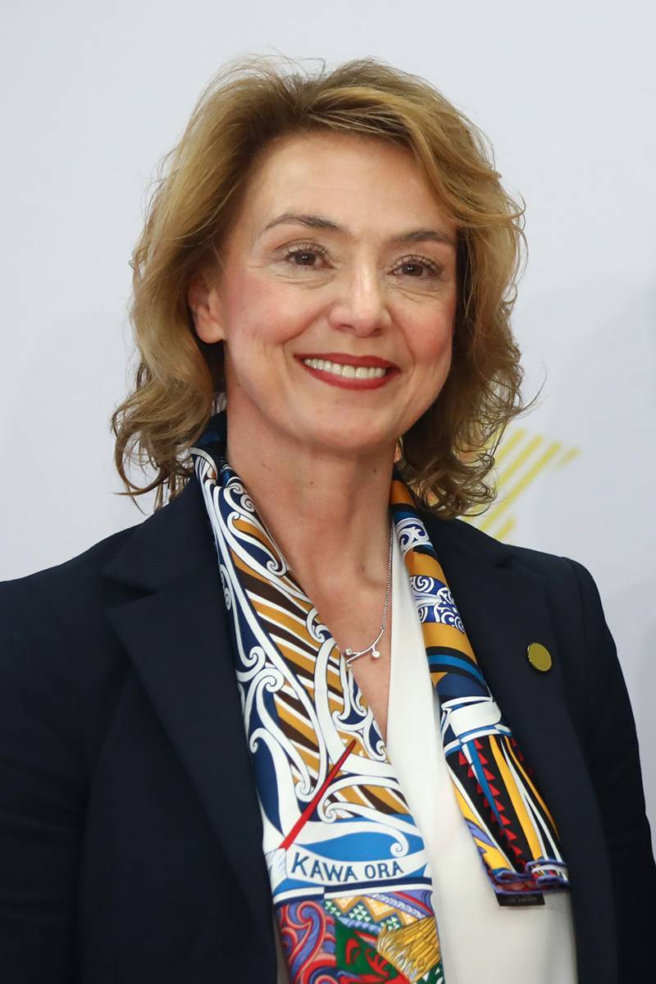
Secretary General of the Council of Europe
Marija Pejčinović Burić - Croatian economist and politician, Deputy Prime Minister and Minister of Foreign and European Affairs from 2017–2019, Secretary General of the Council of Europe from 2019 .

Slide 5
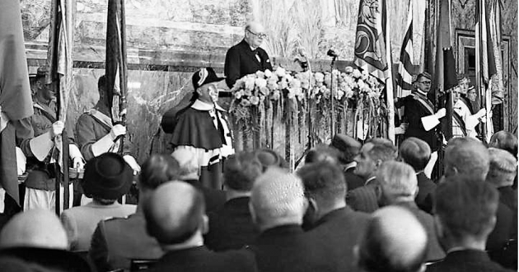
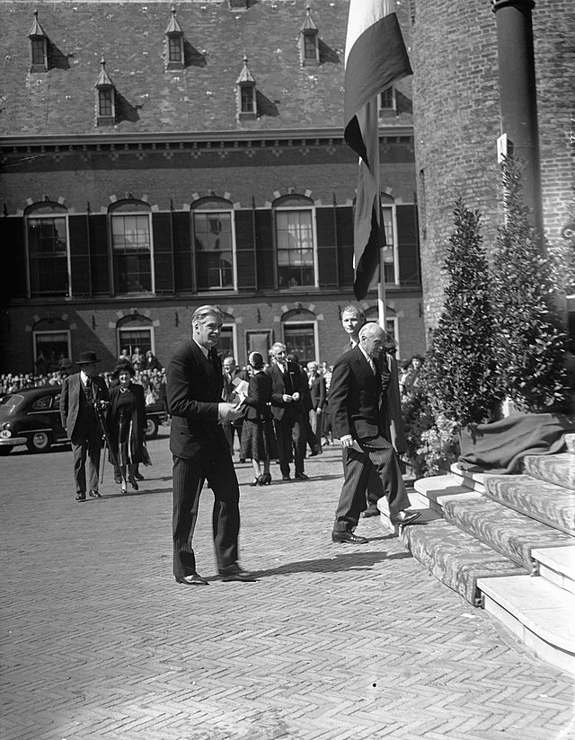
Establishment of the Council of Europe
„We should build a kind of United States of Europe (...) It is in this spirit that I address you with the words: "Europe, awake! "
~ British Prime Minister
Winston Churchill, 1946.
The Hague Congress (European Congress in The Hague) - a meeting organized in The Hague on the 7th – 10th of May 1948 . The Congress became a discussion forum on the ideas and methods of European integration, initiated the creation of the Council of Europe.

Slide 6
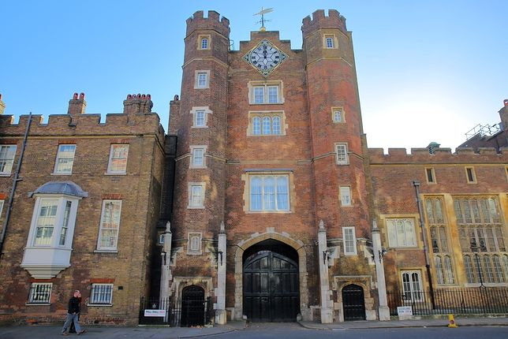
The Council of Europe was established on the 5th of May 1949 in St. James Palace in London as a result of the signing of the London Treaty by 10 countries.
Statute of the Council of Europe (also known as the London Treaty) - an international agreement establishing the Council of Europe. After obtaining the required number of seven ratifications, it entered into force on the 3rd of August 1949.
Currently 46 countries are parties to it - all European countries except Belarus & Russia.
St. James Palace in London

Slide 7
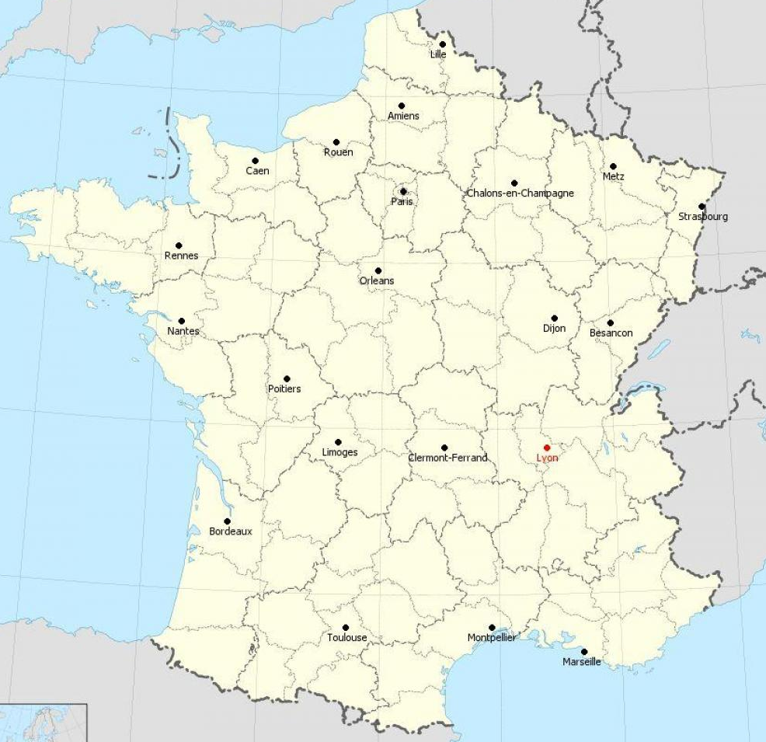
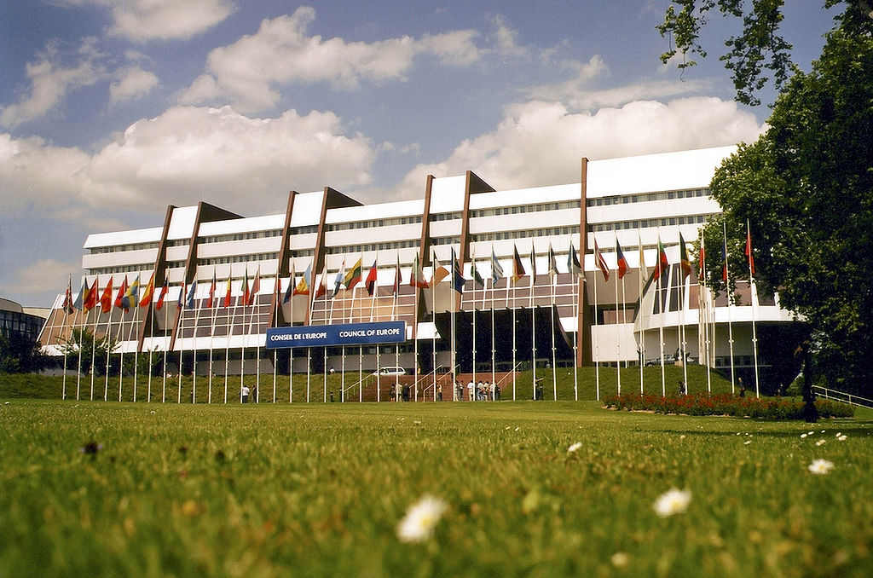
The seat of the Council of Europe is in Strasbourg, where the Palace of Europe - bulit in the years 1976–1977 - is located.
Map of France
The Palace of Europe in Strasbourg, the headquarters of the Council of Europe

Slide 8
The most important tasks of The Council of Europe is:
to protect human rights
to defend parliamentary democracy and the rule of law
to develop continental agreements to harmonize the social and legal practices of individual states
to promote European identity
to strengthen the security of European citizens, in particular by combating terrorism, organized crime and human trafficking
to promote cooperation with other international and European organizations

Slide 9
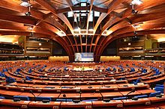
Conventions of The Council of Europe
The Council of Europe adopts documents in the nature of international treaties , called conventions
In some situations, additional protocols to the convention are also signed.
The plenary hall of the Council in the Palace of Europe

Slide 10
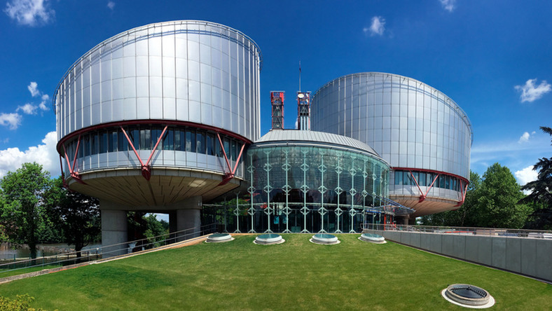
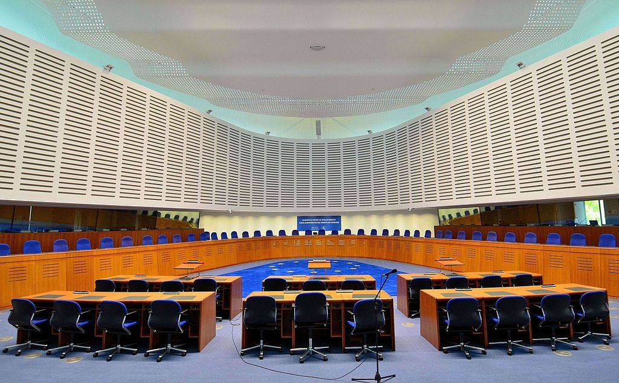
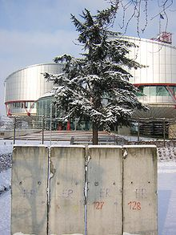
The European Court of Human Rights
The main courtroom of the Court
Front of the building of the European Court of Human Rights in Strasbourg
Fragment of the Berlin Wall in front of the building
The European Court of Human Rights is an international court adjudicating on complaints about violations of rights and freedoms contained in the Convention for the Protection of Human Rights and Fundamental Freedoms and its Additional Protocols.

Slide 11
Convention for the Protection of Human Rights and Fundamental Freedoms (European Convention on Human Rights)
An international agreement on the protection of human rights concluded by the member states of the Council of Europe . The convention was opened for signature on the 4th of November 1950, and after obtaining the necessary 10 ratifications, it entered into force on the 3rd of September 1953.
The Convention guarantees:
the right to life
prohibits torture, slavery and forced labor
the right to liberty and security
the right to a fair trial and prohibits the retroactive application of criminal law
reaffirms the right to respect for private and family life including the right to marry and establishing a family
provides for freedom of thought, conscience and religion
freedom of expression

Slide 12
Differences between The Council of Europe, European Council and The Council of The European Union
The Council of Europe
European Council
The Council of The European Union
An international governmental organization
The Council currently has 46 member states
The most famous institution is the European Court of Human Rights in Strasbourg
The Council of Europe focuses primarily on the issue of respect for human rights
A quarterly summit where EU leaders meet to discuss general policy directions
Members: Heads of state and government of EU countries, president of the European Council, president of the European Commission
The EU 's main decision-making body.
Represents the voice of EU governments, adopts EU legislation and coordinates EU policy.
Members: Ministers from all EU countries depending on the policy area under discussion
Bodies of the European Union
It is not a body of the European Union

Slide 13
References:
https://pl.wikipedia.org/wiki/Rada_Europy
https://pl.wikipedia.org/wiki/Europejska_konwencja_praw_cz%C5%82owieka
http://www.uniaeuropejska.info.pl/rada-europy-jej-organy-i-siedziba
https://www.rpo.gov.pl/pl/content/70-lecie-rady-europy-70-lat-wdra%C5%BCania-idei-praw-cz%C5%82owieka-i-demokracji
https://www.gov.pl/web/dyplomacja/europejski-trybunal-praw-czlowieka
https://europa.eu/european-union/about-eu/institutions-bodies/council-eu_pl
https://europa.eu/european-union/about-eu/institutions-bodies/european-council_pl
https://pl.wikipedia.org/wiki/Statut_Rady_Europy
https://pl.wikipedia.org/wiki/Marija_Pej%C4%8Dinovi%C4%87_Buri%C4%87
https://pl.wikipedia.org/wiki/Europejski_Trybuna%C5%82_Praw_Cz%C5%82owieka

Slide 14
Thank you for your attention.

