Slide 1
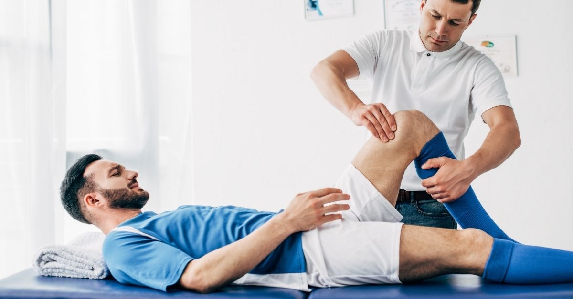
Physiotherapy in Sports: Optimizing Performance and Preventing Injuries
Author: Aleksandra Cholewa
Fizjoterapia JMN IIIR, 2023/24

Slide 2
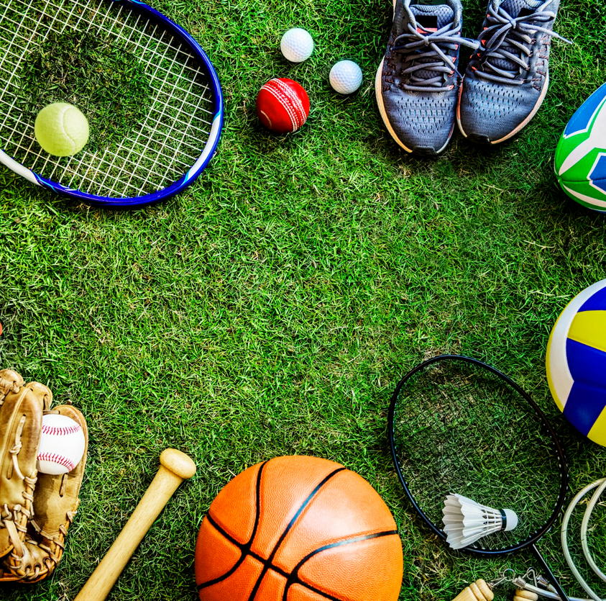
Introduction
The role of physiotherapy in sports: Physiotherapy plays a crucial role in maintaining the health of athletes, enhancing their performance, and preventing injuries.
Presentation goal: To highlight the impact of physiotherapy on athletes and understand why it is a key component of healthcare in sports.

Slide 3
Definition of Physiotherapy
Application of physiotherapeutic techniques for treatment and prevention of injuries: Physiotherapy encompasses a range of methods, such as massage, corrective exercises, and manual therapy, aiming to restore body function and prevent injuries. Improving mobility, strength, and body function: Physiotherapists work on increasing joint mobility, improving muscle strength, and restoring full body function.

Slide 4
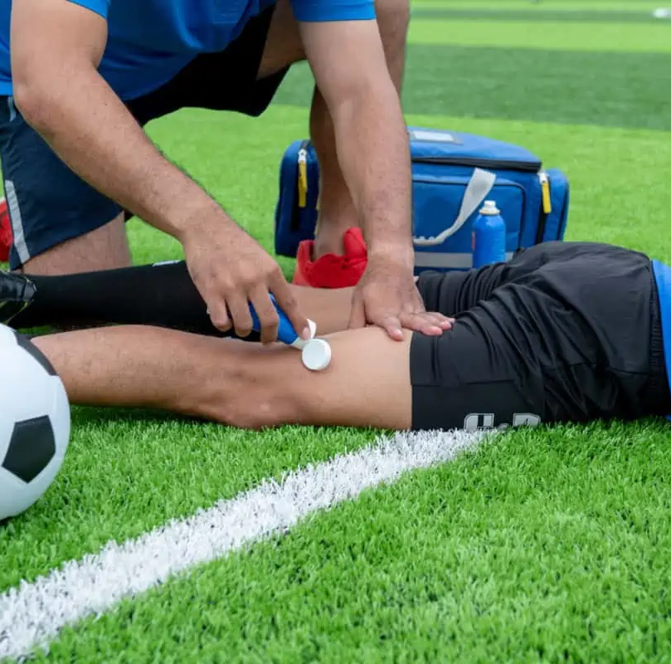
Why Physiotherapy in Sports?
Optimizing sports performance: Through individualized treatment plans, athletes can improve their performance by increasing strength, flexibility, and precision of movements. Faster recovery after injuries: Physiotherapy shortens the recovery time, enabling athletes to return to training and competition more quickly and safely. Preventing overloads and injuries: Regular physiotherapy sessions help identify injury-prone areas, allowing for the implementation of preventive programs.

Slide 5
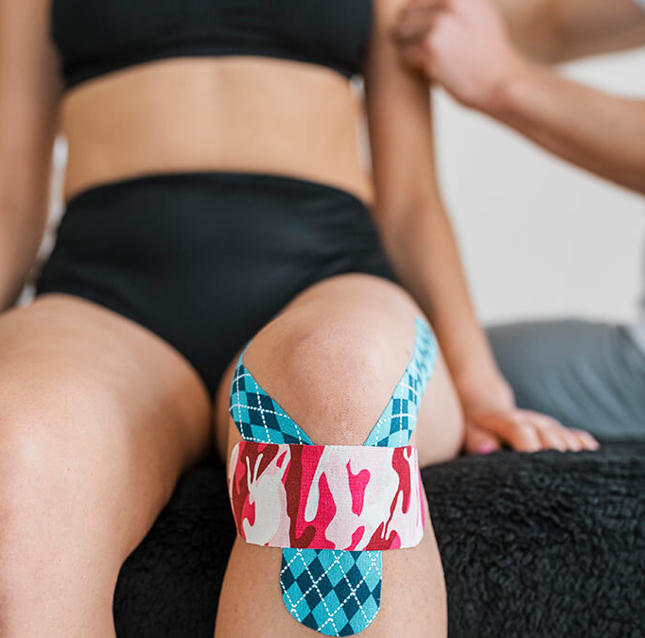
Role of the Physiotherapist
Biomechanical assessment: Physiotherapists conduct thorough biomechanical assessments, identifying areas requiring therapeutic intervention.
Individualized treatment plan: Based on the assessment, personalized treatment programs are created, taking into account the specific needs and goals of athletes.
Rehabilitation after injury: Physiotherapists lead comprehensive post-injury rehabilitation, addressing both treatment and prevention of recurrences.

Slide 6
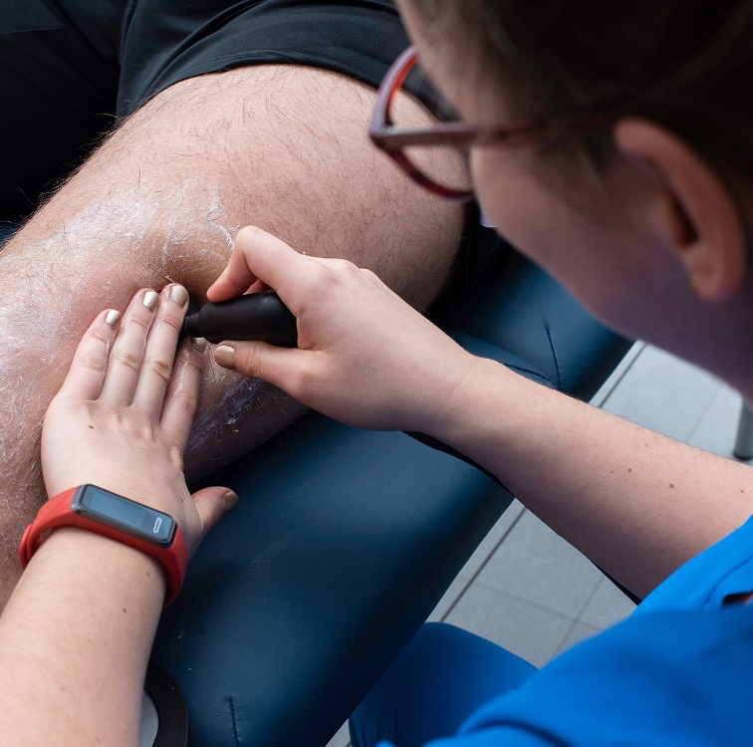
Physiotherapeutic Techniques
Therapeutic massage: Stimulating blood circulation, loosening tense muscles.
Corrective exercises: Strengthening and correcting biomechanical movement irregularities.
Manual therapy: Joint and soft tissue manipulations to restore proper function.
Electrotherapy: Using electrical currents to alleviate pain and accelerate healing processes.

Slide 7
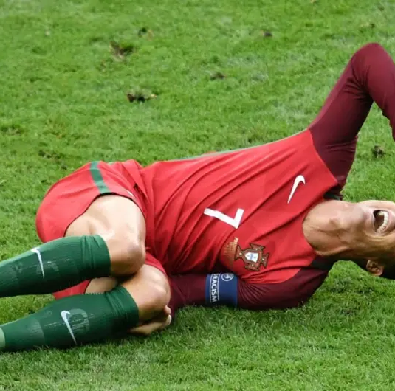
Injury Prevention
Training programs for injury prevention: Physiotherapists collaborate with coaches to develop training programs that address preventive aspects and strengthen weak areas.
Educating athletes on proper training technique: Physiotherapists play an educational role, teaching athletes optimal training techniques to minimize the risk of injuries.

Slide 8
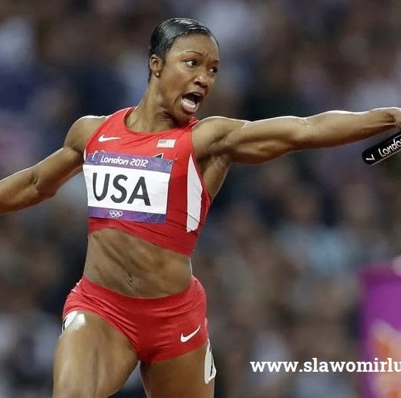
Physiotherapy and Sports Achievements
Accelerating the recovery process: Effective physiotherapy expedites regenerative processes, allowing for a faster return to intense training and competition.
Increasing physical performance: By improving muscle and joint function, athletes experience an increase in physical performance.
Enhancing muscle and joint function: Physiotherapy focuses on restoring full muscle and joint function, influencing the precision and effectiveness of athletes' movements.

Slide 9
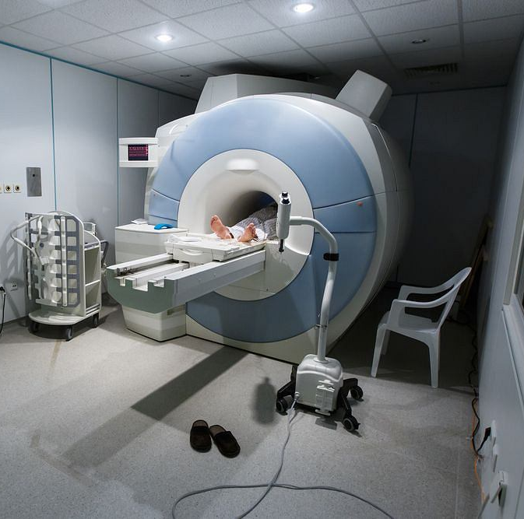
Innovations in Physiotherapy
Advanced technologies in diagnostics: Utilizing modern technologies, such as magnetic resonance imaging (MRI), for accurate diagnosis.
Modern therapeutic methods: Introducing innovative approaches, such as laser therapy or shockwave therapy.

Slide 10
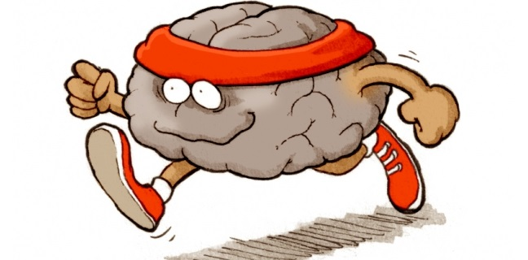
Physiotherapy and Athlete's Psychology
Impact of physiotherapy on the athlete's psychology: Improving mental well-being by minimizing pain, increasing self-confidence, and motivation for training.
Boosting self-confidence: Physiotherapy not only heals the body but also supports psychological aspects, increasing athletes' confidence and positive attitudes.

Slide 11
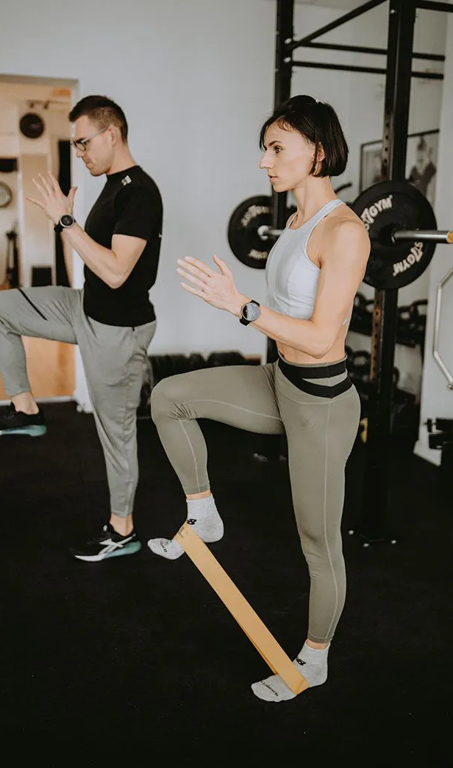
Summary
Benefits of physiotherapy in sports: Optimizing performance, faster recovery from injuries, injury prevention.
Collaboration between physiotherapist, coach, and athlete: Key role of communication and collaboration in providing comprehensive healthcare for athletes.
Encouragement to use physiotherapy for optimizing performance and preventing injuries: Emphasizing the importance of regular physiotherapy sessions for athletes' health and achievements.

Slide 12
Dictionary
enhancing- zwiększenie
approach- podejście
injury- uraz
comprehensive- wszechstronny
increasing- zwiększenie
preventing overloads- zapobieganie przeciążeniom
circulation- cyrkulacja
https://www.freepik.com/premium-photo/support-senior-man-woman-holding-hands-with-care-love-empathy-while-together-closeup-hand-elderly-male-person-hope-trust-kindness-help-with-life-insurance-health_44643391.htm

Slide 13
Bibliography
Hrysomallis, C. (2007). Injury incidence, risk factors, and prevention in Australian rules football. Sports Medicine, 37(6), 497-503.
Prentice, W. E. (2011). Rehabilitation Techniques in Sports Medicine. McGraw-Hill Education.
Shamus, E., Shamus, J., & Shamus, K. (2015). Sports Injury Prevention and Rehabilitation. John Wiley & Sons.
Kisner, C., & Colby, L. A. (2017). Therapeutic Exercise: Foundations and Techniques. F.A. Davis Company.
Magee, D. J. (2014). Orthopedic Physical Assessment. Elsevier Health Sciences.
Cross, T. M., Gibbs, N., Houang, M. T., & Cameron, M. (2004). Acute quadriceps muscle strains: magnetic resonance imaging features and prognosis. The American Journal of Sports Medicine, 32(3), 710-719.
Kibler, W. B., Press, J., & Sciascia, A. (2006). The role of core stability in athletic function. Sports Medicine, 36(3), 189-198.
Błażej Ciesielczyk, Katarzyna Grabowska, Fizjoterapia w sporcie na przykładzie zawodników uprawiających triatlon, ze szczególnym uwzględnieniem roli masażu.

Slide 14
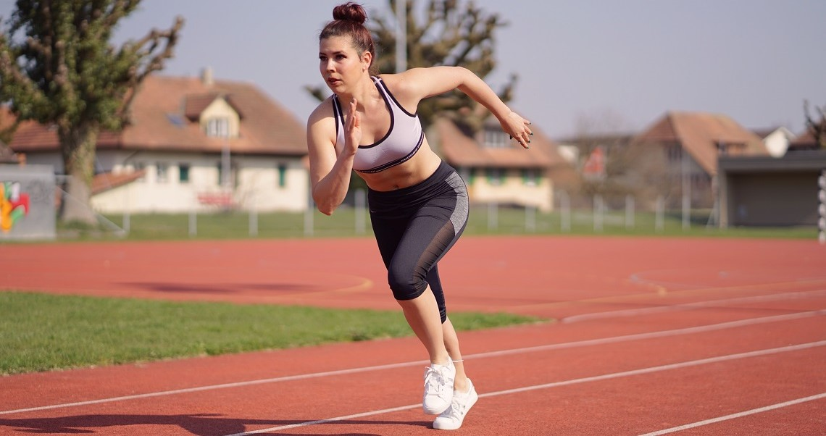
Thank you for your attention!

