Slide 1
Discopathy
Emilia Bolanowska
III R Fizjoterapia JMN
Rok akademicki 2023/2024 sem.zimowy

Slide 2
Intervertebral disc
structure located between the vertebrae
built of two parts

Slide 3
Functions of the intervertebral disc
Spinal depreciation
Equal distribution of axial pressure
Allows movement of the spine in any plane
Prevents friction

Slide 4
What is a discopathy?
https://orthosportsmed.com/what-is-degenerative-disc-disease/
degenerative disease of the intervertebral disc
the pathology of the annulus fibrosus

Slide 5
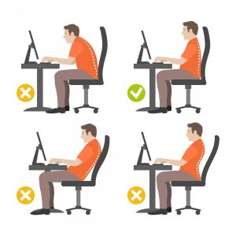
Causes
https://fizjomind.pl/2018/12/11/prawidlowa-pozycja-podczas-siedzenia/
Age
Type of work performed
Obesity
High physical activity
Smoking

Slide 6
Who is affected ?
https://jancop.pl/przeciazenia-kregoslupa/
pressure force on the spinal disc
elderly people
athletes
people performing the same activity for many hours

Slide 7
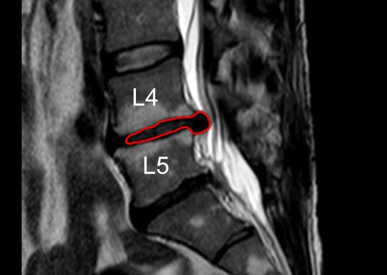
How to diagnose discopathy?
Computed tomography
Magnetic resonance imaging
X-ray examination
https://www.rehab.pl/choroby-i-objawy/dyskopatia-kregoslupa-objawy-leczenie-rehabilitacja/dyskopatia-na-poziomie-l4-l5/

Slide 8
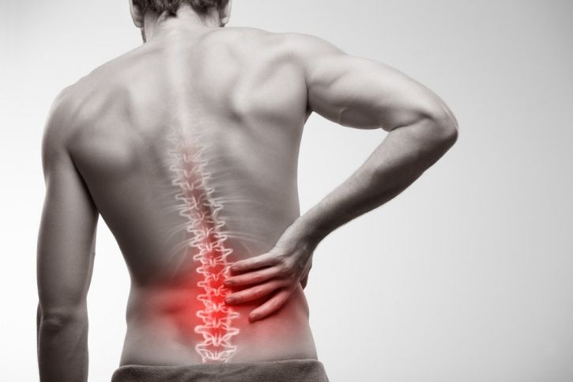
Symptoms
spine pain
neuropathic pain
muscle weakness
spine stiffness
https://fizjoplaner.pl/przyczyny-rodzaje-bolu-kregoslupa-ledzwiowego.html

Slide 9
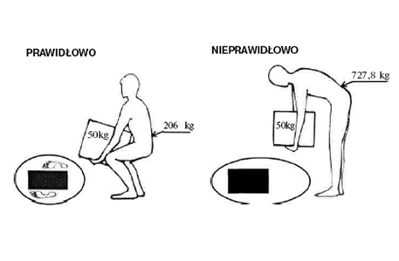
How to prevent discopathy?
Everyday ergonomics
Correct posture
Pharmacotherapy
https://werakso.pl/biomechanika-kregoslupa-czyli-jak-funkcjonuje-nasz-kregoslup/

Slide 10
Physical activity
strengthening exercises
stretching exercises

Slide 11
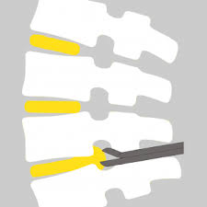
Surgical treatment
Only a small percentage of patients with disc herniations require surgery
individually tailored
http://www.aldemed.pl/neurochirurgia/pagesView,71,mikrodiscektomia,PL

Slide 12
Thanks for your attention

Slide 13
Vocabulary
Intervertebral disc- krążek międzykręgowy
Degenerative disease- choroba degeneracyjna
Annulus fibrosus- pierścień włóknisty
Nucleus pulposus- jądro miażdzyste
Muscle weakness- osłabienie mięśni
Spine stiffness- sztywność kręgosłupa

Slide 14
Bibliography
M. Boisson, M.Lefèvre-Colau, F. Rannou, Christelle Nguyen, Active discopathy: a clinical reality, 2018
B.Fiani,R.Jarrah, A.Wong, A.Alamah, J.Runnels, Repetitive traumatic discopathy in the modern-era tennis player, 2020
P.Roussouly, J.Pinheiro-Franco, Biomechanical analysis of the spino-pelvic organization and adaptation in pathology, 2011

