Slide 1
Sprain of the Ankle Joint Rzeszów University
Physiotherapy, year 3 JMGR, extramural studies 07.11.2023
Gabriela Grasza

Slide 2
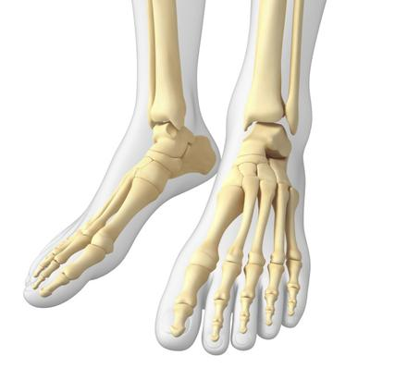
Fact about the incidence of ankle sprains
It is estimated that ankle sprains affect nearly 8% of physically active people.
https://www.poradnikzdrowie.pl/zdrowie/anatomia/staw-skokowy-budowa-i-najczestsze-urazy-stawu-skokowego-aa-zqDr-JYzN-EvDG.html

Slide 3
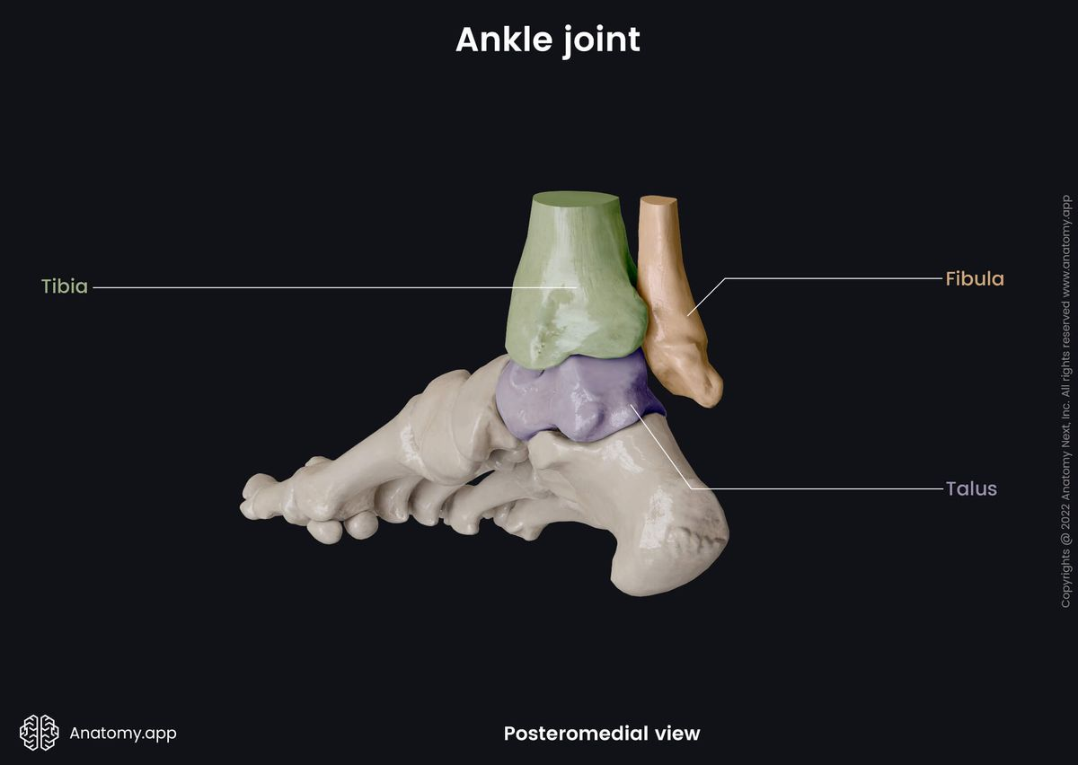
Anatomy of the ankle joint: -complex hinge-type joint -upper ankle joint (flexion movements) *consists of the convex surface of the ankle bone *concave surface of both ankles -lower ankle joint (rotation movements) -connects the talus, calcaneus and navicular bone
https://anatomy.app/encyclopedia/ankle-joint

Slide 4
Ankle joint stabilizers: -passive components -lateral, medial and posterior ligaments and the joint capsule -active components
=

Slide 5
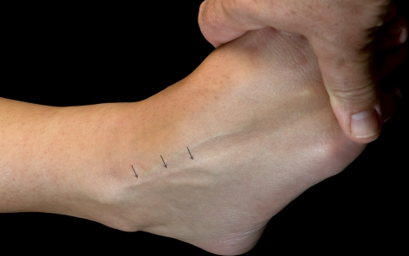
Mechanism of injury
The most common mechanism of injury in ankle sprains is a combination of flexion and inversion.
I anterior talofibular ligament
https://www.researchgate.net/figure/Using-the-combined-ankle-plantar-flexion-and-inversion-position-the-superficial-peroneal_fig3_41911251

Slide 6
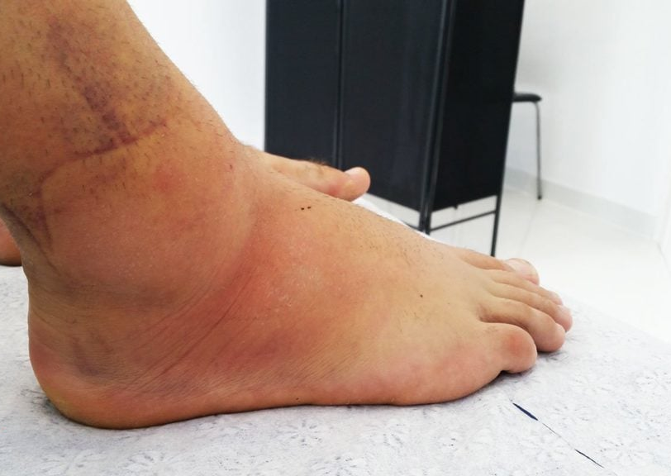
Symptoms
pain in or around the joint,
swelling,
bruising,
limited mobility.

Slide 7
Ankle sprains range
I: ligaments strain,
II: incomplete rupture of the ligament, with moderate impairment of function,
III: complete rupture and loss of integrity of the ligament

Slide 8
"RICE" treatment after ankle sprain
Rest
Ice
Compression
Elevation

Slide 9
Rehabilitation
The four components of rehabilitation are range-of-motion rehabilitation, progressive muscle-strengthening exercises, proprioceptive training and activity-specific training.
The rehabilitation process can also be supported by physical therapy treatments.

Slide 10
MUSCLE-STRENGTHENING EXERCISES
Examples of exercises:
Kicking the big ball,
Gradual weight bearing on the feet,
Exercises on the balance platform,
Rolling feet over the wall.

Slide 11
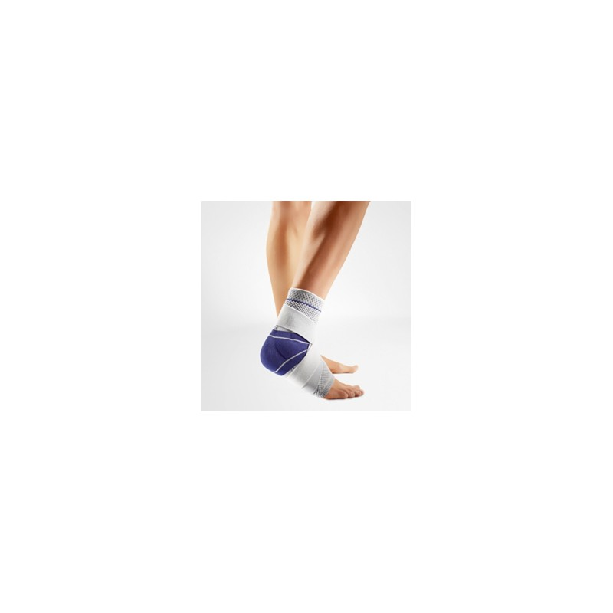
Stability
The stability of the joint is a prerequisite for starting safe functional rehabilitation!
It is important to remember that grade I and II ankle sprains are stable.
https://megamedic.pl/pl/p/Stabilizator-stawu-skokowego-z-bocznymi-stalkami-Variteks-827/1780

Slide 12
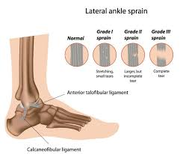
In conclusion, ankle sprain is a common injury, and should not be taken lightly, as it requires comprehensive rehabilitation.
https://www.holisticbodyworks.com.au/ankle-sprain/

Slide 13
Vocabulary
ankle sprain- skręcenie stawu skokowego
talus – kość skokowa
calcaneus – kość piętowa
navicular bone – kość łódkowata
tibia- kość piszczelowa
fibula bone- kość strzałkowa
anterior talofibular ligament- więzadło skokowo-strzałkowe przednie
range-of-motion exercises- ćwiczenia zwiększające zakres ruchu

Slide 14
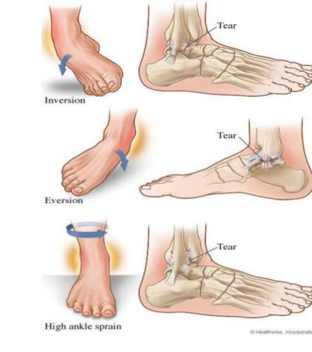
Thank you for your attention!
https://www.nolasportsmedicine.com/blog/low-ankle-sprains-versus-high-ankle-sprains

Slide 15
Biobliography
Ankle sprain: pathophysiology, predisposing factors, and management strategies Tricia J Hubbard & Erik A Wikstrom Pages 115-122 | Published online: 21 Dec 2022
Risk Factors for Lateral Ankle Sprains and Chronic Ankle Instability
Eamonn Delahunt, PhD, BSc (Physiotherapy); Alexandria Remus J Athl Train (2019) 54 (6): 611–616.
Management of Ankle Sprains- MICHAEL W. WOLFE, M.D., TIM L. UHL, PH.D., A.T.-C., P.T., CARL G. MATTACOLA, PH.D, A.T.-C., AND LELAND C. MCCLUSKEY, M.D.

