Slide 1
Physiotherapy After Stroke
Author: Hubert Stępnicki
Język angielski – III Rok Fizjoterapia niestacjonarna studia jednolite magisterskie
Data: 26.11.2023r.
https://encrypted-tbn0.gstatic.com/images?q=tbn%3AANd9GcQFDPoZyFJHu7yBWSPlLmywyY-MQOx1dyT8Kw&usqp=CAU&fbclid=IwAR0qg_bcGlTgWUgzwANHKWMaTTIRRfSAYi7FWS8zn6B3LweRGevzPLUfv8M

Slide 2
What is a Stroke?
A stroke, sometimes called a brain attack, occurs when:
Something blocks blood supply to part of the brain,
When blood vessel in the brain bursts.
In either case, parts of brain become damaged or die.

Slide 3
Risk factors for stroke
Risk factors that can’t be changed:
Older age
Gender
History of prior stroke
Heredity or genetics
Race.

Slide 4
Risk factors for stroke
Risk factors for stroke that can be changed, treated, or medically managed:
High blood pressure
Heart disease
Diabetes
Smoking
High blood cholesterol and lipids
Obesity
Alcohol and drugs.

Slide 5
What are the symptoms of a stroke?
Stroke symptoms may happen suddenly. Each person’s symptoms may vary. Symptoms may include:
Weakness or numbness of the face, arm, or leg, usually on one side of the body
Having trouble speaking or understanding
Problems with vision, such as dimness or loss of vision in one or both eyes
Dizziness or problems with balance or coordination
Problems with movement or walking
Fainting (loss of consciousness) or seizure
Severe headaches with no known cause, especially if they happen suddenly.

Slide 6
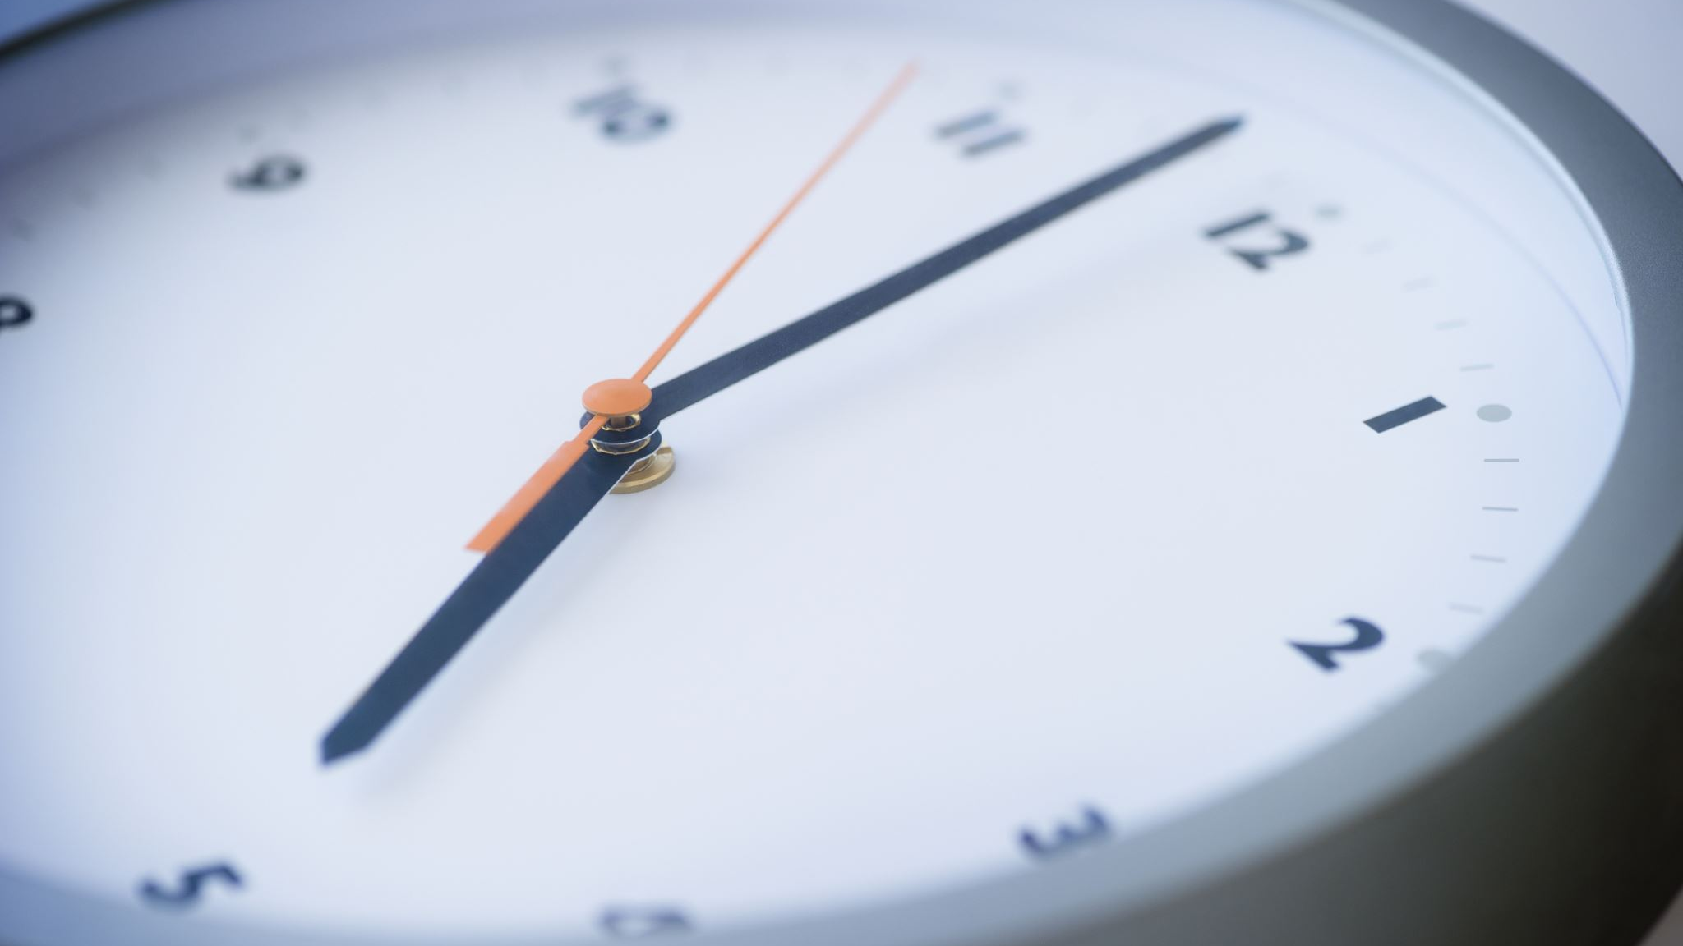
Help FAST
FAST is an easy way to remember the signs of a stroke. When you see these signs, you will know that you need to call 911 fast. FAST stands for:
F - Face drooping.
A - Arm weakness.
S - Speech difficulty.
T - Time to call 911.

Slide 7
How is a stroke diagnosed?
CT scan of the brain. A brain CT scan can show bleeding in the brain or damage to brain cells caused by a stroke. It is used to find abnormalities and help find the location or type of stroke.
MRI. An MRI uses magnetic fields to find small changes in brain tissue that help to find and diagnose stroke.
CTA (computed tomographic angiography).A CT angiogram uses CT technology to get images of blood vessels.

Slide 8
What are the complications of having a stroke?
Recovery from stroke and the specific ability affected depends on the size and location of the stroke.
A small stroke may cause problems such as weakness in your arm or leg.
Larger strokes may cause parts of your body to not be able to move (be paralyzed). Larger strokes can also cause loss of speech or even death.

Slide 9
Consequence of a stroke
The most common types of disability after stroke are
impaired speech,
restricted physical abilities,
weakness or paralysis of limbs on one side of the body,
difficulty gripping or holding things,
a slowed ability to communicate.

Slide 10
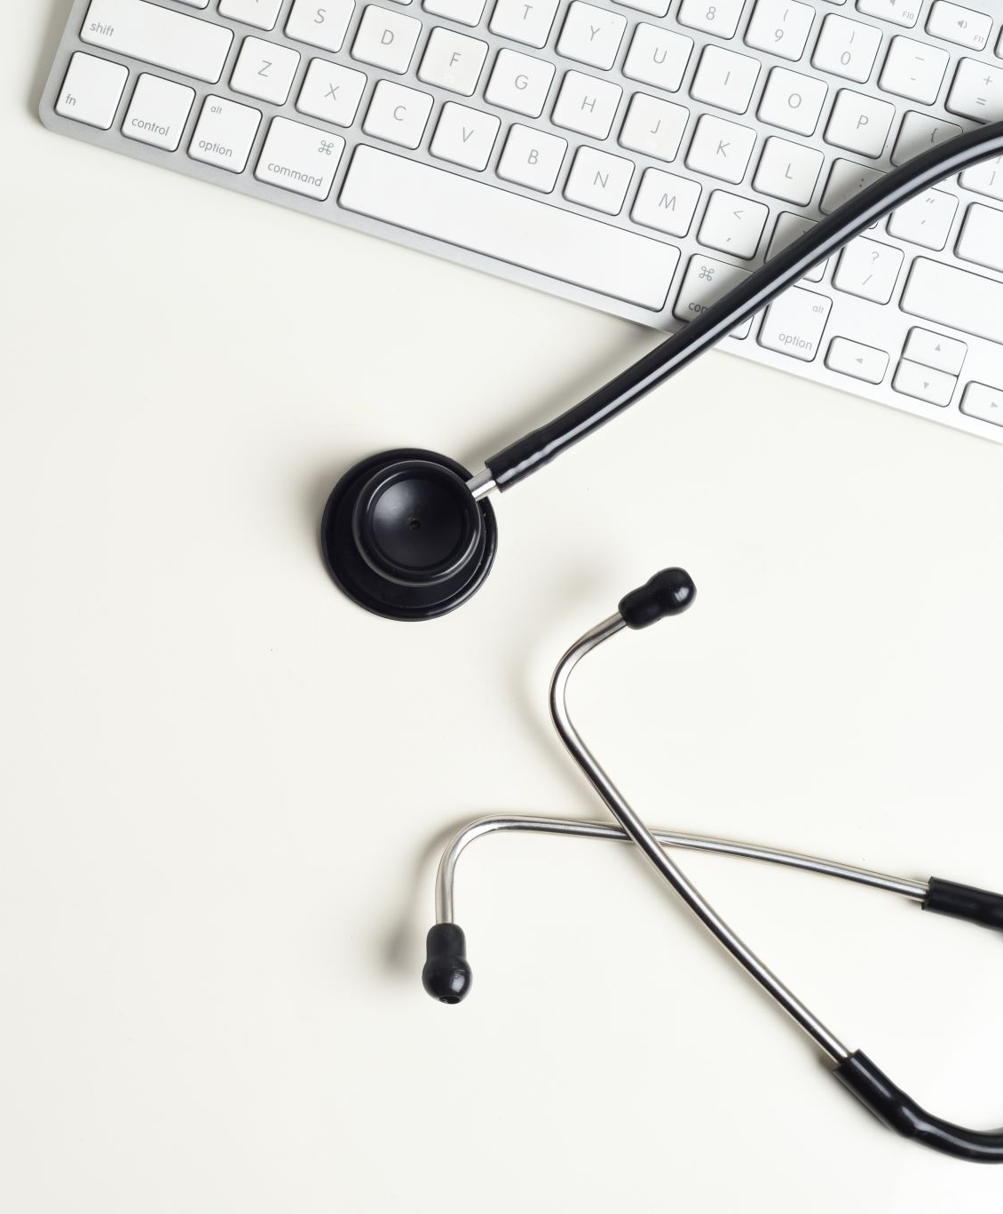
Physiotherapy for stroke
Physiotherapy is an integral component of road to recovery from a Stroke.
Physiotherapy applied early in the patient journey will improve, function, health, and independence.

Slide 11
Stroke Exercises

Slide 12
Calf stretch
Stand next to a stable chair or flat wall.
Place the hands on the top of the chair or a similar height up the wall.
Bend the body to create a triangle and step one leg back, straightening the leg as much as comfortable until feeling a stretch in the calf. Ensure that the toe is facing straight forward.
Hold this position for 1 minute or as long as comfortable, and then repeat this exercise using the opposite leg.
If it is too painful to keep the heel flat and touching the ground during this exercise, keep it raised and gradually attempt to lower it during subsequent repetitions.

Slide 13
Side lying hip flexion
Lie on the unaffected side of the body with the head resting on a bent arm. Ensure the hips are level and the hips, legs, and feet are in line.
Slowly raise and bend the affected leg inward toward the chest or belly, and then straighten it back to the starting position.
Repeat this exercise 15–20 times or until the leg muscles become fatigued.

Slide 14
Wrist Curl Exercise
Grasp the water bottle with your affected hand and use your non-affected hand to support your arm and help isolate the wrist movement.
Allow your wrist to stretch down, and then curl your wrist up.
Repeat 10 times slowly.
The water bottle adds some weight to this recovery exercise. If necessary, you can do it without the bottle or skip it until your strength and mobility improves.

Slide 15
Vocabulary
Blood vessel - Naczynia krwionośne
History of prior stroke - Historia poprzedniego udaru
Heredity - Dziedziczność
Seizure - Drgawki
Numbness of the face - Drętwienie twarzy

Slide 16
Bibliography:
Jan Lexell, Ulla -Britt Flansbejer, Muscle strength training, gait performance and physiotherapy after stroke, 2008.
Justyna Mazurek, Joanna Rymaszewska, Rehabilitation after stroke, 2013.
Johns Hopkins Medicine, Health, Conditions and Diseases, Stroke.
June Lee, The Ultimate Guide to Stroke Exercises, 2020.
Physiopedia, Stroke: Physiotherapy Treatment Approaches.
Flirt Rehab, Stroke Exercises for the Full-Body: How to Recover Mobility at Home, 2022.

Slide 17
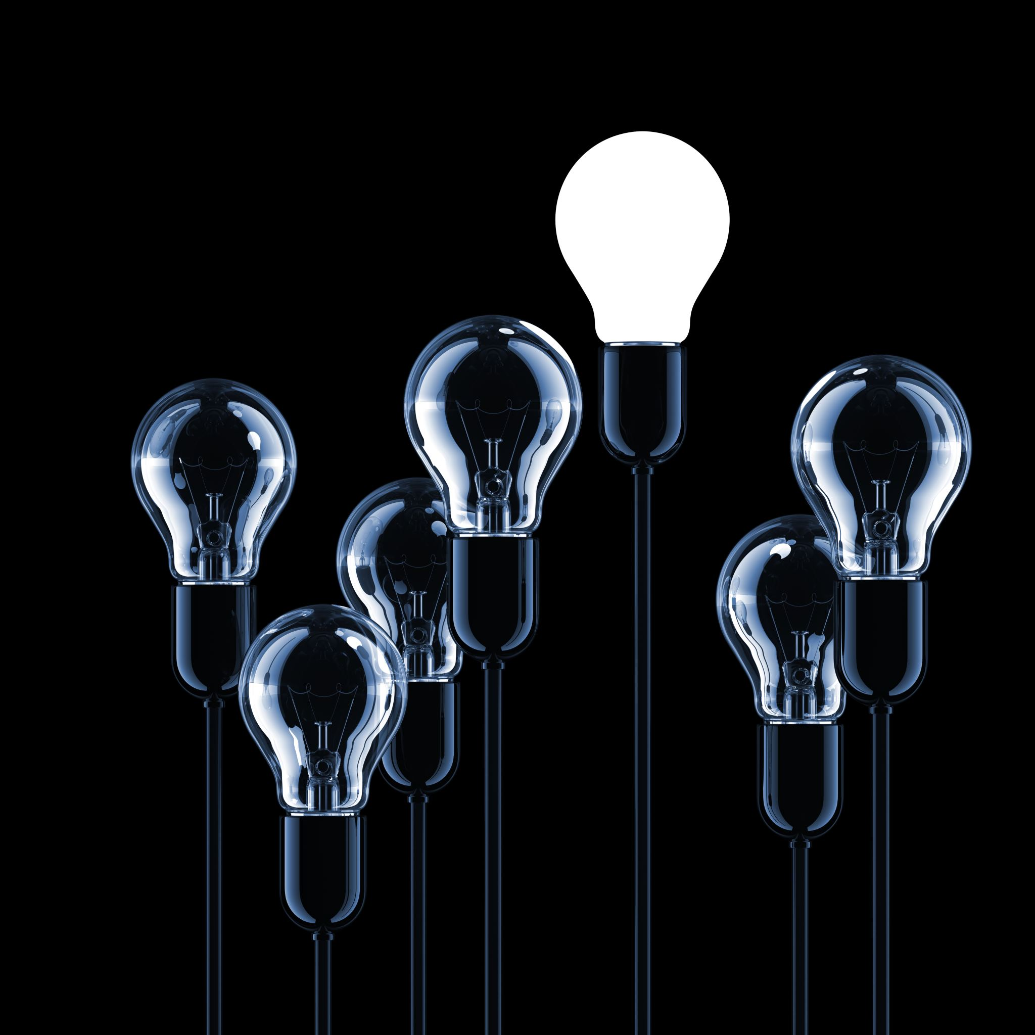
Thanks for your attention.

