Slide 1
Osteoporosis
Faculty of Medicine, Rzeszów University
Master’s degree studies in Physiotherapy
Year 3
Paulina Małozięć
2024/2025

Slide 2
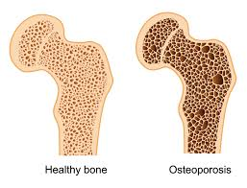
What is osteoporosis?
Osteoporosis is a disease of the skeleton, characterized by a decrease in the mechanical strength of the bones and increasing the risk of fractures
Osteoporosis is a disease in which bone tissue atrophies, resulting in an increased incidence of fractures. The essence of osteoporosis is the process of bone atrophy
https://www.gov.pl/web/psse-brodnica/swiatowy-dzien-osteoporozy
https://www.desertspineandsports.com/osteoporosis-and-bone-health/

Slide 3
Causes of osteoporosis
Osteoporosis occurs in 30% of women and 8% of men
Age
early cessation of menstruation (before age 40)
family propensity for fractures and osteoporosis,
low physical activity
https://milehighspine.com/osteoporosis-whats-the-big-deal/

Slide 4
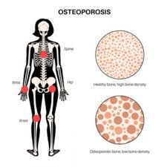
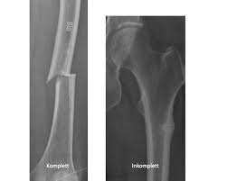
Symptoms of osteoporosis
Very often the first symptom, is a fracture:
knee
wrist
hip
spine
https://liu.se/en/news-item/ny-kunskap-om-ovanliga-benbrott
https://www.chennaispinecare.com/osteoporosis-and-spine-fractures-in-women/
https://www.nbsportsmed.com/blog/osteoporosis-and-fractures

Slide 5
Type of osteoporosis
Type 1 is post-menopausal osteoporosis
Type 2 is senile osteoporosis
secondary osteoporosis
https://www.researchgate.net/figure/Classification-of-Osteoporosis_fig1_353217077

Slide 6
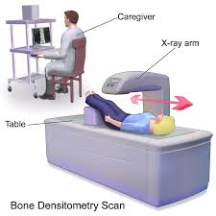
How to diagnose osteoporosis?
Densitometry test - a check of bone mass
Usually the lumbar spine and/or hip are checked
Laboratory and X-ray examinations, mainly of the spine.
https://www.cbkjci.pl/post/blog/61,densytometria-obowiazkowe-badanie-dla-osob-dbajacych-o-zdrowie
https://www.dovemed.com/common-procedures/radiology-procedures/bone-densitometry

Slide 7
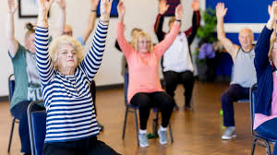
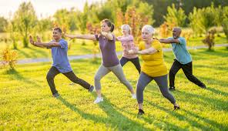
How to support the treatment of osteoporosis?
Movement
Nordic walking
Walking
Dancing
Tai-chi
Running
https://zycieseniora.com/zdrowie-seniora/nordic-walking-dla-osob-starszych
https://akademiaopiekunow.pl/ruch-to-zdrowie/
https://www.aarp.org/health/healthy-living/info-2024/tai-chi-benefits.html

Slide 8
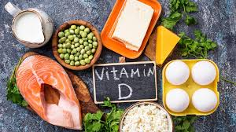
How to support the treatment of osteoporosis?
Consume products rich in minerals and vitamins
Supplemental calcium and vitamin D
Diet with adequate calcium intake
https://posilkiwchorobie.pl/onkologia/jak-uzupelnic-niedobor-witaminy-d-w-organizmie/

Slide 9
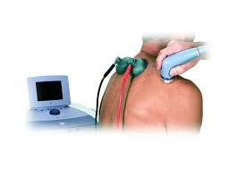
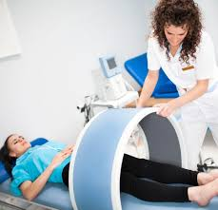
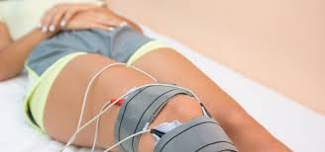
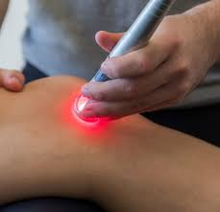
Physiotherapy in osteoporosis
Electrotherapy
Magnetotherapy
Ultrasound
Laser therapy
https://www.bardomed.pl/blog/nowosci-sprzetowe/ultradzwieki-rehabilitacji/
https://fizjomedica.szczecin.pl/magnetoterapia/
https://fizjoterapiawkrakowie.pl/elektroterapia-zabiegi/
https://rudek.com.pl/laseroterapia/

Slide 10
Examples of exercises

Slide 11
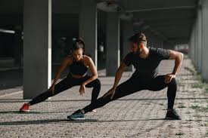
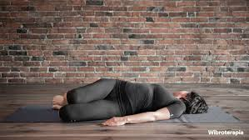
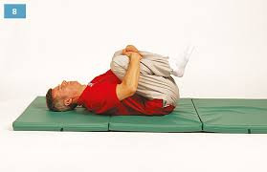
Exercises in osteoporosis
Inner leg stretch
Hip and lower back stretch
Double hip rotation
https://polki.pl/dieta-i-fitness/cwiczenia,rozciaganie-miesni-nog-po-treningu-zestaw-cwiczen,10379004,galeria.html
https://www.wibroterapia.com/proste-cwiczenia-na-bol-biodra/
https://dexak.pl/strefa-pacjenta/zestawy-cwiczen/cwiczenia-na-kregoslup-ledzwiowy/

Slide 12
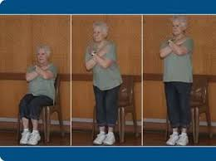
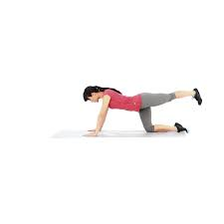
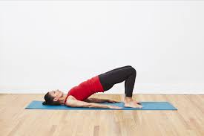
Exercise in osteoporosis
Chair stand
Hip extension
Bridge
https://www.physio-pedia.com/30_Seconds_Sit_To_Stand_Test
https://www.muscleandfitness.com/exercise/workouts/leg-exercises/hip-extension-and-cross/
https://www.verywellfit.com/how-to-do-the-bridge-exercise-3120738

Slide 13
Quiz
Who is more at risk of osteoporosis?
A) Women B) Men C) Kids
2. How many types of osteoporosis are distinguished?
A)1 B) 2 C)3 D) 4
3. Does the photo show a diseased bone ?
A ) Yes B) No
4. Does diet affect the development of the disease?
A) Yes B) NO

Slide 14
Vocablulary
Osteoporosis- osteoporoza
Disease- choroba
Decrease- zmniejszyć
Increasing- zwiększyć
Fractures- złamanie
Atrophy- zanik
Propensity- tendecja
lumbar spine- kręgosłup lędźwiowy
Densitometry- Densytometria
Knee- kolano
wrist- nadgarstek
Hip- biodro
Spine- kręgosłup
post-menopausal- okres po menopauzalny
senile osteoporosis- starcza osteoporoza
secondary osteoporosis- wtórna osteoporoza
Prevent- zapobiegać

Slide 15
Thank you !

Slide 16
Bibliography
https://www.chennaispinecare.com/osteoporosis-and-spine-fractures-in-women/
https://ecosh.com/osteoporosis-symptoms-causes-risk-groups-prevention-and-treatment/
Albright F, Smith PH, Richel AM. Postmenopausal osteoporosis: its clinical features. JAMA 1941; 116: 2463–2474
Osteoporosis: a still increasing prevalence Jean-Yves Reginster ¹, Nansa BurletAffiliations
PMID: 16455317
DOI: 10.1016/j.bone.2005.11.024
https://www.health.harvard.edu/staying-healthy/exercise-rx-for-overcoming-osteoarthritis
https://www.diki.pl/slownik-angielskiego?q=medyczny

