Slide 1
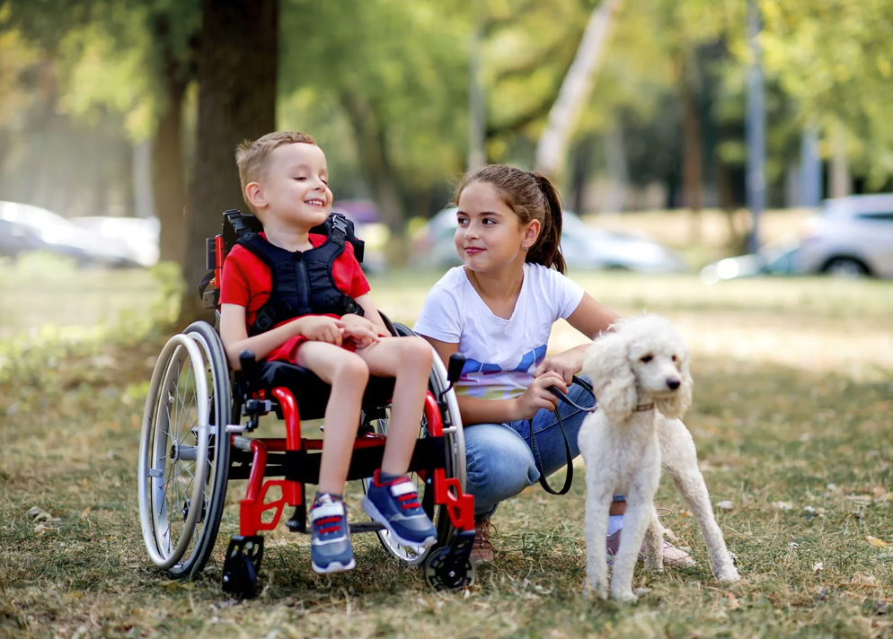
physiotherapy in cerebral palsy
Ewelina Piekarz
III rok Fizjoterapia JMN
29.11.2024r. 2024/2025
https://dobropowraca.pl/baza-wiedzy/mozgowe-porazenie-dzieciece-wiele-twarzy-choroby-littlea/

Slide 2
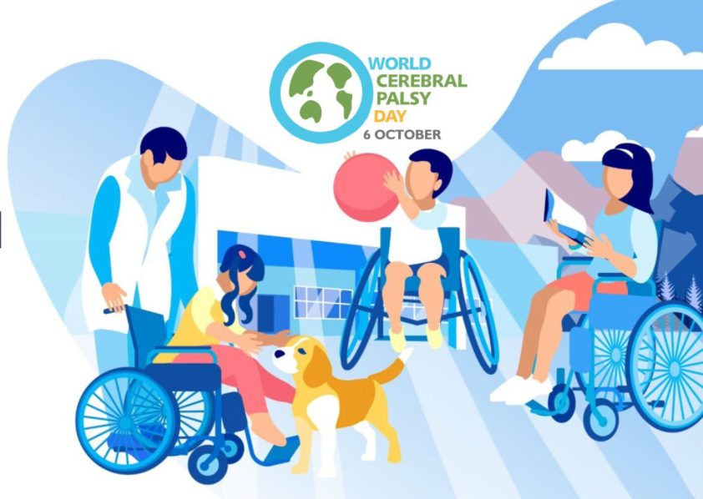
cerebral palsy
Cerebral palsy is a group of conditions that affect movement and posture. It's caused by damage that occurs to the developing brain, most often before birth.
Cerebral palsy is a disease of the nervous system
Cerebral palsy may make it hard to swallow. It also can cause eye muscle imbalance, in which the eyes don't focus on the same object. People with the condition might have reduced range of motion in their joints due to muscle stiffness.
https://www.pacehospital.com/when-to-suspect-a-child-with-cerebral-palsy

Slide 3
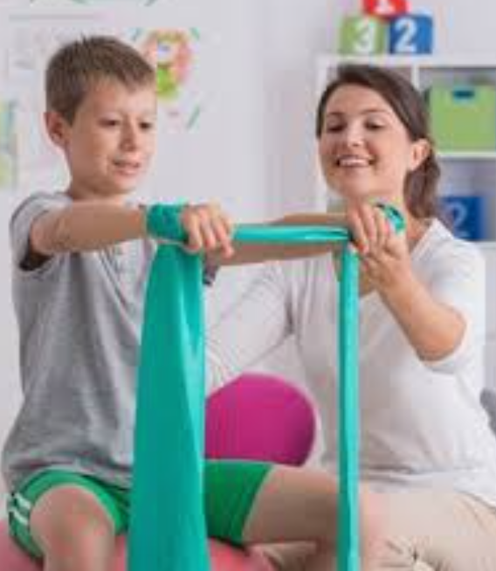
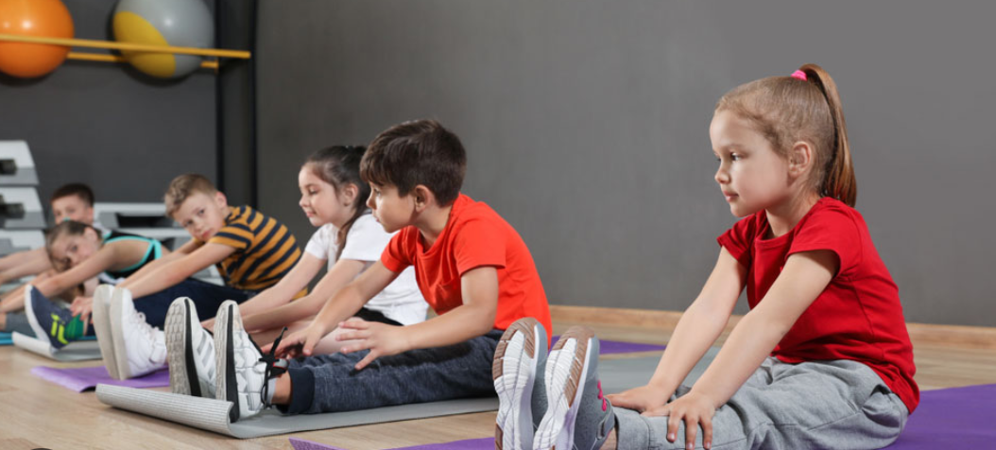
GOALS OF REHABILITATION
Improve mobility
Teach daily living skills
Educate the parents
Teach the child to use remaining potencial
Teach the child functional movement
Gain muscle strength
Have the child participate in daily living activities
To set reasonable expectations
Do the exercise at home
https://www.safesearchkids.com/disability-physiotherapy-improving-child-independence-mobility/
https://socjologia.xmc.pl/socjalizacja/
Prevent deformity
Social integration
Decrease spasticity
Improve joint alignment
Provide community and social support
https://jestfizjo.pl/w-jakim-wieku-powinnismy-sie-zaczac-rozciagac-czy-dzieci-powinny-uzywac-tej-formy-aktywnosci/
https://www.pampers.pl/dziecko-uczace-sie-chodzic/aktywnosc/artykul/gotowanie-z-dziecmi
https://www.physio-network.com/blog/what-does-best-practice-patient-education-look-like/

Slide 4
Basic problems in the neuromotor development of children with CP are:
◦Difficulty with flexing and extending the body against gravity
◦Sitting
◦Functional ambulation
For functional ambulation a child needs:
◦Motivation to move
◦Enough muscle strength and control
◦Able to shift his body weight (balance)
◦Awareness of body position and movement (deep sensation)
◦Sufficient visual and vestibular system
◦No deformities interfering with joint function
https://pl.123rf.com/cliparty-wektory/wykrzyknik.html

Slide 5
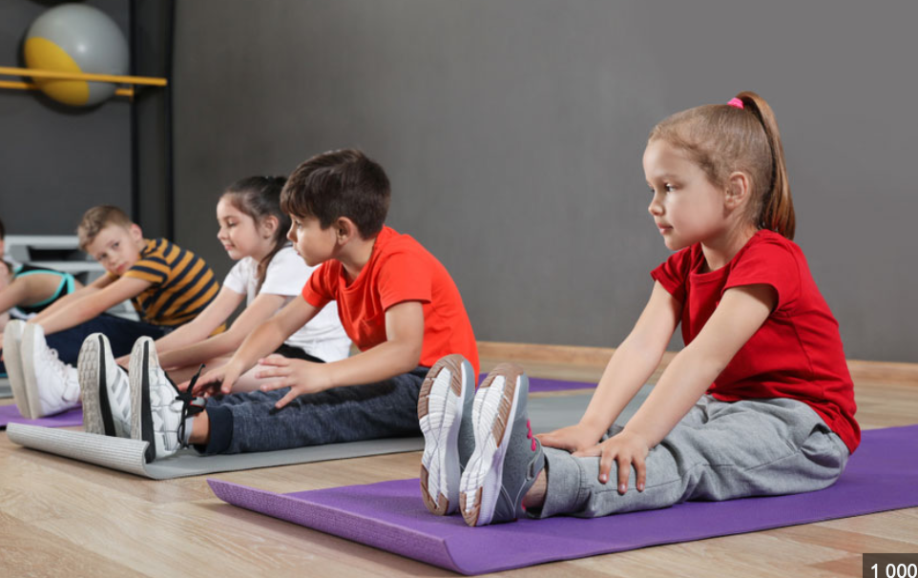
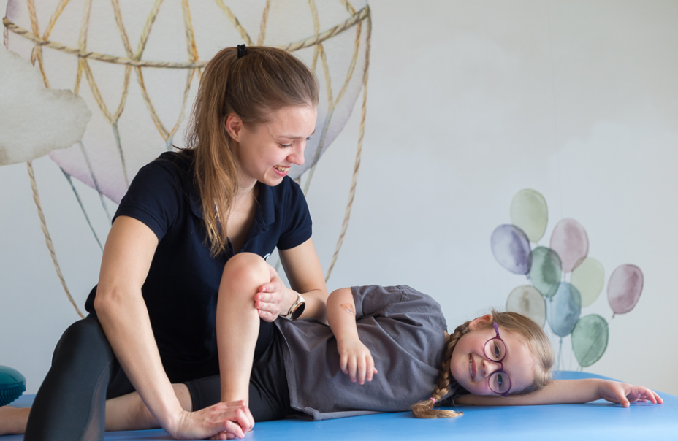
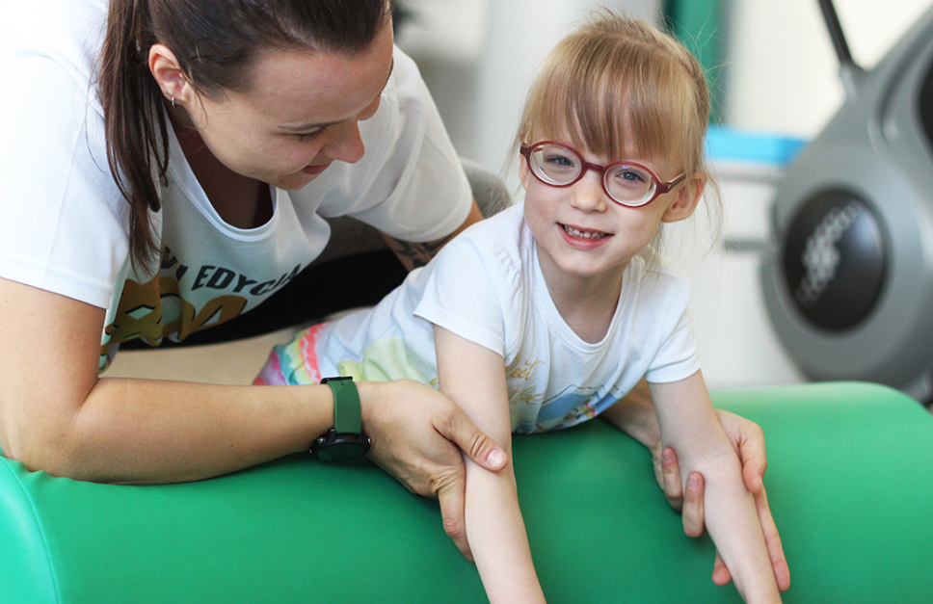
Therapy methods
Active & passive ROM exercises
Weight bearing exercises
https://jestfizjo.pl/w-jakim-wieku-powinnismy-sie-zaczac-rozciagac-czy-dzieci-powinny-uzywac-tej-formy-aktywnosci/
Active ROM: Movement of a joint provided only by the individual performing the exercise. In this case, there is no outside force aiding in the movement.
Passive Range of Motion (PROM): Movement applied to a joint exclusively by another person or persons or a passive motion machine.
Weight-bearing ExercisesThese exercises include activities that make you move against gravity while staying upright.
https://www.kolorowyswiat.org/pl/baza-wiedzy/metody-terapeutyczne

Slide 6
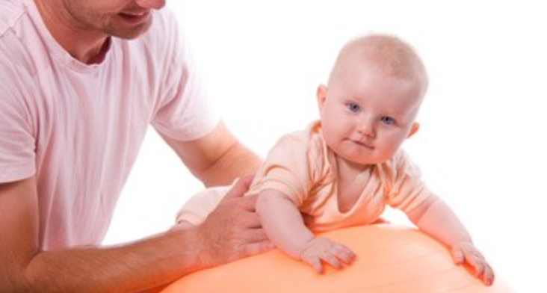
NEUROFACILITATION TECHNIQUES
https://www.doz.pl/czytelnia/a14980-NDT_Bobath_Bobath_concept__na_czym_polega_i_jakie_sa_wskazania_do_rehabilitacji_metoda_Bobath
Bobath Neurodevelopmental Therapy
◦It aims to normalize muscle tone, inhibit abnormal primitive reflexes and stimulate normal movement.
◦It uses the idea of reflex inhibitory positions to decrease spasticity and stimulation of key points of control to promote the development of advanced postural reactions.
Vojta Method Of Therapy
◦Vojta used the positions of reflex crawling and reflex rolling
◦He proposed that placing the child in these positions and stimulation of the key points in the body

Slide 7
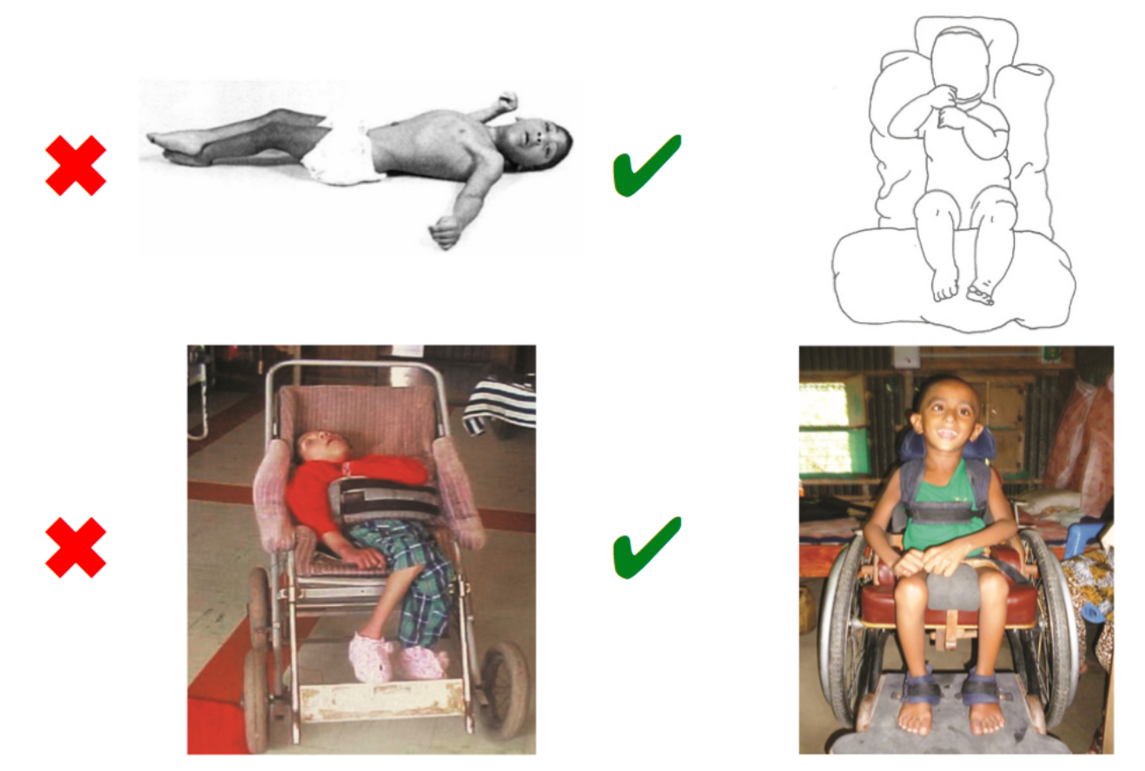
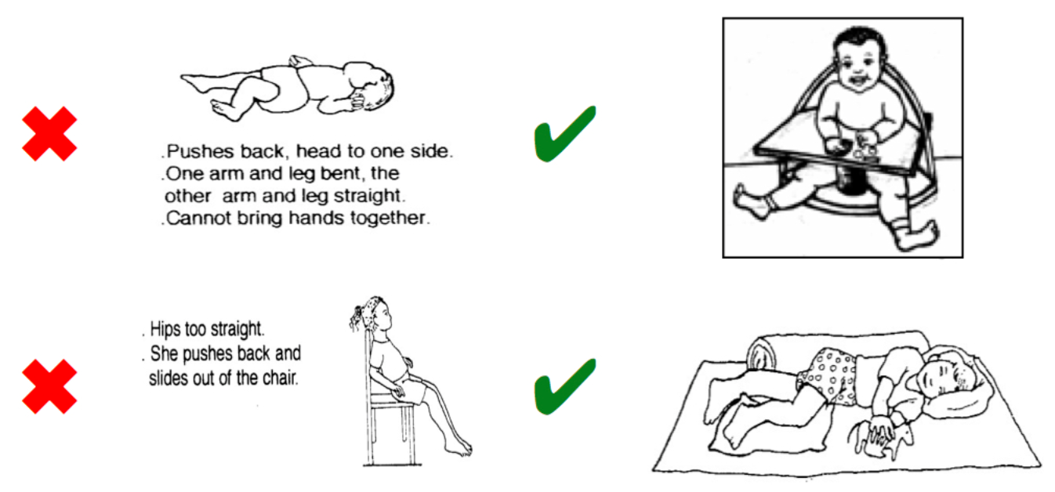
Positioning
Children with Cerebral Palsy need external postural support in different positions (positioning) with the aim of enabling them to experience and develop more normal ways of moving and prevent secondary complications.
Goals:
Preventing skeletal deformity
Providing a stable base of support to promote function
Promoting comfort and relaxation
Facilitating normal movement patterns or controlling
abnormal movement patterns
Decreasing fatigue
https://www.physio-pedia.com/Positioning_the_Child_with_Cerebral_Palsy

Slide 8
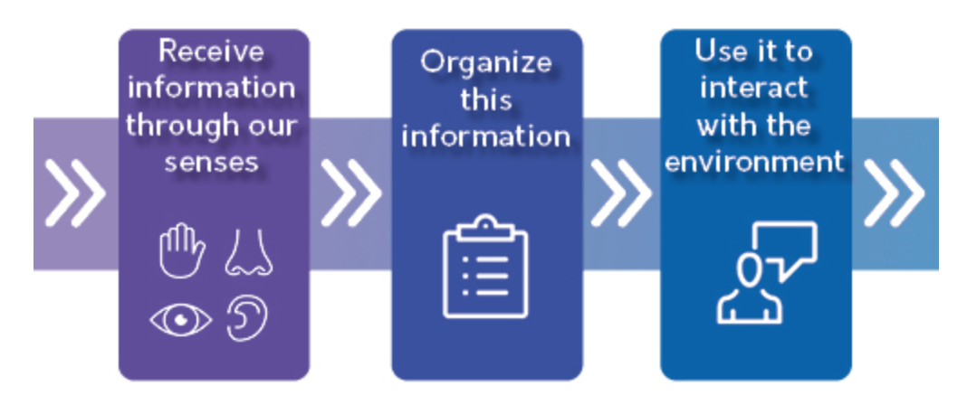
Sensory integration
Sensory integration is the process by which we receive information through our senses, organize this information, and use it to participate in everyday activities.
An example of sensory integration is:
Baby smelling food as they bring it to their mouth
Tasting the food
Feeling the texture of the food
Determining what this food is and if they want more
https://swiatp.pl/integracja-sensoryczna-poradnik-dla-rodzica-czesc-iii/
https://pathways.org/topics-of-development/sensory/

Slide 9
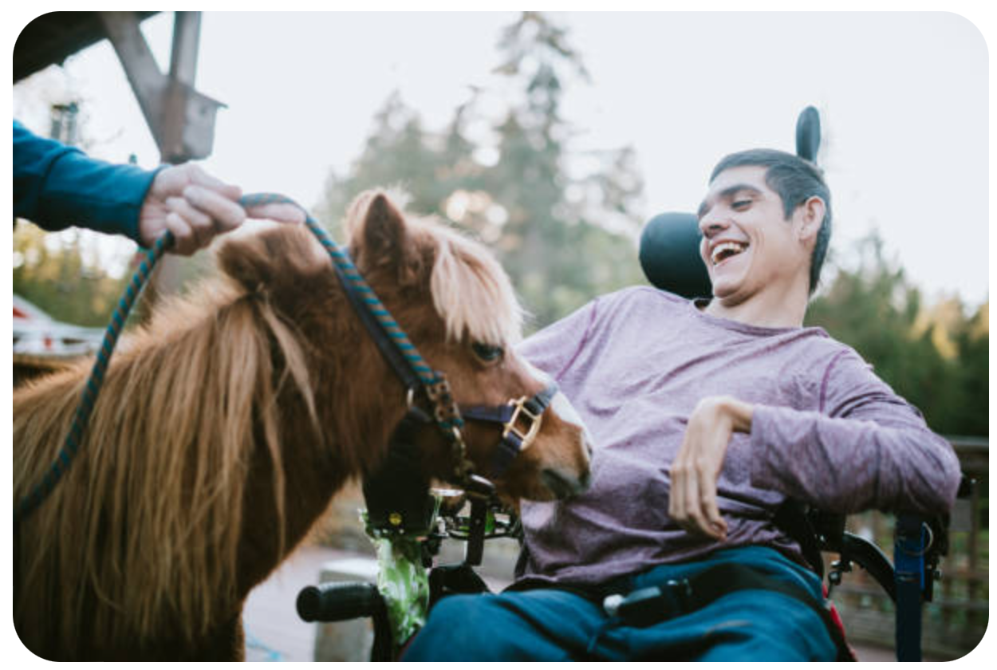
Hippotherapy
Hippotherapy involves a specially trained therapist who uses the horse as a "live" treatment tool. The movement of the horse is used to achieve long-term and short-term treatment goals that are individualized to each patient.
https://www.fundacjaavalon.pl/abc/hipoterapia_jako_metoda_rehabilitacji_w_mpd/

Slide 10
Hydrotherapy
Hydrotherapy has potential to reduce joint load and friction between articular surfaces due to buoyancy. Additionally, it can improve endurance, aerobic capacity, and muscle strength, and reduce spasticity. Water also provides sensory information, improves lymphatic circulation, and offers postural support, a sense of independence, and the opportunity for rotational movements that some patients may not experience without hydrotherapy.
https://myturn.com.au/services/treatments-programs/hydrotherapy/

Slide 11
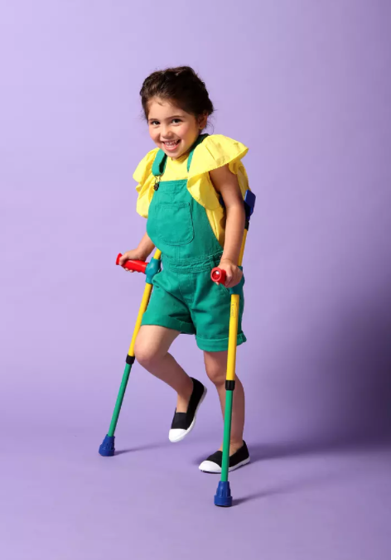
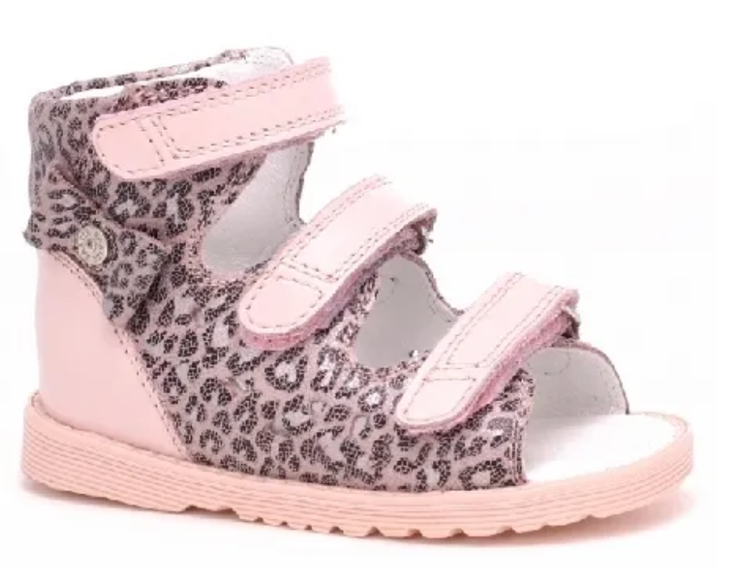
orthopaedic equipment
Walkers
◦Increase function
◦Decrease spasticity
◦Facilitate selective motor control
◦Stabilize the trunk and extremities
◦Keep joint in a functional position
◦Prevent deformity
Crutches
https://rehabilito.pl/produkt/balkonik-rehabilitacyjny-dla-dzieci-streeter-vermeiren/
Standers
Types:
Standers
Walkers
Crutches
Shoes
Shoes
https://erhem.pl/archiwa/product/pionizator-statyczny-erh-90-complete/
https://e-butydladzieci.pl/blog/buty-ortopedyczne-dla-dziewczynki
https://fizjo4sport.pl/kule-lokciowe-dzieciece-ortopedyczne-z-regulacja-wysokosci-i-uchwytem-junior-thuasne

Slide 12
vocabulary
Cerebral Palsy - Mózgowe Porażenie Dziecięce
symptoms – objawy
spasticity - spastyczność
swallow - połykać
muscle imbalance - nierównowaga mięśniowa
muscle stiffness - sztywność mięśni
reduced range of motion – zmniejszony zakres ruchu
daily living skills - umiejętności dnia codziennego
toddler - maluchy
preschooler – przedszkolaki
cardiovascular status – stan układu sercowo-naczyniowego
Vojta Method of Therapy – terapia metodś Vojty
Bobath neurodevelopmental therapy – terapia neurorozwojowa metodą Bobath
positioning – pozycje ułożeniowe
Sensory Integrarion – terapia integracji sensorycznej
orthopaedic equipment – zaopatrzenie ortopedyczne
walker – chodzik/balkonik
stander – pionizator
crutches – kule
Hippotherapy – hipoterapia
Hydrotherapy - hydroterapia
12

Slide 13
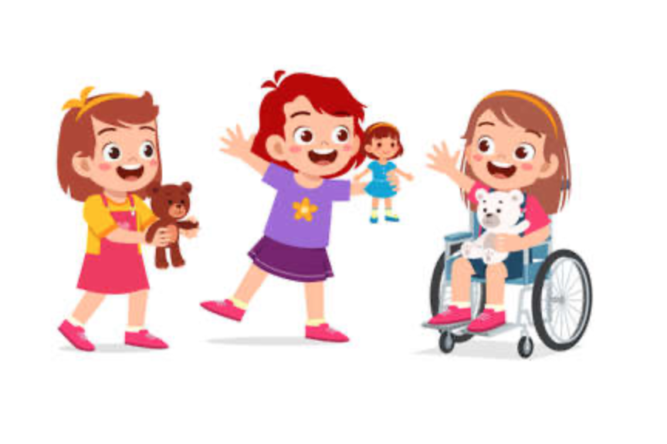
Thank you!

Slide 14
BIBLIOGRAPHY
Barber Ch., A guide to physiotherapy in cerebral palsy, Paediatrics and Child Health, Volume 18, Issue 9, September 2008, Pages 410-413
Avalle C., Vojta W., Prevention of the Development of Cerebral Palsy According to the Concept of Vojta: The Family as Co-Therapist, Social Psychiatry, pages 605-609
Dieter K., Heinemann K., Physiotherapeutic Interventions: Bobath, Vojta, and Motor Learning Approaches, Cerebral Palsy, Multidisciplinary Approach, Third Edition, Springer, 2017, Pages 155-164
Marques S., Vaughan-Graham J., Costa R., Figueiredo D., The Bobath concept (NDT) in adult neurorehabilitation: a scoping review of conceptual literature, Disability and Rehabilitation, 10 Jul 2024, pages 34-42
https://www.physio-pedia.com/Positioning_the_Child_with_Cerebral_Palsy
https://www.physio-pedia.com/Hydrotherapy_for_Children_with_Cerebral_Palsy
https://link.springer.com/chapter/10.1007/978-1-4684-4535-0_65
https://www.kolorowyswiat.org/pl/baza-wiedzy/metody-terapeutyczne
https://www.pacehospital.com/when-to-suspect-a-child-with-cerebral-palsy
https://www.physio-pedia.com/Range_of_Motion
14

