Slide 1
ACL RUPTURE
Paweł Florek
Faculty of Medicine, Rzeszów University Master's degree studies in Physiotherapy, year 3
23.11.2023

Slide 2
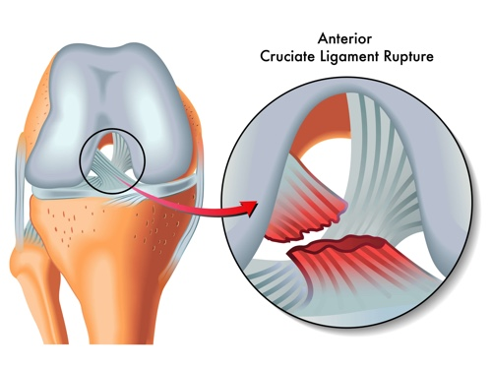
In Poland, there are approximately 15,000 cases of ACL rupture per year, and in the United States - 100,000.

Slide 3
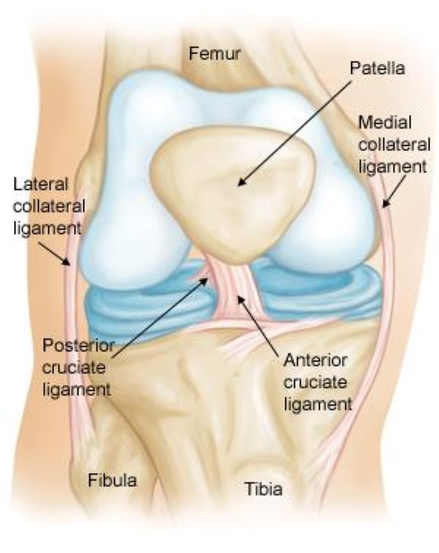
ORIGIN; the bottom of the thighbone
INSERT: to the top of the shinbone (tibia).
FUNCTION: maintain stabilization

Slide 4
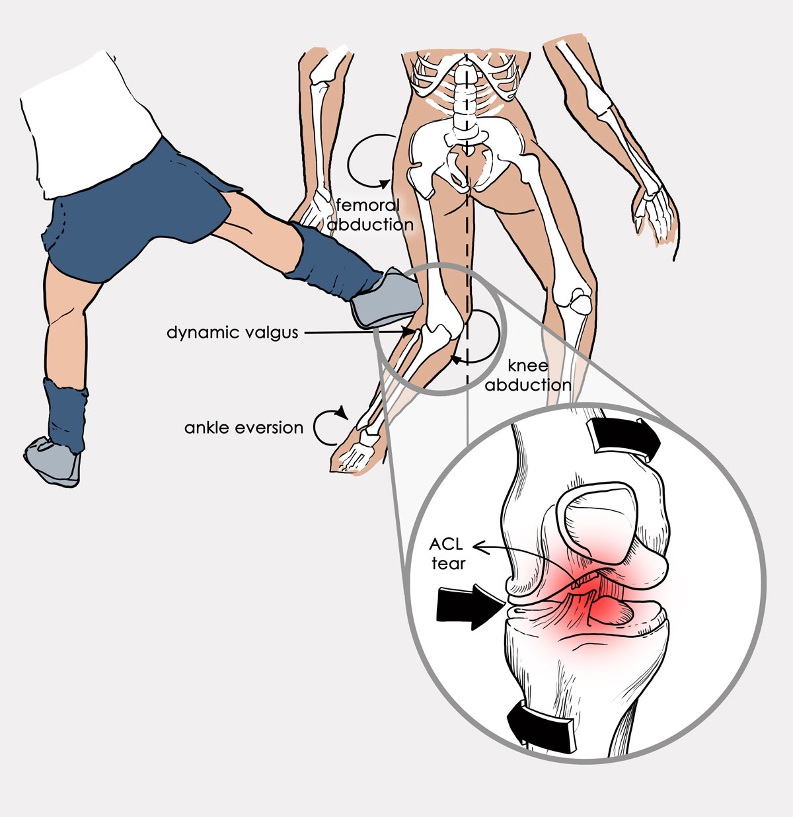

Slide 5
Diagnose
clinical examination
patient history
imaging

Slide 6
PIVOT SHIFT

Slide 7
LEHMAN’S TEST

Slide 8
NONSURGICAL TREATMENT

Slide 9
SURGICAL TREATMENTS

Slide 10
Arthroscope surgery

Slide 11
Stage I – Convalescence
Protect graft
Reduce swelling, minimize pain
Restore patellar mobility
Restore full extension, gradually improve flexion
Stage II – Expanding the range of motion
Continue to protect graft
Maintain full extension, restore full flexion (contra lateral side)
Normalize gait
Safely progress strengthening
Promote proper movement patterns
Avoid post exercise pain/swelling
Avoid activities that produce pain at graft donor site

Slide 12
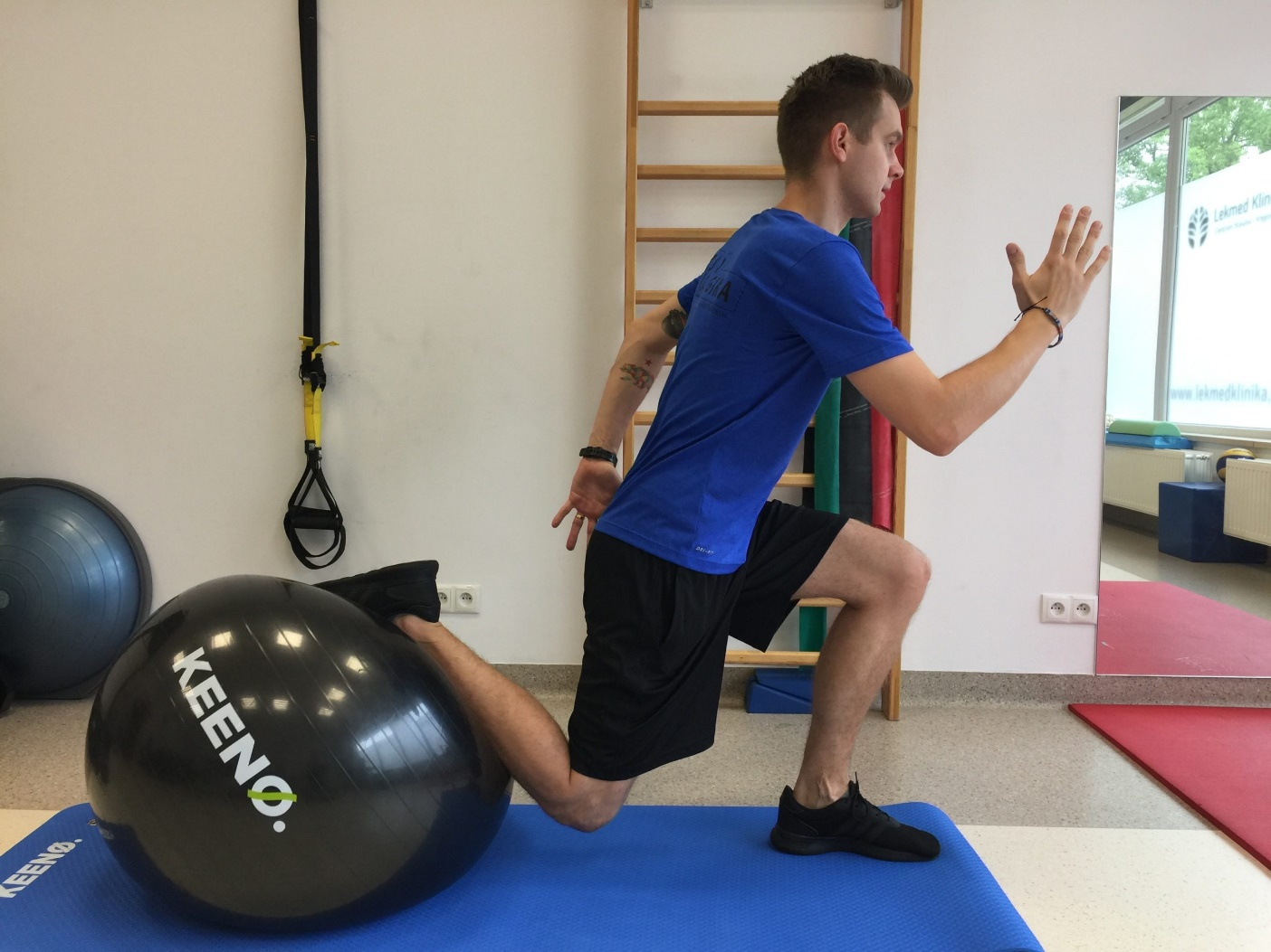
Stage III – Return to full fitness
• Continue to protect graft site • Maintain full ROM • Safely progress strengthening • Promote proper movement patterns • Avoid post exercise pain/swelling • Avoid activities that produce pain at graft donor site

Slide 13
PREVENTION
1. Exercise All Year Round
2. Pay Attention to How You Move
3. Avoid Exercising When You Are Overly Fatigued
4. Strengthen Your Hamstring and Quadriceps
5. Don’t Forget Your Core

Slide 14
THANKS FOR YOUR ATTENTION

Slide 15
Bibliography
1.Słownik Merriam-Webster https://www.merriam-webster.com/
2.Cordelia W. Carter, MD „Five Ways to Prevent Anterior Cruciate Ligament Injuries”
3.South Shore Hospital , Orthopedic, Spine and Sport Therapy
ACL Non-Operative Protocol
https://southshoreorthopedics.com/wp-content/uploads/2016/12/ACL_non-operative_managment.pdf
https://nyulangone.org/news/five-ways-prevent-anterior-cruciate-ligament-injuries
4.Anne Benjaminse, PT, Alli Gokeler, PT, Cees P. van der Schans, PT, PhD
„Clinical Diagnosis of an Anterior Cruciate Ligament Rupture: A Meta- analysis”
https://www.jospt.org/doi/epdf/10.2519/jospt.2006.2011
5.Stephanie R.Filbay, Hege Grindem
„Evidence-based recommendations for the management of anterior cruciate ligament (ACL) rupture” https://www.sciencedirect.com/science/article/pii/S1521694219300191

Slide 16
DICTIONARY
Rupture- zerwać (więzadło)
Graft- przeszczep
Crucial- istotny/ważny
Fatigued- zmęczony, przetrenowany

