Slide 1
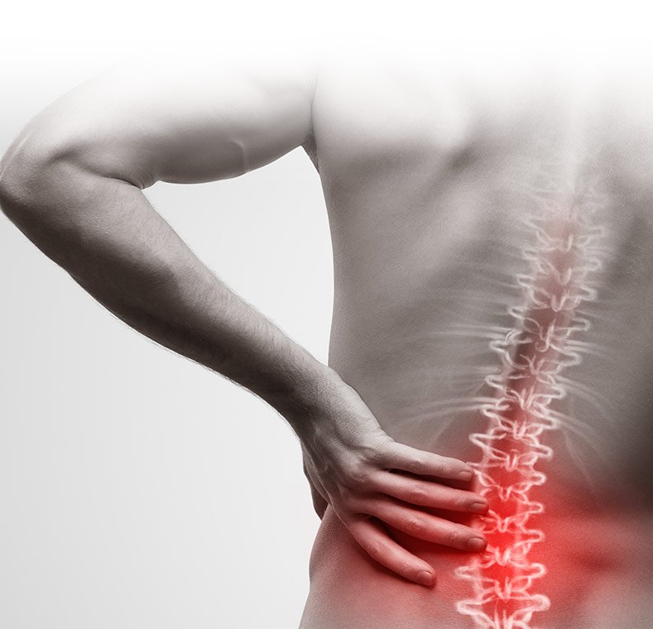
Back pain
23.11.2023r.
Presentation plan:
Risk factors​
Symptoms​
Causes​
Diagnostics​
Prevention
Prepared by:
Andżelika Biernat
Fizjoterapia JMS, III rok
Rok akademicki 2023/24
Grupa A
https://www.google.com/search?client=avast-a-1&sca_esv=581186770&sxsrf=AM9HkKkGCJn8YtYTEdaiRwzL7QUO-mtExg:1699617273375&q=b%C3%B3l+plec%C3%B3w&tbm=isch&source=lnms&sa=X&ved=2ahUKEwiWqtXer7mCAxUpR_EDHZLKCsYQ0pQJegQICxAB&biw=1536&bih=739&dpr=1.25#imgrc=Ju3hGUphzklC3M

Slide 2
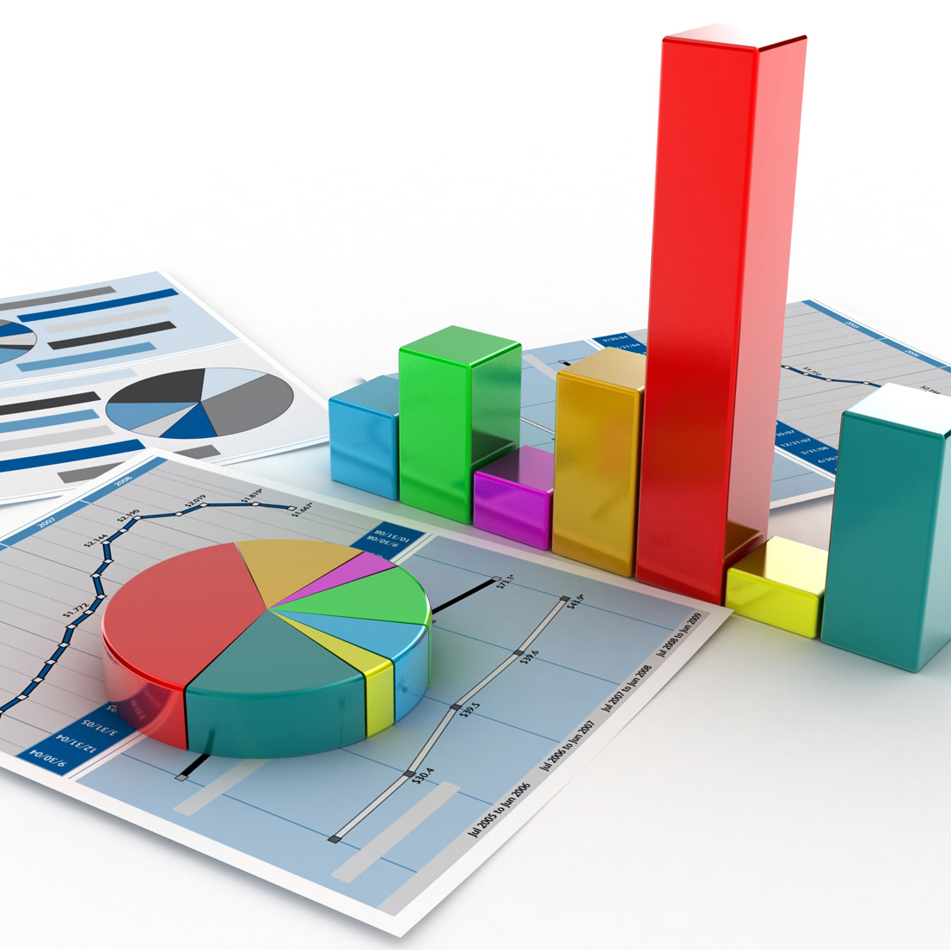
Key facts
In 2020, low back pain (LBP) affected 619 million people globally and it is estimated that the number of cases will increase to 843 million cases by 2050, driven largely by population expansion and ageing.
LBP is the single leading cause of disability worldwide and the condition for which the greatest number of people may benefit from rehabilitation.
LBP can be experienced at any age, and most people experience LBP at least once in their life.
Prevalence increases with age up to 80 years, while the highest number of LBP cases occurs at the age of 50–55 years. LBP is more prevalent in women.
https://www.gov.pl/web/kppsp-sztum/wybrane-statystyki-za-rok-2022

Slide 3
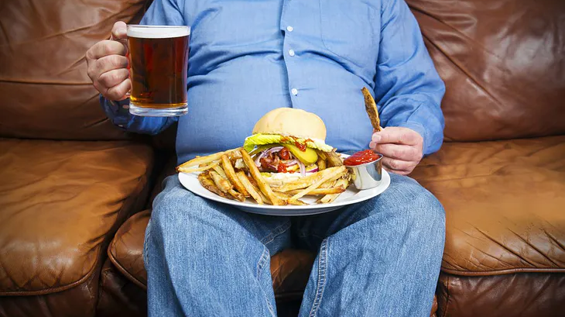
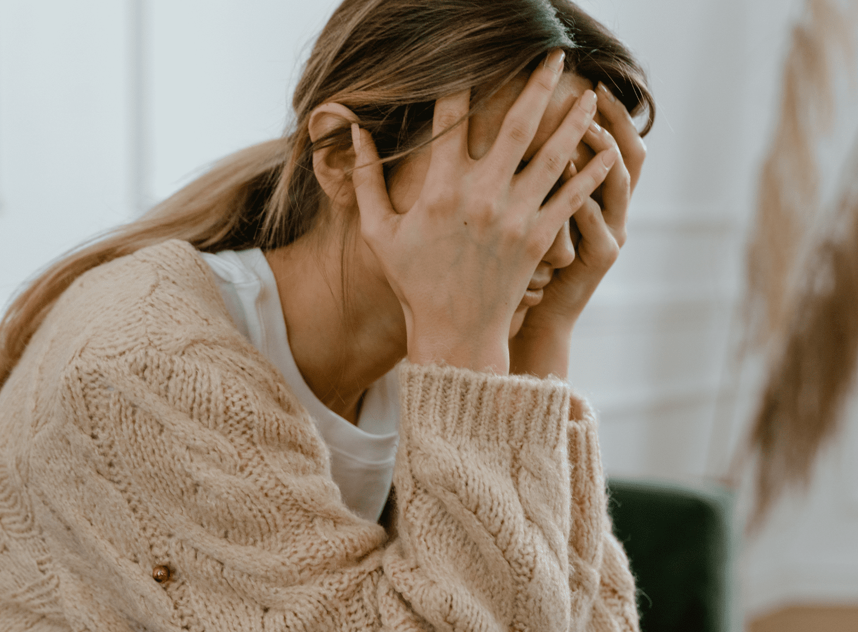
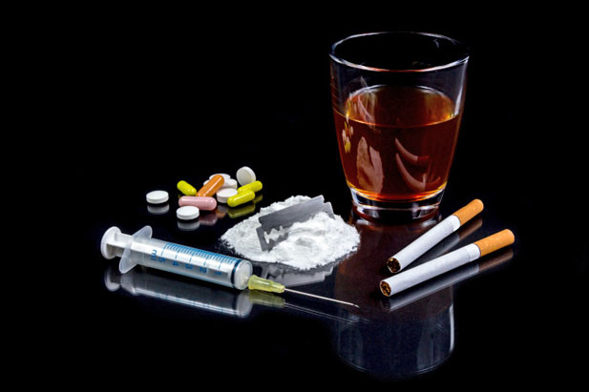
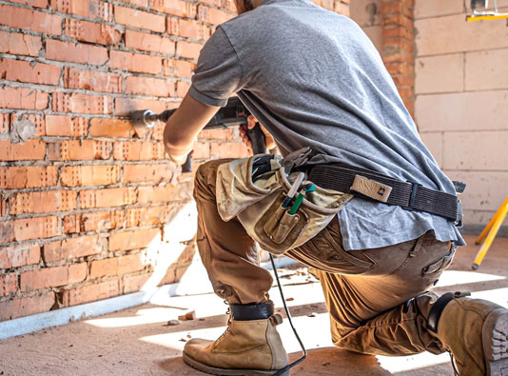
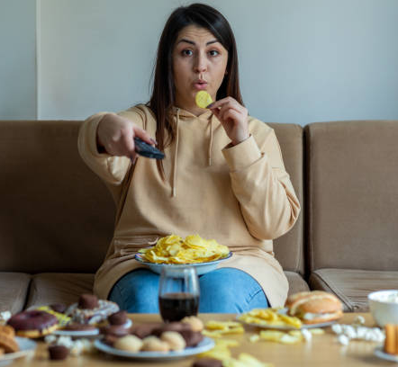
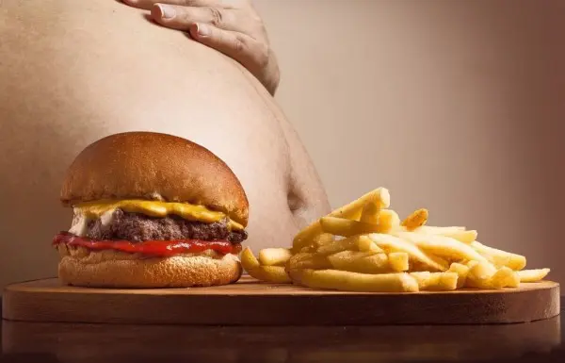
Several factors increase your risk of developing back pain and can include:
Fitness level
Weight gain
Job-related risk factors
Stress level
Age
Heredity
https://www.google.com/search?client=avast-a-1&sca_esv=581186770&sxsrf=AM9HkKmGyCKlk-EAogOQNbc2dnH4oVCItQ:1699617415743&q=niezdrowe+jedzenie&tbm=isch&source=lnms&sa=X&ved=2ahUKEwifz8aisLmCAxWNSPEDHYguArIQ0pQJegQICxAB&biw=1536&bih=739&dpr=1.25#imgrc=BOXttVR1kY4tqM

Slide 4
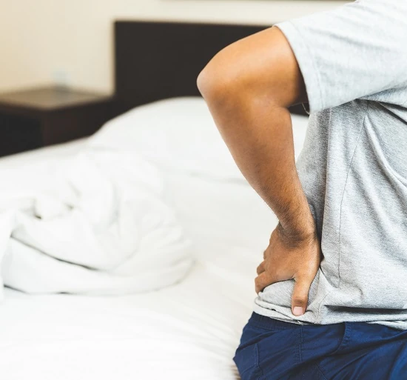
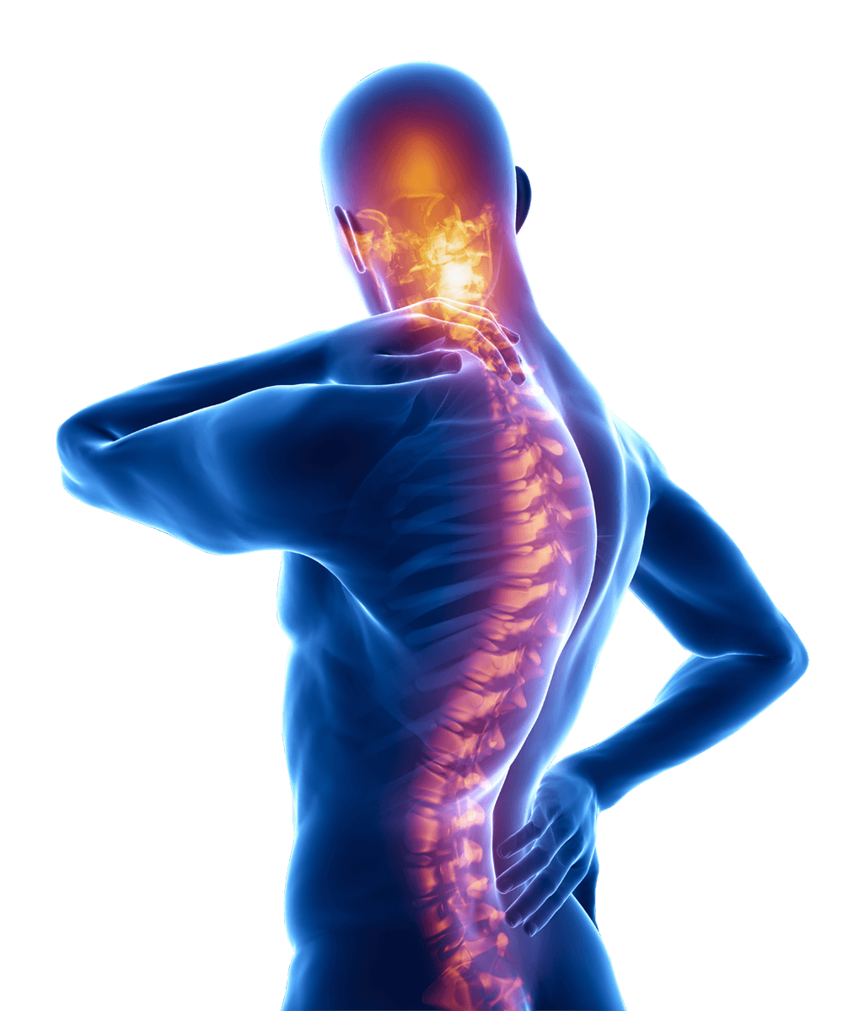
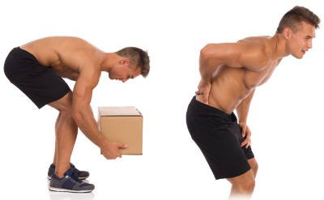
Symptoms of Back Pain
Increasing pain with lifting and bending.
Worsening pain when resting, sitting, or standing.
Back pain that comes and goes.
Stiffness in the morning when a wakening and lessened back pain with activity.
Pain that radiates away from the back into the buttocks, leg, or hip.
Numbness or weakness in your legs or feet.
Tingling.
Posture problems.
Muscle spasms.
https://www.google.com/search?client=avast-a-1&sca_esv=581186770&sxsrf=AM9HkKm5NqVkb7MzdjFDQixZTjLmh1_F9g:1699617496805&q=b%C3%B3l+plec%C3%B3w&tbm=isch&source=lnms&sa=X&ved=2ahUKEwi8rJrJsLmCAxVsSvEDHXhzALsQ0pQJegQICRAB&biw=1536&bih=739&dpr=1.25#imgrc=JPT4BckKpiuy0M
https://www.google.com/search?client=avast-a-1&sca_esv=581186770&sxsrf=AM9HkKm5NqVkb7MzdjFDQixZTjLmh1_F9g:1699617496805&q=b%C3%B3l+plec%C3%B3w&tbm=isch&source=lnms&sa=X&ved=2ahUKEwi8rJrJsLmCAxVsSvEDHXhzALsQ0pQJegQICRAB&biw=1536&bih=739&dpr=1.25#imgrc=UNXj4BmUPSWWhM

Slide 5
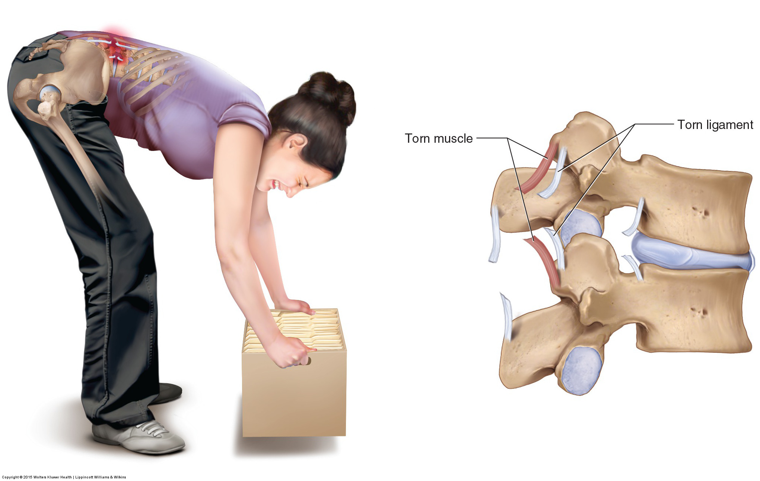
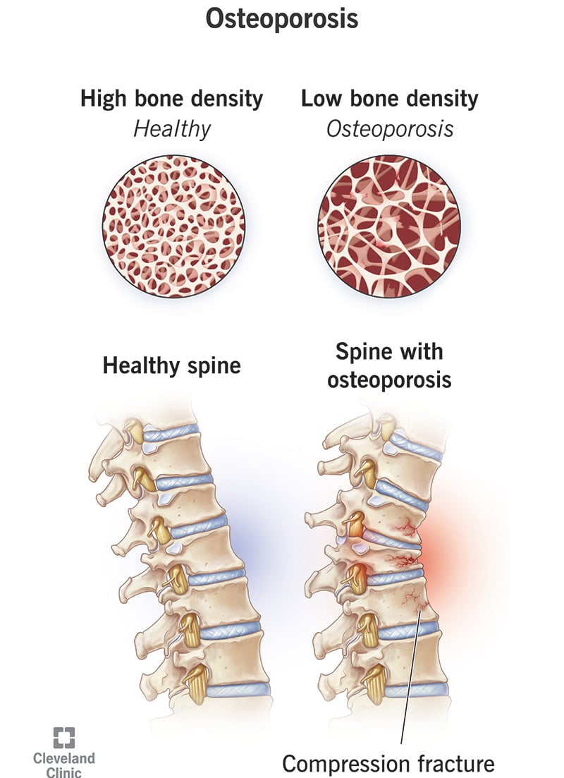
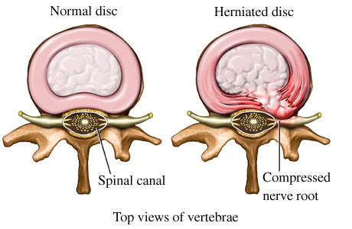
Mechanical/Structural Problems
Sprain
Strain
Herniated or ruptured disk
Osteoporosis
https://www.google.com/search?q=sprain+and+strain+in+spine&tbm=isch&ved=2ahUKEwi965z4sbmCAxXGh_0HHWdfAgkQ2-cCegQIABAA&oq=sprain+and+strain+in+spine&gs_lcp=CgNpbWcQAzoECCMQJzoHCAAQExCABDoICAAQCBAeEBM6BggAEAgQHlDNHliHLGDOLWgAcAB4AIABoAGIAeQJkgEDMS45mAEAoAEBqgELZ3dzLXdpei1pbWfAAQE&sclient=img&ei=RxxOZf2rM8aP9u8P576JSA&bih=739&biw=1536&client=avast-a-1#imgrc=RXCg8-YthJ-GMM
https://www.google.com/search?client=avast-a-1&sca_esv=581186770&sxsrf=AM9HkKkqZRXGe_G7sdb033cCTg_qvjw0dw:1699617930771&q=Herniated+or+ruptured+disk&tbm=isch&source=lnms&sa=X&ved=2ahUKEwjxwZGYsrmCAxURRvEDHQtxA1QQ0pQJegQIChAB&biw=1536&bih=739&dpr=1.25#imgrc=BtpKs4XncsC6TM
https://www.google.com/search?client=avast-a-1&sca_esv=581186770&sxsrf=AM9HkKk0AMBTGK4_v8juoOyjEEzfVQe2OQ:1699618021301&q=osteoporosis&tbm=isch&source=lnms&sa=X&ved=2ahUKEwiNiKfDsrmCAxX1Q_EDHXH7A_YQ0pQJegQIDBAB&biw=1536&bih=739&dpr=1.25#imgrc=sSYbR1zdmGBv3M

Slide 6
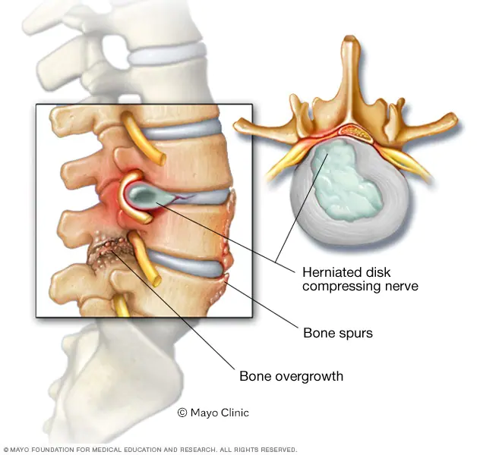
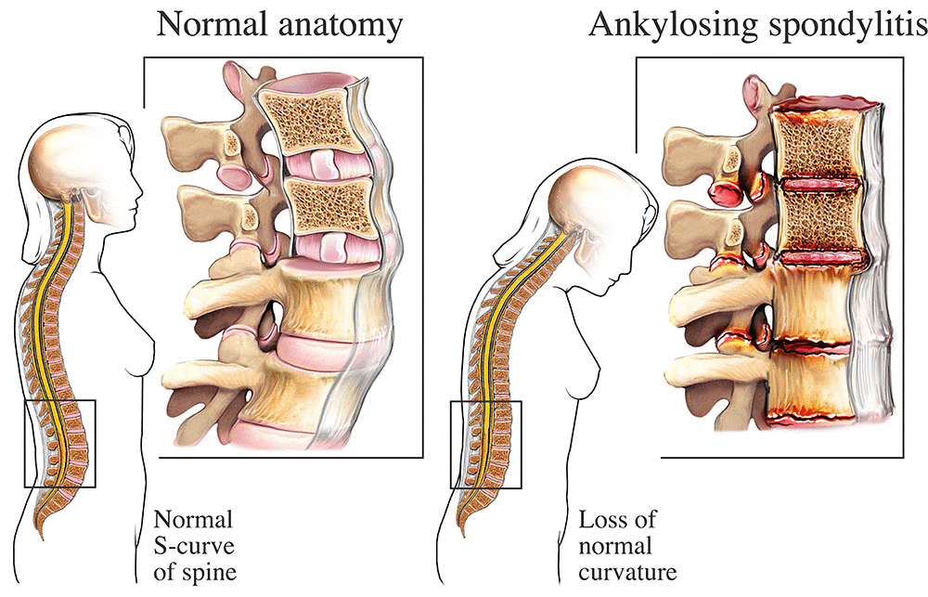
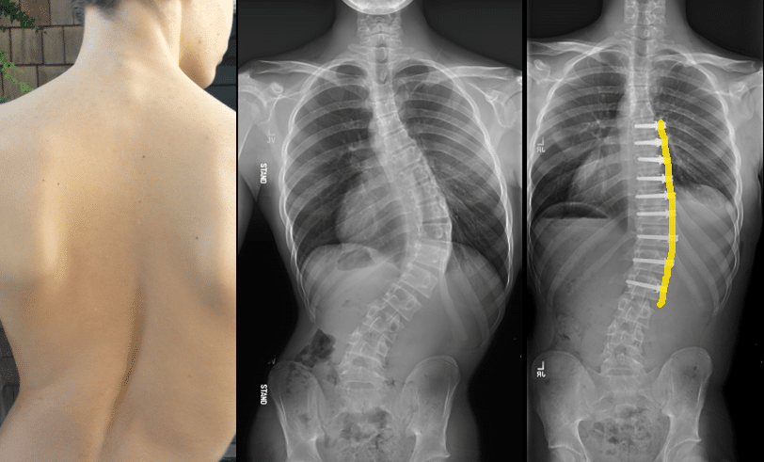
Spinal stenosis
https://www.google.com/search?client=avast-a-1&sca_esv=581186770&sxsrf=AM9HkKm5mJ8Tcnlxrb437LkHwG0jNkAn6g:1699618100249&q=Spinal+stenosis&tbm=isch&source=lnms&sa=X&ved=2ahUKEwjMyPnosrmCAxXdRvEDHULNAlwQ0pQJegQICRAB&biw=1536&bih=739&dpr=1.25#imgrc=ABZogcao6tFF7M
Scoliosis
Ankylosing spondylitis
https://www.google.com/search?client=avast-a-1&sca_esv=581186770&sxsrf=AM9HkKnHx_Rbmf9eh9faPTb87dQCWNy-0g:1699618303902&q=Ankylosing+spondylitis&tbm=isch&source=lnms&sa=X&ved=2ahUKEwiexIfKs7mCAxUcRvEDHcSHBjwQ0pQJegQICxAB&biw=1536&bih=739&dpr=1.25#imgrc=Y0VOcFOgSrw1KM
https://www.google.com/search?client=avast-a-1&sca_esv=581186770&sxsrf=AM9HkKnC15sqSJJH9rDx-PxtH4BT0Vyc8w:1699618190385&q=scoliosis&tbm=isch&source=lnms&sa=X&ved=2ahUKEwjlhveTs7mCAxXKRfEDHa_DE5IQ0pQJegQIDRAB&biw=1536&bih=739&dpr=1.25#imgrc=X31swP5MWBCU4M

Slide 7
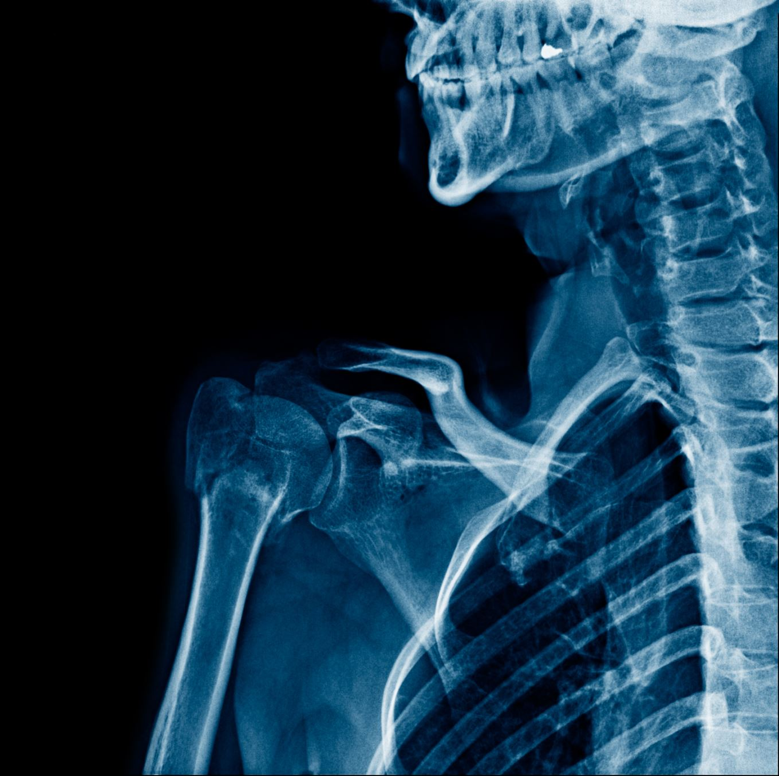
How is lower back pain diagnosed?
Spine X-ray
MRI
CT scan
Electromyography (EMG)

Slide 8
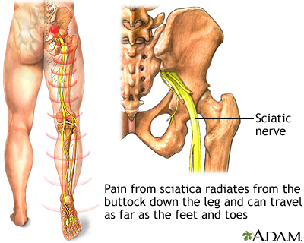
Sciatica - definition
What is sciatica?
What are the symptoms of sciatica?
Sciatica symptoms can include:
Pain
Tingling or “pins and needles” (paresthesia)
Numbness
Muscle weakness.
Urinary incontinence or fecal incontinence
https://www.google.com/search?client=avast-a-1&sca_esv=581186770&sxsrf=AM9HkKkaKoOxFK1iWcIxAZCHrahk229CzQ:1699618371675&q=Sciatica&tbm=isch&source=lnms&sa=X&ved=2ahUKEwjOi7Dqs7mCAxWpS_EDHcXwCjUQ0pQJegQICRAB&biw=1536&bih=739&dpr=1.25#imgrc=JyB7y6MtJVTbkM

Slide 9
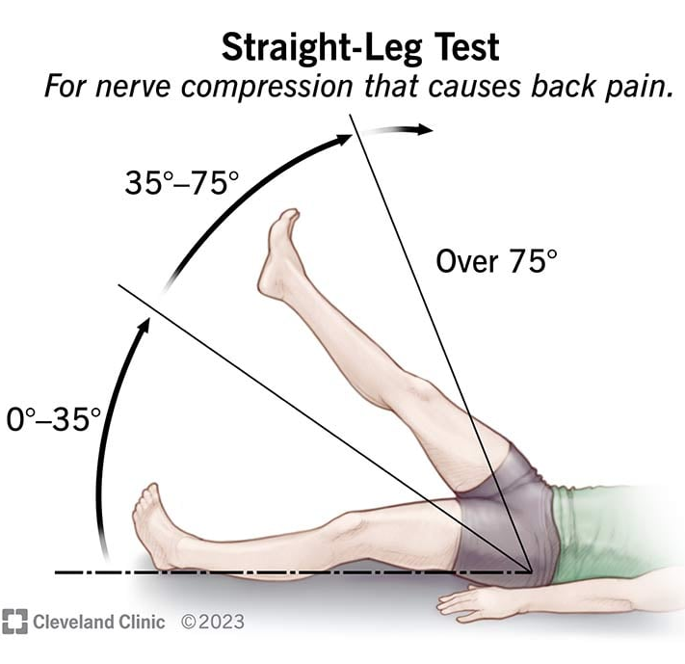
How is sciatica diagnosed?
Straight leg raise test (SLR test). This involves having you lie on an exam table with your legs straight out. They’ll slowly raise your legs one at a time toward the ceiling and ask when you start to feel pain or other symptoms. These can help pinpoint the cause of sciatica and how to manage it.
https://www.google.com/search?client=avast-a-1&sca_esv=581186770&sxsrf=AM9HkKkaKoOxFK1iWcIxAZCHrahk229CzQ:1699618371675&q=Sciatica&tbm=isch&source=lnms&sa=X&ved=2ahUKEwjOi7Dqs7mCAxWpS_EDHcXwCjUQ0pQJegQICRAB&biw=1536&bih=739&dpr=1.25#imgrc=UhBUnXHgugHMbM

Slide 10
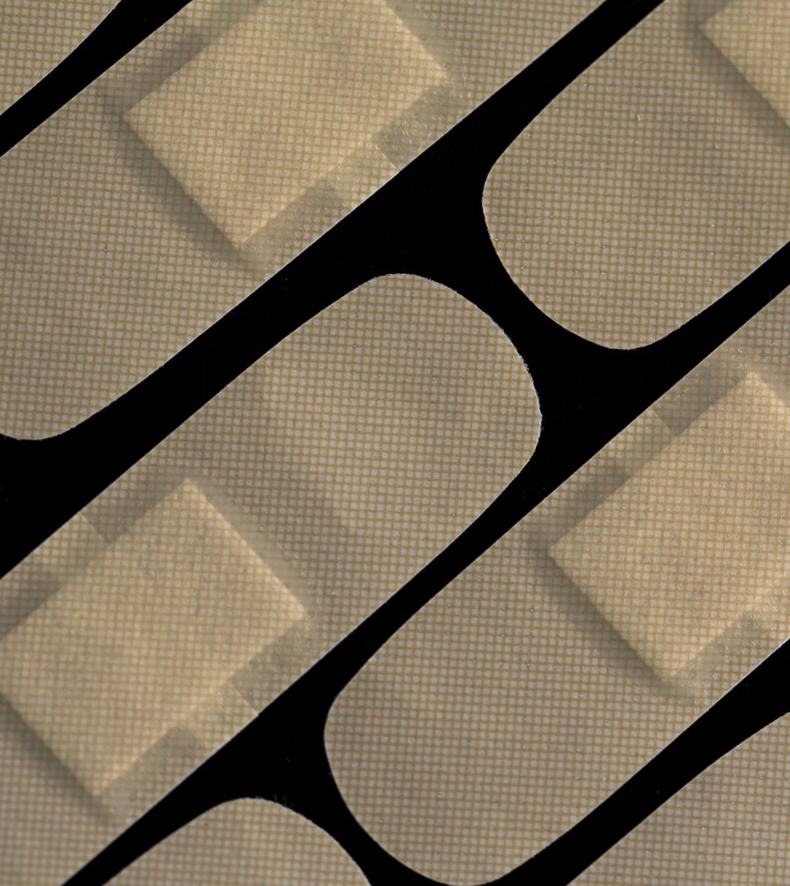
How to Prevent Back Pain?
Exercise regularly to keep muscles strong and flexible.
Maintain a healthy weight.
Eat a healthy diet and make sure you get enough calcium, phosphorus and vitamin D.
Use ergonomically designed furniture and equipment at home and at work.
If you sit a lot at work, switch positions often. Also, get up every now and then and walk around the office or stretch to relieve muscle tension.
Wear comfortable, low-heeled shoes.
Sleep on a firm surface. Sleeping on your side in a fetal position can help relieve pressure on the spine.
Don’t try to lift objects that are too heavy.
When you do lift something, lift from the knees and do not twist when lifting. Pull stomach muscles in and keep your head down and in line with a straight back.
Quit smoking. Smoking reduces blood flow to the lower spine, which can contribute to spinal disc degeneration. Smoking also disrupts healing.

Slide 11
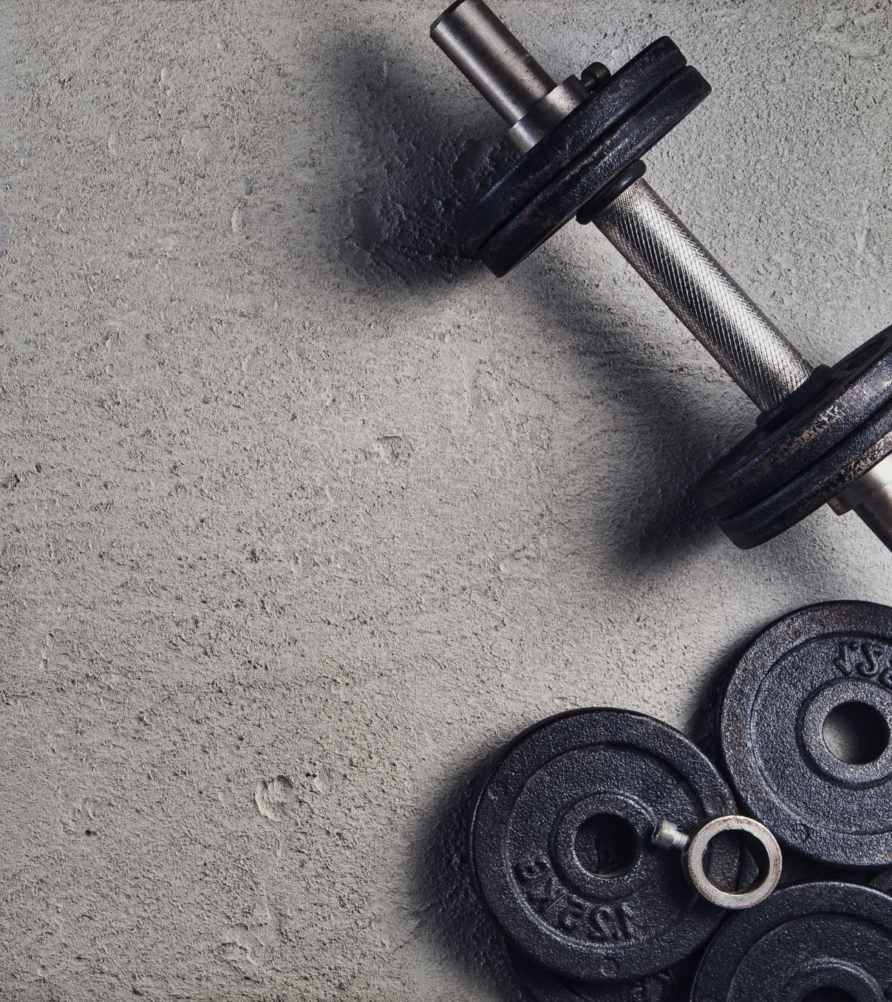
The exercises should help prevent low back pain.
Back pain is a common problem that many people deal with every day. Exercise often helps to ease back pain and prevent further discomfort. The following exercises stretch and strengthen the back and the muscles that support it.
When you first start, repeat each exercise a few times. Then increase the number of times you do an exercise as it gets easier for you. If you're beginning an exercise program due to ongoing back pain or after a back injury, talk to a physical therapist or another member of your health care team about activities that are safe for you.

Slide 12
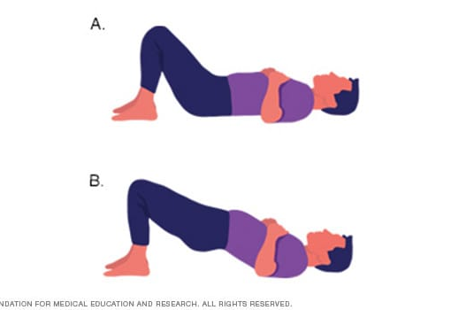
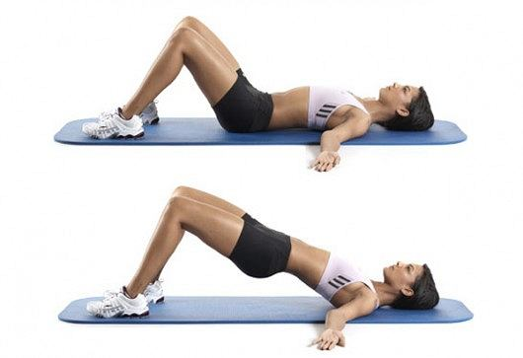
Hip raises
- Bend your knees.
- Feet flat on the floor.
- Straight back.
- Buttocks lifted up.
- Repeat 10 times.
https://www.google.com/search?client=avast-a-1&sca_esv=573218915&sxsrf=AM9HkKkqgannga0pfoOUs1zi2OkBBZgBnw:1697214165912&q=8+%C4%87wicze%C5%84+na+szczup%C5%82e+uda+I+Myfitness.gazeta.pl&tbm=isch&source=lnms&sa=X&ved=2ahUKEwiu0t27t_OBAxVBgf0HHfJCOVgQ0pQJegQICRAB&biw=1536&bih=739&dpr=1.25#imgrc=6ncEooMJZ6gLdM
https://www.mayoclinic.org/healthy-lifestyle/adult-health/in-depth/back-pain/art-20546859

Slide 13
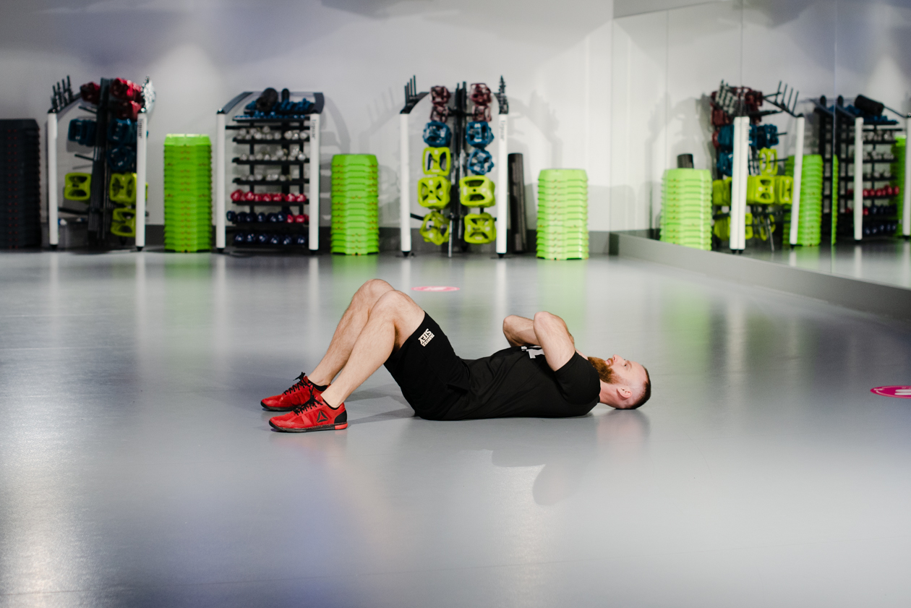
Partial crunches
https://www.google.com/search?client=avast-a-1&sca_esv=573218915&sxsrf=AM9HkKl2IenO7MQi9uKjIIUImoJT56rXRg:1697214065265&q=brzuszki+z+rekami+n+aklatce+piersiowej&tbm=isch&source=lnms&sa=X&ved=2ahUKEwiy2d6Lt_OBAxWd0AIHHVR1BZYQ0pQJegQICxAB&biw=1536&bih=739&dpr=1.25#imgrc=amtY1OX3AQvXQM
https://www.google.com/search?client=avast-a-1&sca_esv=573218915&sxsrf=AM9HkKl2IenO7MQi9uKjIIUImoJT56rXRg:1697214065265&q=brzuszki+z+rekami+n+aklatce+piersiowej&tbm=isch&source=lnms&sa=X&ved=2ahUKEwiy2d6Lt_OBAxWd0AIHHVR1BZYQ0pQJegQICxAB&biw=1536&bih=739&dpr=1.25#imgrc=76h_uKs9h6G9jM
- Lie on your back. - Cross your arms on your chest. - Pull you head towards your chest. - Repeat 10 time.

Slide 14
Knee to chest
- Lie on your back​.
- Bend one knee and bring towards your chest​.
- Hold for a count of five​.
- Repeat with the other leg.
- Do this exercise 10 Times.
https://www.google.com/search?client=avast-a-1&sca_esv=573218915&sxsrf=AM9HkKl5zKBVLwb-Oe4brLjK2OIHsmPkUQ:1697213964259&q=przyci%C4%85gnij+noge+do+klatki+piersiowej&tbm=isch&source=lnms&sa=X&ved=2ahUKEwiM28nbtvOBAxVX2QIHHaPSDHYQ0pQJegQICRAB&biw=1536&bih=739&dpr=1.25#imgrc=TZJ9vh5sCTgmeM

Slide 15
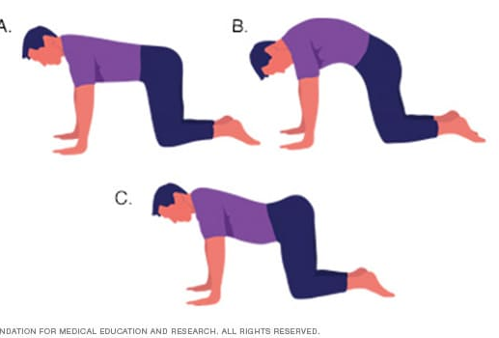
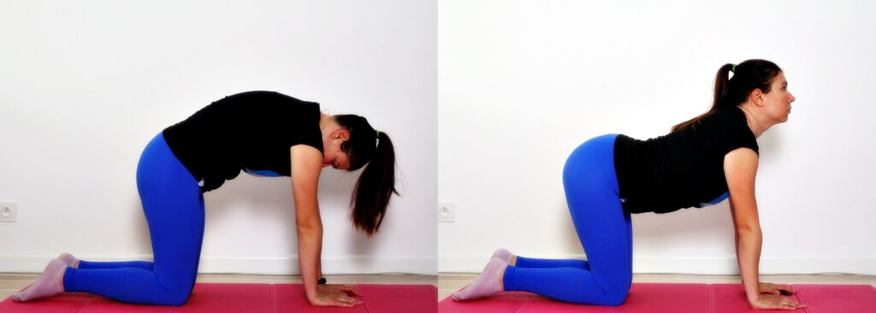
Cat-camel
https://www.google.com/search?client=avast-a-1&sca_esv=573218915&sxsrf=AM9HkKkZMayOl4UWi-Z_IHBgqWR4X_0RkQ:1697213715681&q=Jak+dba%C4%87+o+kr%C4%99gos%C5%82up%3F+%2B+%C4%87wiczenia+na+zdrowy+kr%C4%99gos%C5%82up+%C2%BB+Fitness+Dorota&tbm=isch&source=lnms&sa=X&ved=2ahUKEwiC84XltfOBAxU0CBAIHXrtCy8Q0pQJegQIDRAB&cshid=1697213720174576&biw=1536&bih=739&dpr=1.25#imgrc=TthQaG9F97-HSM
https://www.mayoclinic.org/healthy-lifestyle/adult-health/in-depth/back-pain/art-20546859
- Kneel and support yourself on your hands. - Arch your spine towards the floor.
- Hold the position 10 seconds.
- Arch your spine towards the ceiling.
- Hold the position 10 seconds. - Repeat 10 times.

Slide 16
Sprain – uraz z naciągnięciem więzadeł
Strain - nadwyrężenie
Osteoporosis - osteoporoza
A ruptured or herniated disk – choroba krążka międzykręgowego ,,wypadnięcie dysku''
Spinal stenosis - zwężenie kanału kręgowego
Ankylosing spondylitis - zesztywniejące zapalenie stawów kręgosłupa
Sciatica – rwa kulszowa
Urinary incontinence or fecal incontinence - nietrzymanie moczu lub nietrzymanie stolca
Pins and needles/tingling – mrowienie
Numbness – brak czucia/zrętwienie
https://www.google.com/search?q=vocabulary&tbm=isch&tbs=rimg:CeDscj1ntC0MYTRI7oveXc-VsgIRCgIIABAAOgQIARAAVTMSFj_1AAgDYAgDgAgA&client=avast-a-1&hl=pl&sa=X&ved=0CBoQuIIBahcKEwj4ld2YtLmCAxUAAAAAHQAAAAAQIA&biw=1519&bih=739#vhid=2FhGe9QEG9lQ_M&vssid=3981:hBZBZNu_TVBSnM

Slide 17
Questions
………………. is a bone disease that develops when bone mineral density and bone mass decreases, or when the structure and strength of bone changes. This can lead to a decrease in bone strength that can increase the risk of fractures (broken bones).
Scoliosis
Ankylosing spondylitis
Osteoporosis
2. The sciatic nerve innervates:
Upper limb
Lower limb
Torso
3. What test do we use to detect sciatica?
Patrick test
SLR test
Thomas test

Slide 18
Thank you for your attention!

Slide 19
Bibliography
Effects of yoga, strength training and advice on back pain: a randomized controlled trial Elisabeth Björk Brämberg, Gunnar Bergström, Irene Jensen, Jan Hagberg and Lydia Kwak Brämberg et al. BMC Musculoskeletal Disorders (2017) 18:132 DOI 10.1186/s12891-017-1497-1
Diagnostic accuracy of diagnostic imaging for lumbar disc herniation in adults with low back pain or sciatica is unknown; a systematic review Jung-Ha Kim1,2, Rogier M. van Rijn1,3, Maurits W. van Tulder4,5, Bart W. Koes1 , Michiel R. de Boer4 , Abida Z. Ginai6 , Raymond W. G. J. Ostelo4,5, Danielle A. M. W. van der Windt7 and Arianne P. Verhagen3,8 Kim et al. Chiropractic & Manual Therapies (2018) 26:37 https://doi.org/10.1186/s12998-018-0207-x
Efects of core stabilization exercise and strengthening exercise on proprioception, balance, muscle thickness and pain related outcomes in patients with subacute nonspecifc low back pain: a randomized controlled trial Su Su Hlaing1,2, Rungthip Puntumetakul2,3*, Ei Ei Khine4 and Rose Boucaut Kim et al. Chiropractic & Manual Therapies (2018) 26:37 https://doi.org/10.1186/s12998-018-0207-x
Low Back Pain, a Comprehensive Review: Pathophysiology, Diagnosis, and Treatment Ivan Urits1 & Aaron Burshtein2 & Medha Sharma1 & Lauren Testa1 & Peter A. Gold2 & Vwaire Orhurhu1 & Omar Viswanath3,4,5 & Mark R. Jones1 & Moises A. Sidransky6 & Boris Spektor 7 & Alan D. Kaye8 Current Pain and Headache Reports (2019) 23: 23 https://doi.org/10.1007/s11916-019-0757-1
Physiotherapy management of sciatica [Ostelo RWJG (2020) Physiotherapy management of sciatica. Journal of Physiotherapy 66:83–88] https://www.mayoclinic.org/healthy-lifestyle/adult-health/in-depth/back-pain/art-20546859
https://www.niams.nih.gov/health-topics/back-pain?fbclid=IwAR3ch3f_kUG5-q1mJE8CS0uf-KO3XLIWbdAcr6pHU08WIm7lylUstjnzaGI
https://my.clevelandclinic.org/health/diseases/7936-lower-back-pain?fbclid=IwAR1Zi_38Yvn4cXM3PG2Fdu6a_SWAe_mK_JrXP6UgcKqAoaAIHdVEil5Mzug
https://myhealth.alberta.ca/Health/aftercareinformation/pages/conditions.aspx?hwid=ad1482&fbclid=IwAR3t0HY0BjTV8GEuNttvnsrp5Sr_kYqZ78KkN-CrRGKWsKrMTAiaajYt3CE

