Slide 1
Bone fractures
Patrycja Gabło,
III rok, st. Fizjoterapia, studia jednolite magisterskie

Slide 2
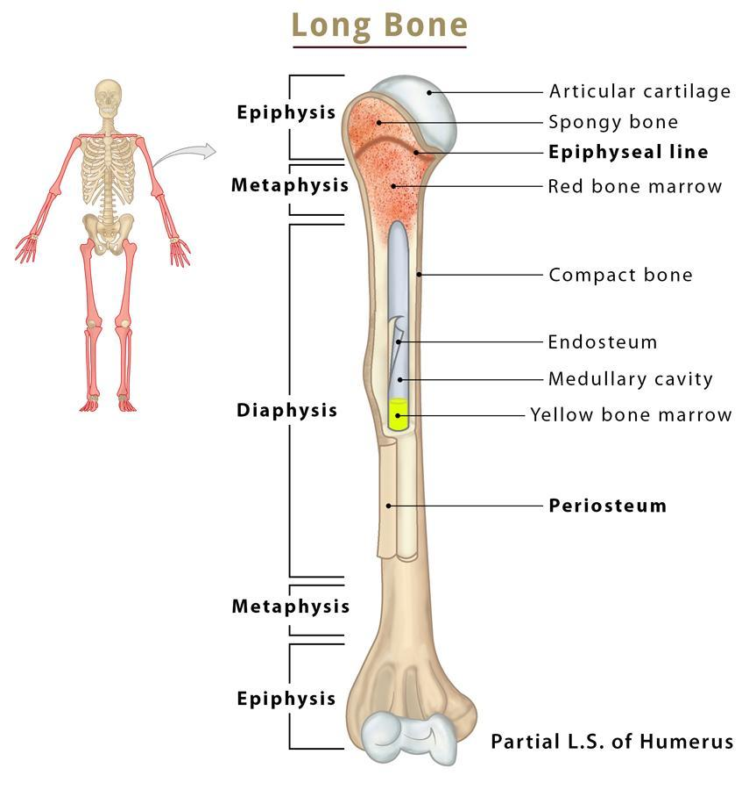
Anatomical structure of bones

Slide 3
Definition and causes of fractures
A fracture is a break in the continuity of a bone caused by an external force.
The most common causes of fractures:
high-energy trauma (traffic accident, fall from height, impacts, gunshot);
"bone fatigue" (often affects athletes who are subjected to heavy loads);
osteoporosis or other skeletal disease

Slide 4
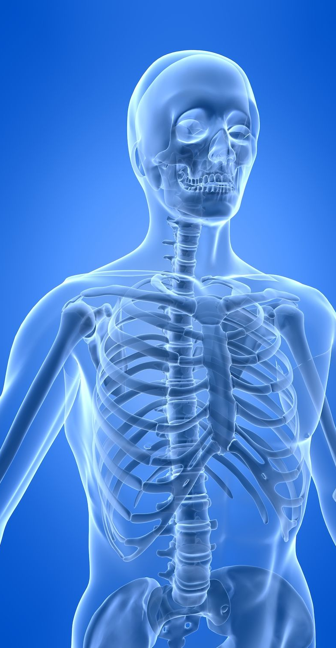
The basic functions of skeletal system
protection of deeper organs (brain is protected by the skull, the chest protects the heart and lungs, the pelvis protects the reproductive organs)
passive locomotor system – support for muscles
store of calcium and phosphate ions in the body
indirectly hematopoietic (bone marrow is located in bones)

Slide 5
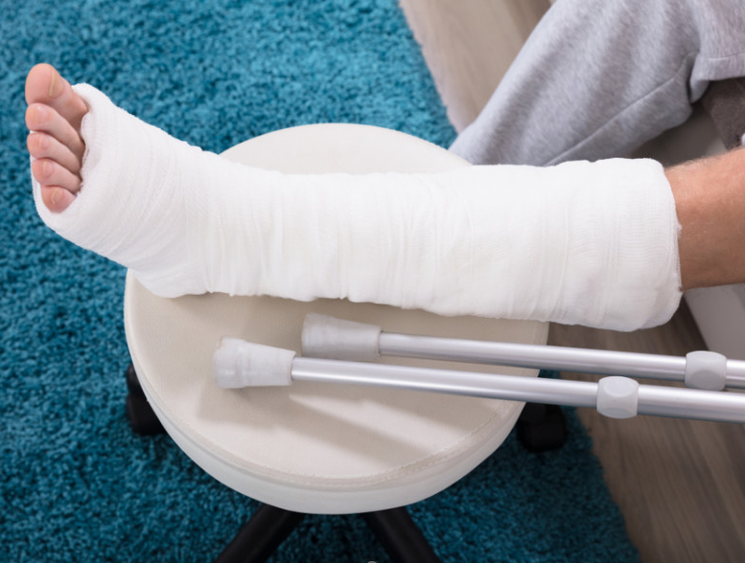
Fracture symptoms
sharp, growing pain that lasts for a long time
local tenderness,
tingling,
disturbance or loss of feeling in a limb,
swelling,
bruising,
loss of pulse near the injured area,
difficulty or inability to move a limb,
abnormal bone movements

Slide 6
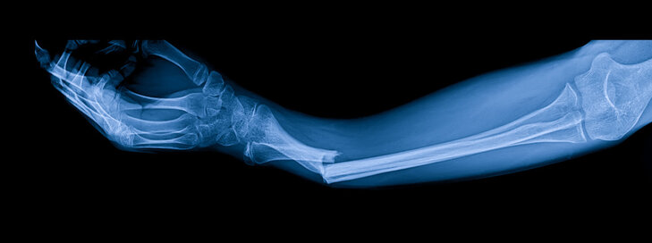
Diagnosis
X-ray
Magnetic resonance imaging (MRI)
Computed tomography scan

Slide 7
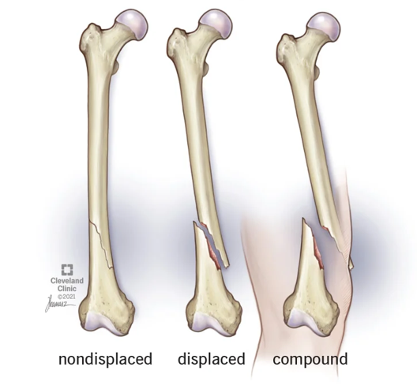
Types of fractures
A NONDISPLACED FRACTURE
the bone axis is preserved
A DISPLACED FRACTURE
the bone axis is not preserved
A COMPOUND FRACTURE
the continuity of the skin has been damadged by the bone

Slide 8
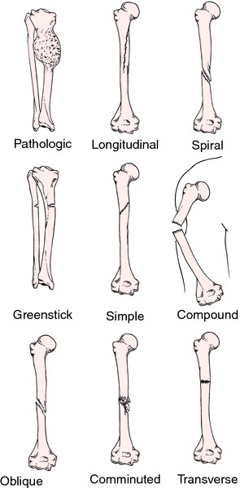
A PATHOLOGICAL FRACTURE
A fracture caused by an underlying disease which weakened the bones.
A LONGITUDINAL FRACTURE
A fracture going along the longitudinal axis.
A SPIRAL FRACTURE
A fracture going round and down the length of the bone.
A GREENSTICK FRACTURE
A partial crack, the fracture does not estend through the width of the shaft.
AN OBLIQUE FRACTURE
The bone is broken at an angle.
A COMMINUTED FRACTURE
The bone is broken into many pieces.
A TRANSVERSE FRACTURE
The bone is broken straight across

Slide 9
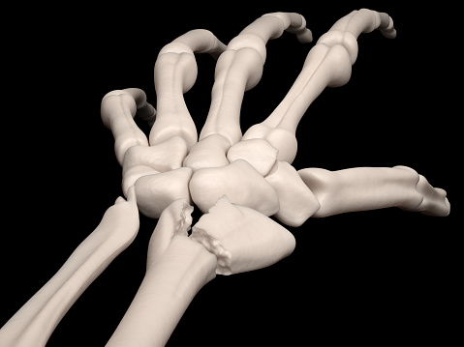
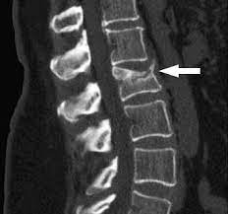
AN INTRA-ARTICULAR FRACTURE
A fracture involving the bones of a joint.
A COMPRESSION FRACTURE
A fracture caused by hyperflexion of the spine, usually appearing in the lumbar section.

Slide 10
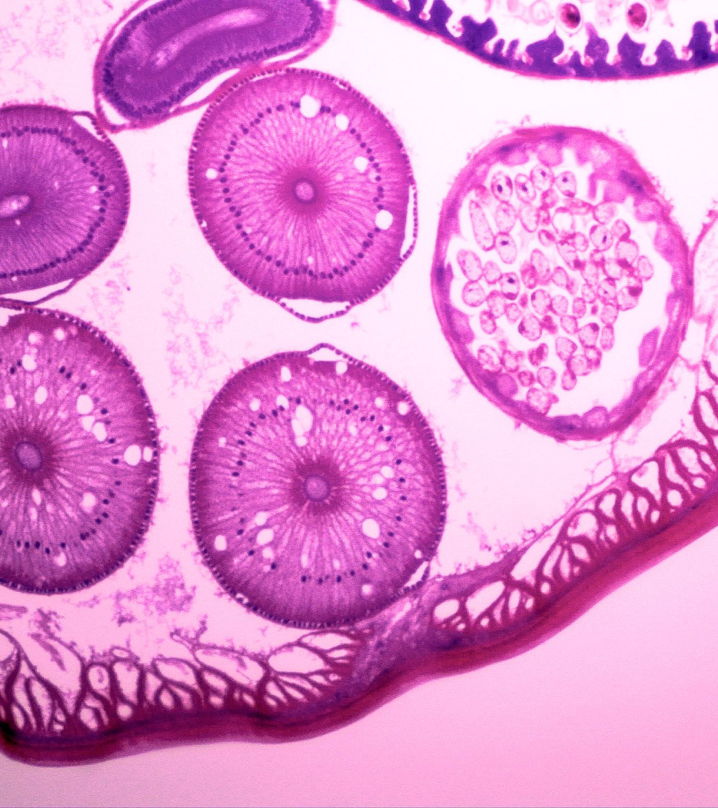
Phases of bone union formation
I . Hematoma formation
II . Soft callus formation
III . Bony callus formation
IV . Bone remodeling

Slide 11
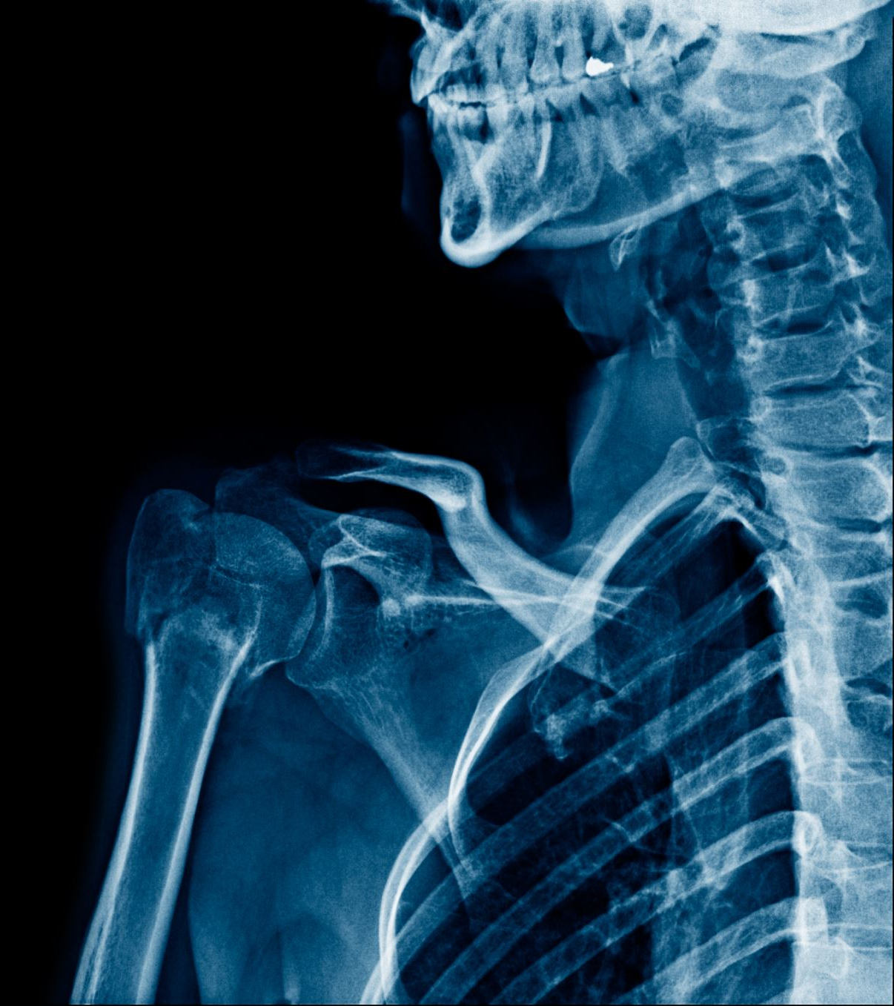
Treatment
Immobilization of the injured limb with a plaster or splint
Surgery to restore the correct bone axis (displaced fractures)
Surgery to fuse bone fragments and stabilize them
Traction

Slide 12
Rehabilitation
After removing the immobilization and obtaining bone union, the following is used:
transverse massage and functional massage
exercises to increase joint mobility
manual therapy
strengthening exercises
kinesio taping

Slide 13
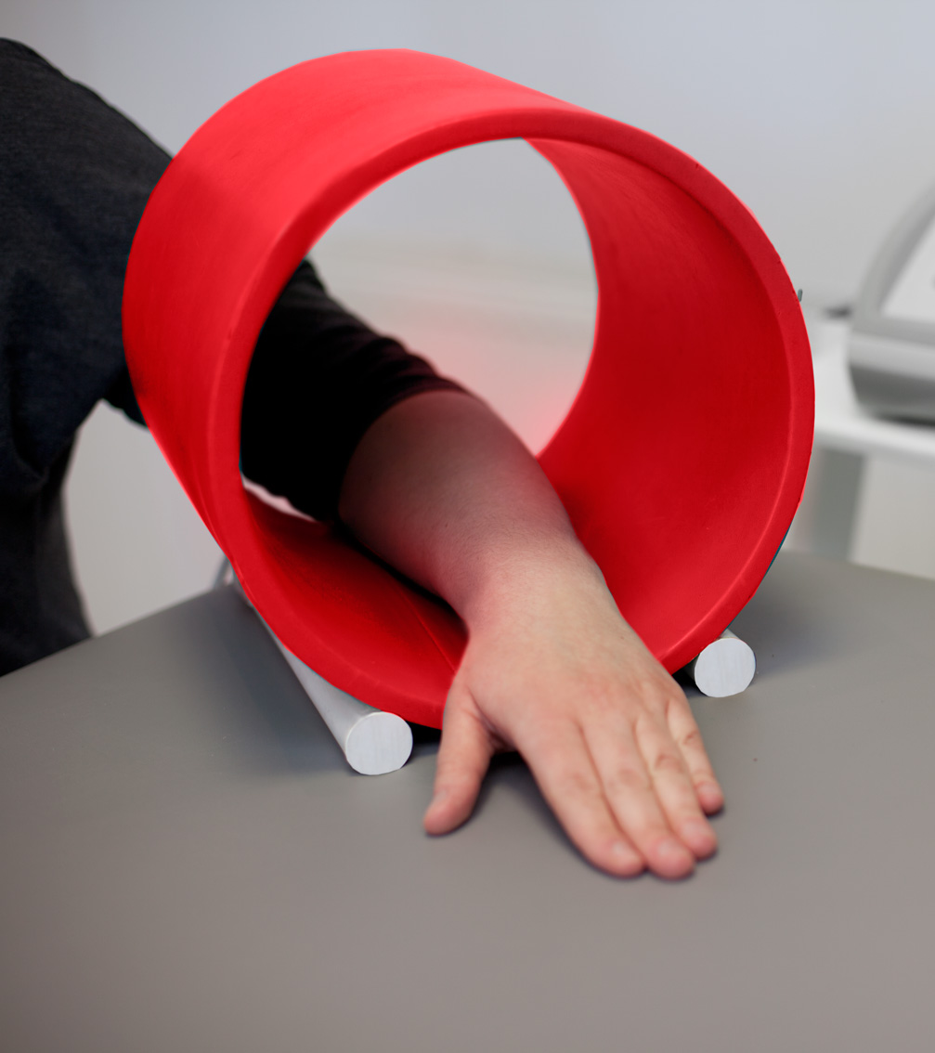
Physical therapy
magnetic field,
laser therapy,
cryotherapy,
whirlpool massage,
Sollux lamp.

Slide 14
Dictionary
Periosteum - okostna
Endosteum- śródkostna
Medullary cavity – jama szpikowa
Oblique fracture – złamanie skośne
Greenstick fracture - złamanie ,,zielonej gałązki’’
Longitudinal fracture- podłużne złamanie
Compound fracture- złamanie otwarte
Comminuted fracture- złamanie wieloodłamowe
Protrusion- zgrubienie
Cast immobilization- unieruchomienie gipsowe
Bone marrow- szpik kostny

Slide 15
BIBLIOGRAPHY
A. Bigham-Sadegh & A. Oryan ‚’’Basic concepts regarding fracture healing and the currentoptions and future directions in managing bone fractures’’; International Wound Journal ISSN 1742-4801, may 2015
Baig M (August 28, 2017) A Review of Epidemiological Distribution of Different Types of Fractures in Paediatric Age. Cureus 9(8): e1624. doi:10.7759/cureus.1624
Rodney C. Diaz , Brian Cervenka , Hilary A. Brodie, ’’Treatment of Temporal Bone Fractures’’, Neurol Surg B Skull Base 2016; 77(05): 419-429, DOI: 10.1055/s-0036-1584197
B. Wildemann, A. Ignatius, F. Leung, L. A. Taitsman, R. M. Smith, R. Pesántez, M. J. Stoddart, R. G. Richards & J. B. Jupiter; ’’Non-union bone fractures’’, Nature Reviews Disease Primers https://www.nature.com/articles/s41572-021-00289-8
https://my.clevelandclinic.org/health/diseases/15241-bone-fractures

