Slide 1
Cardiac rehabilitation
Uniwersytet Rzeszowski Kolegium Nauk Medycznych Instytut Nauk o Zdrowiu
23rd November 2023
Krzysztof Brzyski 3rd year of Physiotherapy 2023/24

Slide 2
Agenda
1. Glossary 2. General structure of the circulatory system - Structure of the heart
3. General structure of the circulatory system - Structure of arteries and veins
4. Blood circulation in the human body - Small and large circulation
5. Risk factors for cardiovascular diseases
6. Physiotherapeutic approach in a selected disease entity
7. Quiz
8. Bibliography

Slide 3
Glossary
1. Artery – Tętnica 2. Aorta – Aorta 3. Superior/inferior vena cava - Żyła główna górna/dolna 4. Bicuspid valve (Mitral valve) - Zastawka dwudzielna (Zastawka mitralna) 5. Tricuspid valve - Zastawka trójdzielna 6. Right atrium - Prawy przedsionek 7. Right ventricle - Prawa komora 8. Coronary heart disease - Choroba wieńcowa 9. Atherosclerosis – Miażdżyca 10. Chest pain - Ból w klatce piersiowej 11. Shortness of breath – Duszność 12. Cardiac arrhythmias - Zaburzenia rytmu serca 13. Systemic circulation - Obieg krwi duży (układ krążenia ogólnoustrojowego) 14. Pulmonary circulation - Obieg krwi mały (układ krążenia płucnego) 15. Arrhythmia – Arytmia 16. Heart rate - Tętno (częstość rytmu serca)

Slide 4
General structure of the circulatory system - Structure of the heart
superior vena cava
Pulmonary veins
Aorta
Right atrium
Left atrium
Tricuspid valve
Bicuspid valve (Mitral valve)
Right ventricle
Left ventricle
inferior vena cava
https://pl.wikipedia.org/wiki/Zastawki_serca

Slide 5
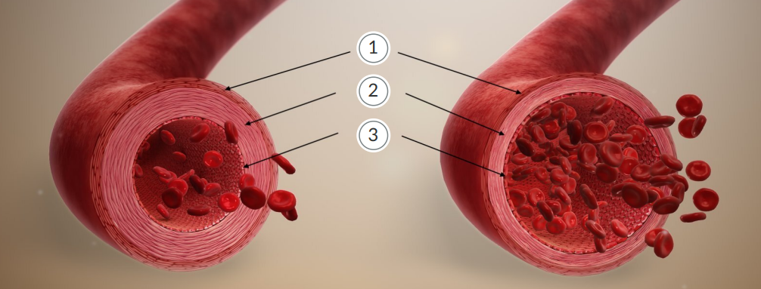
General structure of the circulatory system - Structure of arteries and veins
Artery
Vein
1. Outer membrane
2. Middle membrane
3. Inner membrane
https://zpe.gov.pl/pdf/PHaLJW4WW

Slide 6
Blood circulation in the human body - Small and large circulation
https://fizjoterapeuty.pl/uklad-krwionosny/krwiobieg.html
Pulmonary circulation
Systematic circulation

Slide 7
Risk factors for cardiovascular diseases
Smoking
Diet
Physical activity
Sleep

Slide 8
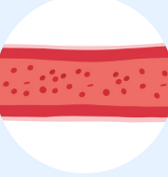
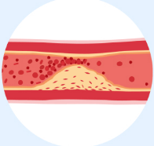
Physiotherapeutic approach in a selected disease entity
Coronary heart disease (ischemic heart disease)
Healthy artery
Artery with accumulated atherosclerotic plaque
atherosclerosis
https://upacjenta.pl/poradnik/miazdzyca

Slide 9
coronary heart disease
Physiotherapeutic goals in the treatment of coronary heart disease:
1. Improving the heart's function by reducing peripheral resistance,
2. Slowing down heart activity,
3. Enhancing its blood supply.

Slide 10
coronary heart disease rehabilitation plan (model a)
Period 1 | Period 2 | Period 3
1 day | 2 days | 3-5 days
5-10 min. | 10-15 min. | 15-20 min
Position for exercises
- Lying position - Semi-sitting position - Sitting position | - Sitting position | - Sitting position - Standing position - Walking position
Rehabilitation plan
1. Breathing exercises 2. Active dynamic exercises from small to larger muscle groups isometric contractions of small muscle groups 3. Relaxing exercises 4. Passive uprighting or with assistance | 1. Exercises from period I with an increase in physical exercise load - Increase in the number of exercise repetitions - Increase in the pace of exercises - Increase in the number of exercise sets 2. Elements of coordination and balance exercises 3. Uprighting 4. Moving within the patients | 1. Exercises from period II with further increase in physical exercise load 2. Exercises of large muscle groups with a general rehabilitative character 3. Locomotion: - Walking training - Climbing stairs
Functional range
- Independent position changes in bed - Bathing, shaving in bed - Using the bedpan or transporting to the toilet in a wheelchair | - Active sitting with legs down and standing up - Independent toileting - Self-care regarding meals and toileting | - Full mobilization of the patient - Free movement with the ward

Slide 11
Red flags
Chest pain
Shortness of breath
Heart rate increase of more than 20 beats per minute
Heart rate decrease of more than 10 beats per minute
Dangerous, exercise-induced arrhythmias
A decrease in arterial blood pressure of more than 10-15 mm Hg or an increase in systolic blood pressure of more than 40 mm Hg and/or diastolic blood pressure of more than 20 mm Hg compared to the baseline

Slide 12
Quiz
1. How is the heart structured?
a) right ventricle, left ventricle, left atrium, right atrium,
b) left atrium, right ventricle, left ventricle, posterior atrium,
c) right atrium, left atrium, right ventricle, middle ventricle.
2. What is the main cause of coronary heart disease?
a) feeling unwell,
b) atherosclerosis,
c) intense physical effort.
3. During the third phase of cardiac rehabilitation, the time a patient should allocate to physical activity falls within the range:
a) 5-10 minutes,
b) 10-15 minutes,
c) 15-20 minutes.
4. Red flags in coronary artery disease include:
a) chest pain, shortness of breath,
b) bad mood,
c) blood pressure 120/80 mmHg.

Slide 13
Bibliography
1. D. Hansen, P. Dendale, K. Coninx, L. Vanhees, M. F. Piepoli, J. Niebauer, V. Cornelissen, R. Pedretti, E. Geurts, G. R. Ruiz, U. Corra`, J-P. Schmid, E. Greco, C. H. Davos, F. Edelmann, A. Abreu, B. Rauch, M. Ambrosetti, S. S. Braga, O. Barna, P. Beckers, M. Bussotti, R. Fagard, P. Faggiano, E. Garcia-Porrero, E. Kouidi, M. Lamotte, D. Neunh, R. Reibis, M. A. Spruit, Ch. Stettler, T. Takken, C. Tonoli, C. Vigorito, H. Voller, P. Doherty, The European Association of Preventive Cardiology Exercise Prescription in Everyday Practice and Rehabilitative Training (EXPERT) tool: A digital training and decision support system for optimized exercise prescription in cardiovascular disease. Concept, definitions and construction methodology, European Journal of Preventive Cardiology, 2017, Vol. 24(10) 1017–1031, doi: 10.1177/2047487317702042, [30.10.2023r.],
2. S. Mori, D. E. Spicer, R. H. Anderson, Revisiting the Anatomy of the Living Heart, Circulation Journal Official Journal of the Japanese Circulation Society, 2016, PMID: 26673171 DOI: 10.1253/circj.CJ-15-1147, [30.10.2023r.],
3. J. Ciecierska, English for Physiotherapy, Wydawnictwo Lekarskie PZWL, Warszawa, 2011,
4. P. Friedrich, J. Waschke, Sobotta Atlas of Anatomy, Vol. 2, pub. Ubran&Fischer, 2020.
5. World Health Organization, Who guidelines on physical activity and sedentary lifestyle, 2021 [30.10.2023r.]
https://apps.who.int/iris/bitstream/handle/10665/341120/WHO-EURO-2021-1204-40953-58211-pol.pdf
6. R. Piotrowicz, A. Jegier, D. Szalewska, J. Wolszakiewice, E. Piotrowicz, E. Smolis-Bąk, Z. Eysymontt, M. Gałaszek, M. Łazorczyk, I. Przywarska, J. Rybick, E. Straburzyńska-Migaj, J. Tylka, K. Węgrzynowska-Teodorczyk, A. Wilczek-Banc, Rekomendacje w zakresie kompleksowej rehabilitacji kardiologicznej, pub. AsteriaMed, Gdańsk, 2017
The image generated by the PowerPoint program

Slide 14
Thank you for your attention

