Slide 1
Understanding cerebral palsy
University of Rzeszów
Faculty of Medicine
A comprehensive overview
Rafał Gondek
Physiotherapy JMS
2023/2024

Slide 2
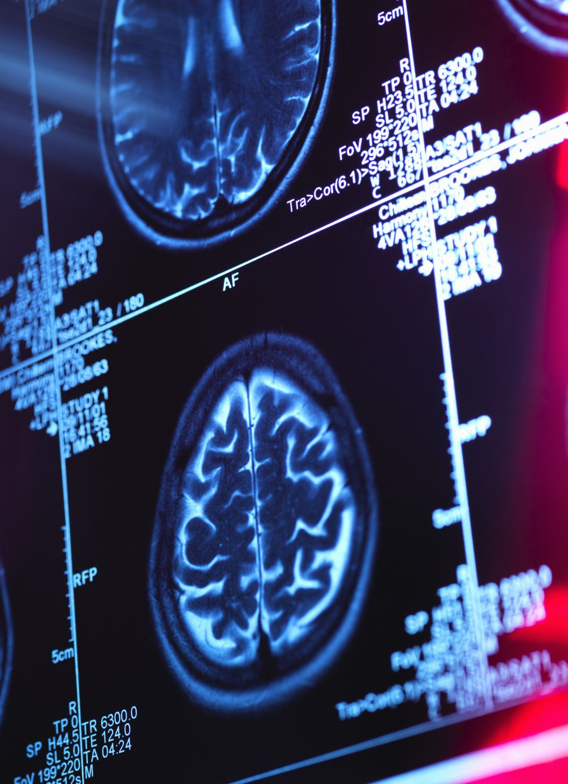
Introduction
A condition marked by impaired muscle coordination (spastic paralysis) and/or other disabilities, typically caused by damage to the brain before or at birth (WHO)
1 on 500 live births
Various forms
Lifelong condition

Slide 3
Causes of Cerebral Palsy
Prenatal
Perinatal
Postnatal
Genetic issues
Infections during pregnancy
In vitro
Birth complications
Lack of oxygen
Traumatic brain injury
Infections after pregnancy

Slide 4
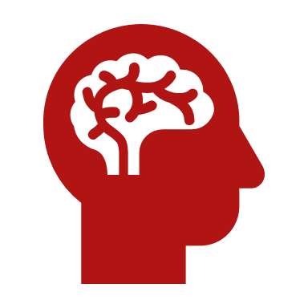
Types od Cerebral Palsy
Hemiplegia
Diplegia
Tetraplegia
Athetoid
Dystonic
Ataxic

Slide 5
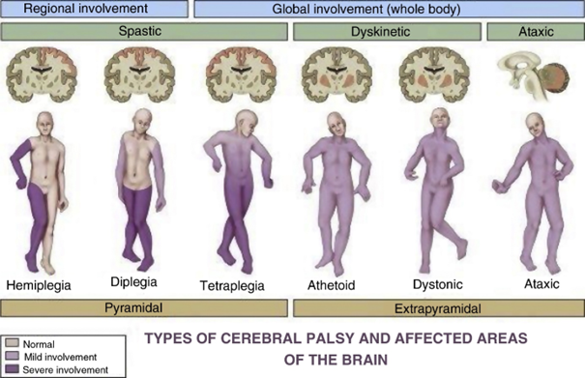
Ryc.1 [1]

Slide 6
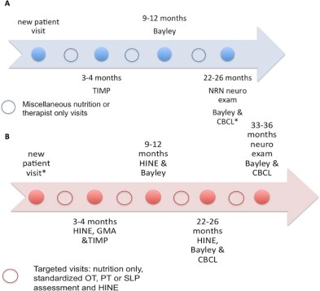
Diagnosis
Picture A shows old way of diagnosis
Picture B is scheme used nowadays
Ryc. 2 [2]

Slide 7
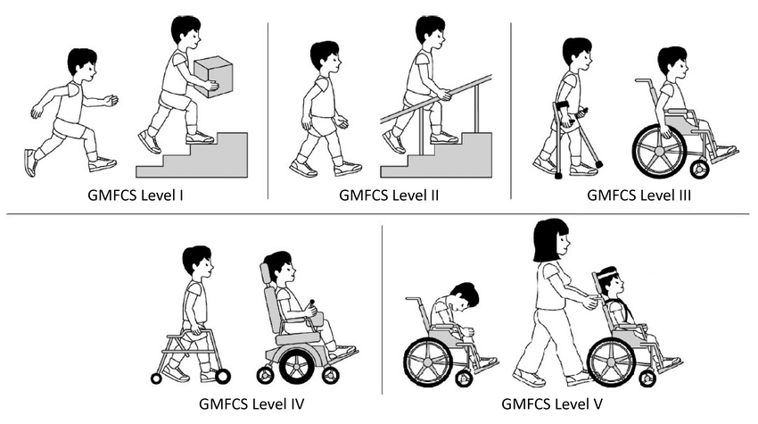
Scales
GMFCS (Gross Motor Function Classification System)
Source: https://www.researchgate.net/figure/Levels-of-Gross-Motor-Function-Classification-System-GMFCS_fig2_326345460

Slide 8
MACS (Manual Ability Classification System)
Level I | Handles objects easily and successfully
Level II | Handles most objects but with somewhat reduced quality or speed of achievement
Level III | Handles objects with difficulty; needs help to prepare or modify activities
Level IV | Handles a limited selection of easily managed objects in adapted situations
Level V | Does not handle objects and has severely limited ability to perform even simple actions

Slide 9
CFCS ( Communication Function Classification Scale)
Level I | Effective sender and receiver with unfamiliar and familiar partners
Level II | Effective but slower paced sender and/or receiver with unfamiliar and familiar partners
Level III | Effective sender and receiver with familiar partners
Level IV | Sometimes uneffective sender and receiver with familiar partners
Level V | Seldom effective sender and receiver even with familiar partners

Slide 10
Physiotherapy
Goals in physiotherapy:
Improving motor functions and independent
Promoting optimal posture
Managing spasticity
Enhance muscle strenght

Slide 11
Physiotherapy methods
Stretching exercises
Strenght exercises
Gait exercises
Balance exercises
Adaptive equipment

Slide 12
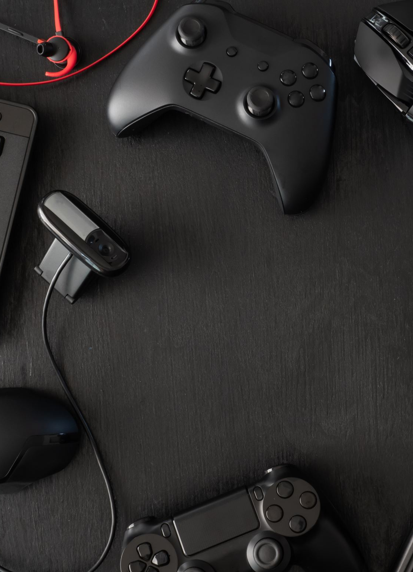
Biofeedback
Exercises with EMG
Interactive gaming systems
Goniometers and joints angle sensors
Treadmills with interactive walking track

Slide 13
Dictionary
Hemiplegia - porażenie połowicze
Diplegia - paraliż poprzeczny
Tetraplegia - porażenie czterokończynowe
Dystonic - dystonia
Ataxic - ataktyczny (móżdżkowy)
Miscellaneous - różne
Paced - w tempie
Spasticity - spastyczność
Gait exercises - trening chodu
EMG (Electromyography) - elektromiografia

Slide 14
Quiz
Which scale is usually used in CP diagnosis?
GMFCS
Lovett
Babińskiego
Which type of CP is spastic?
Ataxic
Athetoid
Diplegia
What is main goal for physiotherapy in CP?
Teach patient how to ride a bike
Improving independence
Educate patient on healthy lifestyle

Slide 15
Bibliography
1. ” Comprehensive approach to children with cerebral palsy” María José Peláez Cantero, Esther Eugenia Moreno Medinilla, Ana Cordón Martinez, Silvia Gallego Gautierrez, doi: https://doi.org/10.1016/j.anpede.2021.07.002
2. ” Early, Accurate Diagnosis and Early Intervention in Cerebral PalsyAdvances in Diagnosis and Treatment” Iona Novak, Cathy Morgan, Lars Adde, doi: 10.1001/jamapediatrics.2017.1689
3. "Cerebral Palsy: An Overview" Kirsten Vitrikas, Heather Dalton, Dakota Breish PMID: 32053326

Slide 16
Thank you for your attention

