Slide 1
Electrotherapy
University of Rzeszów
Faculty of Medicine
Prepared by:
Bartosz Kalita
3rd year of Physiotherapy
2023/2024

Slide 2
Vocabulary
Frequency – częstotliwość
Capacitance - pojemność
Overlap – nachodzić na siebie (zachodzić)
Contraction – skurcz
Peripheral neuropathies – neuropatie obwodowe
Fragile – kruchy
Threshold - próg
Tuberoculosis - Gruźlica
Current – prąd
Voltage – napięcie
Amplitude - amplituda
Diminished - zmniejszone

Slide 3
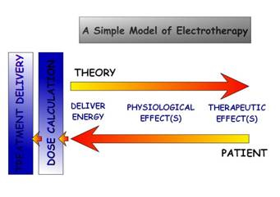
What is electrotherapy?
It is a type of treatment, focused on applying external forms of Energy (electricity); Treatment involves direct current, low and medium frequency impulse.

Slide 4
How does electrotherapy work?
Biological tissues such as nerve and muscle membrane have the ability to simultaneously store and electric charge and oppose change in current flow (capacitance). Skin and adipose act as resistors or oppose current slow. Current always takes the "path of least resistance" when faced with multiple resistors.
Key things:
Charge = Strength
Current = Rate of Flow
Voltage = Driving Force
Resistance or Impendence = opposition;
Current will flow when:
There is an energy source creating a difference in electrical potential
There is a conducting pathway between the two potentials

Slide 5
Types of electrotherapy
Galvanic current – constant current
Iontophoresis – Inducing medication into tissues
TENS – medium and high frequency currents.
Diadynamic currents – long-term increase in pain threshold.
Interference currents – medium frequency currents created as a overlap of two alternating currents.
Trabert currents – improving blood and nutrient supply of tissues
Electrostimulation – creating muscle contraction
Kotz currents – for healthy muscles using medium frequency currents.

Slide 6
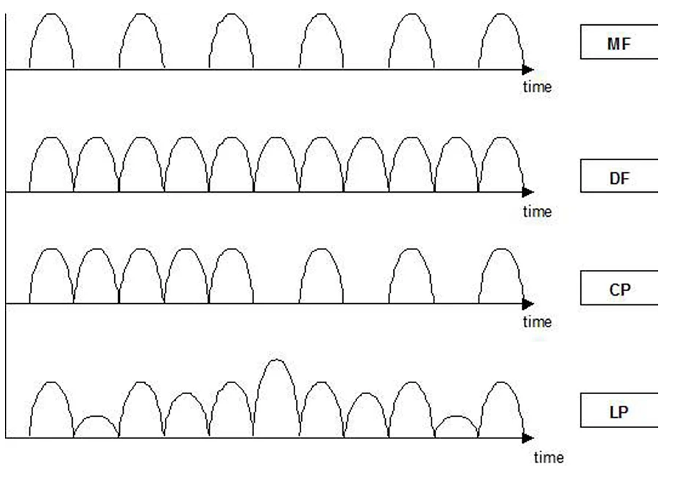
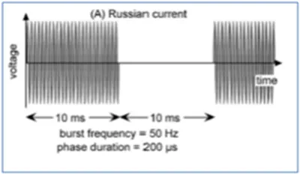
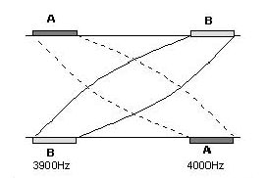
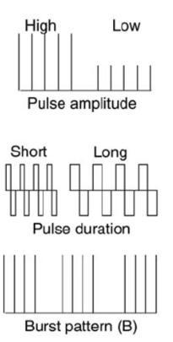
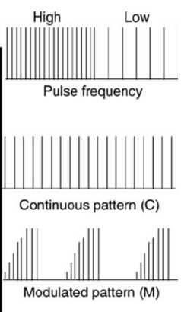
https://www.electrotherapy.org/diadynamic
https://www.electrotherapy.org/russian-and-bmac
https://www.maricaproducts.co.za/index.php/interferential-current-ifc/
https://www.researchgate.net/figure/A-standard-TENS-device-delivers-biphasic-pulsed-currents-with-durations-of-50-250-m-s_fig2_277576652

Slide 7
Electrotherapy equipment
Electrical stimulation device;
Electrodes (catode and anode);
Source of electricity;
Sanitizer;
Gauze pads

Slide 8
https://www.amazon.com/Channel-Electrotherapy-Physical-Therapy-Machine/dp/B08ZJJNJCV

Slide 9
Indications:
Pain Management
Muscle Strengthening
Stimulation of degenerated muscle
Wound care
Fracture Healing
Increase joint range of motion (ROM)
Deliver Medication through the skin (Iontophoresis)
Replace Orthotics
Reduce spasm and spasticity
Reduce scoliosis

Slide 10
Contraindications
Pregnancy - except during labor for pain control
Pacemaker or other cardiac implants for interference
Cancer
Location of thrombophlebitis or phlebothrombosis for risk of embolism
Active Tuberculosis
Overcarotid sinus
Area of active hemorrhage

Slide 11
Precautions
Obesity (Insulator)
Absent or diminished sensation
Skin conditions - eczema, psoriasis, acne, dermatitis, infection
Diabetes - fragile thin skin
Peripheral neuropathies or areas of denervation
Metal - internal or external
Range of Motion or exercise limitations
Cognitive Impairments - unable to follow directions or provide feedback
Spinal Cord Injury - dysreflexia

Slide 12
Bibliography
"Electrotherapy”: yesterday, today and tomorrow" R. TIKTINSKY, L. CHEN, P. NARAYAN Haemophilia(2010),16(Suppl. 5), 126–131
„Electrotherapy” - Tim Watson Tidy's Physiotherapy 2013, Pages 417-455
http://www.ckphysio.co.uk/blog/key-benefits-electrotherapy-physiotherapy-treatments/
https://sportoklinik.pl/en/uslugi/rehabilitation/electrotherapy/
„Electrotherapy for the treatment of painful diabetic peripheral neuropathy: a review” Karin Pieber, MD, Malvina Herceg, MD and Tatjana Paternostro-Sluga J Rehabil Med 2010; 42; 289–295

