Slide 1
Obesity
Piotr Hus 117732
Fizjoterapia Jednolite Magisterskie 3 rok semestr 5

Slide 2
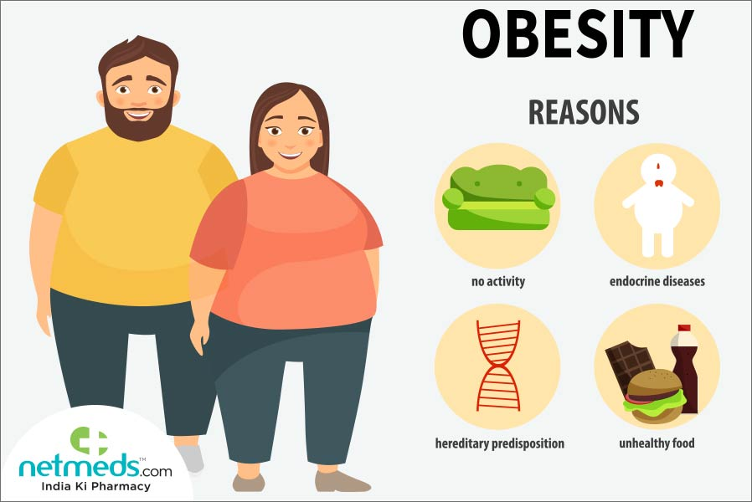
What is obesity
Obesity is a chronic disease
the amount of nutrients supplied with food exceeds the patient's needs.
The diagnosis of obesity is usually made based on body mass index (BMI) when it is ≥ 30 kg/m2. BMI values in the range of 25–29.9 kg/m2 indicate overweight.
Obesity is considered to be the result of eating disorders.

Slide 3
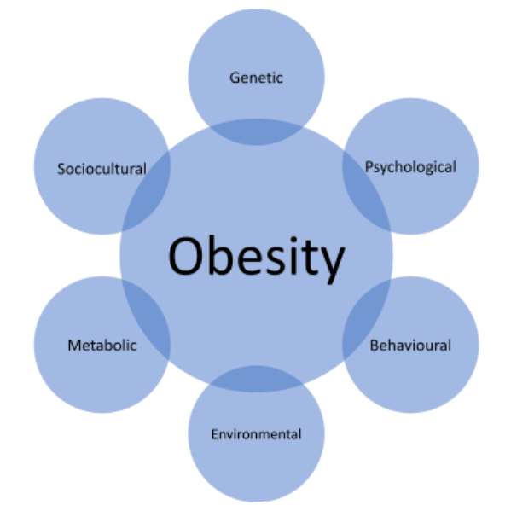
Causes of obesity
The following factors may contribute to the development of obesity:
environmental conditions,
congenital syndromes,
acquired diseases
treatment.

Slide 4
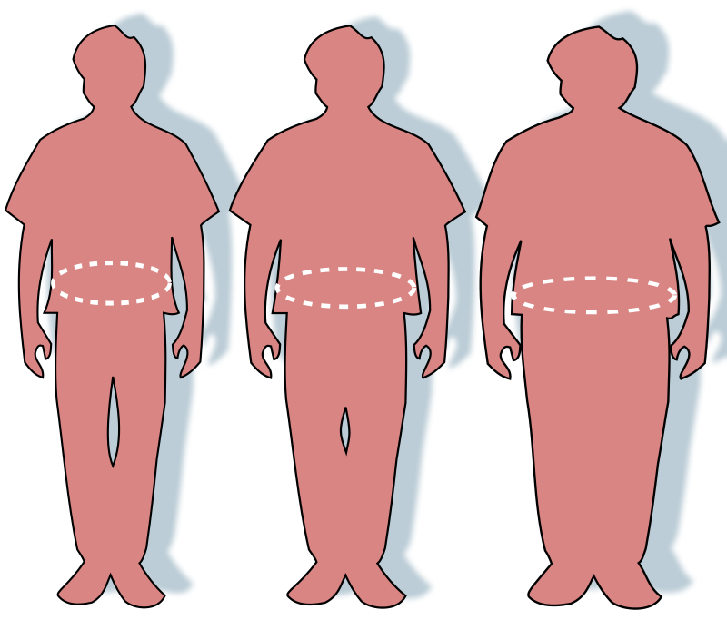
Environmental factors
The main environmental causes of obesity include:
inappropriate eating habits,
little physical activity,
long-term excess of the body's energy requirements,
experiencing chronic stress.

Slide 5
Genetics
relationship has been described for some substances involved in the axis that regulates the feeling of hunger and satiety, e.g. leptin and proopiomelanocortin (POMC).
Albright osteodystrophy and Prader-Willi syndrome.

Slide 6
Factors of emotional disorders
difficulties in meeting psychological needs in a mature way, e.g. love or security;
lower self-esteem and mood, which can lead to depression;
food addiction
binge eating syndrome (BED)
night eating syndrome (NES)

Slide 7
Hormonal disorders
Obesity most often develops in the course of:
Cushing's disease or syndrome
growth hormone deficiency
excess androgens in women
abnormal development of the sexual organs,
Hypopituitarism
hypothyroidism

Slide 8
Side effects of taken medications
increase food intake, e.g. glucocorticosteroids, insulin, some antidepressants
they reduce the body's energy expenditure, e.g. beta-blockers, which are used in the treatment of cardiovascular diseases.

Slide 9
What can be the effects of obesity?
prediabetes,
type II diabetes
non-alcoholic fatty liver disease
cardiovascular diseases, e.g. hypertension, coronary syndromes and stroke
kidney damage
hormonal disorders, e.g. regarding sex hormones, cancer

Slide 10
Diagnostics
Overweight values are between 25–29.9 kg/m2.
Obesity equal or exceeds 30 kg/m2.
Diagnosis of visceral obesity
diagnosis of metabolic obesity in a person with normal body weight,

Slide 11
Treatment
Dietary management
Introducing physical activity
Psychotherapy
Pharmacotherapy,
Surgical or endoscopic methods

Slide 12
REHABILITATION GOALS
Reducing body weight and accelerating metabolism
Improving physical fitness and performing everyday activities
Regulation of the functioning of the respiratory, circulatory and other systems and internal organs
Improving well-being and increasing energy for an active lifestyle
Reducing the risk of other emerging chronic diseases and their obesity-related consequences

Slide 13
Bibliography
-ISTANBUL PROVINCIAL DIRECTORATE OF HEALTH
https://erenkoyftr.saglik.gov.tr/EN-525326/obesity-rehabilitation.html
-The role of the rehabilitation in the prevention and treatment of obesity – an editorial article Anna Golus1 , Marta Bielejewska1 , Dominika Ciecierska1 , Karolina Kuźba1 , Kamil Potyra1 , Wiktoria Śniegowska1 , Paweł Wojtczak1 , Anna Ziółkowska1 , Bartłomiej Wrzesiński2 , Edyta Piechocka2
-The obesity epidemic: too much food for thought? R C Davey
-Obesity as a Disease Jagriti Upadhyay, MDa,b,c, *, Olivia Farr, PhDc , Nikolaos Perakakis, MD, PhDc , Wael Ghaly, MDc , Christos Mantzoros, MD, PhDa,c

Slide 14
pictures
https://southernweightloss.co.nz/resources/understanding-obesity/what-causes-obesity-nz/
https://www.netmeds.com/health-library/post/obesity-causes-symptoms-and-treatment
https://www.simplypsychology.org/mood-disorder.html

Slide 15
Vocabulary
eating disorders- zaburzenia odżywiania
body mass index (BMI) – index masy ciała
congenital syndromes – zespół wrodzony
Axis -oś
Prediabetes- stan przed cukrzycowy
Overweight - nadwaga
Obesity - otyłość
Chronic - przewlekły
Dietary management – zażądzanie dietą
Exceeds – przekroczyć
Hypopituitarism – niedoczynność przysadki
Hypothyroidism – niedoczynność tarczycy
Cushing's disease or syndrome – choroba kuszinga albo syndrom kuszinga
visceral obesity – otyłość wisceralna
abnormal development – nieprawidłowy rozwój
body's energy expenditure – wydatek energetyczny ciała

