Slide 1
OSTEOARTHROSIS of the HIP JOINT
University od Rzeszów
Prepared by
Martyna Czyżyk
3rd year of Physiotherapy (JMS)
2023/2024

Slide 2
DICTIONARY
OSTEOARTHROSIS- choroba zwyrodnieniowa
RISK FACTORS- czynniki ryzyka
JOINT DYSPLASIA- dysplazja stawu biodrowego
ROM- RANGE OF MOTION- zakres ruchomości
CREPITUS- krepitacje, przeskakiwanie w stawie
„WEAR AND TEAR” ARTHRITIS- zapalenia stawów powstałe z „zużycia” elementów tworzących staw
PROPRIOCEPTIVE SENSATION- czucie proprioceptywne (głębokie)
HIP ARTHROSCOPY- artroskopia stawu biodrowego
TOTAL HIP ARTHROPLASTY- całkowita endoprotezoplastyka stawu biodrowego
HIP RESURFACING- wymiana stawu biodrowego (alternatywa dla endoprotezoplastyki)
TRIGGER POINTS- punkty spustowe
WEIGHT- BEARING EXERCISES- ćwiczenia w odciążeniu
DUMBBELLS- hantle
TREADMILL- bieżnia

Slide 3
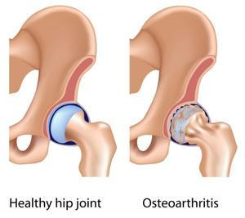
WHAT IS OA?
OSTEOARTHROSIS is the most common form of arthritis. Some people call it degenerative joint disease or “wear and tear” arthritis. It occurs most frequently in the hands, hips, and knees. The cartilage within a joint begins to break down and the underlying bone begins to change.
https://www.oihnv.com/blog/3-signs-you-may-have-osteoarthritis-in-your-hip

Slide 4
RISK FACTORS
LOCAL:
JOINT DYSPLASIA
TRAUMA
GENERAL:
AGE
SEX
OBESITY
GENETICS
OCCUPATION

Slide 5
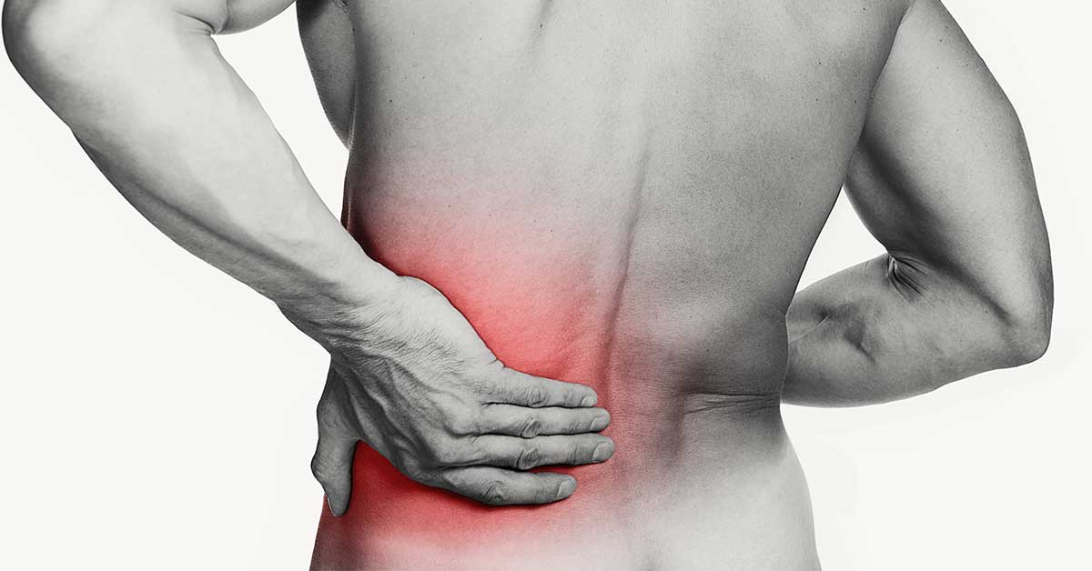
SYMPTOMS
https://www.buoyhealth.com/learn/hip-pain
PAIN
STIFFNESS
TENDERNESS
SWELLING
CREPITUS
LIMITED ROM
ABNORMAL GAIT STEREOTYPES
https://www.bodyprochiro.com/blog/hip-stiffness-the-effects-to-your-sport

Slide 6
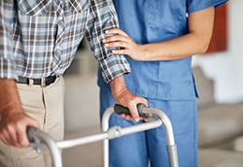
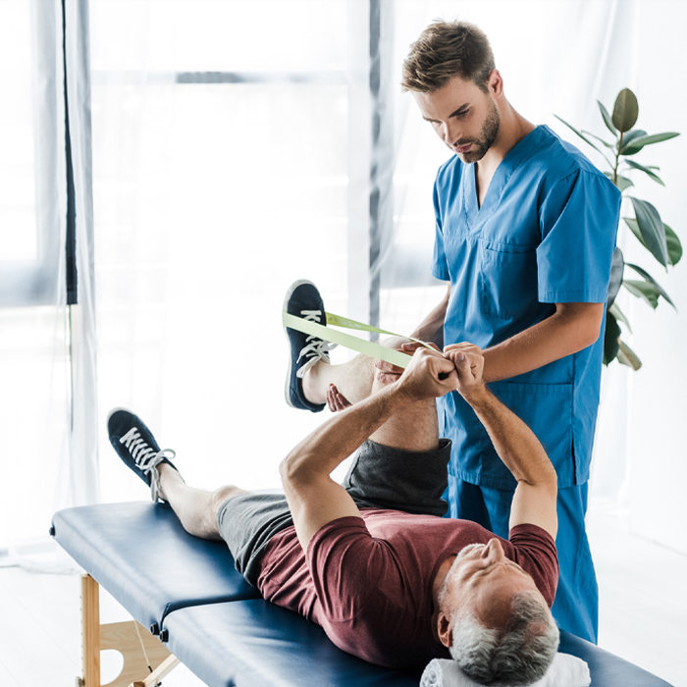
MAIN GOALS OF PHYSIOTHERAPY
https://www.singhealth.com.sg/patient-care/specialties-services/rehabilitation-medicine
Relieve pain
Improve circulation and ROM
Increase muscle strength of the lower limb
Improve proprioceptive sensation
Gait reeducation
Preservation of normal hip joint function
Patient education on activities of daily living and how to deal with the disease
https://www.sunwaymedical.com/en/centres-of-excellence/rehabilitation-medicine-centre

Slide 7
PHYSIOTHERAPY EXAMINATION
Medical interview
Observation of the patient
Assessment of the patient's posture
Palpation
Examination of limb length and range of motion
Test of muscle strength
Gait assessment
https://musculoskeletalkey.com/measurement-of-range-of-motion-of-the-hip/

Slide 8
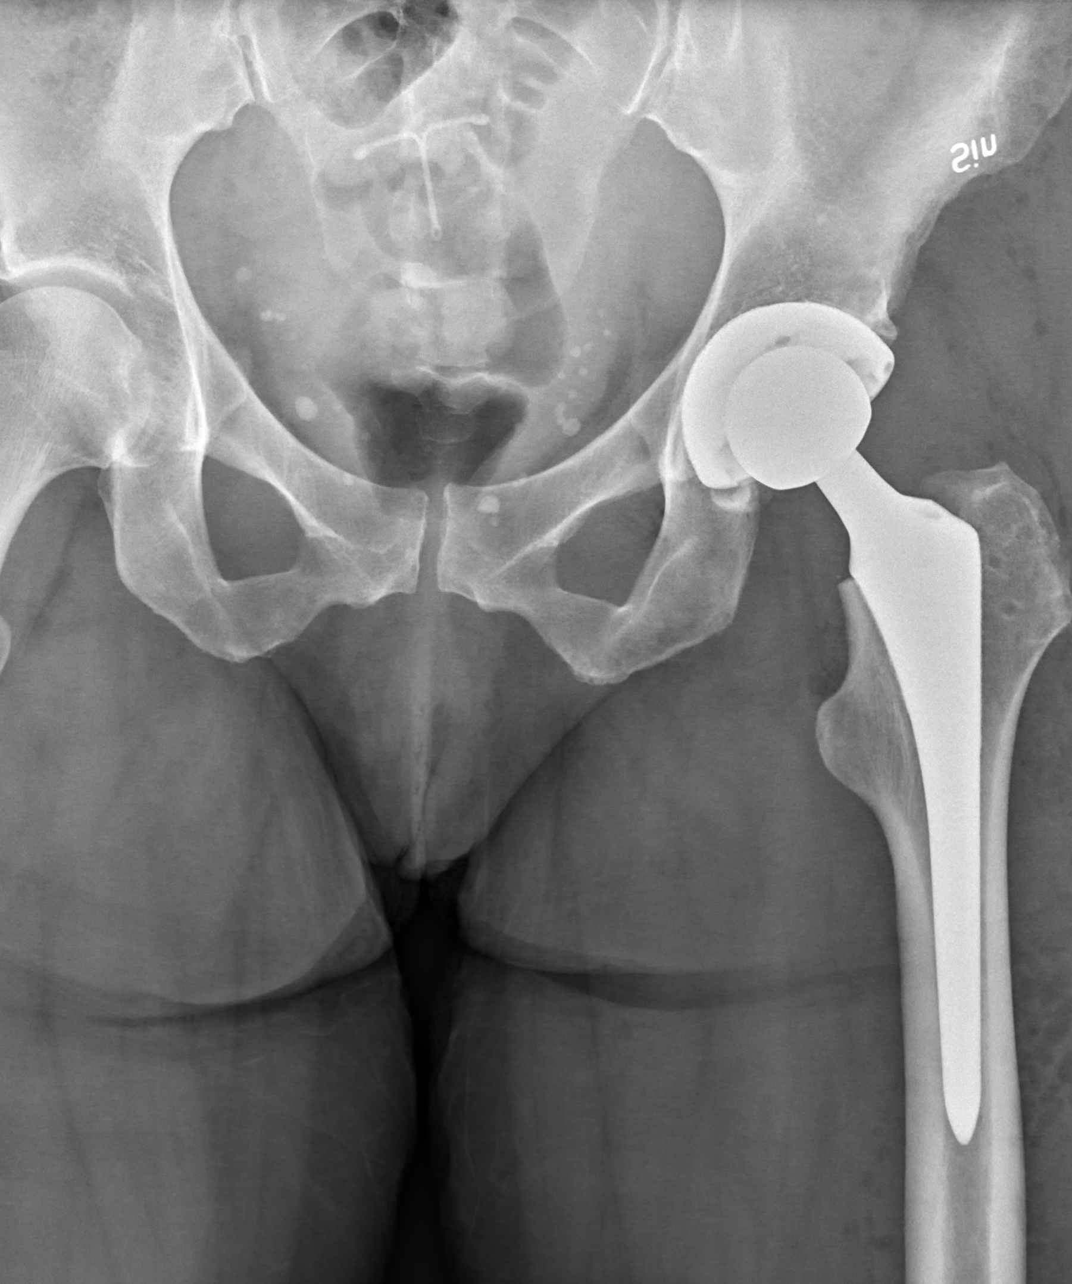
SURGICAL TREATMENT
Hip Arthroscopy
Total Hip Arthroplasty
Hip Resurfacing
https://en.wikipedia.org/wiki/Hip_replacement

Slide 9
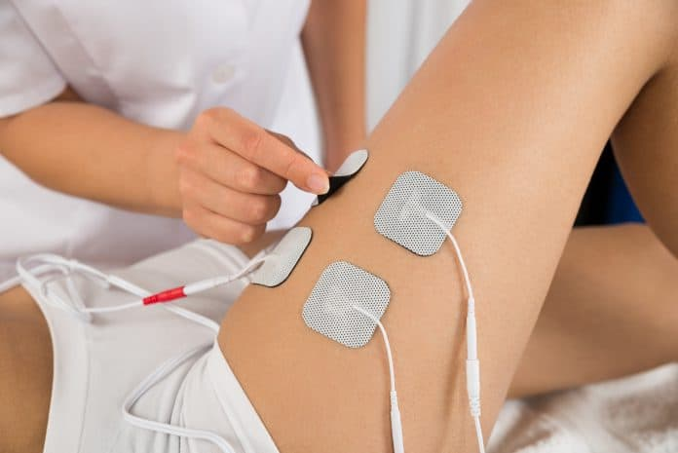
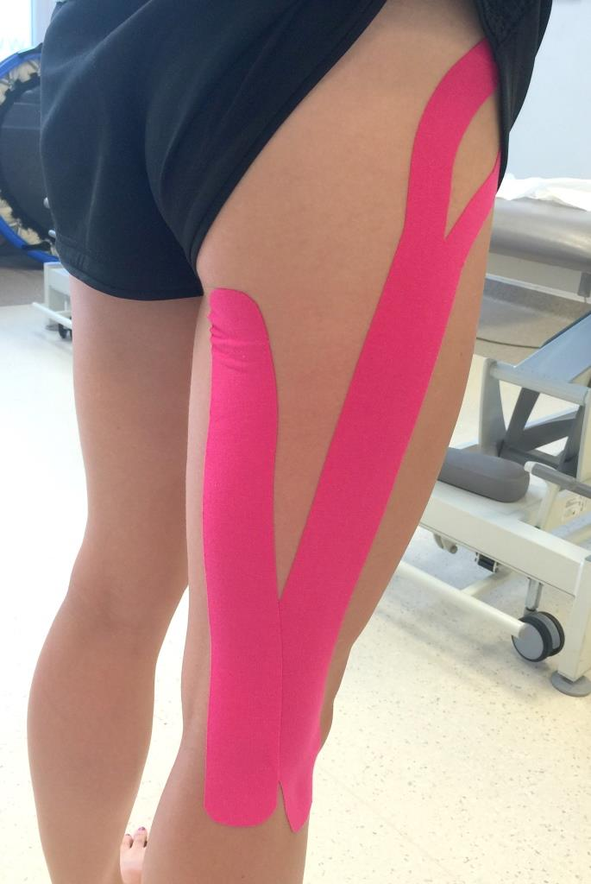
PHYSIOTHERAPY TREATMENT: Reduce pain
Physical therapy
Massage
Deactivation of trigger points
Manual Therapy Techniques
Taping
https://rosamedclinic.pl/elektrostymulacja/
https://pressmodernmassage.com/blogs/going-deep/massage-for-hip-pain
https://www.fizjologika.pl/kinesiotaping-marketingowa-sila-kolorowych-plastrow/

Slide 10
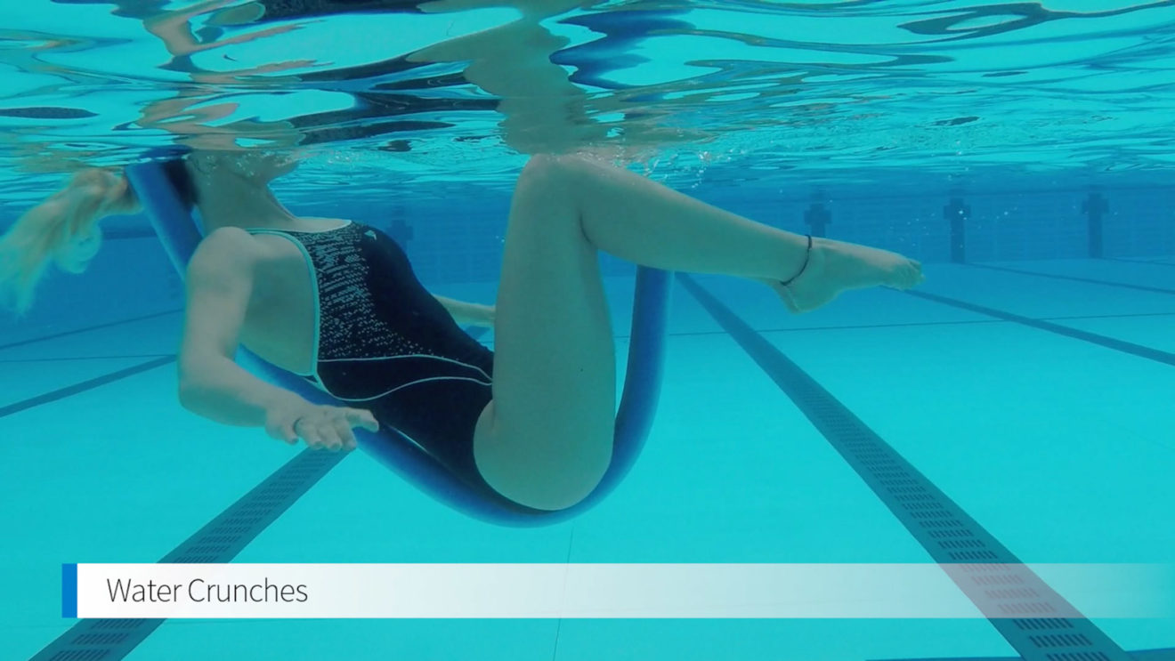
PHYSIOTHERAPY TREATMENT: Improve ROM
Passive exercises
Weight-bearing exercises
Water exercises
Manual Therapy Techniques
Stretching Exercises
https://www.sweat.com/blogs/fitness/hip-flexor-stretches
https://www.swimming.org/justswim/get-fitter/pool-exercise-ideas/

Slide 11
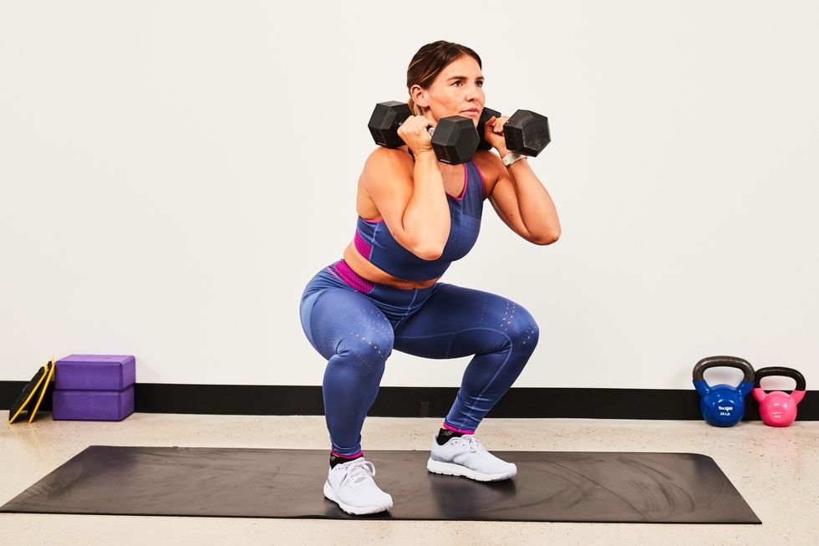
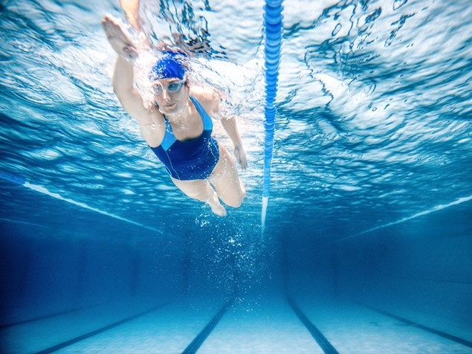
PHYSIOTHERAPY TREATMENT: Increase muscle strength:
Strengthening exercises
Resistance exercises with dumbbells, ankle weights
Cardio exercises on the treadmill
Swimming
https://www.runnersworld.com/training/a41231275/dumbbell-workout-for-beginners/
https://www.livestrong.com/article/398070-do-ankle-weights-work/
https://www.runnersworld.com/uk/training/a775008/7-things-to-remember-when-taking-up-swimming-as-a-runner/

Slide 12
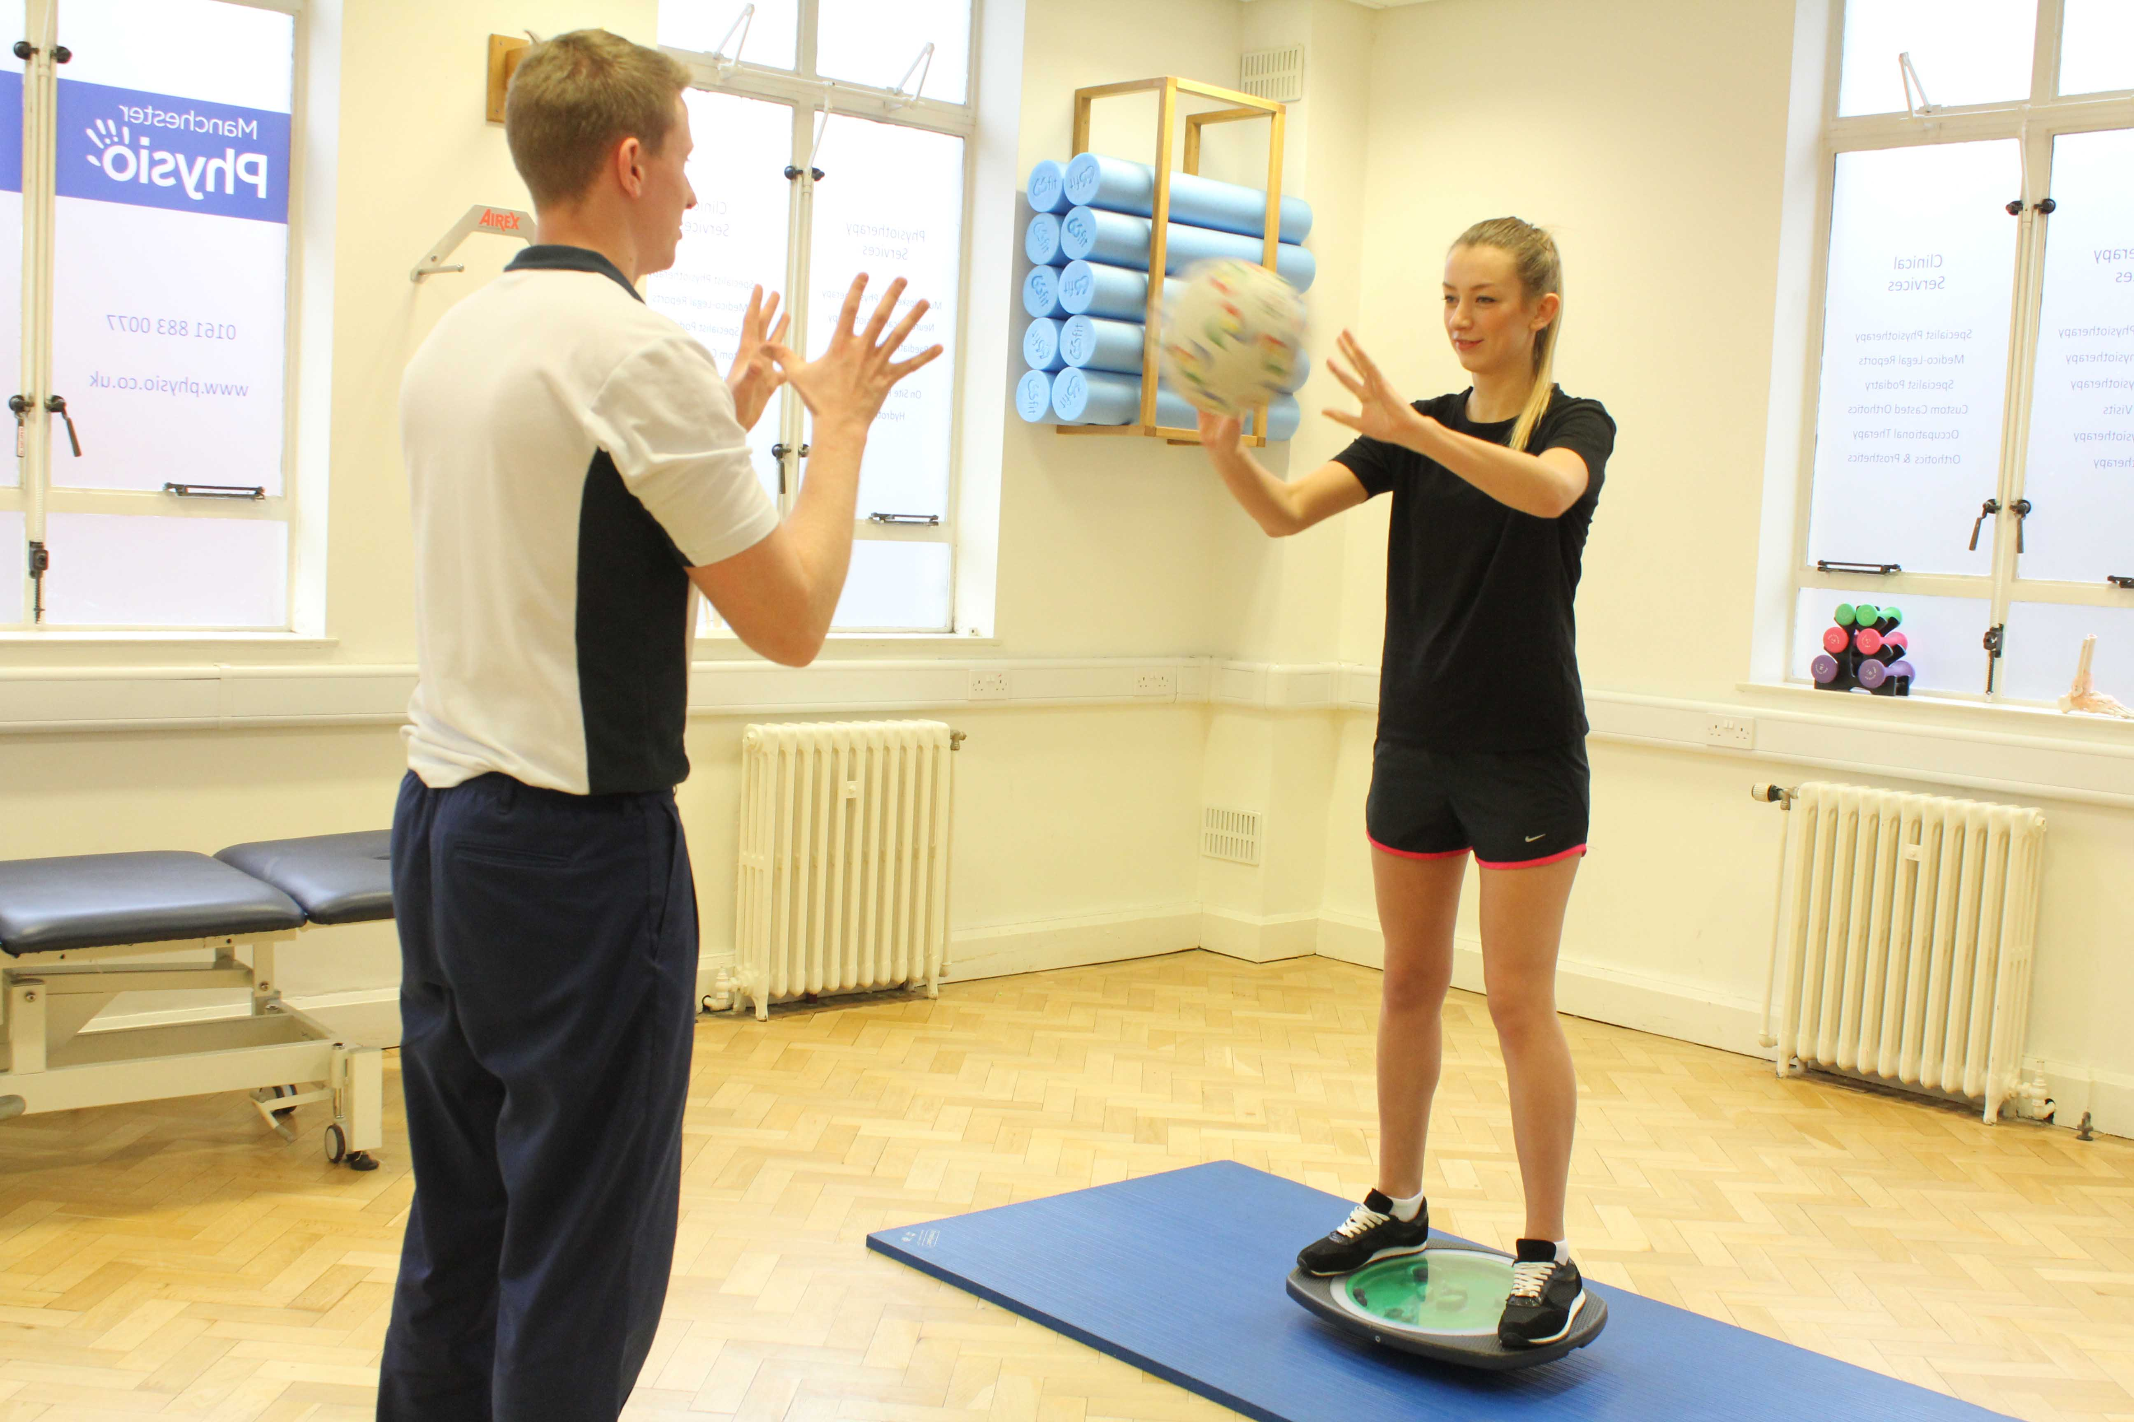
PHYSIOTHERAPY TREATMENT Improve proprioceptive sensation
Exercises on stable/unstable platforms
Balance exercises
Coordination exercises
https://www.physio.co.uk/what-we-treat/musculoskeletal/symptoms/coordination-problems.php
https://www.healthshots.com/fitness/staying-fit/5-exercises-for-better-balance-and-stability/
https://lifemanagerka.pl/2017/01/czego-wykorzystac-poduszke-sensoryczna/

Slide 13
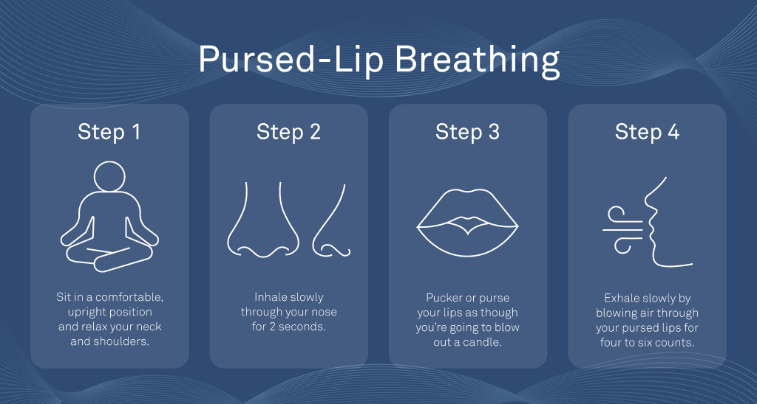
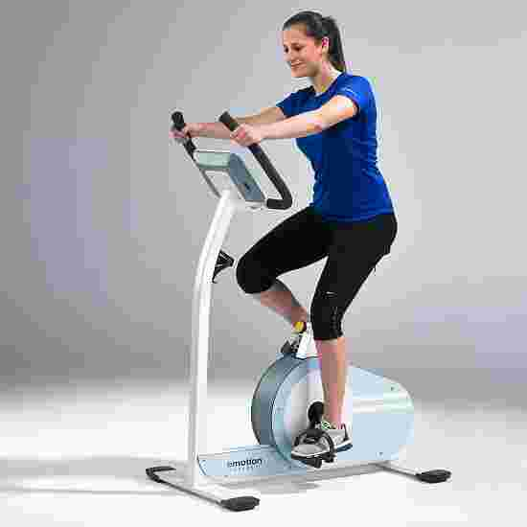
PHYSIOTHERAPY TREATMENT: Improve overall fitness and condition
https://ouraring.com/blog/10-simple-breathing-exercises-for-relaxation/
Training on a cycle ergometer
Breathing exercises
Regular physical activities (swimming or Nordic Walking)
https://www.sport-thieme.com/Fitness-equipment/Ergometers/Bicycle-ergometer/art=1402302
https://www.zikodlazdrowia.org/blog/nordic-walking-dla-kazdego-2/

Slide 14
SUMMARY QUIZ
Osteoarthrosis is the most common form of arthritis. TRUE/ FALSE
General risk factors are joint dysplasia and trauma. TRUE/ FALSE
The main symptoms of OA are pain, stiffness, swelling, crepitus and limited ROM. TRUE/ FALSE
Physiotherapy examination consists of ONLY a test of muscle strength. TRUE/ FALSE
Weight-bearing and stretching exercises improve ROM. TRUE/ FALSE
For the patient with OA it is NOT important to improve proprioceptive sensation. TRUE/ FALSE
To reduce pain, the physiotherapist may use physical therapy or taping. TRUE/ FALSE

Slide 15
REFERENCES
M. J Lespasio, DNP, JD, ANP, A. A. Sultan, N. S. Piuzzi, A. Khlopas, M. E. Husni, G. F. Muschler, M. A. Mont ‚Hip Osteoarthritis: A Primer’, Published Online: March 1, 2018
Kim Bennell ‚Physiotherapy management of hip osteoarthritis’, Centre for Health, Exercise and Sports Medicine, Department of Physiotherapy, The University of Melbourne, Australia, Journal of Physiotherapy 2013 Vol. 59 – © Australian Physiotherapy Association 2013
3. S.T. Skou, E.M. Roos ‚Physical therapy for patients with knee and hip osteoarthritis: supervised, active treatment is current best practice’, © Copyright Clinical and Experimental Rheumatology 2019.
https://www.physio-pedia.com/Hip_Osteoarthritis
Wilfred Peter ‚Physiotherapy in hip and knee osteoarthritis: evidence and daily practise’
Słownik języka angielskiego: https://www.diki.pl/

