Slide 1
Physiotherapy in hip joint injuries
Filip Gmiterek
Faculty of Medicine, Rzeszów
University
Master's degree studies in
Physiotherapy, year 3

Slide 2
Anatomy

Slide 3
Muscles

Slide 4
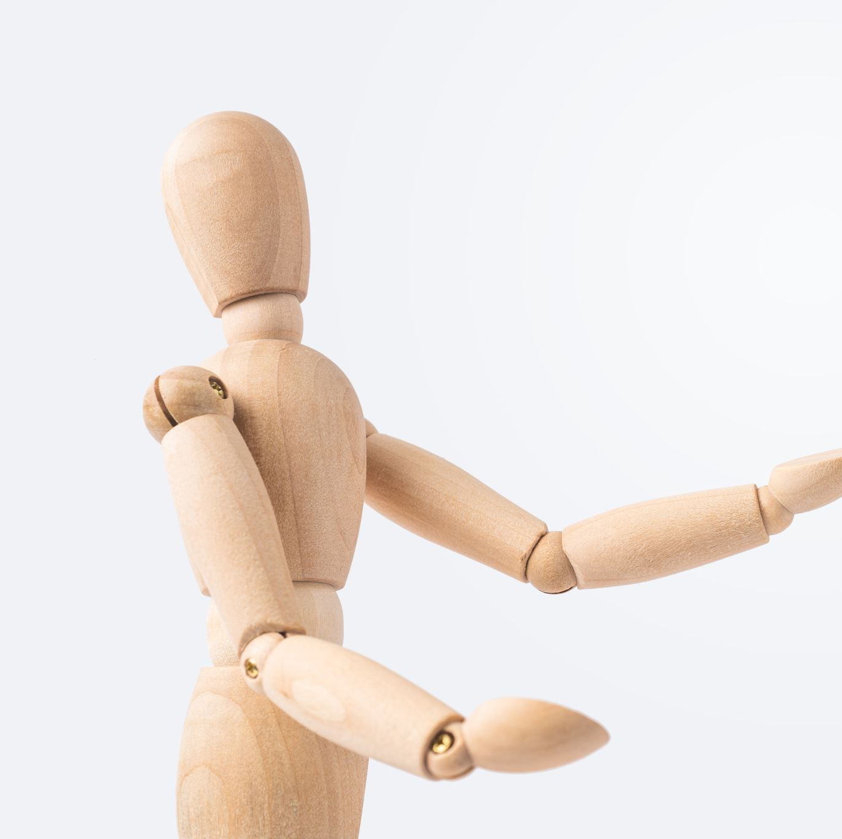
Functions
Body support and stabilization
Support for movement
Amortisation and absorption of forces
Support for the upper body
Ensuring stability when sitting and standing
Importance for overall body posture

Slide 5
fracture of the neck of the femoral head

Slide 6
Dislocation of the joint capsule

Slide 7
Osteoarthritis of the hip joint

Slide 8
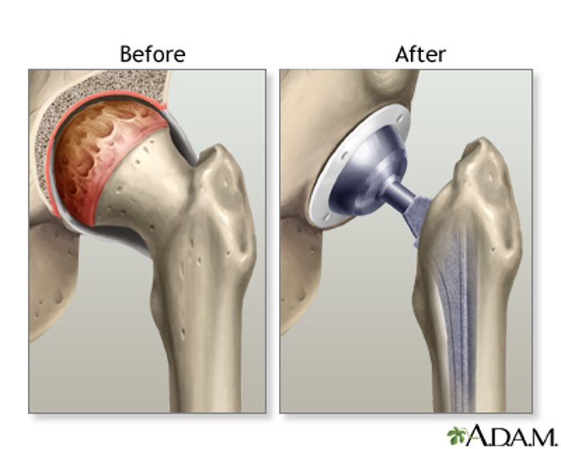
Hip joint replacement

Slide 9
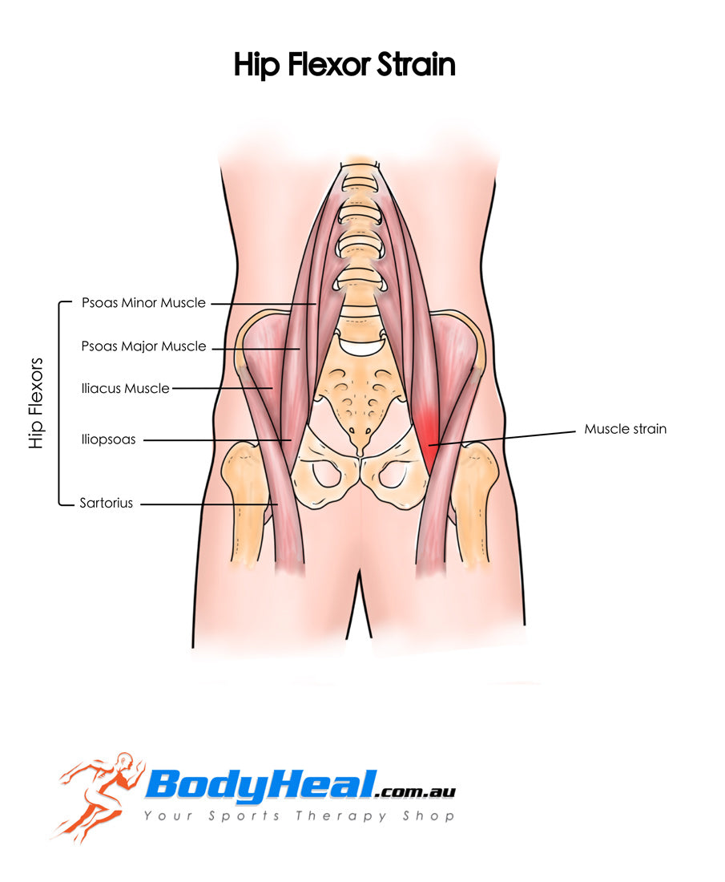
Muscle strains, sprains and injuries
The most common sprain is iliopsoas muscle sprain

Slide 10
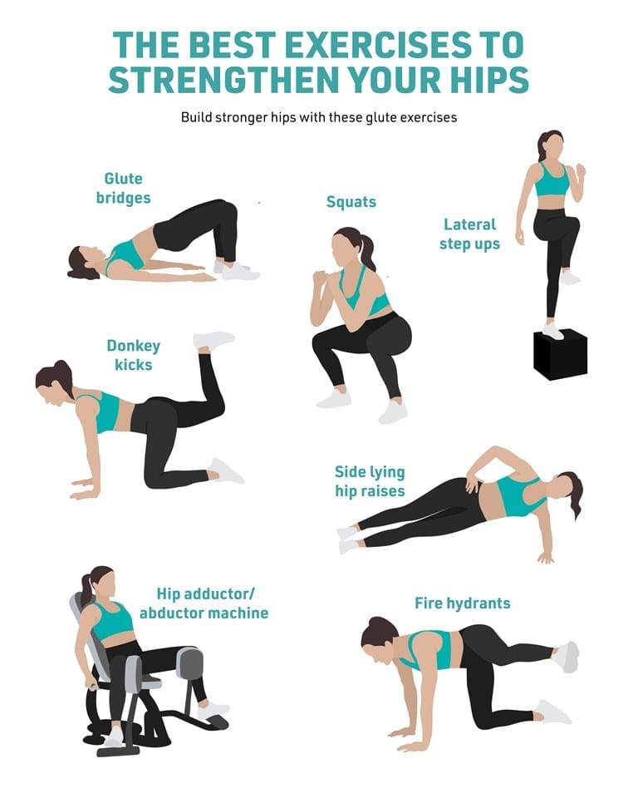
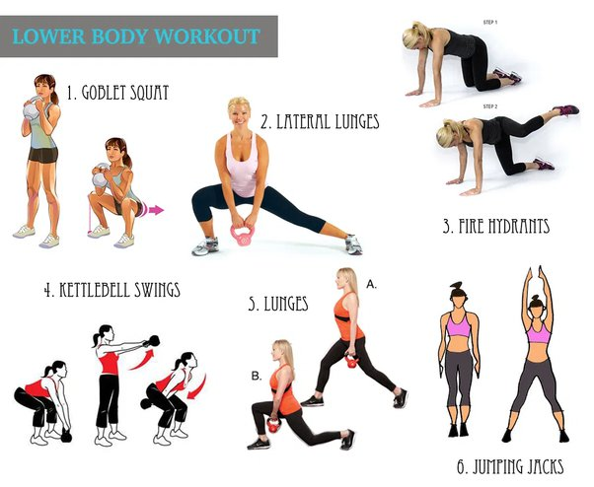
Rehabilitation
exercises to strengthen the hip joint
Stretching exercises
Balance and coordination training

Slide 11
Week 1-2: Initial Phase
Assessment: Thorough evaluation of the injury by a physiotherapist, determining range of motion, muscle strength, and pain levels.
Pain and swelling reduction: Utilizing techniques such as rest, ice, compression, elevation (RICE) to reduce pain and swelling.
Breathing exercises and posture control: Basic breathing exercises and postural control exercises.
Stabilizing muscles strengthening: Exercises focusing on strengthening the gluteal, thigh, and stabilizing muscles around the hip joint.
Stretching exercises and mobilization: Stretching exercises to improve muscle and tissue flexibility around the hip joint.
Muscle electrostimulation: If necessary for muscle strengthening or pain reduction.
Week 3-4: Strengthening and Range of Motion Improvement Phase

Slide 12
Week 5-6: Stabilization and Functional Recovery Phase
Balance and coordination training: Exercises aiming to improve balance and motor coordination.
Functional exercises: Gradually incorporating exercises simulating daily activities like walking, stair climbing, and descending.
Posture control and ergonomic techniques: Education on proper body posture and ergonomic techniques.
Increasing exercise intensity: Gradually increasing exercise intensity and resistance.
Personalization of the program: Adjusting the physiotherapy program according to the patient's response and progress.
Fitness training: Exercises aiming to improve overall physical fitness.
Week 7-8: Activity Restoration Phase

Slide 13
Manual theraphy

Slide 14
Biblioggrpahy
https://www.epainassist.com/joint-pain/hip-pain/hip-pain-caused-by-hip-joint-dislocation-causes-types-symptoms-treatment
Handoll, Helen HG, et al. "Multidisciplinary rehabilitation for older people with hip fractures." Cochrane Database of Systematic Reviews 11 (2021).
Lee, Kyung-Jae, Sang-Hyun Um, and Young-Hun Kim. "Postoperative rehabilitation after hip fracture: a literature review." Hip & pelvis 32.3 (2020)
Bouman, Ans IE, et al. "Effects of an integrated ‘fast Track’Rehabilitation Service for Multi-Trauma Patients: a non-randomized clinical trial in the Netherlands." PLoS One 12.1 (2017)
Rudyk, Aleksandra. "Wpływ rehabilitacji na jakość życia chorych po endoprotezie stawu biodrowego." (2022).

Slide 15
Dictionary
Ensuring – zapewnienie, grwarantowanie
Fracture - pękniecię
Cartilage - chrząstka
Screw - wkręt
Traction – trakcja
Slide - ślizg

