Slide 1
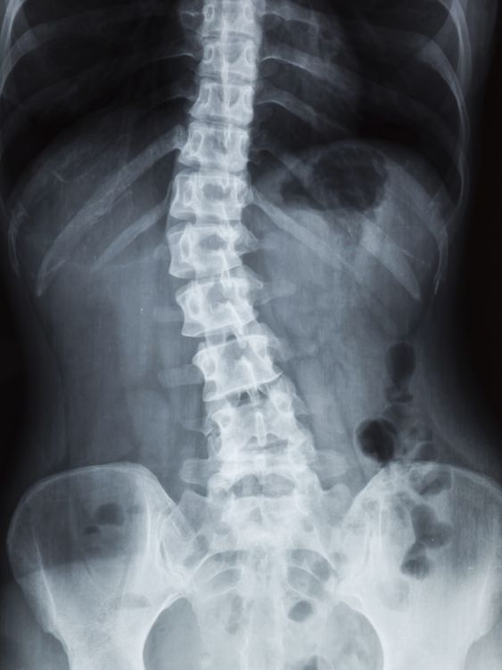
POSTURE DEFECTS
(LORDOSIS ,KYPHOSIS,
SCOLIOSIS )
Andżelika Brzuchacz
Język angielski- 3 rok Fizjoterapia stacjonarne studia jednolite magisterskie
Rok akademicki 2023/2024

Slide 2
Anatomy
correct curves
excessive kyphosis
scoliosis
excessive lordosis

Slide 3
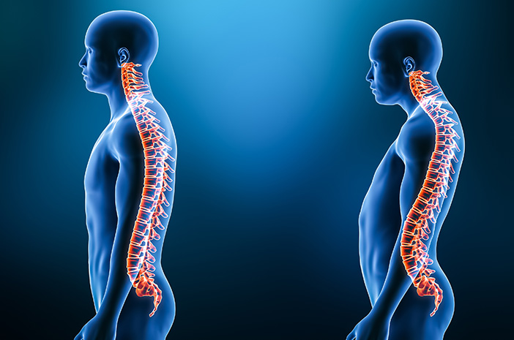
What is lordosis?
An exaggerated inward curve of the spine that typically affects the lower back
https://www.halodoc.com/kesehatan/lordosis

Slide 4
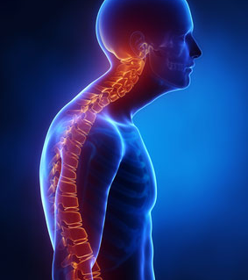
What is kyphosis?
An abnormally excessive convex curvature of the spine as it occurs in the thoracic and sacral regions
https://neurosurgicalassociatespc.com/kyphosis/

Slide 5
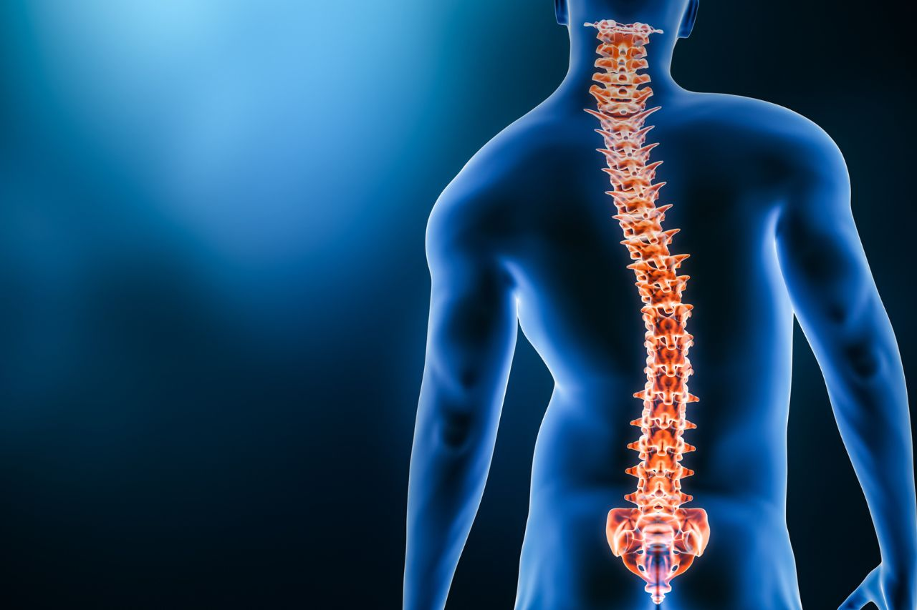
What is scoliosis?
A sideways curvature of the spine
The curve is usually "S"- or "C"-shaped over three dimensions
https://www.baptisthealth.com/-/media/images/blog/types-of-scoliosis.jpg?rev=53b108789d1e424795de46dabe9a7707

Slide 6
What causes lordosis?
Shortening of the muscles that tilt the pelvis anteriorly
• Weakness of the muscles that tilt the pelvis posteriorly
• Structural changes in the vertebrae
• Shortening of the ligaments and the fascia covering the posterior surface of the waist
• Faulty movement habits
• Hereditary structure
• Unbalanced alignment of joints in the lower extremities (ankle, knee, hip)

Slide 7
What are lordosis symptoms?
Head and neck tilted forward
Anterior tilt of the pelvis
Butt sticking out
Extra space beneath your lower back when you’re laying down
Low back pain

Slide 8
What are kyphosis symptoms?
Rounded shoulders
Pain or stiffness in the back and shoulder blades
Numb, weak tingling legs
Extreme fatigue
Shortness of breath or other breathing trouble due to the spine pressing against the airways
Balance issues
Bladder incontinence or bowel incontinence

Slide 9
What causes kyphosis?
Pathologies of the spinal vertebrae
Imbalance between antagonist muscle groups
Psychological factors, such as emotional stress and low self esteem, among adolescent females, for example
Low body awareness and faulty movement habits in daily activities

Slide 10
What causes scoliosis and what are scoliosis symptoms?
Certain neuromuscular conditions, such as cerebral palsy or muscular dystrophy
Birth defects affecting the development of the bones of the spine
Previous surgery on the chest wall as a baby
Injuries to or infections of the spine
Spinal cord irregularities

Slide 11
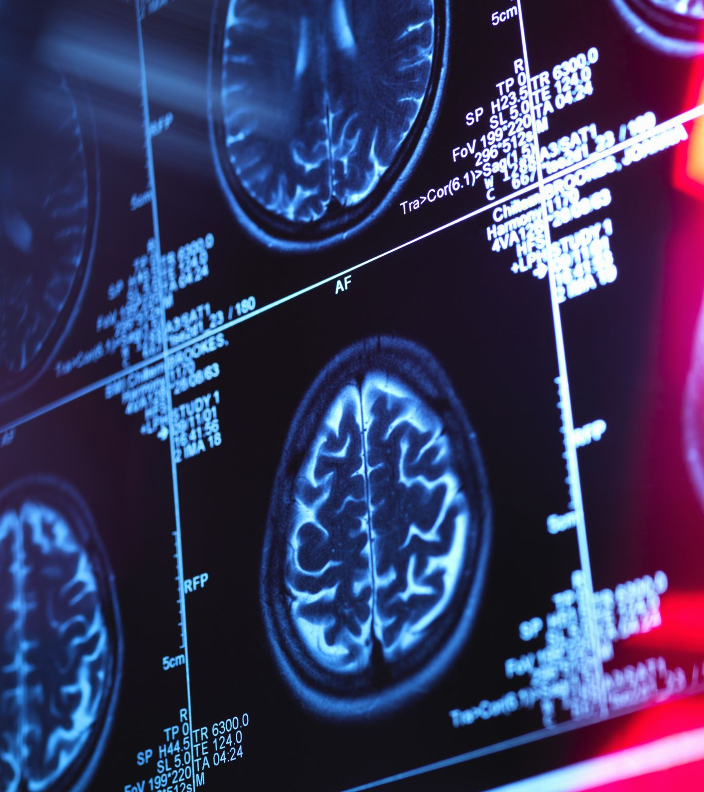
Diagnosis & Treatments
X –ray
MRI
Bone scan
CT scan

Slide 12
How to fix it?
Properly selected exercises for a specific defect , for example relaxing ,strengthening
Surgical treatment

Slide 13
Vocabulary
Lordosis- lordoza
Scoliosis-skolioza
Kyphosis- kifoza
Posture defects- wady postawy
Exaggerated- nadmierny
Curve- krzywizna
Convex curvature- wypukła krzywizna
Thoracic region- okolica piersiowa
Sacral region- okolica krzyżowa
Sideways- boczne
Dimensions-wymiary
Anteriorly-przednio
Posteriorly-tylnio
Pelvis -miednica
Alignment of the joint- wyrównanie stawów
Awareness - świadomość
Cerebral palsy- porażenie mózgowe
Previous- poprzedni
Beneath- pod
Shoulder blades- łopatki
Fatigue- zmęczenie
Incontinence- niemożność utrzymania

Slide 14
Bibliography
Posture and posturology, anatomical and physiological profiles: overview and current state of art. Francesco Carini 1, Margherita Mazzola, Chiara Fici.Acta Biomed 2017 Apr 28;88(1):11-16.doi: 10.23750/abm.v88i1.5309.
Scoliosis: review of types of curves, etiological theories and conservative treatment.Halima Shakil 1, Zaheen A Iqbal 2, Ahmad H Al-Ghadir 2. J Back Musculoskelet Rehabil. 2014;27(2):111-5.doi: 10.3233/BMR-130438.
https://my.clevelandclinic.org/health/diseases/23908-lordosis
Postural disorders and musculoskeletal dysfunction.Diagnosis, prevention and treatment.Dr.Gill Solberg.
https://www.scoliosisreductioncenter.com/blog/fix-scoliosis-without-surgery

Slide 15
QUIZ
What posture defect is S-shaped?
Lordosis B.Kyphosis C.Scoliosis
2. In what section of the spine does lordosis most often occur?
Lumbar section B. Thoracic section C. Cervical section
3. What are kyphosis symptoms?
Low back pain B. Rounded shoulders C.Previous surgery on the chest wall as a baby
4. How many planes is scoliosis?
Two-plane B. Three-plane C.Five-plane
5. What are the three different parts of the spine?
A. Cervical,thoracic,lumbar B. None of the above C.Dorsal,ventral, lateral
6. Who suffers from scoliosis more often?
A. Boys B. Both of them C. Girls

Slide 16
Thank you for your attention!

