Slide 1
Down syndrome
Wioletta Jędryczka
Fizjoterapia 3 rok JMGR stacjonarne

Slide 2
Prevalence of Down Syndrome is independent of climate, race, culture, social conditions.

Slide 3
down syndrome - zespół downa
dysmorphic – dysmorficzny
valgus knees – kolana koślawe
prenatal care – opieka prenatalna
trisomy 21 – trisomia 21
chromosome abnormality - nieprawidłowości chromosomowe
cell-free fetal DNA (cffDNA) - bezkomórkowe DNA płodu
noninvasive prenatal screening (NIPS) - nieinwazyjne badanie prenatalne

Slide 4
Down syndrome is a group of congenital defects caused by trisomy of chromosome 21.
https://www.baptistpress.com/wp-content/uploads/images/98792883-37e3-497d-a5d8-438c4bd987d3-down-syndrome-girl-iStock.jpg

Slide 5
There are three forms of Down Syndrome:
- simple trisomy - translocation trisomy - mosaicism

Slide 6
There are three developmental stages in Down syndrome:
1) occurs between 4 and 6 years of age, the corresponding mental age is approximately 18 months;
2) occurs between 8 and 11 years of age, the corresponding mental age is approximately 30 months;
3) occurs between 12 and 17 years of age, the approximately 48 months.

Slide 7
The main dysmorphic features in Down syndrome - including selected body parts:
Body part | Characteristics of Down syndrome
head | flattened occiput, shortened anteriorly and posteriorly, hair: straight, rare, delicate
face | flat profile, round
nose eyes | small, flat, broad back Mongoloid arrangement of palpebral fissures, oblique palpebral fissures, epicantal wrinkle, Brushield's spots on the iris, hypertelorism, disorders refraction, nystagmus, strabismus
ears | low-set, small, misshapen
Palate teeth | gothic, short tooth hypoplasia, incorrect spacing
tongue | protruding, furrowed (so-called scrotal)
neck limbs | short, so-called webbedness, with a skin fold - in infancy short, wide hands and feet, sandal and palmar furrow (so-called monkey furrow), kinodactyly of the 5th finger, syndactyly
skin | marbled, dry

Slide 8
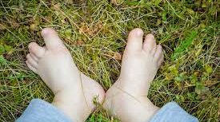
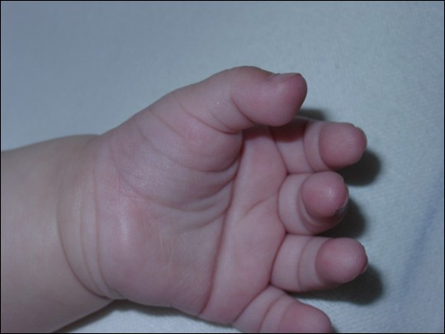
https://c8.alamy.com/comp/PGMHTW/small-feet-of-baby-with-down-syndrome-on-the-grass-PGMHTW.jpg
https://assets.babycenter.com/ims/2018/06/iStock-913753136_wide.jpg

Slide 9
The most common dysfunctions and postural defects in Down Syndrome:
- flat feet
- valgus knees
- round back with protruding shoulder blades
- flat chest
- head moved forward
- pelvis tilted forward
- limited mobility and neck pain
- impaired coordination of limb movements

Slide 10
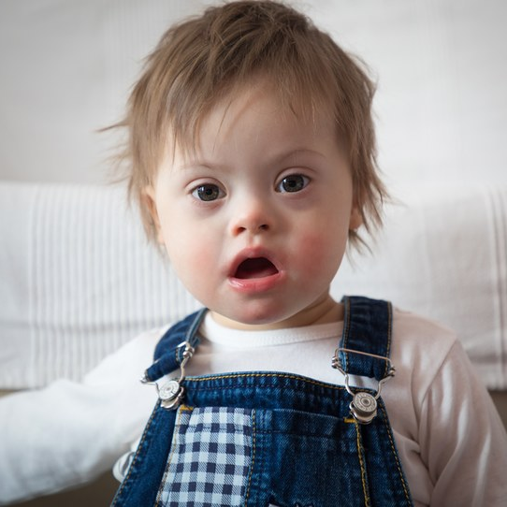
Congenital defects in Down syndrome:
- Cardiovascular system defects
- Respiratory system defects
- Defects of the digestive system
- Defects of the urogenital system
- Defects of the musculoskeletal system
- Defects of the endocrine system

Slide 11
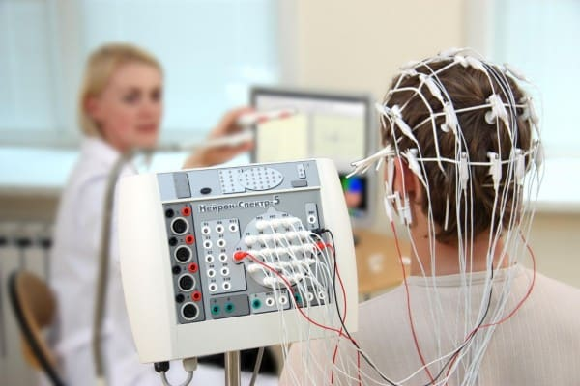
Electroencephalographic examination of children with Down syndrome

Slide 12
Screening methods:
Screening for DS is an important part of routine prenatal care. The most common screening method involves measuring a combination of factors: advanced maternal age, multiple second-trimester serum markers, and second-trimester ultrasound.

Slide 13
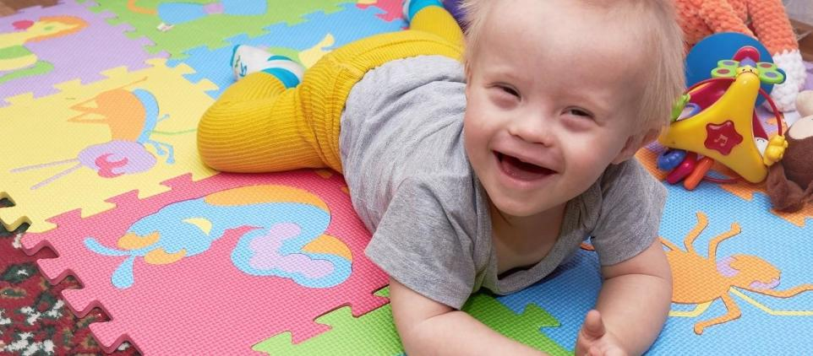
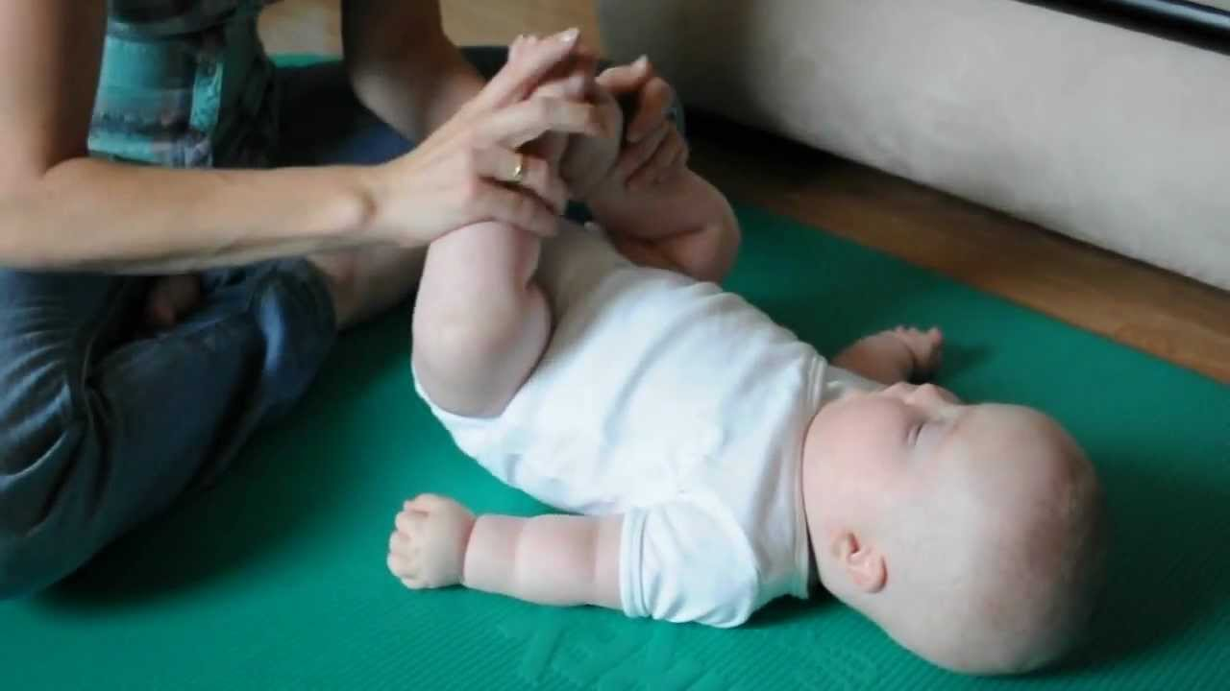
Rehabilitation:
NDT-Bobath method
Vojta method
sensory integration
music therapy
Hippotherapy
educational kinesiology

Slide 14
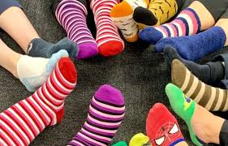
March 21 is World Down Syndrome Day. This date is not accidental and refers to the presence of an additional third chromosome in the 21st pair of chromosomes in people with Down syndrome.
The symbol of Down Syndrome are colorful socks, which are synonymous with the social and genotypic mismatch faced by people with Down Syndrome.

Slide 15
Quiz:
In which pair of chromosomes is there an extra chromosome in people with Down syndrome?
in the 19th pair
In the 20th pair
In the 21st pair
What is the symbol for Down syndrome?
pink lips
colorful socks
Glasses
Is there a relationship between the mother's age and the possibility of giving birth to a child with Down syndrome?
Yes
No
This is not known

Slide 16
Bibliography:
Accelerated epigenetic aging in Down syndrome, Steve Horvath ¹, Paolo Garagnani, Maria Giulia Bacalini, Chiara Pirazzini, Stefano Salvioli, Davide Gentilini, Anna Maria Di Blasio, Cristina Giuliani, Spencer Tung, Harry V Vinters, Claudio Franceschi, 2015
The challenge of Down syndrome, Stylianos E. Antonarakis,
Charles J. Epstein, 2006
Down Syndrome: Current Status, Challenges and Future Perspectives, Mohammad Kazemi, Mansoor Salehi, and Majid Kheirollahi
The challenge of Down syndrome
The challenge of Down syndrome1

