Slide 1
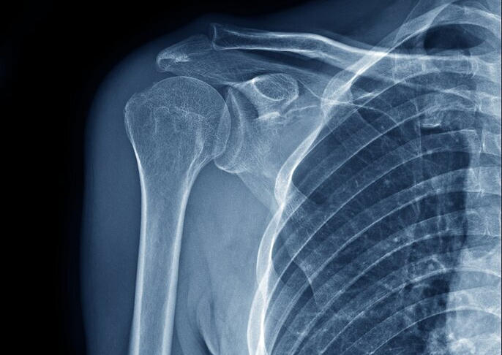
The Joints
Prepared by:
Julia Dudek
3rd year of Physiotherapy
2023/2024

Slide 2
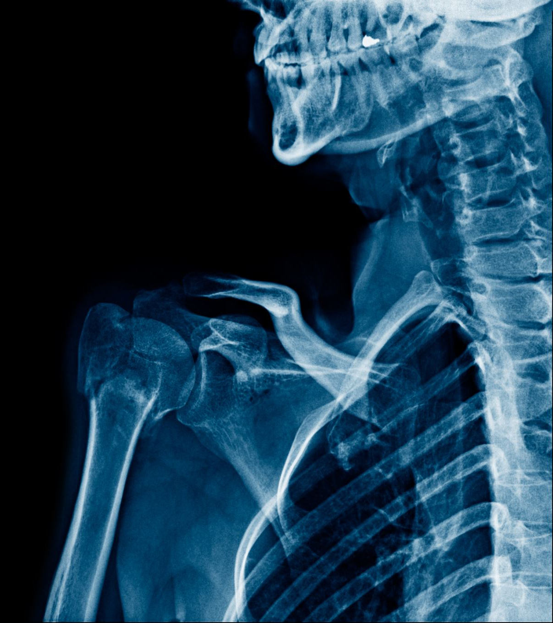
What are joints?
A joint is the part of the body where two or more bones meet to allow movement.
Functions:
- Joints support body from head to toe
- Joints hold the skeleton together and support movement
- Joints provide the structure that allows movement and flexibility

Slide 3
Construction of the synovial joint
Articular capsule
- fibrous layer
- synovial layer
Articular Surface
- hyline cartilage
Synovial membrane
Synovial fluid
Additional structures:
- articular disc
- bursae
https://en.wikipedia.org/wiki/Synovial_joint

Slide 4
Joint classification
Range of motion
Mobility
Structure

Slide 5
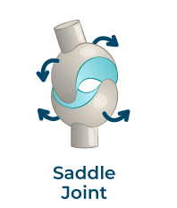
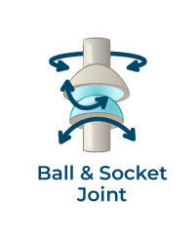
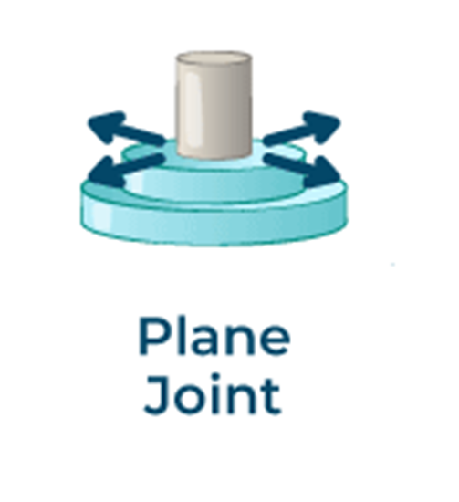
Joint classification: range of motion
Uniaxial
Biaxial
Polyaxial or multiaxial
Nonaxial
https://www.geeksforgeeks.org/types-of-joints/

Slide 6
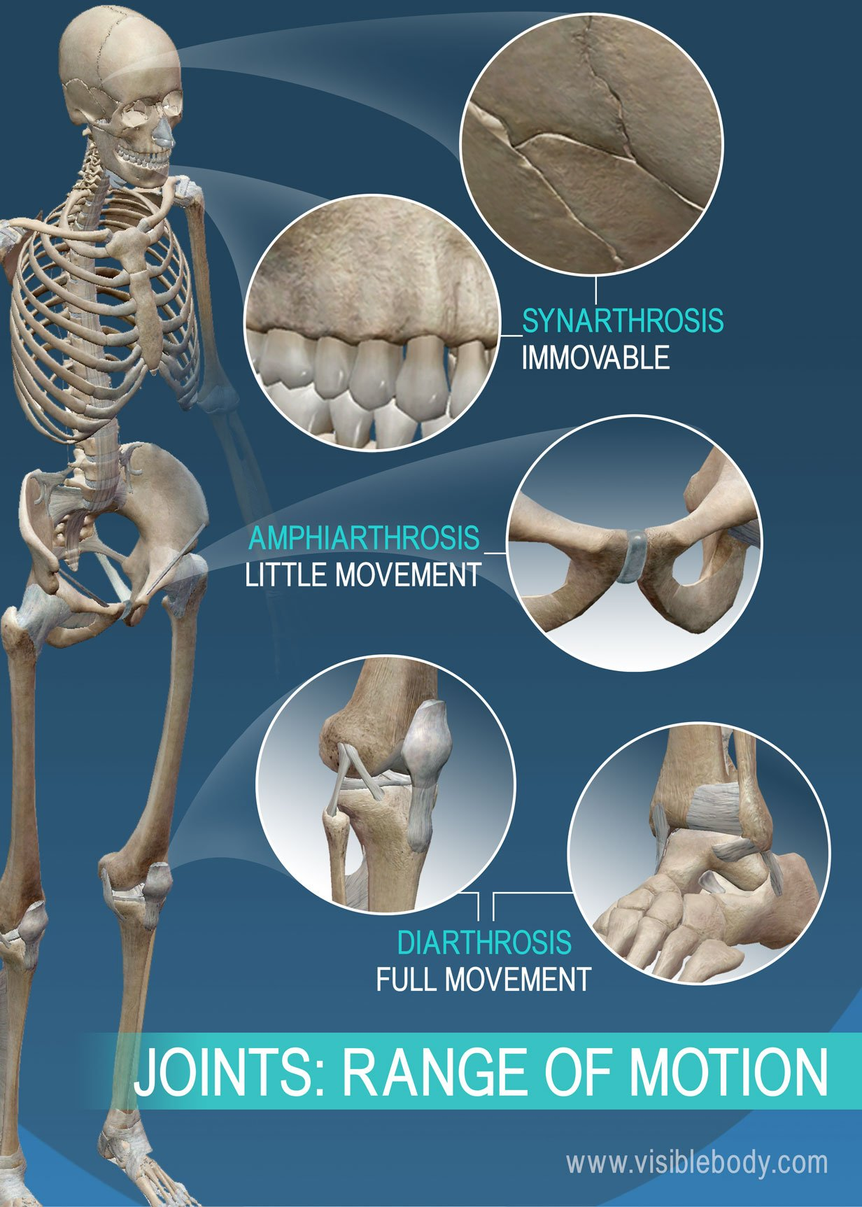
Joint classification: mobility
Diarthrosis
- freely mobile joint
Amphiarthrosis - slightly mobile joint
Synarthrosis
- immobile joint
https://www.visiblebody.com/learn/skeleton/joints-and-ligaments

Slide 7
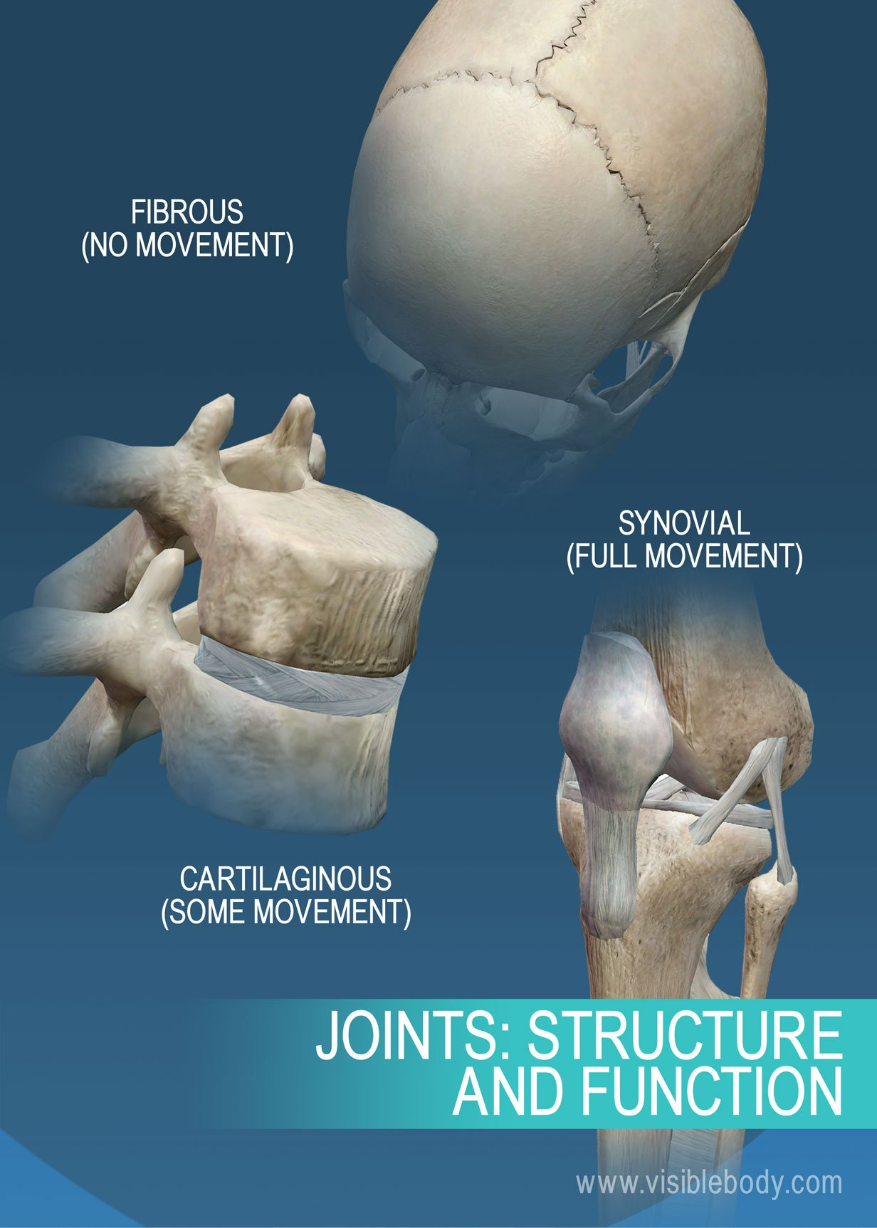
Joint classification: structure
The synovial joint
The fibrous joint
The cartilaginous
joint
Low mobility
Symphyses
Synchondroses
No mobility
Sutures
Gomphoses
Syndesmoses
Freely movable
Ball and socket
Hinge
Pivot
Condyloid
Saddle
Plane
https://www.visiblebody.com/learn/skeleton/joints-and-ligaments

Slide 8
Ball and socket joint
Polyaxial,
Flexion and extension,
Adduction and abduction,
Rotation,
The shoulder and the hip joint.
https://www.geeksforgeeks.org/types-of-joints/

Slide 9
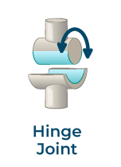
Hinge joint
Uniaxial,
Flexion and extension,
The tibiofemoral joint or the knee joint and the elbow joint.
https://www.geeksforgeeks.org/types-of-joints/

Slide 10
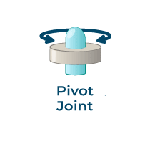
Pivot joint
Uniaxial,
Rotation,
Occurs between C1 and C2 vertebrae.
https://www.geeksforgeeks.org/types-of-joints/

Slide 11
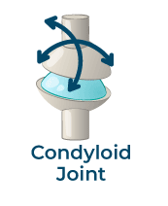
Condyloid joint
Biaxial,
Flexion and extension,
Circumduction,
Radial and ulnar deviation,
The radiocarpal joint or the wrist joint.
https://www.geeksforgeeks.org/types-of-joints/

Slide 12
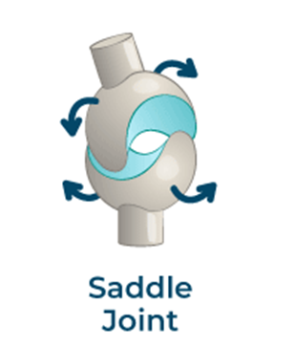
Saddle joint
Biaxial,
Abduction and adduction,
Flexion and extension,
Circumduction,
The carpometacarpal joint of the thumb.
https://www.geeksforgeeks.org/types-of-joints/

Slide 13
Plane joint
Nonaxial,
Sliding or a gliding movement,
The acromioclavicular joint.
https://www.geeksforgeeks.org/types-of-joints/

Slide 14
Dictionary
Joint – staw
Articular capsule – torebka stawowa
fibrous layer – warstwa włóknista
synovial layer – warstwa maziowa
Articular Surface – powierzchnia stawowa
hyline cartilage – chrząstka szklista
Synovial membrane – błona maziowa
Synovial fluid – płyn maziowy
Additional structures – dodatkowe struktury
Articular disc – krążek stawowy
Bursae – kaletki
Structure – struktura
Mobility – mobilność
The cartilaginous joint - staw z połączeniem chrząstkowym
The fibrous joint - staw nieruchomy
The synovial joint - staw z błoną maziową
Sutures – szwy
Gomphosis - wklinowanie
Syndesmosis - więzozrost
Symphysis - spojenie
Synchondrosis - chrząstkozrost
Ball and socket joint – staw panewkowy
Hinge joint – staw zawiasowy
Pivot joint – staw obrotowy
Condyloid joint – staw eliptyczny
Saddle joint – staw siodełkowy
Plane joint – staw płaski
Flexion – zgięcie
Extension – wyprost
Adduction – przywodzenie
Abduction – odwodzenie
Rotation – rotacja
Circumduction – ruch okrężny
Diarthrosis – staw z błoną maziową
Amphiarthrosis – staw z połączeniem chrząstkowym
Synarthrosis – staw nieruchomy

Slide 15
Bibliography
Abu Ilius Faisal, Sumit Majumder, Tapas Mondal, David Cowan, Sasan Naseh and M. Jamal Dee. „Monitoring Methods of Human Body Joints: State-of-the-Art and Research Challenges”. doi:10.3390/s19112629
Pallavi Juneja; Akul Munjal; John B. Hubbard. „Anatomy, Joints”. PMID: 29939670. Bookshelf ID: NBK507893
Marco Gupton, Akul Munjal, Robert R. Terreberry. „Anatomy, Hinge Joints”. Treasure Island (FL): StatPearls Publishing; 2023 Jan. 2023 Jul 24. PMID: 30085509 Bookshelf ID: NBK518967
Lou-Ren Chang, Prashanth Anand, Matthew Varacallo. „Anatomy, Shoulder and Upper Limb, Glenohumeral Joint”. Treasure Island (FL): StatPearls Publishing; 2023 Jan. 2023 Aug 8. PMID: 30725703 Bookshelf ID: NBK537018
Richard A. Watts, Philip G. Conaghan, Christopher Denton, Helen Foster, John Isaacs, Ulf Müller-Ladner. „Oxford Textbook of Rheumatology”. CHAPTER 46 Normal Functional Anatomy of Joints Library of Congress Control Number: 2013946780. ISBN 978–0–19–964248–9.
https://www.visiblebody.com/learn/skeleton/joints-and-ligaments
https://www.healthline.com/health/how-many-joints-in-human-body#takeaway
https://mydr.com.au/sports-fitness/joint-synovial/
https://www.youtube.com/watch?v=bfiUnhAHt8Q
https://my.clevelandclinic.org/health/body/25137-joints
https://www.deepl.com/pl/translator
https://www.diki.pl/slownik-angielskiego?q=Gomphosis

Slide 16
A quiz about joints in the human body
Question 1 : How many types of joints are there in the human body (by structural classification)?
a) 3
b) 4
c) 5
Question 2 : Which type of joints are freely movable?
a) cartilaginous joints
b) synovial joints
c) fibrous joints
Question 3 : The elbow joint is an example of a ...
a) saddle joint
b) hinge joint
c) ball and socket joint
Question 4 : The sutures between the bones of the skull are an example of ...
a) fibrous joints
b) cartilaginous joints
c) synovial joints
Question 5 : What sort of synovial joint is the hip joint?
a) a hinge joint
b) a saddle joint
c) a ball and socket joint
Question 6 : The proximal and distal radioulnar joints are examples of ...
a) saddle joints
b) condyloid joints
c) pivot joints

Slide 17
Thank you for your attention

