Slide 1
Myocardial infarction
Patrycja Potęcka
III R Fizjoterapia JMGR stacjonarne
16.01.2023/rok akademicki 2022/23 sem. zimowy
https://www.creativefabrica.com/pl/product/heart-attack-icon-2/

Slide 2
Cardiovascular diseases - statistics
17.9 million deaths worldwide
175,000 deaths
in Poland
https://politykazdrowotna.com/artykul/umieralnosc-w-polsce-najczestsze-przyczyny-zgonow/832841

Slide 3
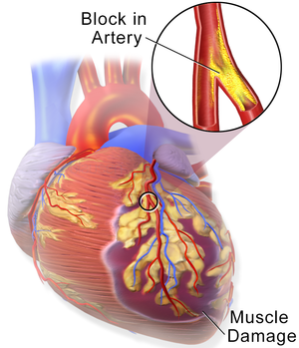
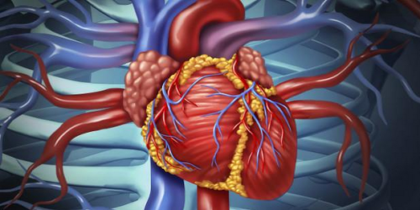
What is myocardial infarction?
A myocardial infarction (heart attack) occurs when blood flow decreases or stops to the coronary artery of the heart, causing damage to the heart muscle.
https://piastunzoz.pl/zawal-serca-moze-oznaczac-niezdiagnozowana-cukrzyce/
https://en.wikipedia.org/wiki/Myocardial_infarction

Slide 4
Types of myocardial infarction
NSTEMI (No ST Elevation Myocardial Infarction)
STEMI (ST Elevation Myocardial Infarction)
https://www.google.com/url?sa=i&url=https%3A%2F%2Fwww.youtube.com%2Fwatch%3Fv%3Dond98UVBvyE&psig=AOvVaw2fFa35THMdvoJBks6n3_B-&ust=1673913179315000&source=images&cd=vfe&ved=0CA0QjRxqFwoTCPDq-eziyvwCFQAAAAAdAAAAABAc
https://www.ouson.care/blogs/health-tips/types-of-heart-attack-and-its-causes

Slide 5
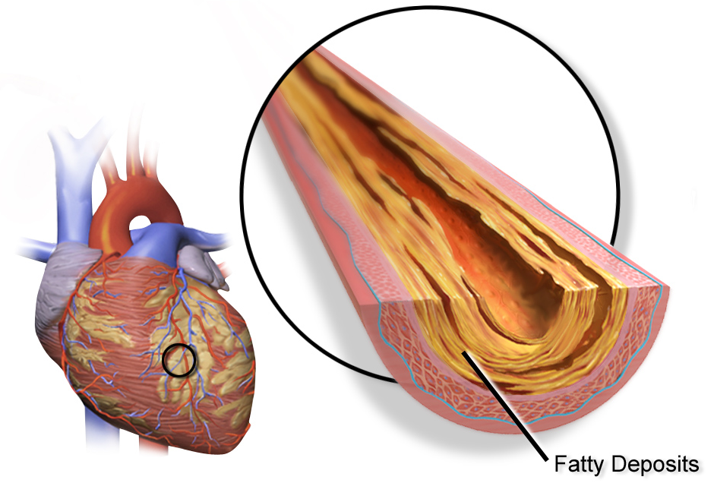
Causes of a heart attack
https://upload.wikimedia.org/wikipedia/commons/d/d1/Blausen_0257_CoronaryArtery_Plaque.png
https://www.nhlbi.nih.gov/sites/default/files/inlineimages/heart%20attack%20figure%20A.gif

Slide 6
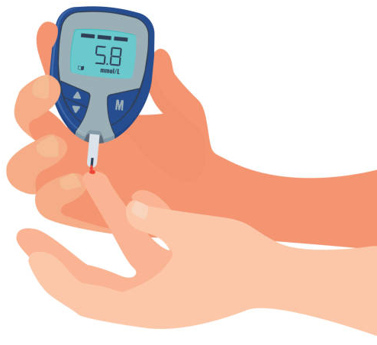
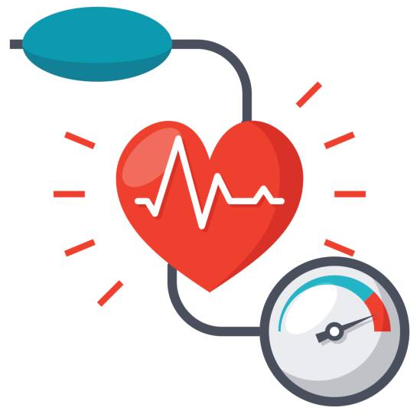
Risk factors
https://pl.dreamstime.com/starzy-ludzie-siedzie%C4%87-na-kanapie-siedzi-starszej-kobiety-i-m%C4%99%C5%BCczyzna-famil-image107556175
https://pl.depositphotos.com/91046580/stock-illustration-male-gender-colored-vector-icon.html
https://missionhealth.org/wp_quiz/heart-health-quiz/
Less significant factors: obesity, low physical activity and stress.
https://pl.depositphotos.com/vector-images/z%C5%82y-cholesterol.html
https://www.istockphoto.com/pl/wektor/ikona-ci%C5%9Bnienia-krwi-gm695935540-129048363
https://www.vecteezy.com/free-vector/diabetes
https://pixabay.com/vectors/man-cigarette-smoke-smoker-smoking-5665527/

Slide 7
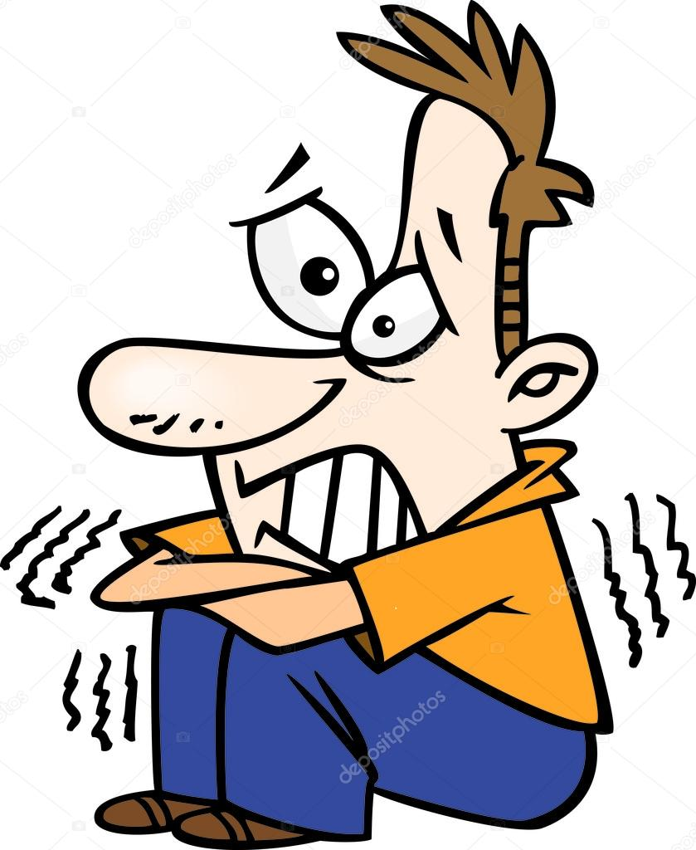
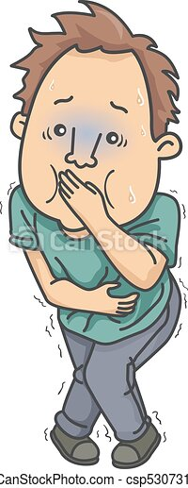
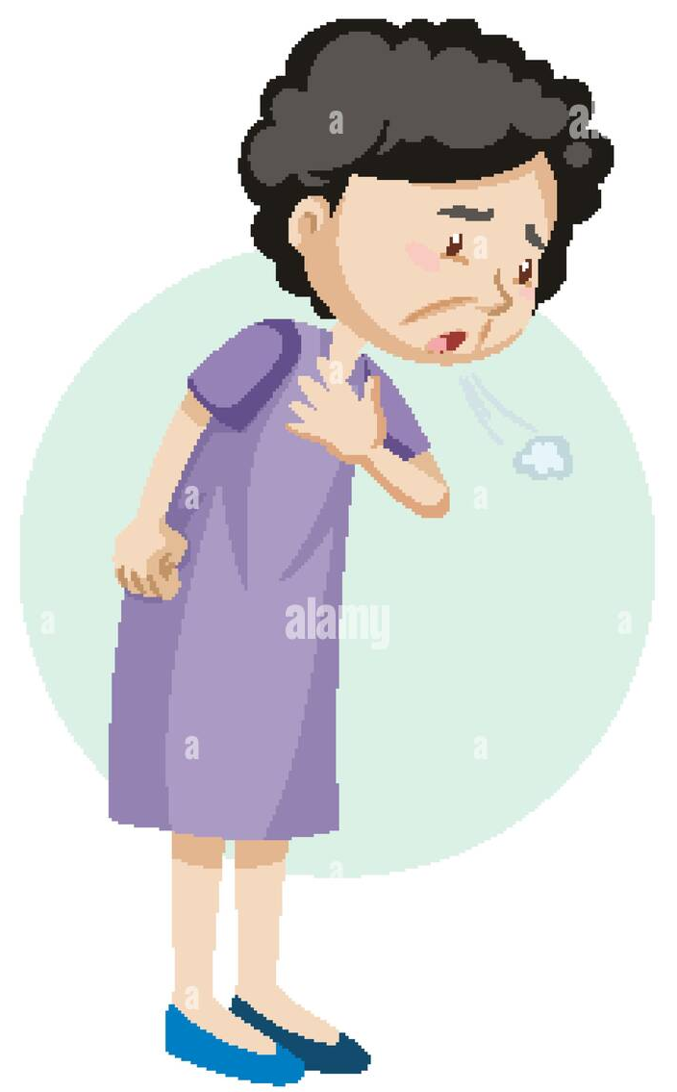
Symptoms

Slide 8
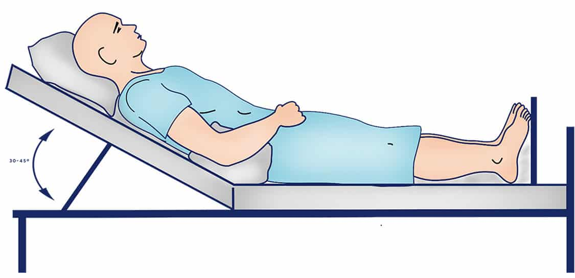
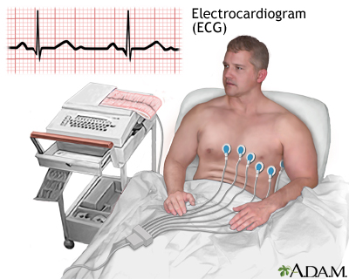
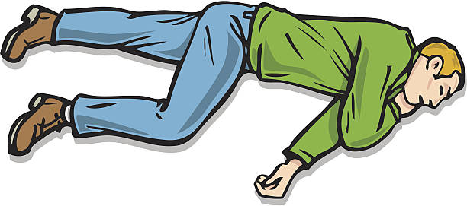
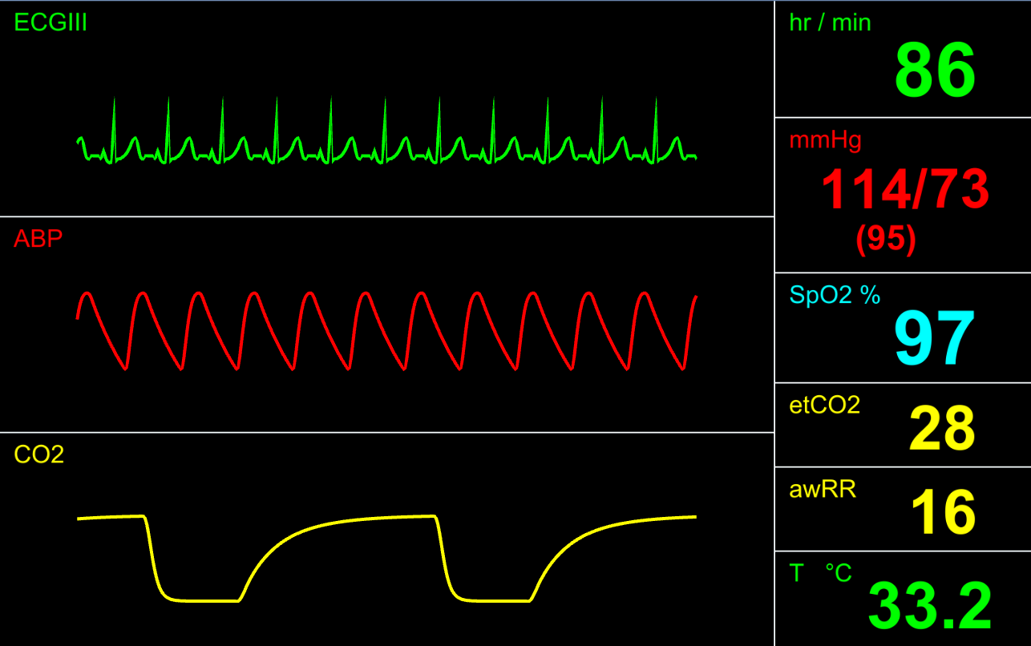
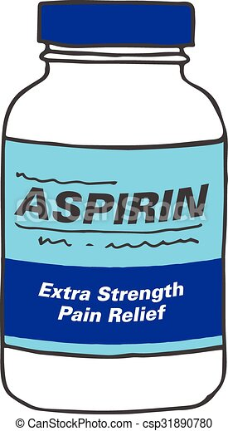
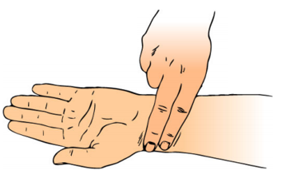
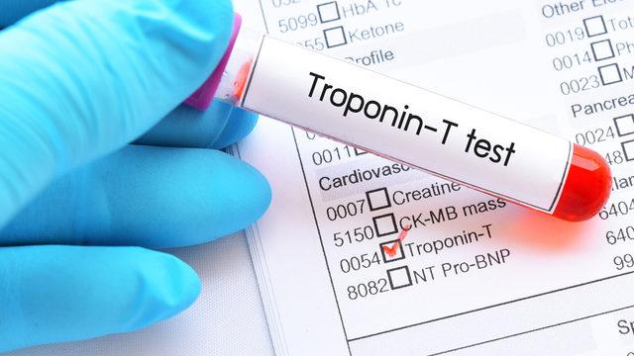
First aid and diagnosis
At home
In hospital
https://nurseslabs.com/patient-positioning/
https://www.istockphoto.com/pl/ilustracje/recovery-position
https://censusatschool.ie/resource/just-what-is-a-pulse-rate/
https://medlineplus.gov/ency/imagepages/1135.htm

Slide 9
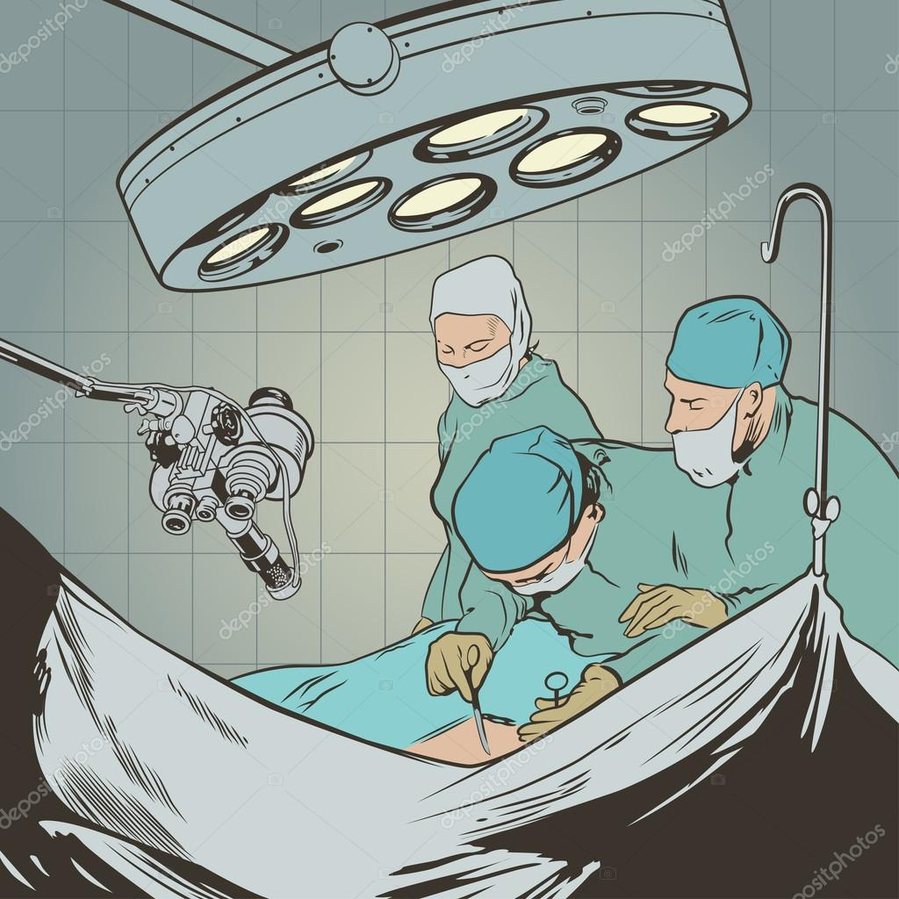
Treatment
Medicines
Surgery
Anticoagulants
Cholesterol-lowering drugs,
Beta-blockers and angiotensin-converting enzyme inhibitors
Coronary angioplasty
Coronary artery bypass grafting
https://pl.depositphotos.com/vector-images/operacja-pok%C3%B3j.html
https://create.vista.com/pl/photos/leki/

Slide 10
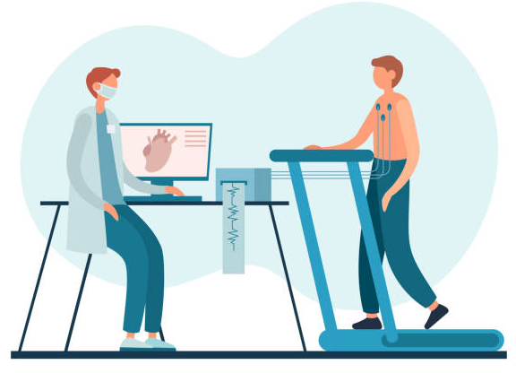
Physiotherapy after myocardial infarction
First phase
Second phase
Third phase
Fourth phase
https://www.allianz.pl/pl_PL/dla-ciebie/zycie-i-zdrowie/umowy-dodatkowe/na-zdrowie.html
https://www.istockphoto.com/pl/obrazy/cardiac-rehabilitation
https://pl.pinterest.com/pin/374221050294675323/

Slide 11
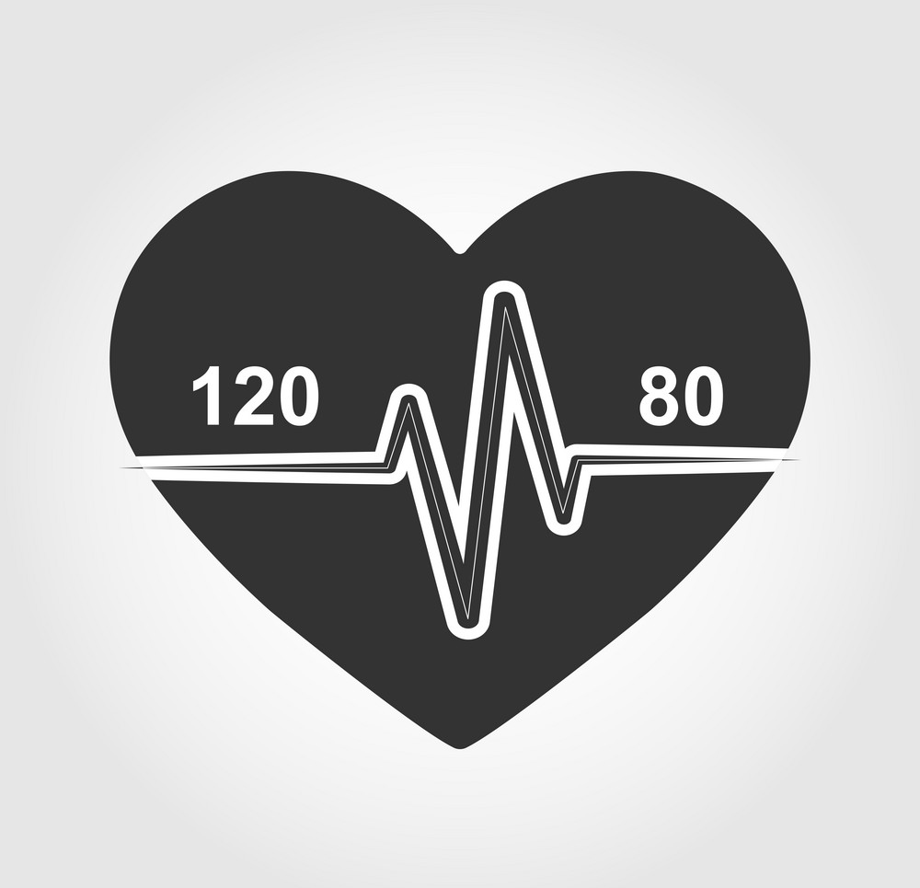
Heart attack prevention
There are 3 main steps you can take to help prevent a heart attack:
eat a healthy, balanced diet
do not smoke
try to keep your blood pressure at a healthy level
https://www.vectorstock.com/royalty-free-vector/no-smoking-symbol-sign-doodle-hand-drawing-vector-22962760
https://www.vectorstock.com/royalty-free-vector/icon-normal-heart-and-blood-pressure-120-80-vector-31622485
https://www.freepik.com/free-photos-vectors/healthy-food-drawing

Slide 12
Quiz
Which of the following groups is LESS likely to have the classic chest pain associated with heart attack?
Women
Men
People under age 75
People with high blood pressure
Which of the following is the most common symptom of myocardial infarction?
Dyspnea
Edema
Chest pain
Palpitations
Which of the following is NOT classified as an acute coronary syndrome?
Non–ST-segment elevation myocardial infarction (MI)
Unstable angina
ST-segment elevation MI
Stable angina
https://pl.123rf.com/cliparty-wektory/quiz_na_tablicy.html

Slide 13
Dictionary
myocardial infarction/heart attack – zawał serca
blood flow – przepływ krwi
heart’s arteries – tętnice serca
coronary vessels – naczynia wieńcowe
cessation of blood flow – ustanie przepływu krwi
clogged – zatkany
plaque – płytka miażdżycowa
blood clot – skrzep krwi
hypertension – nadciśnienie
diabetes – cukrzyca
angina – dławica piersiowa
crushing pain – przytłaczający, miażdżący ból
fatigue – zmęczenie
ipending doom – zbliżające się nieszczęście
anticoagulants – antykoagulanty, leki przeciwzakrzepowe
acetylsalicylic acid – kwas acetylosalicylowy
coronary angioplasty – angioplastyka wieńcowa
coronary artery bypass grafting – pomostowanie aortalno-wieńcowe
tailored - dopasowane

Slide 14
Bibliography
Boersma, E., Mercado, N., Poldermans, D., Gardien, M., Vos, J., & Simoons, M. L. (2003). Acute myocardial infarction. The Lancet, 361(9360), 847-858.
White, H. D., & Chew, D. P. (2008). Acute myocardial infarction. The Lancet, 372(9638), 570-584.
Anderson, J. L., & Morrow, D. A. (2017). Acute myocardial infarction. New England Journal of Medicine, 376(21), 2053-2064.
https://en.wikipedia.org/wiki/Myocardial_infarction#Rehabilitation_and_exercise
https://my.clevelandclinic.org/health/diseases/16818-heart-attack-myocardial-infarction
https://www.nhlbi.nih.gov/health/heart-attack/treatment
https://www.diki.pl/

