Slide 1
The cardiovascular system
Paulina Zych
III R Fizjoterapia JMGR stacjonarne
09.01.2022/ rok akademicki 2022/23, sem. zimowy
Notes:
<numer>

Slide 2
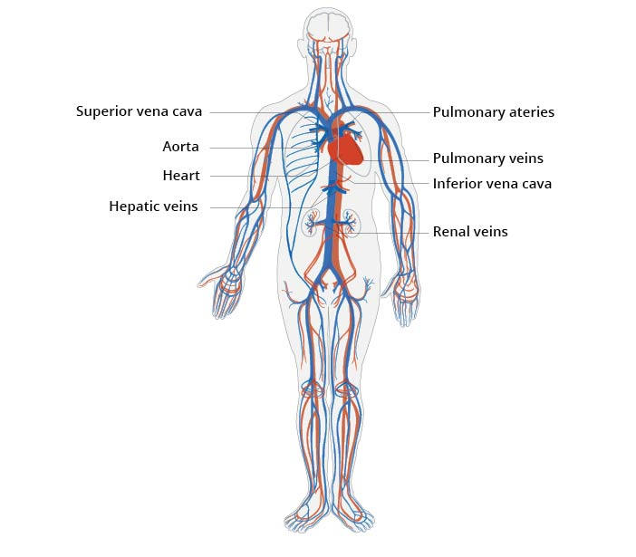
Structure of the cardiovascular system
Heart - a muscular pomp
Blood
Blood vessels - a closed system responsible for delivering blood to different parts of the body. Blood vessels are divided into:
Veins
Capillaries
Arteries
https://www.cardiosecur.com/fileadmin/content/Fachartikel/Cardiovascular_system_EN_2.jpg
Notes:
<numer>

Slide 3
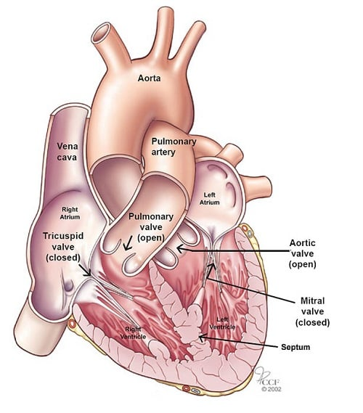
Heart
Two atriums (left and right)
Two ventricles (left and right)
Heart septum: interatrial, interventricular
Hearts valves: tricuspid valve, mitral valve, pulmonary valve, aortic valve
Herats walls: endocardium, myocardium, epicardium
https://my.clevelandclinic.org/-/scassets/2b69f880fdd1492ebde8a31a15715eae.ashx
Notes:
<numer>

Slide 4
Heart function
The heart generates blood pressure.
The heart routes the blood as it separates the pulmonary and systemic circulations.
It ensures one-way blood flow because of the valves.
The heart regulates the blood supply as it changes contraction rate and force, responding to metabolic needs.
It provides the cardiac cycle.
Notes:
<numer>

Slide 5
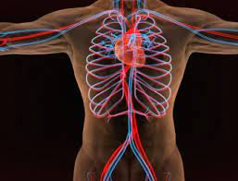
Other functions
Maintaing a constant body temperaturę
Regulating the level of blood pressure
Regulating immune reactions
Fighting pathogenic microorganisms
Communicating between individual body systems
https://zdrowie.pzu.pl/poradnik-o-zdrowiu/szczegoly/uklad-krwionosny-czlowieka-budowa-i-funkcje-jakie-choroby-mu-zagrazaja

Slide 6
Trivia about a heart
Heart beats about 100,000 times/day and pumps about 5,6 liters of blood/min.
A healthy adult's resting heart rate varies between 60 and 100 beats a minute.
During exercise the amount of blood which flows through the heart grows four times.
Over a lifetime, the number of contractions exceeds 2.5 billion.
Throughout life, the heart beats 2.5 billion times, or pumps over 173 million liters of blood.
During each contraction, the heart ejects 60-70 ml of blood into the aorta.
In stressful situations, the heart can increase its efficiency up to five times.
Notes:
<numer>

Slide 7
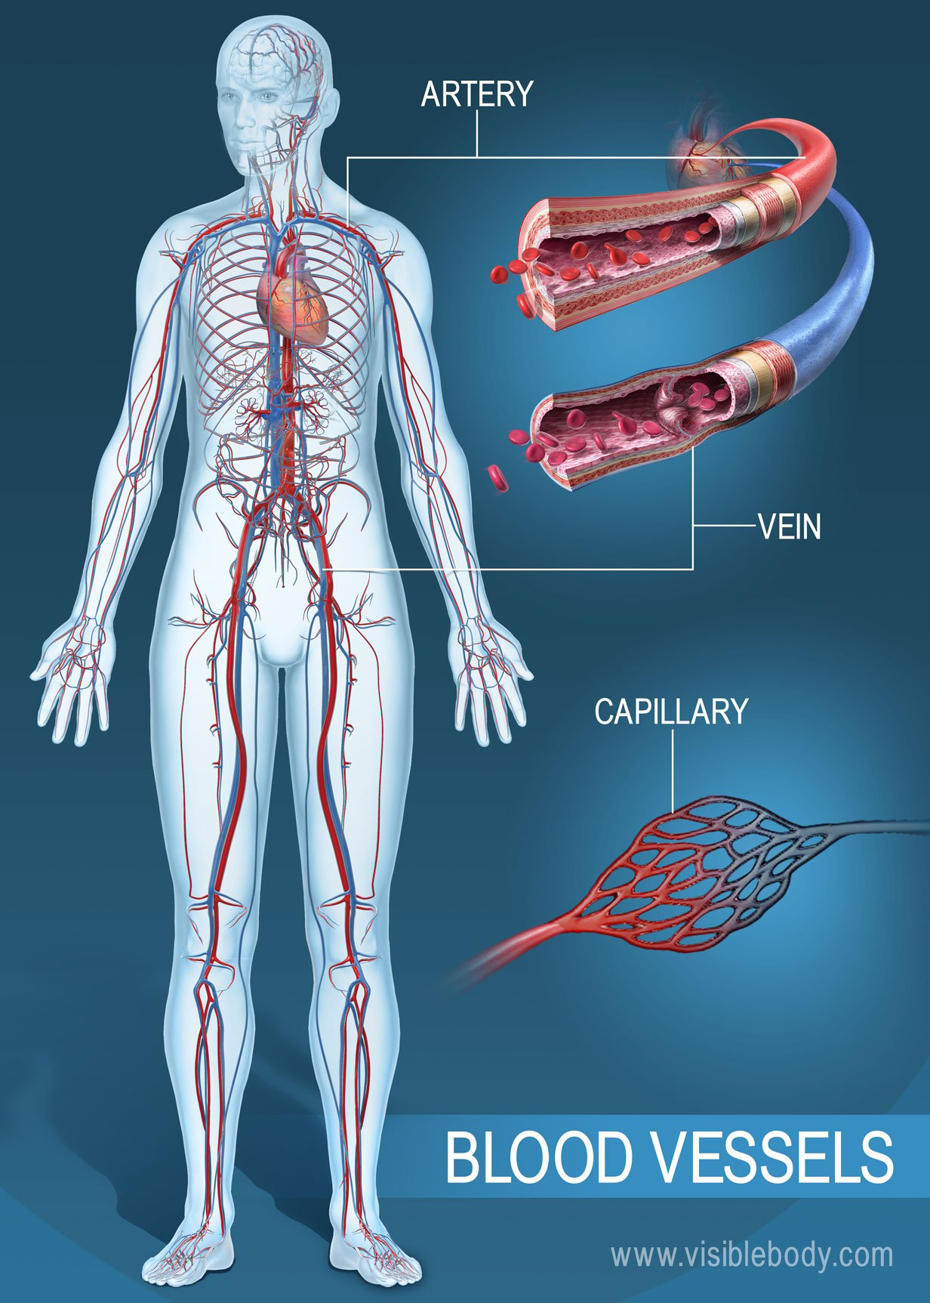
Blood vessels
Blood vessels are included:
Arteries - vessels that carry blood away from the heart.
Veins - vessels that bring blood back to the heart.
Capillaries - tiny vessels that branch off from arteries to deliver blood to all body tissues trusted source.
https://www.visiblebody.com/hubfs/Learn_Articles/Circulatory_System/01B-Blood-Vessels.jpg
Notes:
<numer>

Slide 8
The cardiovascular system function
Move blood throughout your body
Controls the rhythm and speed of your heart rate
Maintains a constant body temperature
Regulates the level of blood pressure
Is a regulator of immune reactions, fights pathogenic microorganisms
Communicates between individual body systems,
Notes:
<numer>

Slide 9
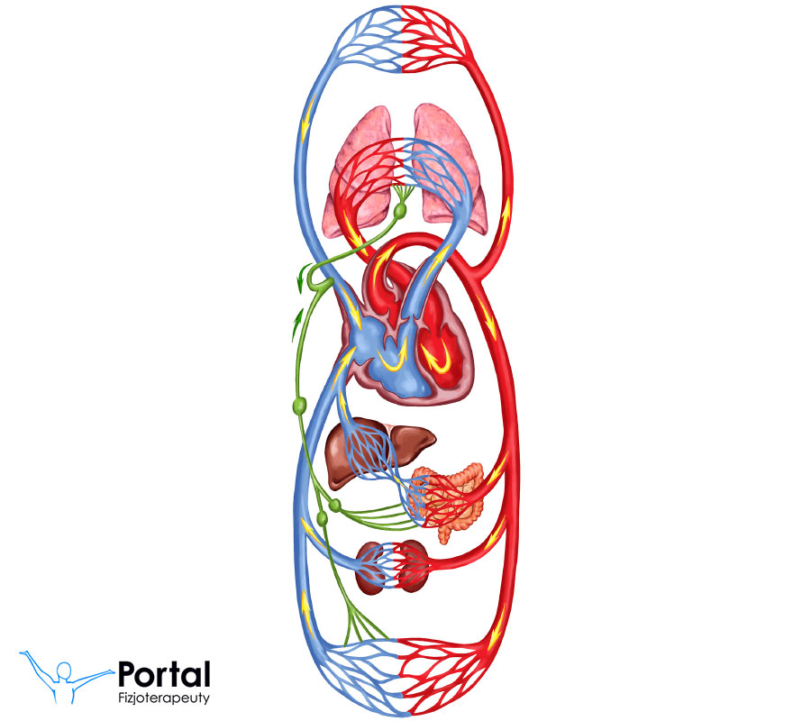
Systemic Circulatory system
There are two blood circuits in the cardiovascular system:
Large bloodstream (peripheral)
Small bloodstream (pulmonary)
https://fizjoterapeuty.pl/wp-content/uploads/2020/02/krwiobieg.jpg
Notes:
<numer>

Slide 10
Large bloodstream
AORTA
LEFT VENTRICLE
ARTERIES
RIGHT ATRIUM
TISSUES CAPILLARIES
VEINS
Notes:
<numer>

Slide 11
SMALL BLOODSTREAM
PULMONARY ARTERIES
RIGHT VENTRICLE
LUNG CAPILARIES
LEFT ATRIUM
PULMONARY VEINS
Notes:
<numer>

Slide 12
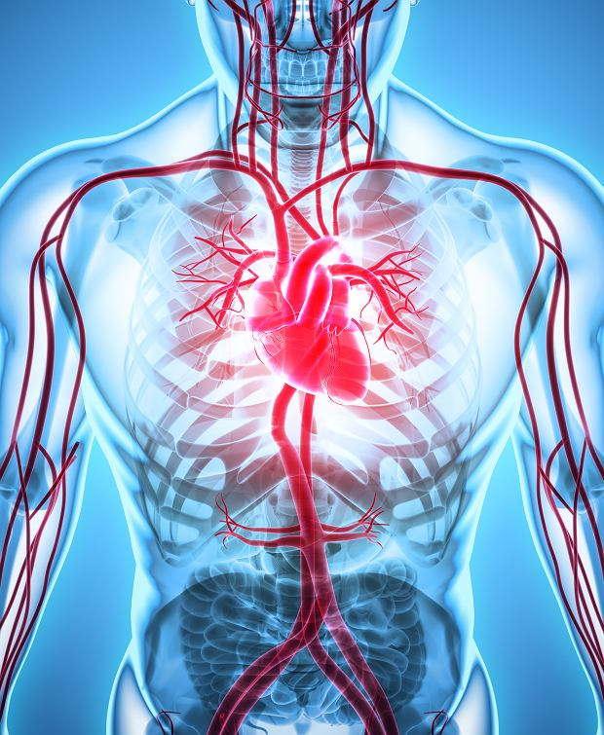
Factors affecting cardiological diseases
High Blood Pressure and High Cholesterol
Diabetes
Smoking and Secondhand Smoke Exposure
Obesity, Unhealthy Diet, and Physical Inactivity
https://bi.im-g.pl/im/c0/eb/18/z26130624Q,Choroby-sercowo-naczyniowe-zwiazane-sa-z-ukladem-k.jpg
Notes:
<numer>

Slide 13
The cardiovascular disease
Cardiovascular disease includes heart or blood vessel issues, including:
Narrowing of the blood vessels in your heart, other organs or throughout your body.
Heart and blood vessel problems present at birth.
Heart valves that aren’t working right.
Irregular heart rhythms.

Slide 14
Dictionary
Blood vessels- naczynia krwionośne
Veins- żyły
Arteries- tętnice
Capillaries- naczynia włosowate
Ventricle- komora serca
Atrium- przedsionek sercaValve- zastawka:
tricuspid- trójdzielna
bipartite- dwudzielna
semilunar- półksiężycowa
Heart layer- warstwa serca
Bloodstream- krwioobieg
Tissues- tkanki
Maintain- utrzymywać
Nutrients- składniki odżywcze
Notes:
<numer>

Slide 15
Bibliography
https://my.clevelandclinic.org/health/body/21704-heart
https://anatomy.app/encyclopedia/heart
https://www.medtoday.com/articles/cardiovascular-system#organs-and-tissues
Bochenek A., Reicher M., Human Anatomy
R.H. Anderson, N.A. Brown., „The anatomy of the heart revisited”, Anat Rec. 1996 Sep;246(1):1-7.
Notes:
<numer>

