Slide 1
JAVA VS C#

Slide 2
History of Java

Slide 3
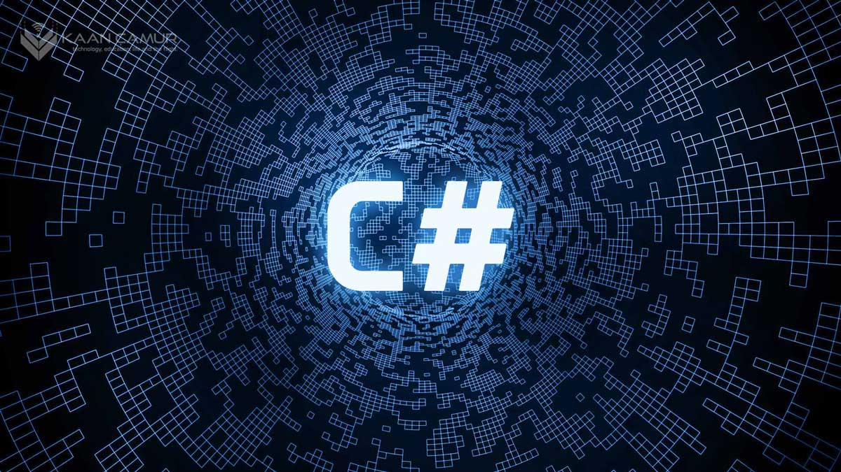
History of C#

Slide 4
Advantages of C# Over Java
Operator Overloading
Pointers
Dynamic Types
Real Generics

Slide 5
Advantages of Java Above C#
Platform-Independent
Robustness
Security
Extensive Libraries

Slide 6
Usage of Java and C#

Slide 7
Future of both languages

Slide 8
Thanks for your attention

