Slide 1
Light Painting Photography
University of Rzeszów
Institute of Fine Arts
Prepared by:
Aleksandra, Kotlarska
5th year of Graphic Design
2023/2024

Slide 2
Vocabulary
Shutter Speed – szybkość migawki
Aperture – otwór
Exposure – Ekspozycja
F-stop – przystanek przysłonowy (przysłona)
Depth of field – głębia
Light painting – malowanie światłem
ISO – czułość matrycy aparatu
Remotely – zdalnie
Set camera – ustawić aparat
Settings - ustawienia

Slide 3
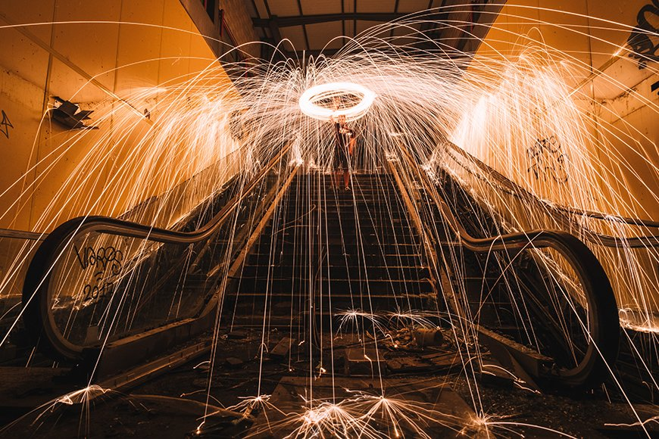

Slide 5
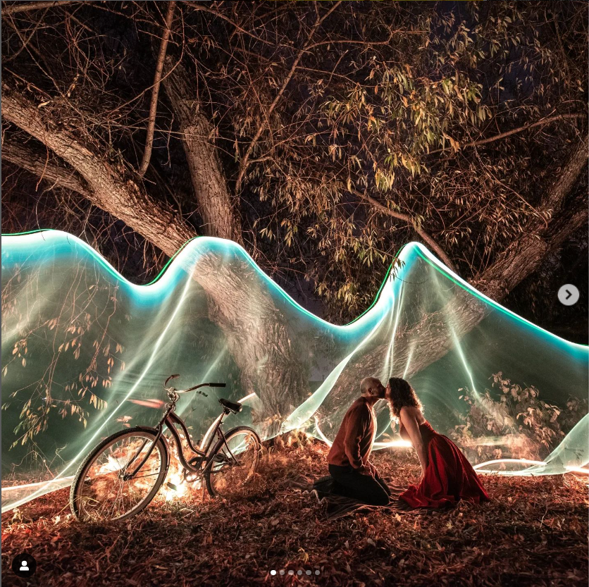
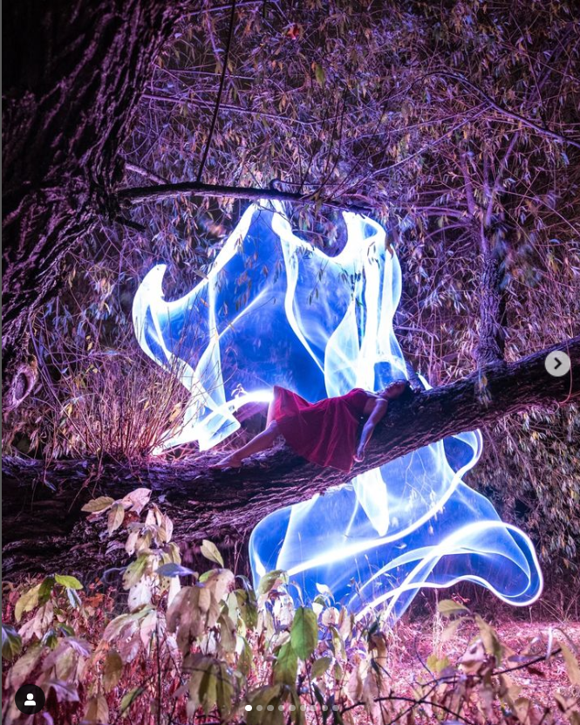
What is light painting?
Kristopher Foot, Instagram: halogi

Slide 6
How to do this?
https://www.dariustwin.com/how-to-light-paint

Slide 7
Most basic camera setting
Mode: Manual or bulb
Shutter speed: 30 seconds
F-stop or aperture: 8 or 10
ISO: 100

Slide 9
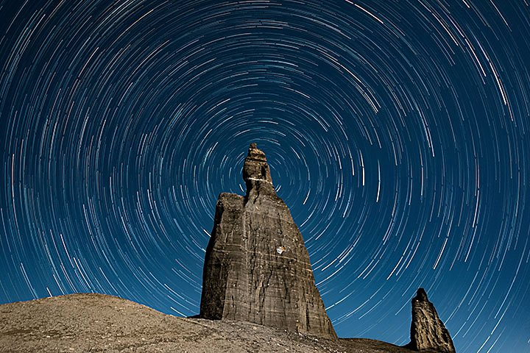
Taking advantage of environment

Slide 11
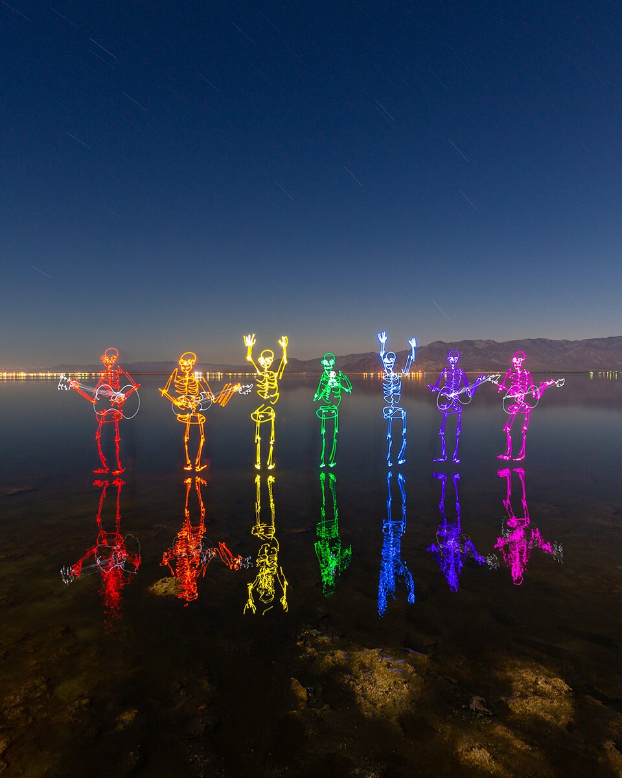

Slide 13
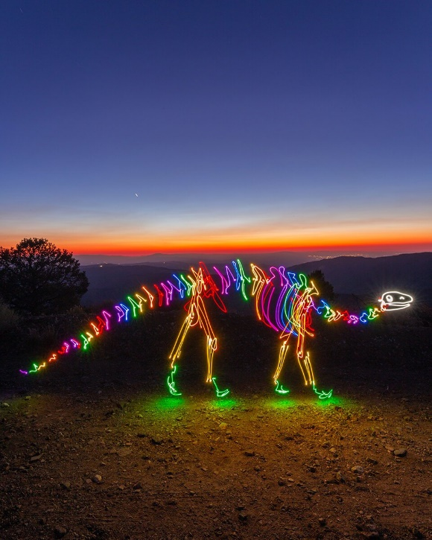
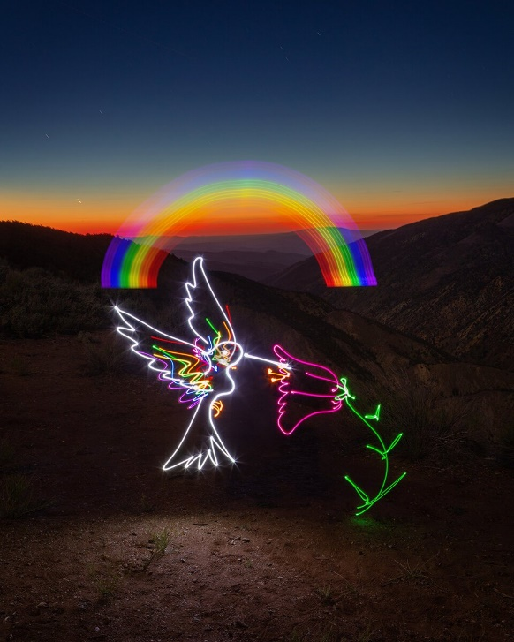
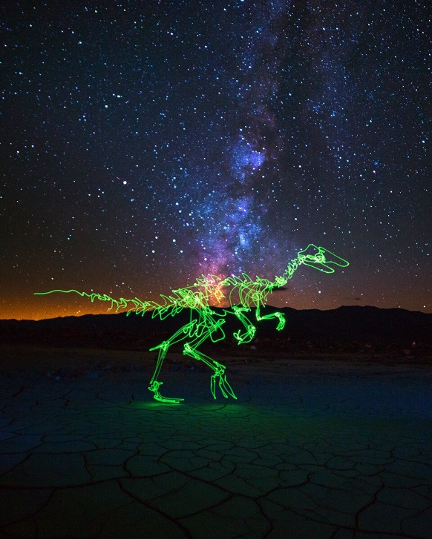
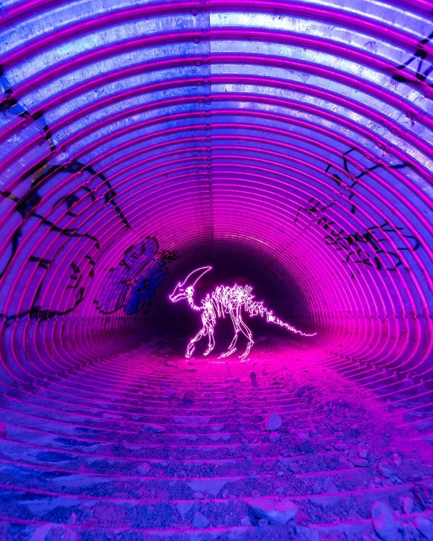
Darren Pearson

Slide 14
https://www.dariustwin.com/light-painting-gear-guide - Darren Pearson
https://www.instagram.com/halogi/?hl=pl&img_index=1 - Kristopher Foot

Slide 15
Bibliography
https://www.adobe.com/creativecloud/photography/discover/light-painting-photography.html
https://www.masterclass.com/articles/the-best-light-painting-photography-tips
https://www.dariustwin.com/how-to-light-paint
https://www.dariustwin.com/light-painting-gear-guide
https://www.instagram.com/halogi/?hl=pl

