Slide 1
The Timeless Artistry of Tattoos
Nikodem Leś, Grafika V.

Slide 2
Origins of tattooing
It's almost impossible to pinpoint the exact time and place where tattooing originated, evidence suggests that it has been a part of human history for thousands of years. The practice of tattooing has ancient origins and can be traced back to various cultures around the world:
Ötzi the Iceman,
Jerusalem (Crusaders),​
Egypt,
Polynesia,
Japan (penal tattoos).

Slide 3
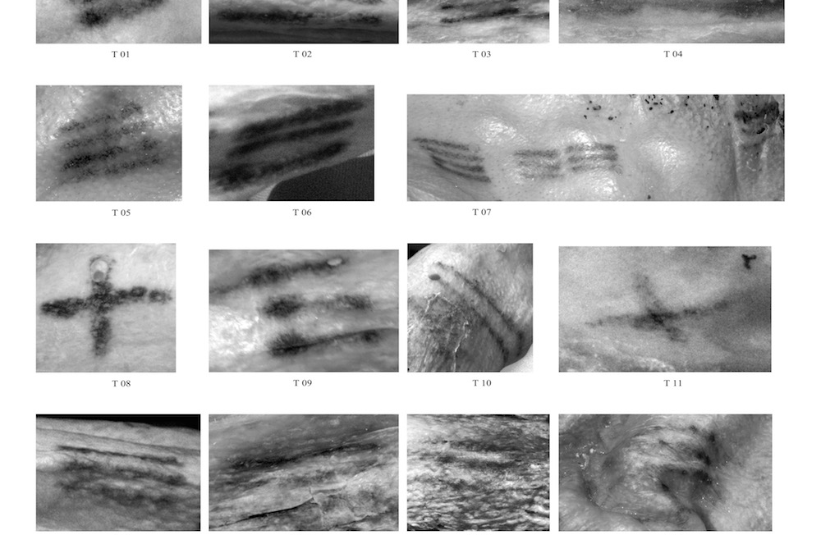
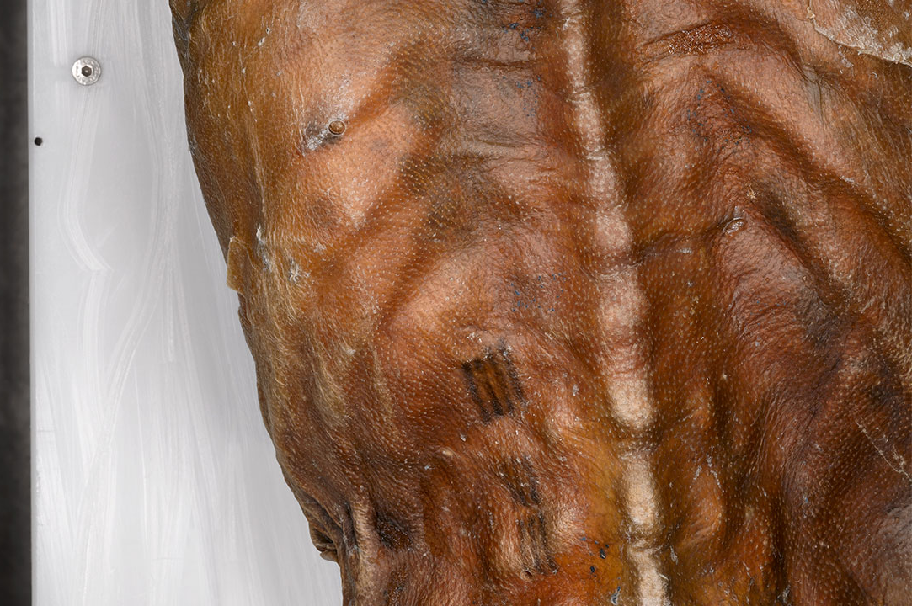
Ötzi the Iceman

Slide 4
A microscopic examination of samples collected from his tattoos revealed that they were created from pigment manufactured out of fireplace ash. This pigment was then rubbed into small cuts or punctures.

Slide 5
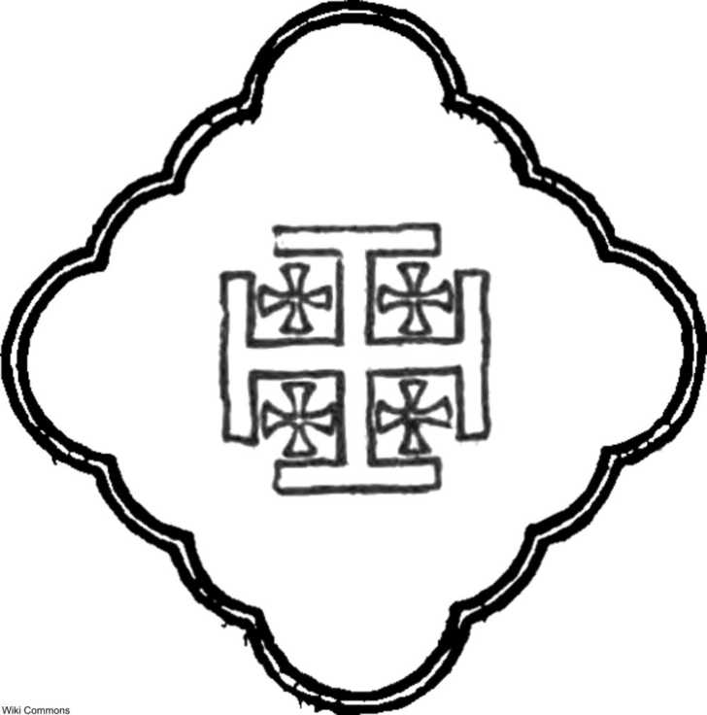
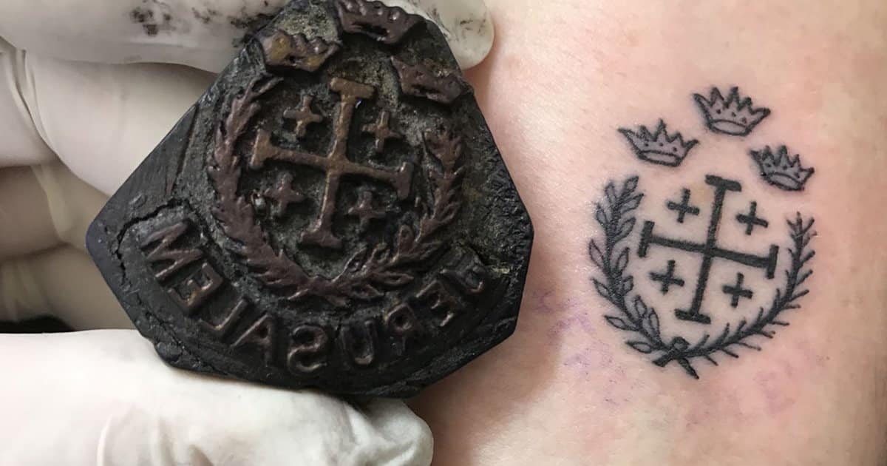
Jerusalem (Crusaders)

Slide 6
Crusaders used to have a cross on their body, because if they happen to die in the battle, they would get a Christian burial.

Slide 7
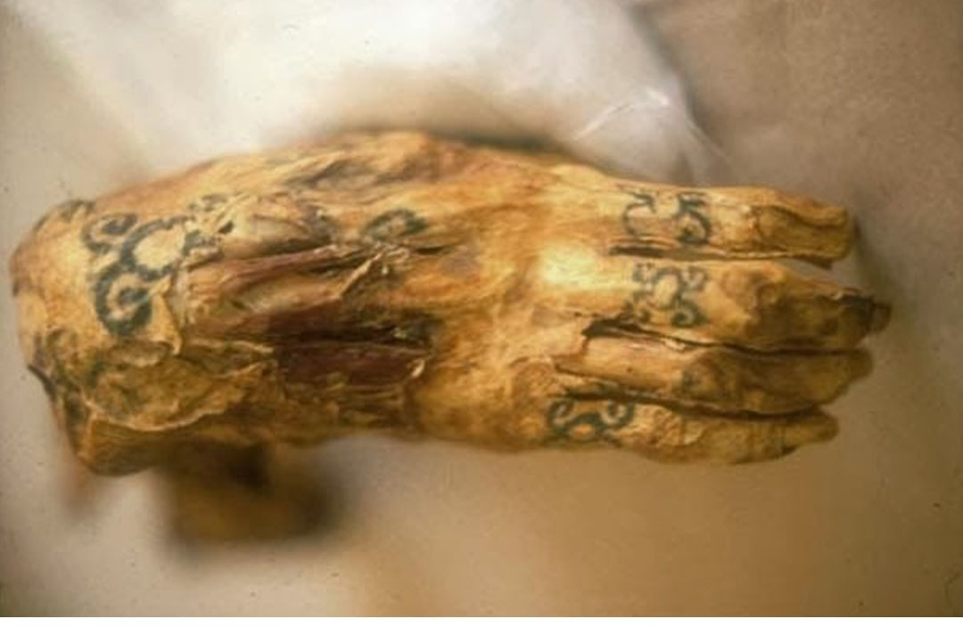
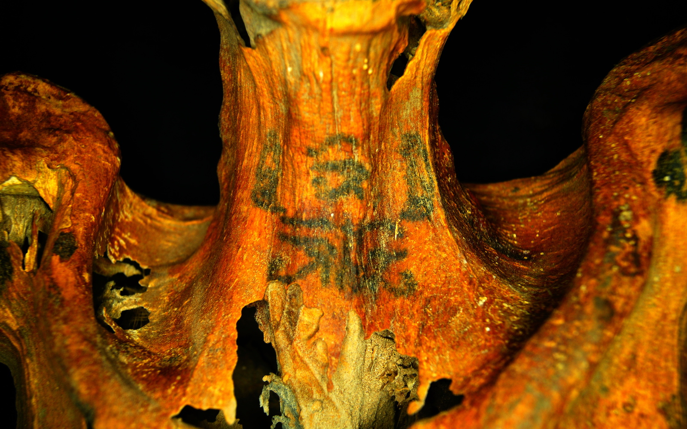
Egipt

Slide 8
The ritualistic tattooing process began with the creation of a flat “tattooing brush,” which was made up of an odd number of needles, braided together in a bundle. Tattooing brushes were usually made up of three, seven, or nine needles, as the Egyptians placed special importance on those numbers.

Slide 9
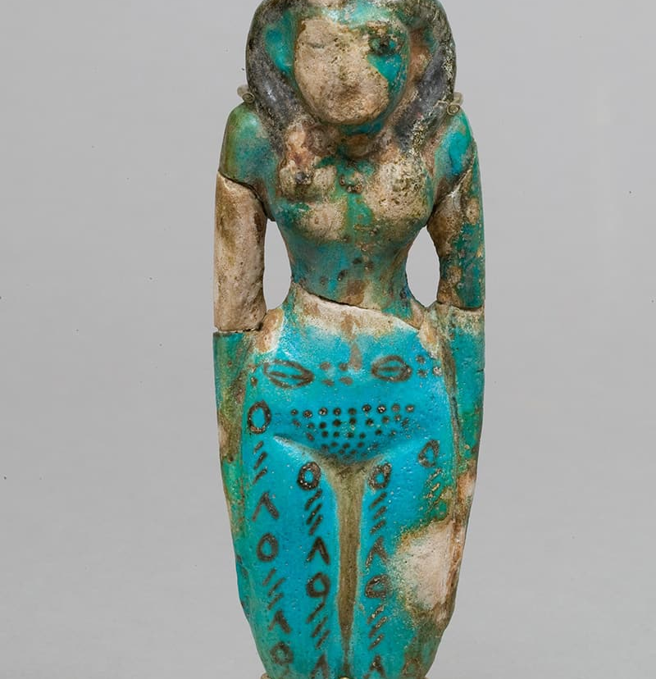
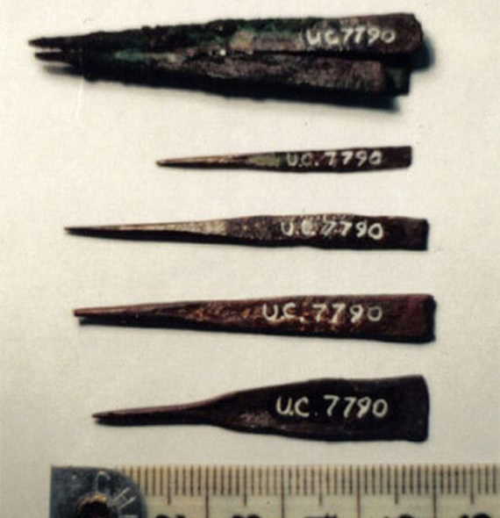

Slide 10
During pregnancy, this specific pattern would expand and reach legs. They believed that's a good way to protect a child.

Slide 11
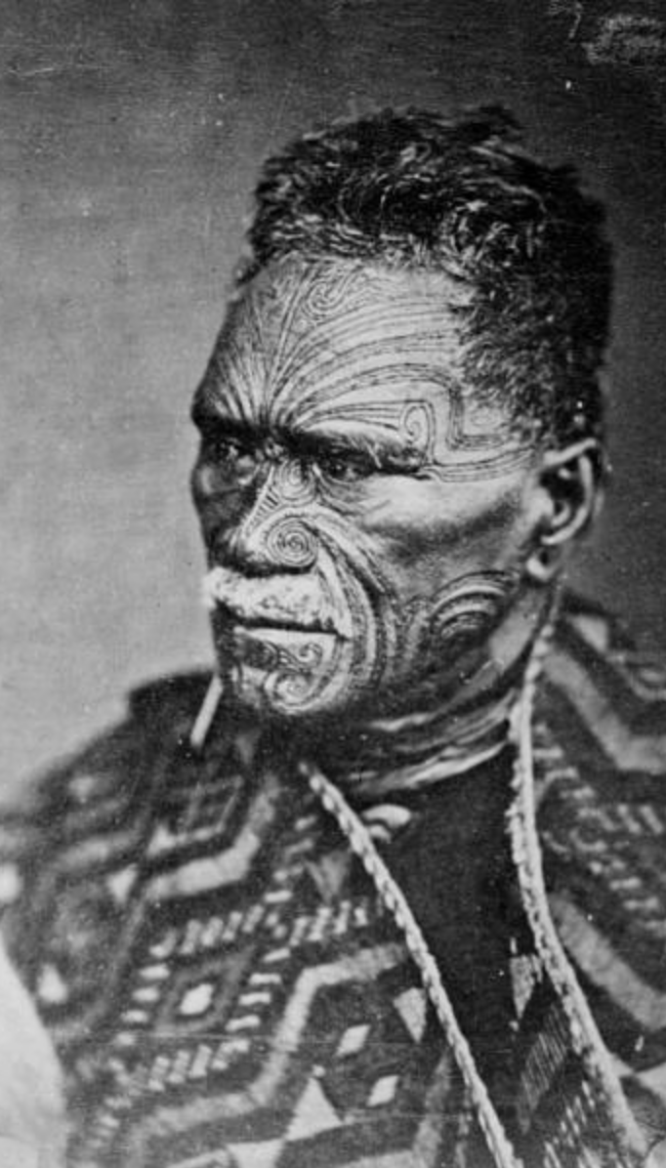
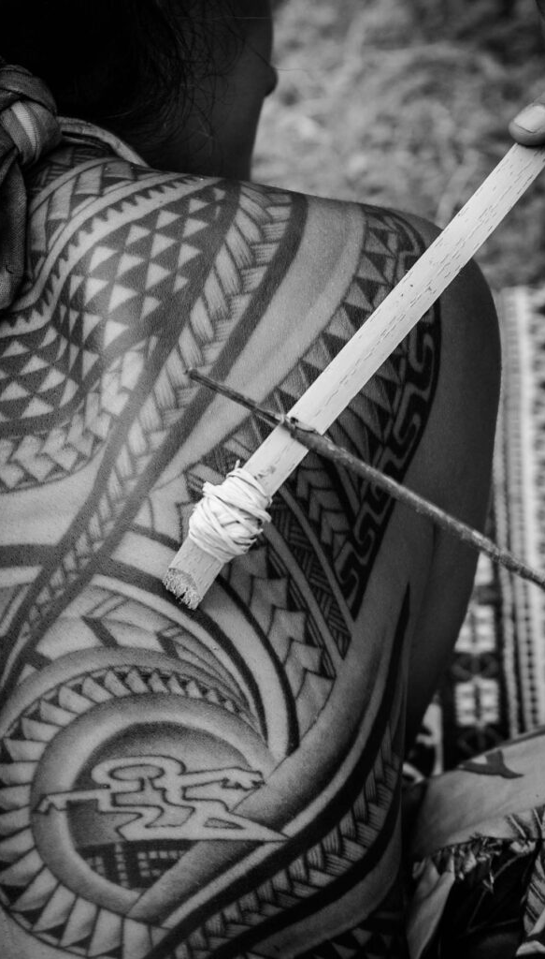
Polynesia

Slide 12
Tattoo artists held highly privileged positions amongst the Samoan and Maori people. They typically tattooed men in groups of six or more. The process was a ceremony and celebration, with the ritual being attended by their friends and family.

Slide 13
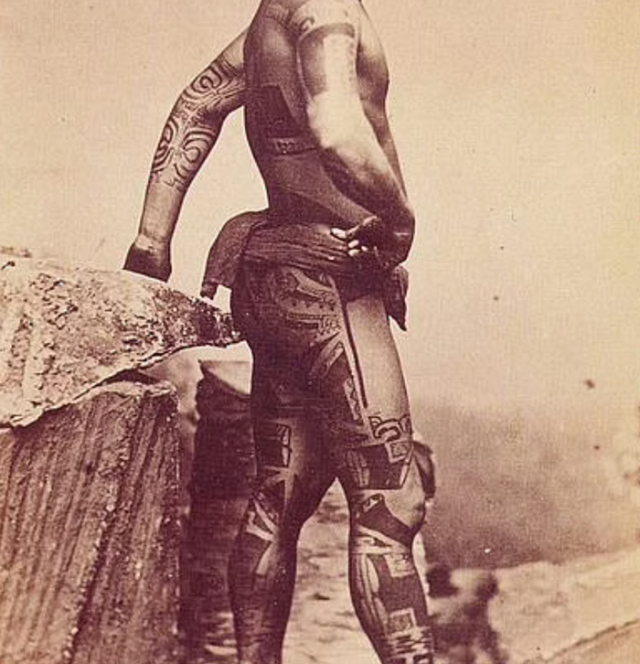
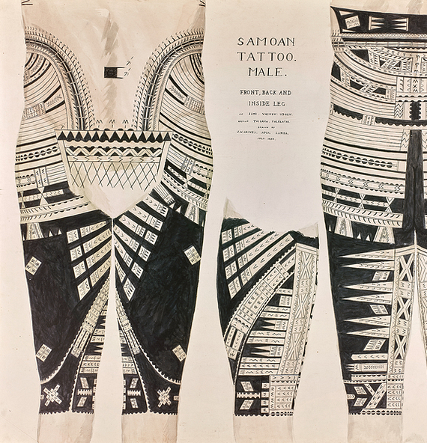

Slide 14
First coil machine was invented by Samuel O’Reilly in 1891 and it made the whole process much faster and less painful. What was used before?

Slide 15
Hand-Tapping: In many ancient cultures, including Polynesian and Indigenous cultures, hand-tapping was a common method.
Bamboo Sticks: In places like Southeast Asia, bamboo sticks were commonly used for tattooing. The needles were typically made from sharpened bamboo and attached to the end of the stick.
Comb Tools: In ancient Egypt, tattooing was performed using a comb-like tool. The comb had multiple needles, and the design was created by repeatedly raking the comb across the skin.
Abrasive Techniques: This method involved rubbing ash into cuts or incisions on the skin (Ötzi's tattoos).

Slide 16
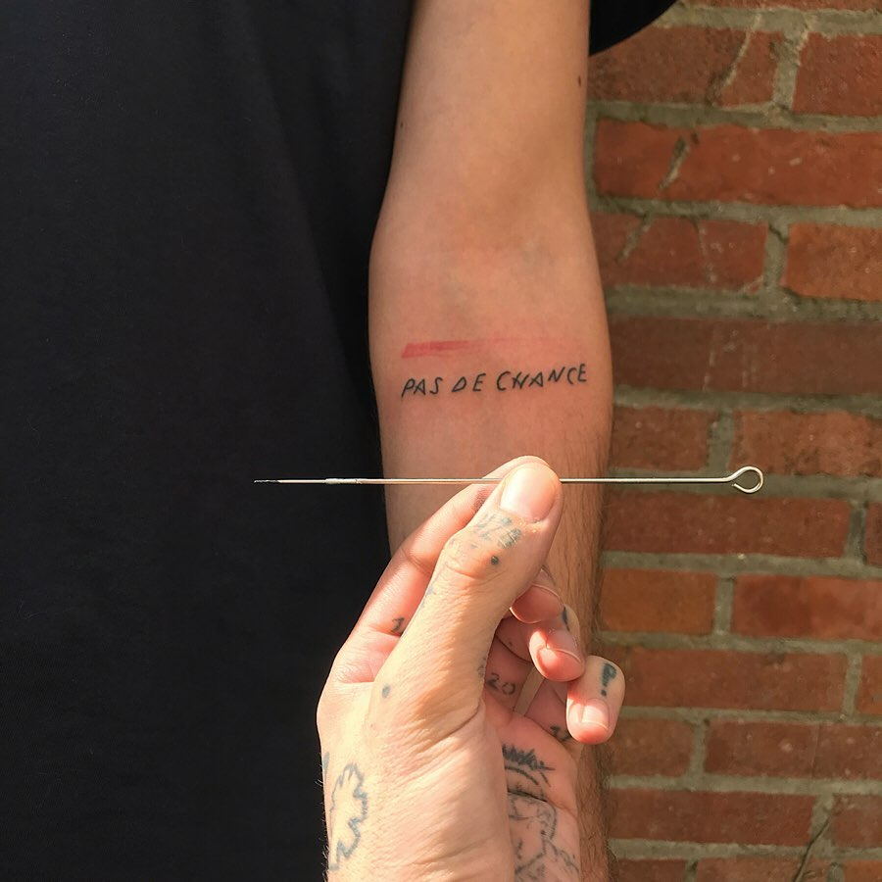
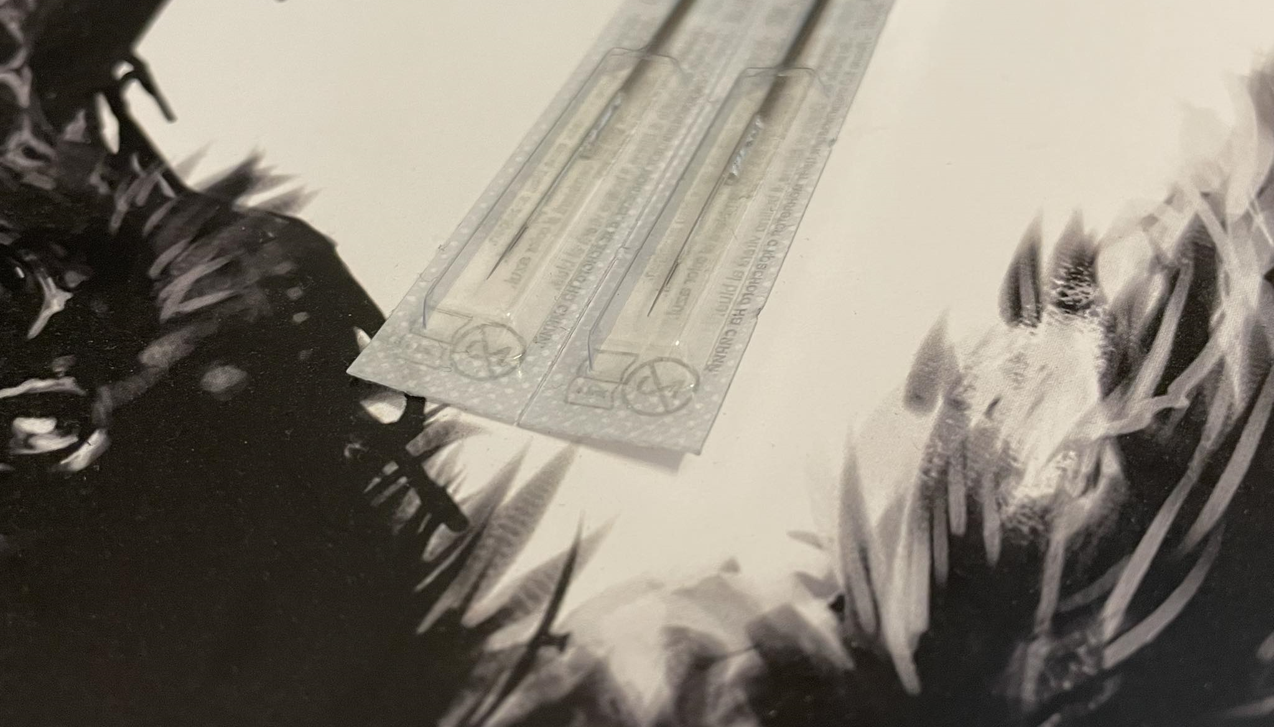
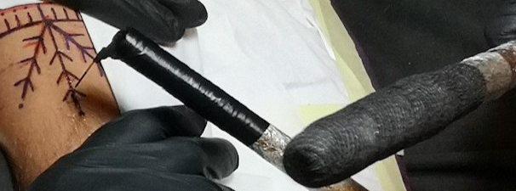

Slide 17
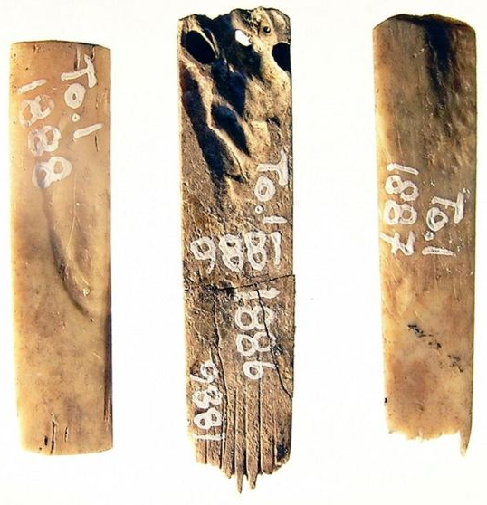
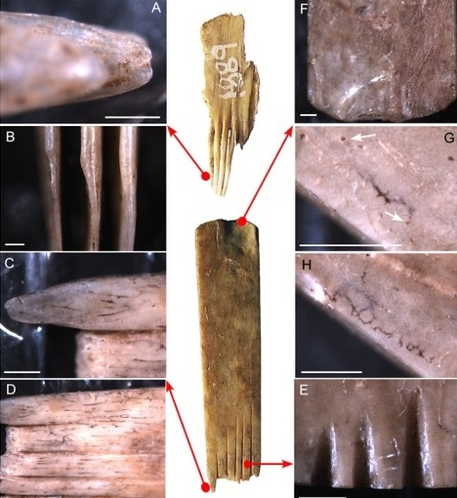

Slide 18
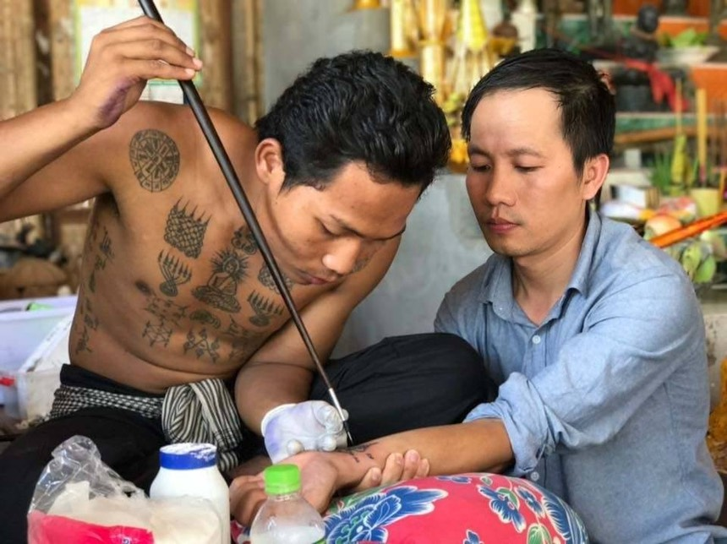
Bamboo Stick

Slide 19
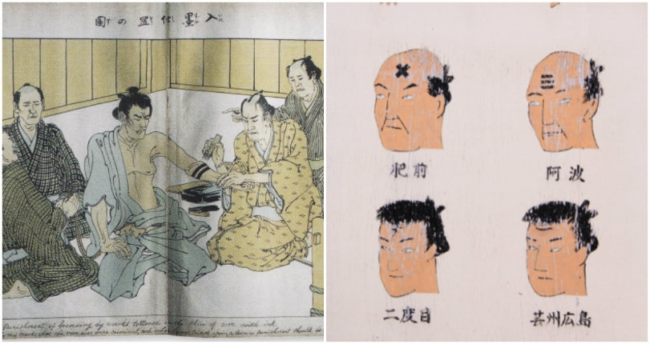
Japanese people before the second World War started to add some decorations to their penal tattoos and now if we think about Japanese tattoos. We think of these big full body suits, representing dragons and tigers.

Slide 20
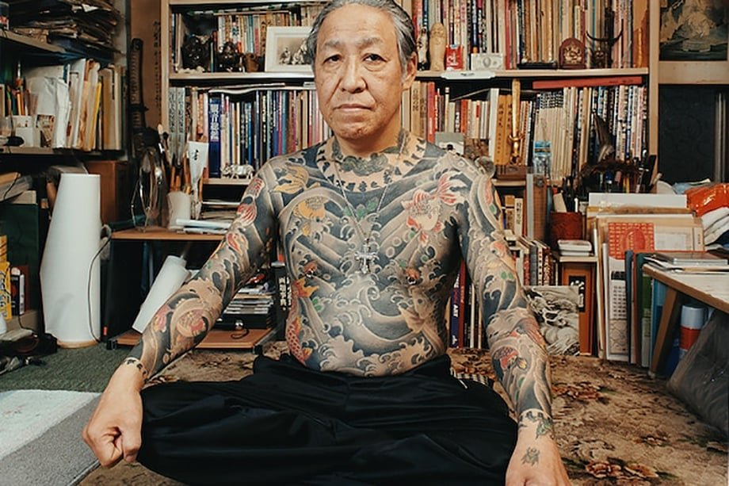
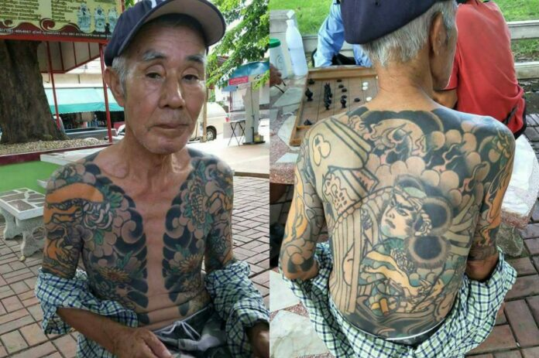
Yakuza Tattoos

Slide 21
How does it look like today?
Tattoo guns classification:
Coil machines,
Rotary machines,
Pnaumatic machines.

Slide 22
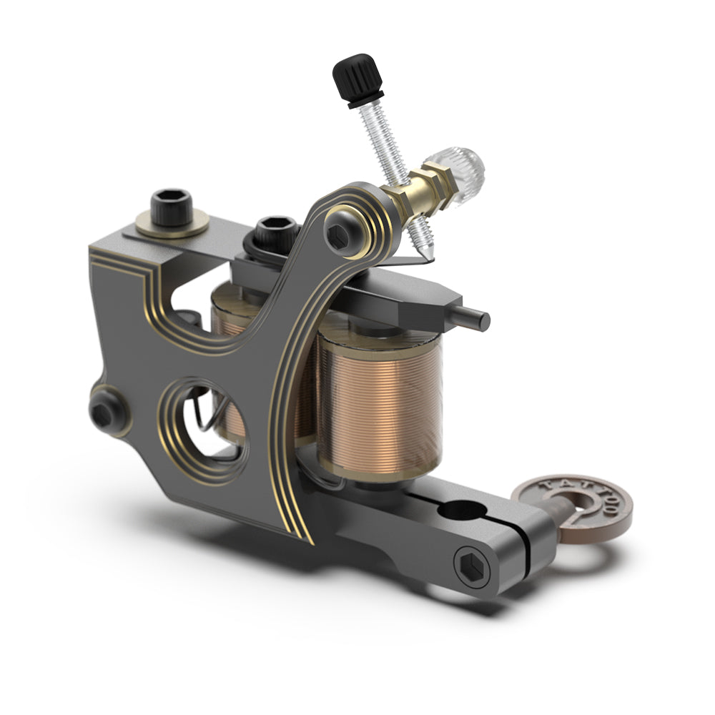
The magnetic coil machine is a classic machine which uses an alternating current to pass through coils and turn magnets on and off in rapid succession.

Slide 23
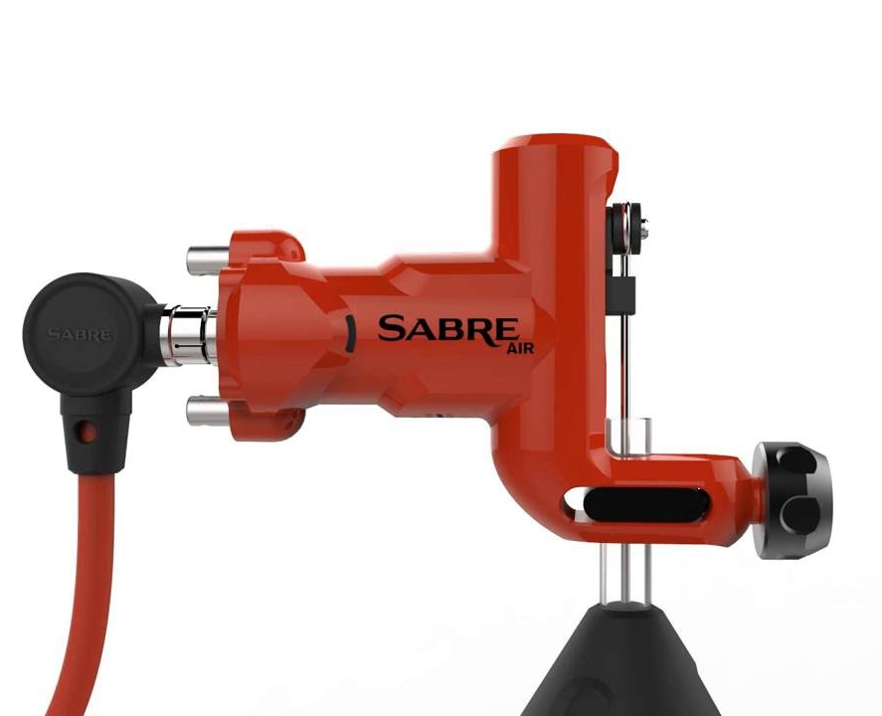
Pneumatic tattoo machines use pressurized air to drive the needles up and down.

Slide 24
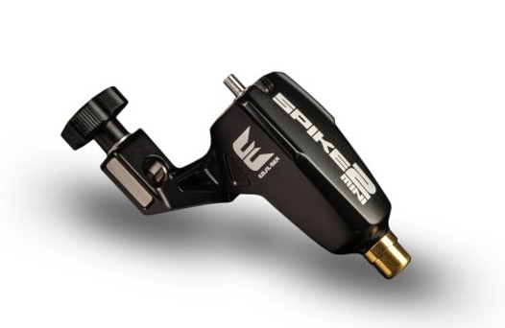
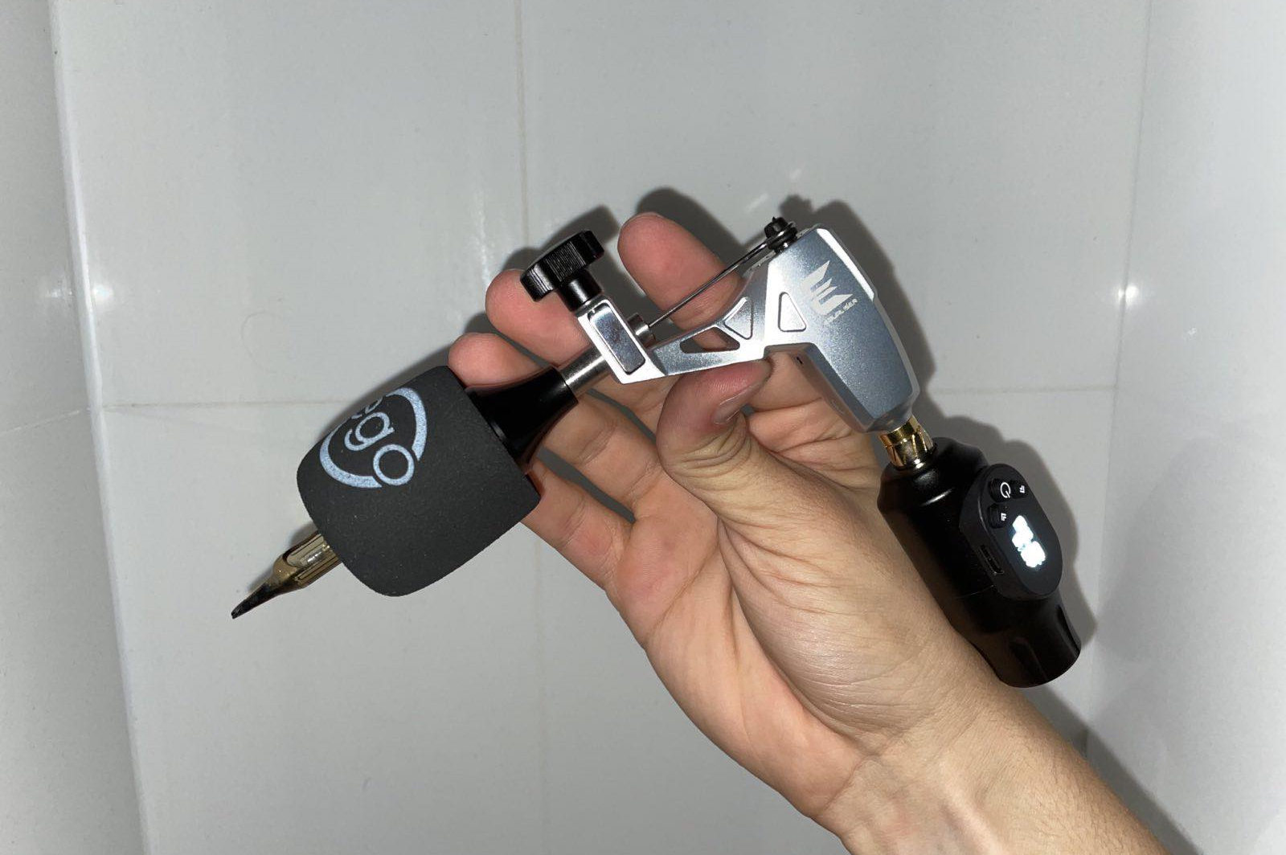
Rotary type machines use an electric motor to drive the needles

Slide 25
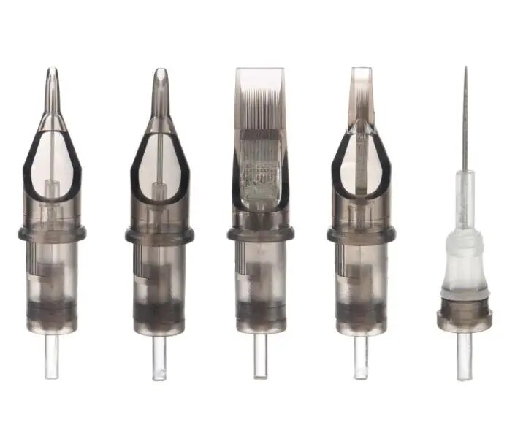
Cartridges

Slide 26
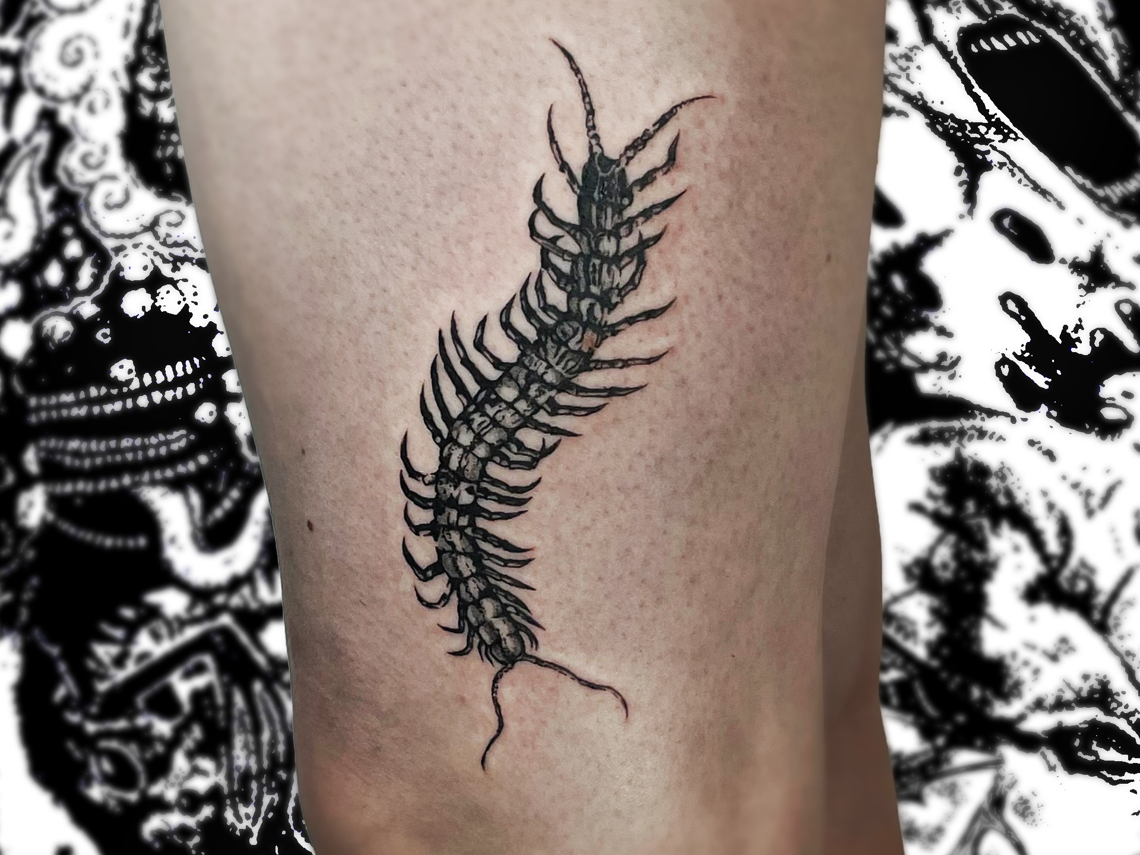
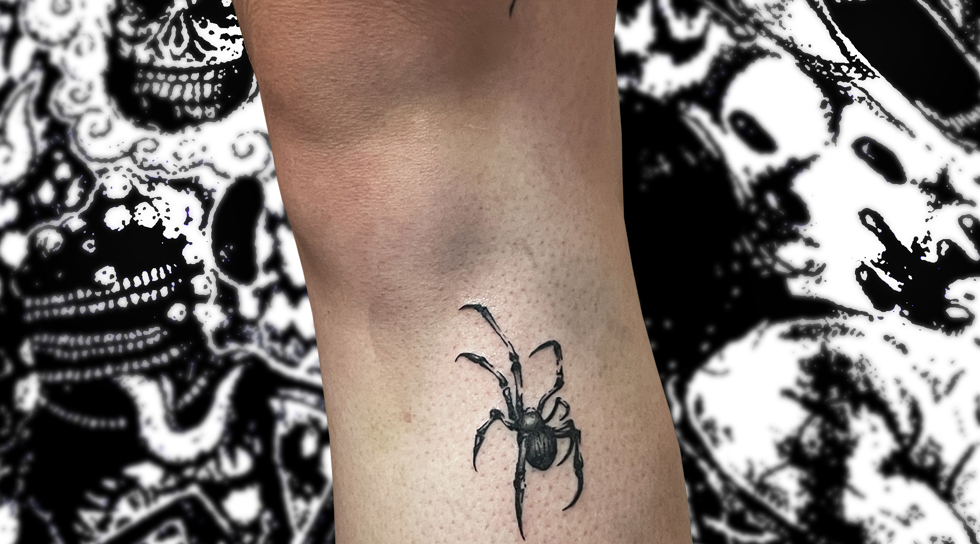
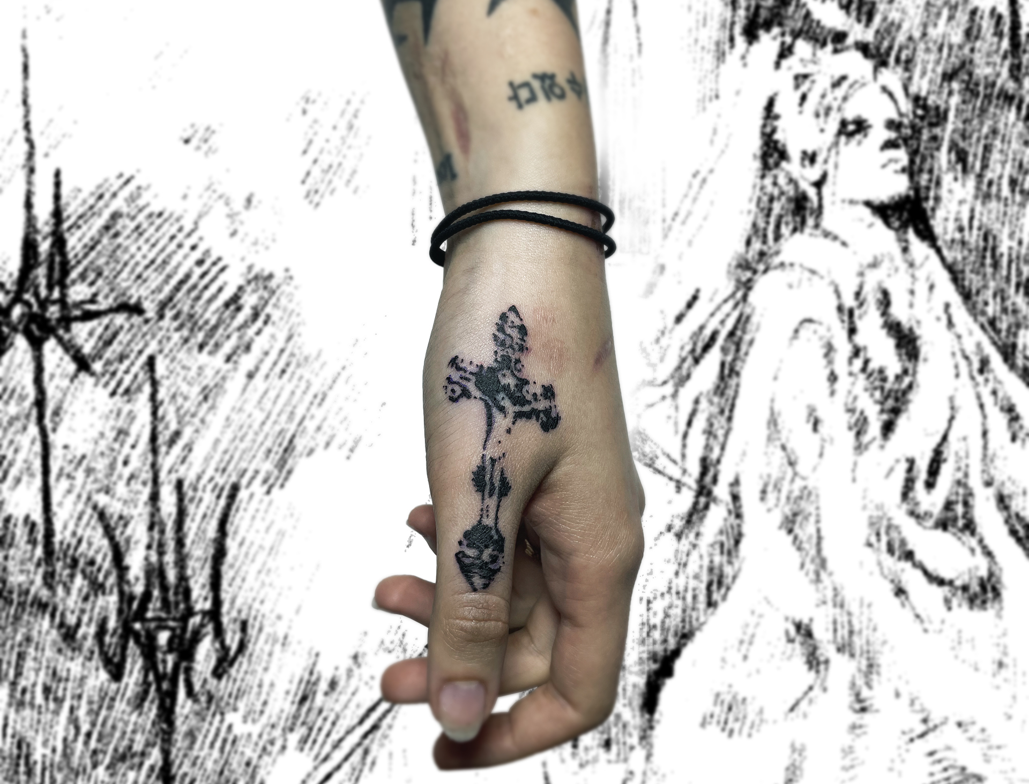

Slide 27
Vocabulary:
Coil – cewka / zwój,
rotary - rotacyjne,
alternating current - prąd przemienny,
penal – karny,
punctures - nakłucia,
to pinpoint - sprecyzować,
artistry – kunszt.

Slide 28
Thank you all for your attention!

