Slide 1
Phantoms in art
University of Rzeszów
Institute of Fine Arts
College of Humanities
Prepared by
Marcja Olbrycht
2023/2024

Slide 2
Vocabulary set
Apparition / spectre / wraith / phantom – zjawa
Epoch of romanticism – epoka romantyzmu
Intangible – (rzecz) nieuchwytna
Mare – klacz
A pervasive sense of dread – wszechobecne poczucie strachu
Tormented – udręczony
Jester – błazen
laurel wreath – wieniec laurowy
Solace – pociecha
Hermit – pustelnik
alluring figure of a woman – pociągająca kobieca postać
harbinger of a disaster – zapowiedź tragedii
Wilderness – puszcza
Cloak – peleryna

Slide 3
Phantoms
Why do they show up?
Is there a negative or a positive aura around them?
What do they bring to the artwork?

Slide 4
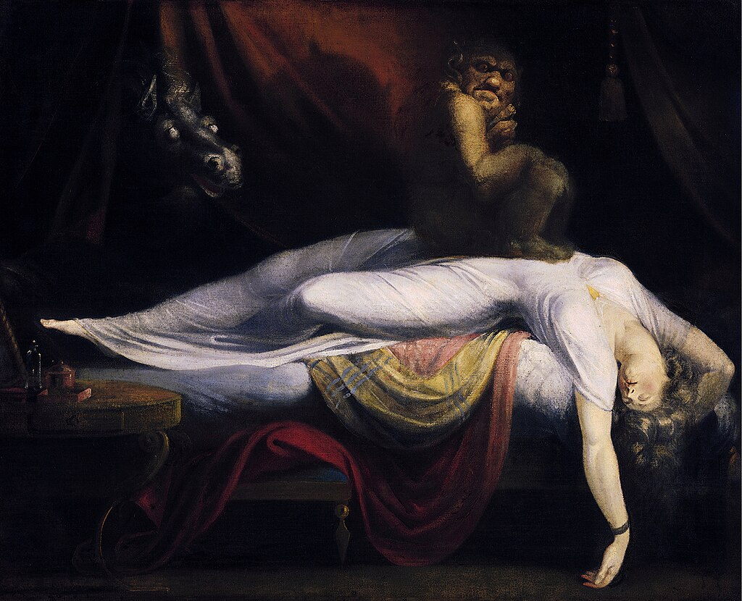
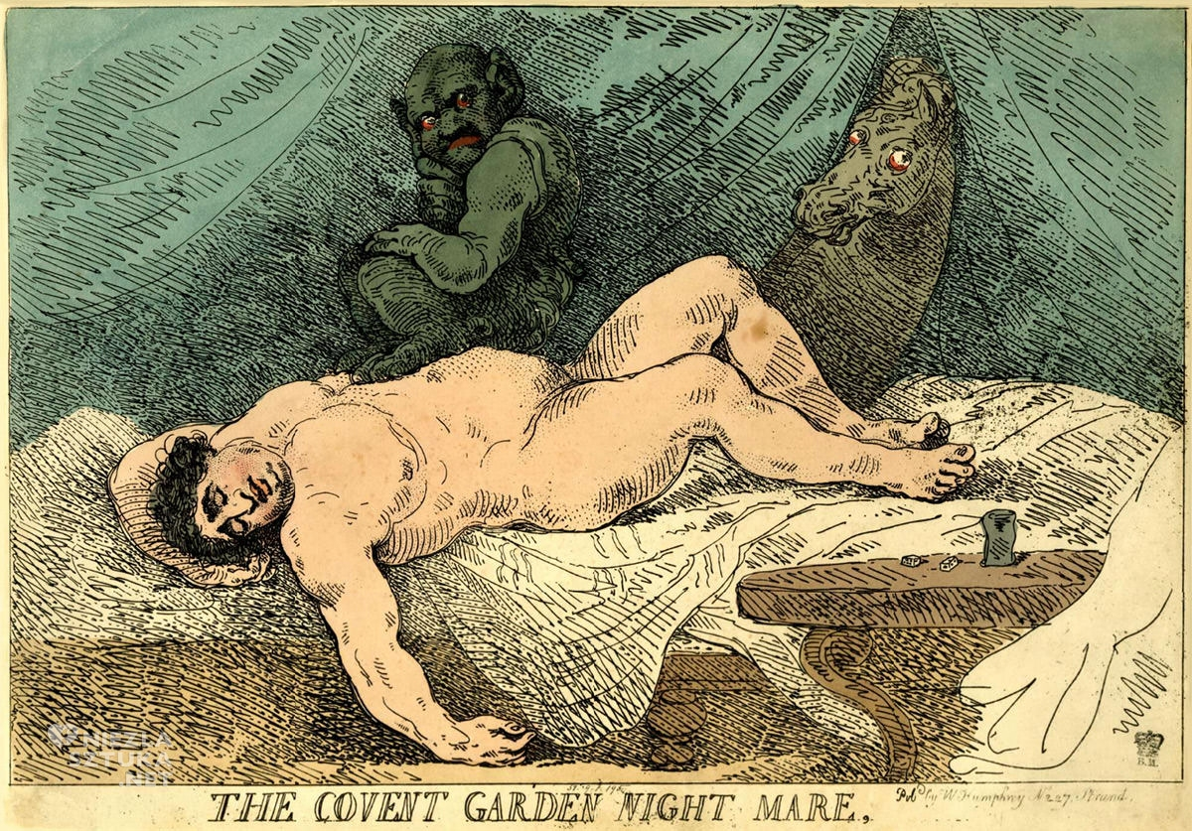
Johann Heinrich Füssli
An incubus
Thomas Burke,
The Covent Garden Night Mare, 1784
The Nightmare, 1781

Slide 5
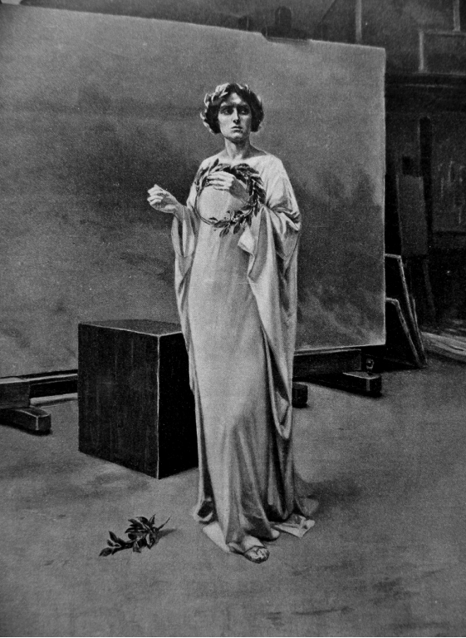
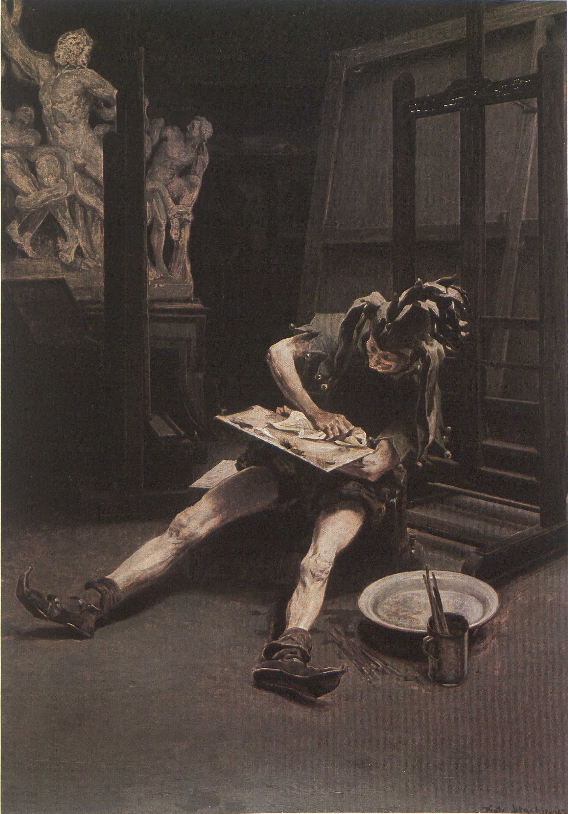
Piotr Stachiewicz
Phantoms in the Atelier
1883–1885
Muse
Irony

Slide 6
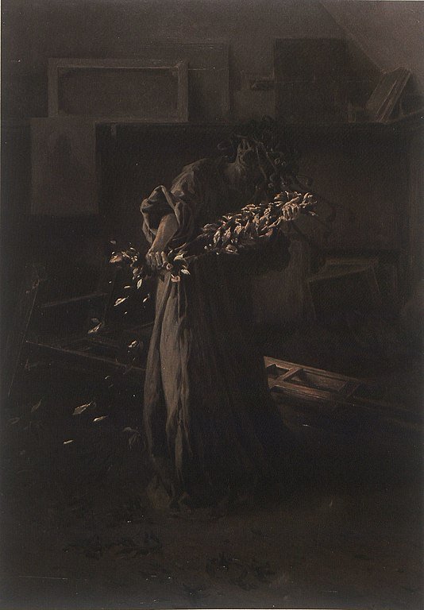
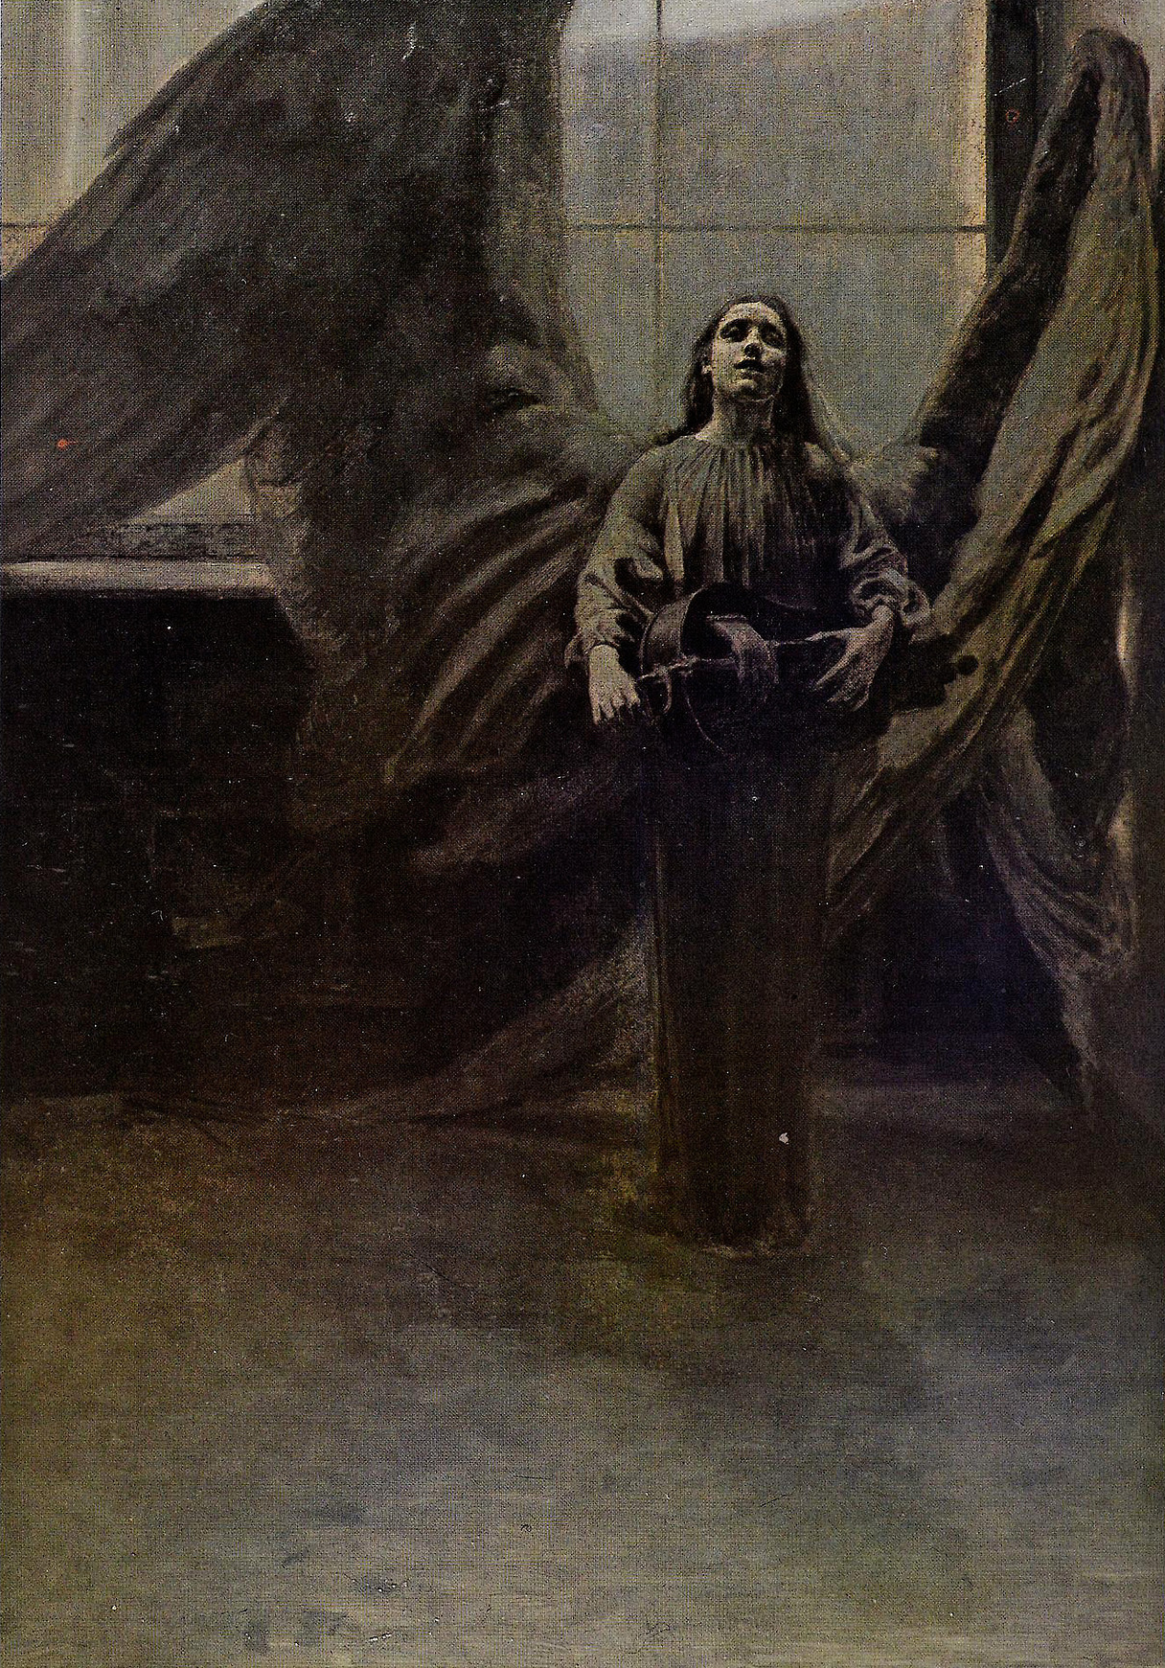
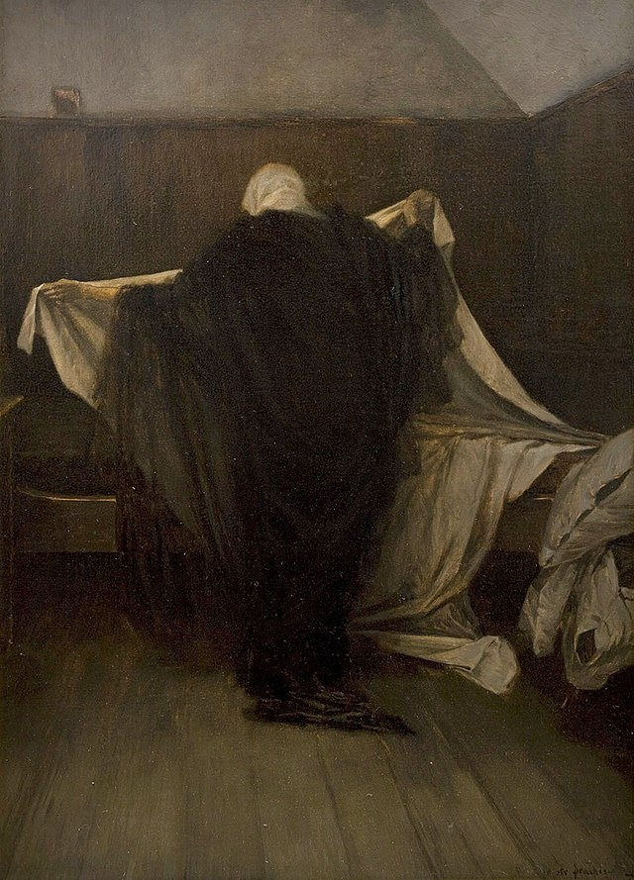
Melancholy
Doubt
Solace

Slide 7
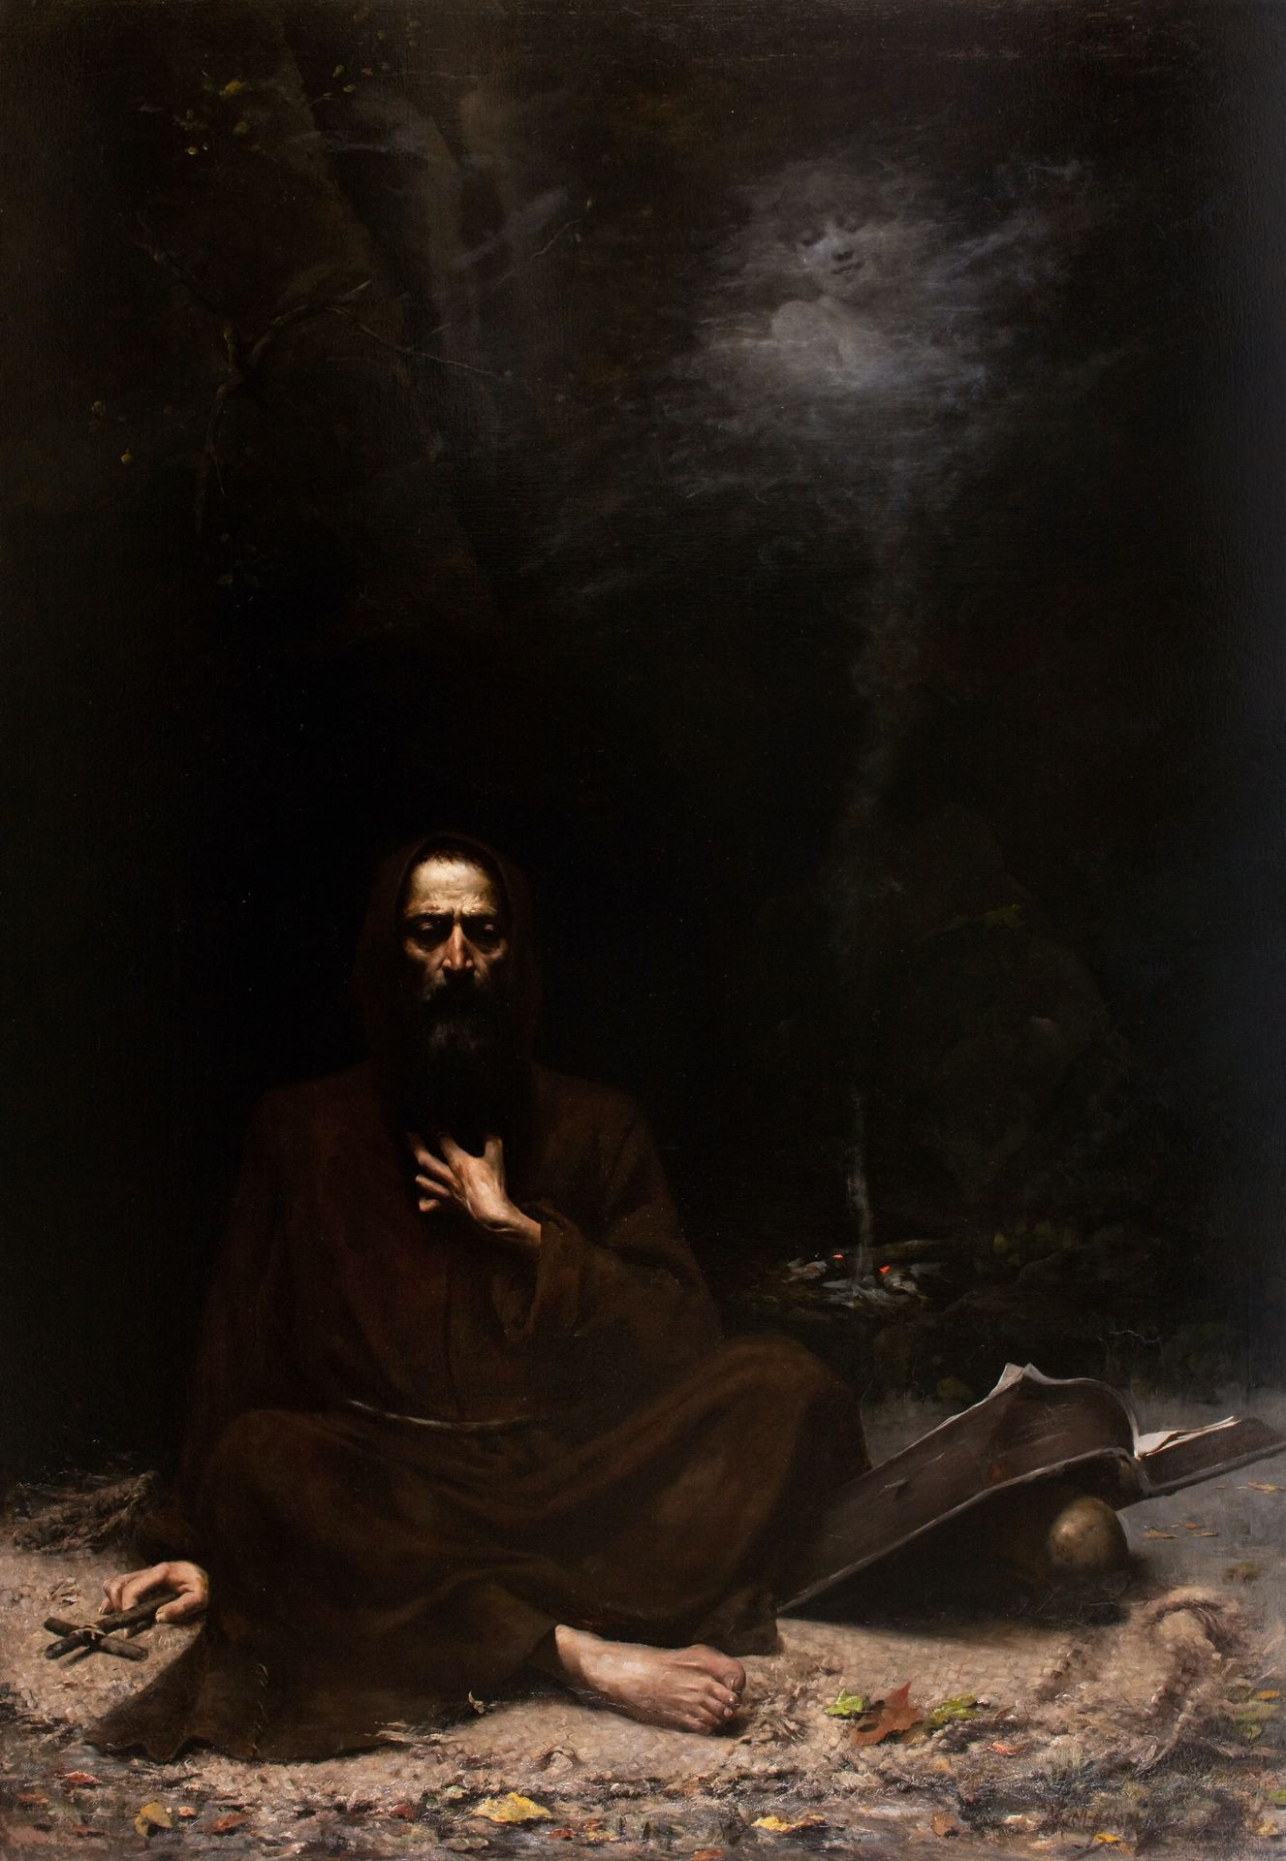
Lucjan Wędrychowski Temptation of st. Anthony 235 × 165 cm 1886

Slide 8
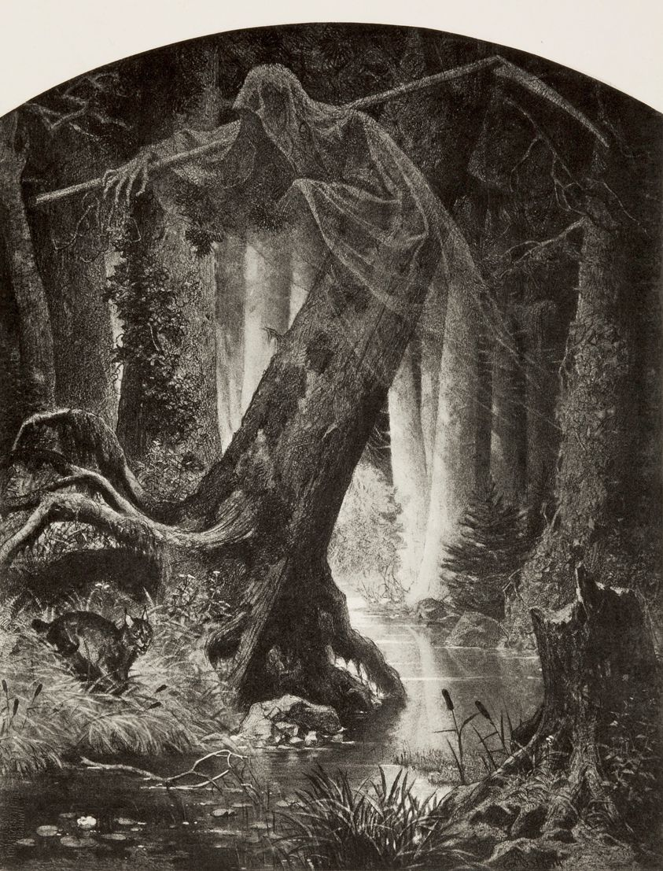
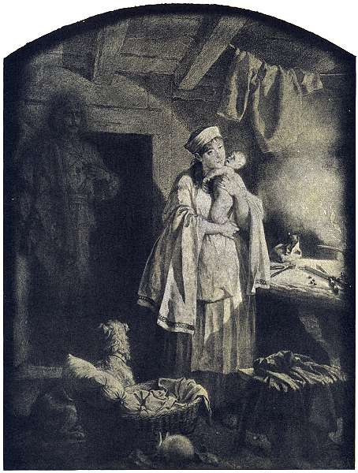
The wilderness
Artur Grottger
The ghost
1866
1864

Slide 9
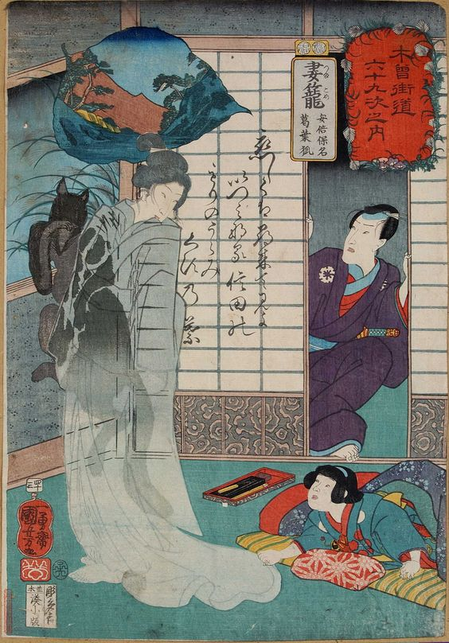
Utagawa Kuniyoshi
Abe no Yasuna and Fox Kuzunoha, 1852
Abe no Yasuna finding his child with an apparition of its mother, the fox-woman Kuzunoha (woodblock print)

Slide 10
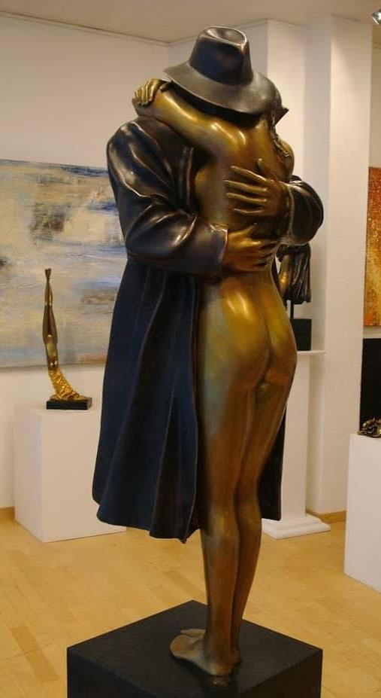
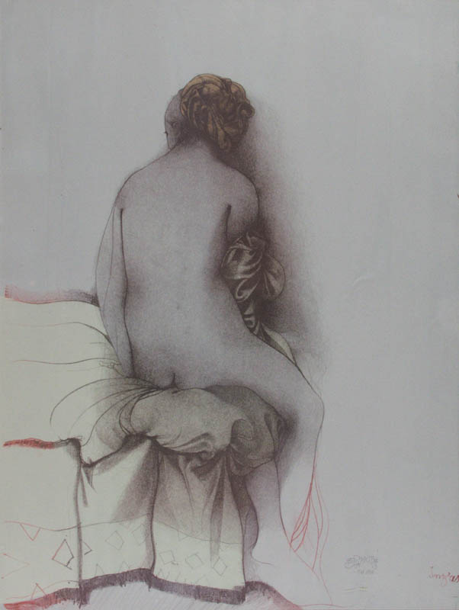
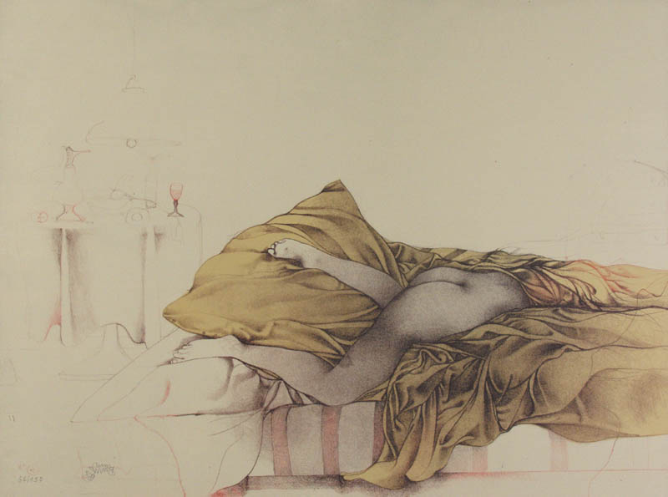
The kiss / The hug
Bruno Bruni
Bronze sculpture from 1980

Slide 11
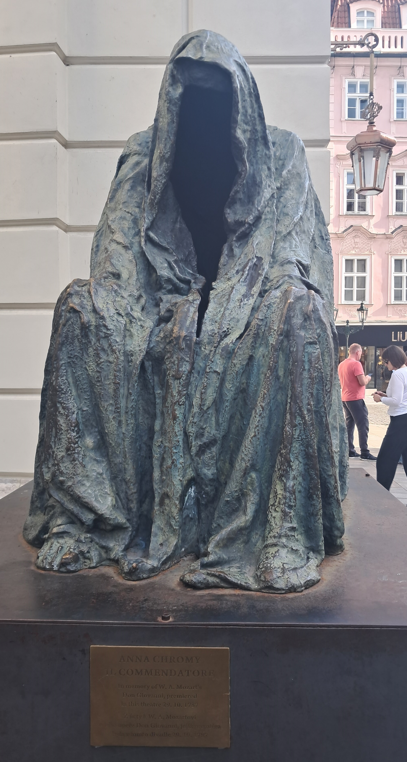
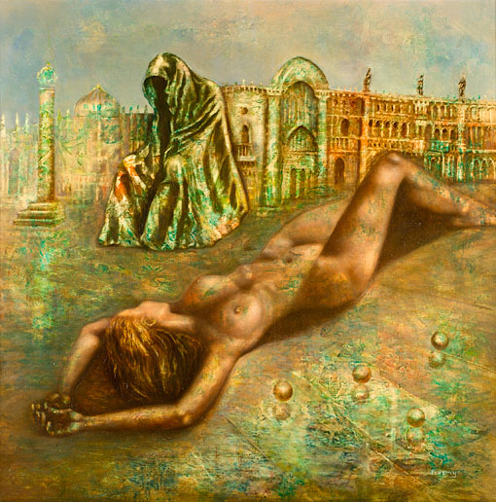
Anna Chromy
Il Commendatore, in memory of Mozart's Don Giovanni premiered 29 October 1787
"The most beautiful experience we can have is the mysterious.
It is the fundamental emotion that stands at the cradle of true art and true science..."
Albert Einstein
To Be Or Not To Be (1980)

Slide 12
References
Access: 27.10.2023
https://niezlasztuka.net/o-sztuce/johann-heinrich-fussli-nocna-mara/
http://cejsh.icm.edu.pl/cejsh/element/bwmeta1.element.desklight-f06769a0-f5e4-4dd6-80eb-d5bc52c6ac99
https://zbiory.mnk.pl/pl/katalog/303607
https://zbiory.mnk.pl/pl/wyniki-wyszukiwania/katalog/303863
https://www.roningallery.com/Tsumagome-Ave-no-Yasuna-and-Fox-Kuzunoha
https://www.art415ny.com/art/Bruno-Bruni-ArtWork-BRONZE3/3697
https://sztuka.agraart.pl/autor/licytacje/866/bruno-bruni
https://en.wikipedia.org/wiki/Anna_Chrom%C3%BD
https://en.wikipedia.org/wiki/Cloak_of_Conscience

Slide 13
Thank you for your attention!

